Slide 1

Force-Torque Sensor
MLA0103-ARTIFICIAL INTELLIGENCE AND EXPERT SYSTEMS
GUIDED BY:
DR.PRAKASH MATHIALAGAN
PRESENTED BY:
T BHUPAL(19242523)

Slide 2


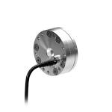
INTRODUCTION
A Force-Torque (FT) sensor is a precision measuring device that acts as a "sense of touch" for automated machinery and robotics.
It is designed to measure mechanical forces (push/pull) and rotational torques (twist) applied to a specific point.
The most advanced and common type is a 6-axis FT sensor, which captures data across six degrees of freedom simultaneously.
By translating physical contact into digital data, it allows robots to feel resistance and adjust their movements dynamically rather than moving blindly.

Slide 3
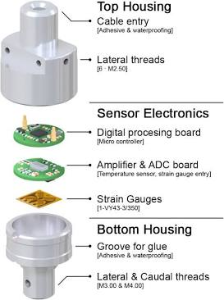
FORCE-TORQUE SENSOR IMAGE & COMPONENTS
Outer Shell: The strong metal cover that protects the delicate inside parts from dust and damage.
Mounting Plates (Flanges): The top and bottom flat pieces. One connects to the robot arm, and the other connects to the tool (like a robot hand).
Flexure (Metal Body): A special metal piece inside that is designed to bend just a tiny, invisible amount when pushed.
Strain Gauges: Tiny electronic stickers glued to the metal body that stretch or squeeze when the metal bends.
Circuit Boards: The tiny computer brain inside that turns the stretching of the stickers into digital numbers for the robot.

Slide 4
HOW THE COMPONENTS WORK
When the robot's tool touches an object, the push or twist transfers into the sensor.
This push makes the special metal body (the flexure) bend a microscopic amount.
Because the tiny "strain gauge" stickers are glued to the metal, they stretch or squeeze as the metal bends.
When these stickers stretch or squeeze, the electricity flowing through them changes.
The circuit board reads this changing electricity and immediately tells the robot exactly how much force it is feeling.

Slide 5


APPLICATIONS
Putting Parts Together: Helping robots slide pegs into tight holes or snap small parts together without smashing them.
Polishing and Sanding: Letting a robot press a sanding machine against a car door with the exact right amount of pressure.
Medical Surgery: Allowing doctors to "feel" what the robot arms are touching during remote surgeries.
Product Testing: Pressing buttons on a phone or keyboard repeatedly to test exactly how much strength is needed to click them.

