Slide 1

School of Electronics Engineering (SENSE)
Project-I (2026)
Prompt Engineering Strategy Benchmark for RAG Pipelines
Student Name(s):
Astitva Thakkar — 23BAI1057
Parth Sharma — 23BAI1528
Bhupender Singh — 23BRS1107
Guide's Signature with Date
Guide:
Dr. Manmohan Sharma, SENSE
Signature: _____________________
Programme / School:
B.Tech — SENSE, VIT Chennai
Date: _________________________
Review & Date:
Review-II · 30.09.2026 (Wednesday)
Approval is mandatory before every review. After signing, scan this slide and keep the scanned copy as Slide 1 of the presentation.
2

Slide 2
Introduction & Problem Recap
Problem recap:
  • Answer quality inside a RAG pipeline depends heavily on how retrieved context is handed to the LLM — the prompting strategy — not just on retrieval quality.
  • No controlled study isolates prompting strategy as the sole variable while holding chunking, embeddings, retrieval, and the base model fixed.
Objectives:
  • Build a common, reusable RAG pipeline as the fixed experimental baseline.
  • Implement four distinct prompting strategies on top of it — Zero-shot, Few-shot, Chain-of-Thought, Structured Output.
  • Evaluate all strategies on an identical dataset and metric suite (RAGAS + a human-calibrated hallucination judge).
  • Compare trade-offs in accuracy, hallucination rate, latency, and cost.
Refinements after Review-I feedback:
  • No major revisions were requested by the panel at Review-I; feedback was limited to minor clarifications, which have been folded into the project documentation and this deck.
4

Slide 3
Detailed Literature Review
No. | Author(s) & Year | Title / Source | Method / Approach | Findings & Research Gap
1 | Lewis et al., 2020 | Retrieval-Augmented Generation for Knowledge-Intensive NLP Tasks (NeurIPS) | Dense retriever + seq2seq generator, jointly fine-tuned | Cuts hallucination on knowledge tasks; prompt format on retrieved context not studied
2 | Brown et al., 2020 | Language Models are Few-Shot Learners (NeurIPS) | 175B-param LM evaluated via in-context few-shot examples | Establishes few-shot prompting; not tested in a retrieval-grounded setting
3 | Shuster et al., 2021 | Retrieval Augmentation Reduces Hallucination in Conversation (EMNLP Findings) | Retrieval-augmented dialogue vs. retrieval-free baseline | Retrieval cuts hallucination; prompting on top of retrieval not varied
4 | Wei et al., 2022 | Chain-of-Thought Prompting Elicits Reasoning (NeurIPS) | Few-shot exemplars with intermediate reasoning steps | Improves reasoning; not evaluated for RAG grounding or hallucination
5 | Kojima et al., 2022 | Large Language Models are Zero-Shot Reasoners (NeurIPS) | Single trigger phrase (“Let's think step by step”), no exemplars | Zero-shot CoT rivals few-shot; not tested against retrieved evidence
6 | Jiang et al., 2023 | Active Retrieval Augmented Generation / FLARE (EMNLP) | Predicts the next sentence to trigger on-demand retrieval | Improves long-form generation; prompting for the final answer not the variable studied
7 | Liu et al., 2023 | Pre-train, Prompt, and Predict (ACM Comput. Surv.) | Systematic taxonomy of prompting methods across NLP | Catalogs prompting broadly; no controlled RAG-hallucination comparison
8 | Ji et al., 2023 | Survey of Hallucination in Natural Language Generation (ACM Comput. Surv.) | Literature survey of hallucination types, causes, and metrics | Frames a hallucination taxonomy; doesn't isolate prompting as a RAG mitigation
Minimum 15 recent papers. Duplicate this slide as needed; conclude with research gaps identified.
5

Slide 4
Detailed Literature Review (contd.)
No. | Author(s) & Year | Title / Source | Method / Approach | Findings & Research Gap
9 | Gao et al., 2023 | Retrieval-Augmented Generation for LLMs: A Survey (arXiv) | Survey of RAG architectures and augmentation techniques | Maps the RAG design space; prompting is a minor sub-topic, not benchmarked
10 | Zheng et al., 2023 | Judging LLM-as-a-Judge with MT-Bench and Chatbot Arena (NeurIPS) | LLM-graded scoring validated against human agreement | Validates LLM-as-judge; motivates this project's judge-calibration step
11 | Es et al., 2024 | RAGAS: Automated Evaluation of RAG (EACL) | Reference-free Faithfulness / Answer Relevancy via LLM prompting | Automates RAG evaluation; doesn't compare prompting strategies
12 | Niu et al., 2024 | RAGTruth: A Hallucination Corpus for RAG (ACL) | ~18K human-annotated RAG responses, labeled by span | Rich ground truth; labels apply to original models' answers — used as this project's dataset
13 | Asai et al., 2024 | Self-RAG: Learning to Retrieve, Generate, and Critique (ICLR) | Model fine-tuned to emit reflection tokens and self-critique | Reduces unsupported claims via self-critique; needs fine-tuning, not a prompting-only comparison
14 | Yan et al., 2024 | Corrective Retrieval Augmented Generation (arXiv) | Retrieval evaluator triggers correction / web search on low confidence | Improves robustness to poor retrieval; targets retrieval quality, not prompt design
15 | Liu et al., 2024 | Lost in the Middle: How LMs Use Long Contexts (TACL) | Varies the position of the answer-bearing passage in context | Context use is non-uniform (U-shaped); motivates why prompt structure affects grounded accuracy
Research gap: no existing work isolates prompting strategy as the sole variable in a RAG pipeline while holding retrieval, embeddings, and the base model fixed — the gap this project addresses (see Proposed Solution, Review-I).
6

Slide 5
System Design & Architecture
RAGTruth QA subset
5,934 rows · Hugging Face
FIXED — identical for every strategy
Chunk
500 / 50 overlap
Embed
text-embedding-3-small
Chroma DB
vector store
Retriever
top-k = 4
Why this design
Retrieval is built once and reused, read-only, by all four strategies — so any measured difference can only come from the prompt.
THE ONE VARIABLE — prompt strategy only
Zero-shot
Few-shot
Chain-of-Thought
Structured Output
gpt-4o-mini · T = 0.0
shared generation call
RAGAS + LLM Hallucination Judge
calibrated against RAGTruth labels
7
Notes:
Insert your architecture / block diagram here.

Slide 6
Implementation Details
Modules developed and integrated:
  • data_loader.py — RAGTruth loading, QA-subset filtering, eval/calibration split, corpus construction
  • ingest.py — chunking → embedding → ChromaDB indexing (shared, read-only across strategies)
  • prompts/ — four independent LangChain LCEL chains (zero_shot, few_shot, chain_of_thought, structured_output)
  • evaluate.py — RAGAS wrapper + custom LLM hallucination judge
  • run_benchmark.py, generate_report.py — experiment runner and chart generation
  • webapp/ — FastAPI + WebSocket backend and JS frontend for live, interactive runs
Algorithms implemented:
  • Recursive character-based chunking (500 chars / 50 overlap)
  • Dense vector retrieval via cosine similarity (ChromaDB, top-k = 4)
  • Four prompting algorithms: Zero-shot, Few-shot (3 exemplars), Chain-of-Thought (tagged reasoning/answer), Structured Output (Pydantic-enforced schema)
  • Claim-decomposition LLM-judge algorithm — decomposes each answer into atomic claims and checks each individually against retrieved context
def chunk_documents(docs: list[Document]) -> list[Document]:
splitter = RecursiveCharacterTextSplitter(
chunk_size=config.CHUNK_SIZE, # 500
chunk_overlap=config.CHUNK_OVERLAP, # 50
separators=["\n\n", "\n", ". ", " ", ""],
)
return splitter.split_documents(docs)
src/ingest.py — chunk_documents()
8

Slide 7
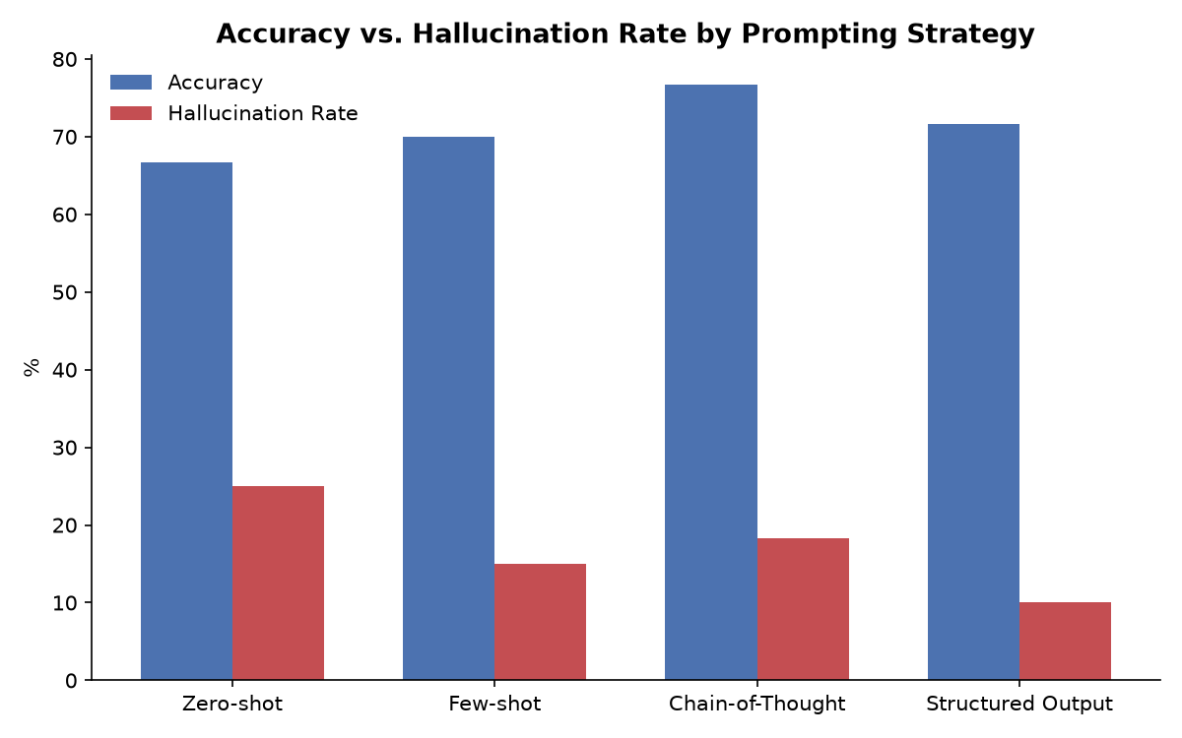
Results & Analysis (75%)
Strategy | Accuracy | Halluc. Rate | Faithfulness | Latency | Cost / query
Zero-shot | 0.667 | 0.250 | 0.743 | 1.80s | $0.000101
Few-shot | 0.700 | 0.150 | 0.829 | 1.65s | $0.000136
Chain-of-Thought | 0.767 | 0.183 | 0.744 | 2.79s | $0.000167
Structured Output | 0.717 | 0.100 | 0.866 | 3.10s | $0.000191
Judge calibration (n=30, vs. RAGTruth human labels):
0.81
PRECISION
0.87
RECALL
0.84
F1
0.83
ACCURACY
n = 60 questions per strategy — real, completed benchmark run, not illustrative.
9
Notes:
Add your results here — graphs, tables, screenshots or outputs.

Slide 8
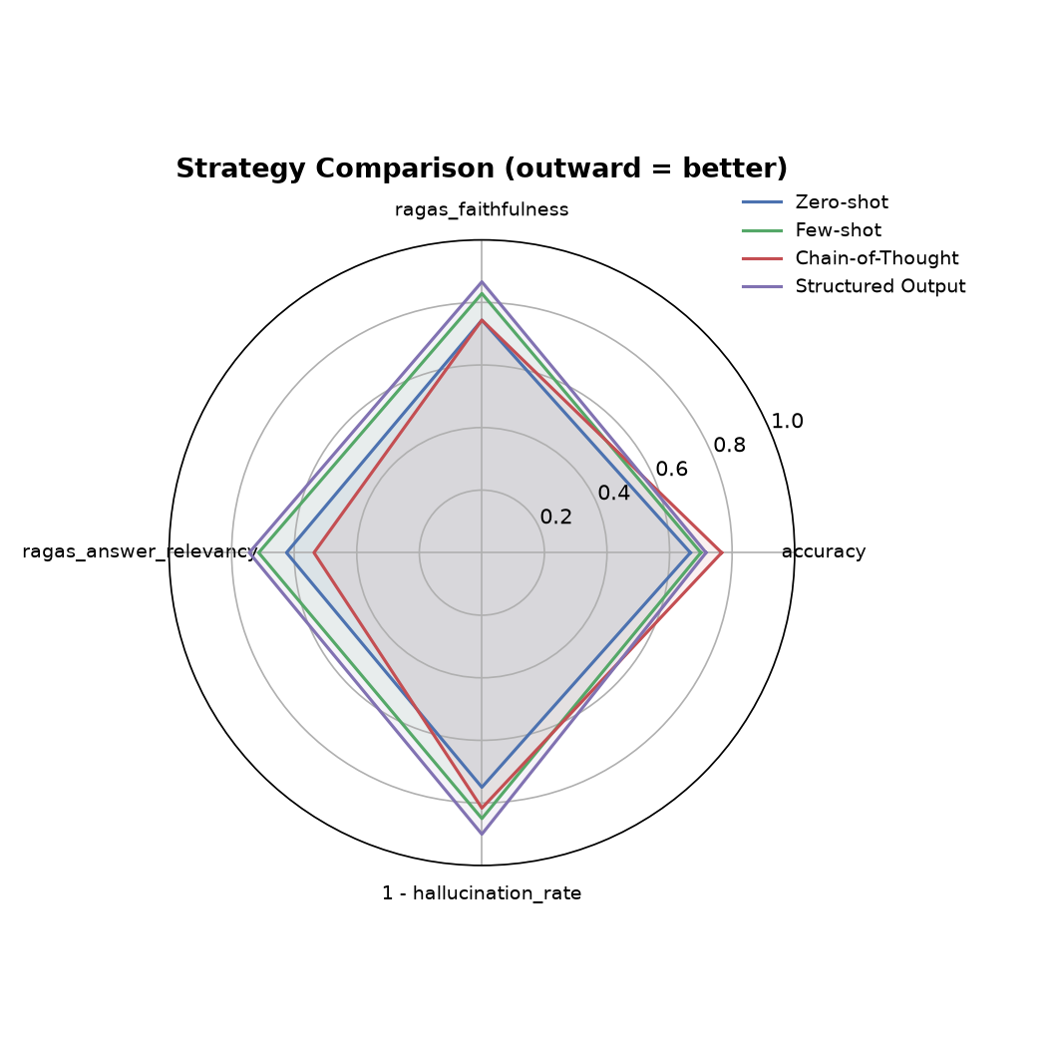
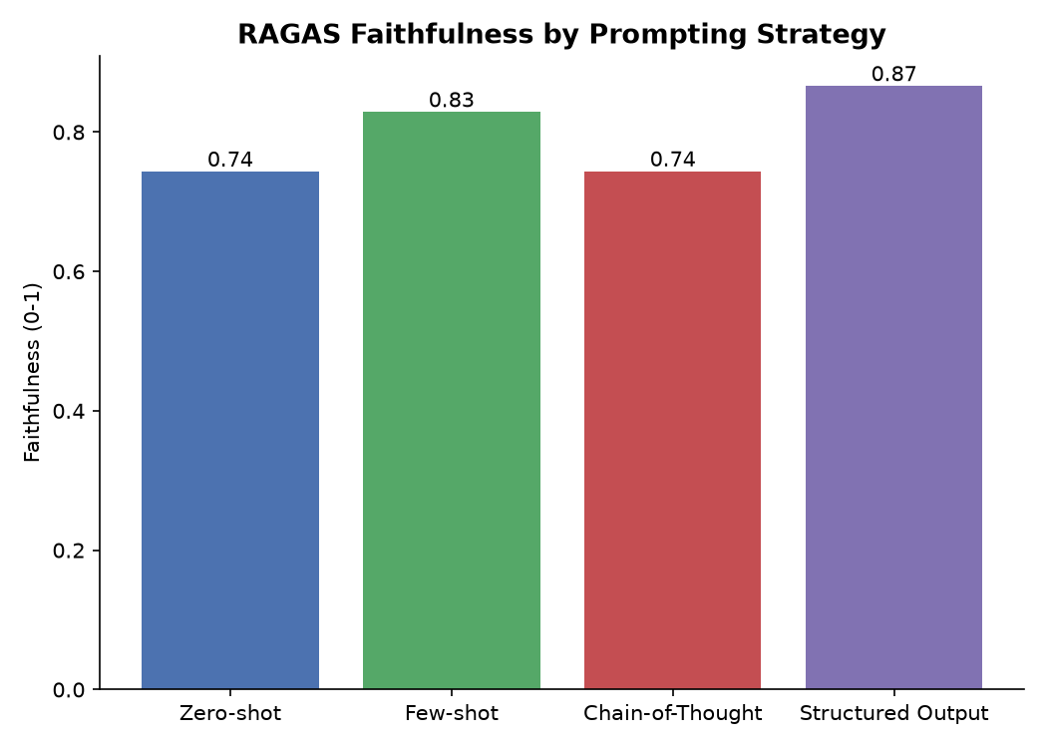
Results & Analysis (contd.)
Strategy colors:
Zero-shot
Few-shot
Chain-of-Thought
Structured Output
Findings vs. the original hypothesis:
— Structured Output's grounding advantage is robust across two independent runs — lowest hallucination rate both times (10.0% exactly, both runs), and the ranking Structured < Few-shot < Chain-of-Thought < Zero-shot on hallucination rate held in both.
— Which strategy has the best accuracy is NOT stable across runs — Few-shot led the first n=60 run (71.7%); Chain-of-Thought leads this run (76.7%). That instability is itself the evidence motivating the statistical-significance work still remaining, not a settled result yet.
— Zero-shot is consistently the weakest strategy — highest hallucination rate in both runs and lowest accuracy in this run — the strongest and most repeatable finding is simply that prompting strategy matters at all.
10
Notes:
Add your results here — graphs, tables, screenshots or outputs.

Slide 9
Challenges & Remaining Work
Challenges faced and solutions:
  • RAGAS import crashed at runtime (a dependency it hard-imports was removed upstream) — fixed with a small, documented compatibility shim.
  • The LLM hallucination judge under-counted real hallucinations (recall 0.20 against RAGTruth's human labels) — found via calibration, fixed by making the judge decompose answers into atomic claims and check each individually; recall rose to 0.87.
  • Re-running ingestion silently accumulated duplicate chunks in the vector store instead of replacing them — fixed by clearing the collection before every rebuild.
  • ChromaDB's default dependency required a C++ compiler unavailable on the dev machine — resolved by using ChromaDB's newer Rust-backed release, which ships prebuilt Windows wheels.
Remaining work (25%):
  • Statistical significance / confidence intervals on the observed strategy gaps — two independent n=60 runs already show the accuracy ranking is not stable, which is exactly why this can't be skipped.
  • A larger-scale run to tighten those confidence intervals.
  • Final written report and production-scenario recommendations.
Timeline for completion by Review-III (28.10.2026):
  • Weeks 1–2 (Sep 30 – Oct 14): larger-sample benchmark run; statistical significance analysis on all metrics.
  • Week 3 (Oct 15 – Oct 21): results interpretation and final report drafting.
  • Week 4 (Oct 22 – Oct 28): report finalization, Review-III deck, and rehearsal.
11

Slide 10
References
[1] P. Lewis et al., “Retrieval-augmented generation for knowledge-intensive NLP tasks,” in Advances in Neural Information Processing Systems 33 (NeurIPS 2020), 2020.
[2] T. B. Brown et al., “Language models are few-shot learners,” in Advances in Neural Information Processing Systems 33 (NeurIPS 2020), 2020.
[3] K. Shuster, S. Poff, M. Chen, D. Kiela, and J. Weston, “Retrieval augmentation reduces hallucination in conversation,” in Findings of ACL: EMNLP 2021, Punta Cana, Dominican Republic, Nov. 2021, pp. 3784–3803.
[4] J. Wei et al., “Chain-of-thought prompting elicits reasoning in large language models,” in Advances in Neural Information Processing Systems 35 (NeurIPS 2022), 2022.
[5] T. Kojima, S. S. Gu, M. Reid, Y. Matsuo, and Y. Iwasawa, “Large language models are zero-shot reasoners,” in Advances in Neural Information Processing Systems 35 (NeurIPS 2022), 2022.
[6] Z. Jiang et al., “Active retrieval augmented generation,” in Proc. 2023 Conf. Empirical Methods in Natural Language Processing (EMNLP), Singapore, Dec. 2023, pp. 7969–7992.
[7] P. Liu, W. Yuan, J. Fu, Z. Jiang, H. Hayashi, and G. Neubig, “Pre-train, prompt, and predict: A systematic survey of prompting methods in natural language processing,” ACM Computing Surveys, vol. 55, no. 9, pp. 1–35, Jan. 2023.
[8] Z. Ji et al., “Survey of hallucination in natural language generation,” ACM Computing Surveys, vol. 55, no. 12, 2023.
[9] Y. Gao et al., “Retrieval-augmented generation for large language models: A survey,” arXiv preprint arXiv:2312.10997, Dec. 2023.
[10] L. Zheng et al., “Judging LLM-as-a-judge with MT-Bench and Chatbot Arena,” in Advances in Neural Information Processing Systems 36 (NeurIPS 2023), Datasets and Benchmarks Track, 2023.
[11] S. Es, J. James, L. Espinosa-Anke, and S. Schockaert, “RAGAS: Automated evaluation of retrieval augmented generation,” in Proc. 18th Conf. European Chapter Assoc. Comput. Linguistics: System Demonstrations (EACL), St. Julian’s, Malta, Mar. 2024, pp. 150–158.
[12] C. Niu et al., “RAGTruth: A hallucination corpus for developing trustworthy retrieval-augmented language models,” in Proc. 62nd Annual Meeting Assoc. Comput. Linguistics (ACL), Vol. 1: Long Papers, Bangkok, Thailand, Aug. 2024, pp. 10862–10878.
[13] A. Asai, Z. Wu, Y. Wang, A. Sil, and H. Hajishirzi, “Self-RAG: Learning to retrieve, generate, and critique through self-reflection,” in Proc. 12th Int. Conf. Learning Representations (ICLR), 2024.
[14] S.-Q. Yan, J.-C. Gu, Y. Zhu, and Z.-H. Ling, “Corrective retrieval augmented generation,” arXiv preprint arXiv:2401.15884, Jan. 2024.
[15] N. F. Liu et al., “Lost in the middle: How language models use long contexts,” Trans. Assoc. Comput. Linguistics, vol. 12, pp. 157–173, 2024.
Use IEEE format. Every reference listed must be cited in the slides / report.
12

Slide 11
Thank You
Project-I (2026) · SENSE · VIT Chennai
13

