Slide 1




KATHMANDU UNIVERSITY
PHONE BOOK
GROUP :- J
NAME :- BHUPENDRA KUMAR SAH
ROLL NO :- 16
Sep , 10 , 2021
GROUP :- J
NAME :- BHUPENDRA KUMAR SAH
ROLL NO :- 16
May , 31 , 2021

Slide 2
Introduction To Phone Book System
The phonebook is a very simple C++ (oop) mini-project that can help us to understand the basic concepts of functions, Linked List, and data structure.
This program will teach you how to add, list, change or edit, search and remove data from/to a file.
Adding new records, listing them, editing and updating them, looking for saved contacts, and removing phonebook records are simple Functions that make up the main menu of this Phonebook program.
Personal information, such as name, phone number, e-mail, and address, is requested when you add a record to your phonebook.
These records can then be updated, entered, searched, and deleted. I’ve used a lot of functions in this mini-project. These functions are easy to understand since their name means just their respective operations.

Slide 3
AIM OF THE PROJECT
Create a “Contact Phonebook” framework using C++ programming.
This software is very useful nowadays to store full information under a single contact number..
The software also has options for removing and adding the contact number entered.

Slide 4
ADVANTANGES
It is simple for the user to store complete Information (e.g. Name , Number , e-mail) .
It’s simple for the user to simply check his/her appropriate contact number by entering the contact name/number.

Slide 5

DISADVANTAGES
It is also difficult to store contacts with two or more contact number.
It takes O(n) time for searching.

Slide 6
Why Phone Book System ?
In Mobile, Phone Phone Book System is required .
It help us to save our contact list.
It’s still exits in our digital life.

Slide 7
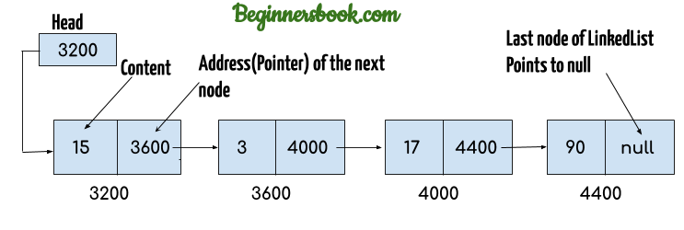
How To Implement

Slide 8
What a Phone Book Can Do :-
It takes two inputs from the user :-
Name
Number
It can search the Contect Name and Number entered by the user.
It can delete the Contact Name and Number which they want to delete.
It can display the all the Contact records that is in the list.
It can clear all the Contact records that is in the list.

Slide 9
ALGORITHM FOR ADDING CONTACT NUMBERS
Creating the Structure.
Creating the New Node for Insertion.
Check whether the list is Empty or Not.
If Empty then add to head .
If Head is Not NULL then run the loop to check where is the NULL and then add to that position.

Slide 10
ALGROITHM FOR DISPLAY
Check the List is Empty or Not.
Make Traversal Pointer , and run the loop until the Traversal->next != NULL .
Print each data that Traversal visit the Node.

Slide 11
ALGORITHM FOR SEARCH
Take a input form the User.
Check whether the List is Empty or Not
Run the Loop to chech the Contact or Name enter by the user is in the list or Not.
If it fount the Display the Contact Information.
If Not the print the Not fount.

Slide 12
OBJECTIVES
Large data can be stored.
To record the details various activities of user.
It will simplify the task and reduce the paper work.
The system is very user friendly.
Easily accessed by administrators, academics, students and applicants.

Slide 13
ACCOMPLESHED WORKE
Creat a new Contact Information.
Display all the Contact List.
Search the Contact Information.
Delete the Contact of our Choice.

Slide 14
CONCLUSION :-
Optimum utilization of recources.
Efficient management of records.
Simplification of the operation.
User friendly.
Portable and flexible for further enhancement.
Takes O(n) processing time and getting required information.

Slide 15
REFERENCE / BIBLIOGRAPHY
Code With Harry (https://www.youtube.com/watch?v=5_5oE5lgrhw&list=PLu0W_9lII9ahIappRPN0MCAgtOu3lQjQi)
Saurabh Shukla (https://www.youtube.com/watch?v=5uTQz43k4gg&list=PLe_7x5eaUqtXn30ILctb28rooeNkmdAib)
Telephone Directory (https://stackoverflow.com/questions/4579967/telephone-directory-using-linked-list)

Slide 16


