Slide 1
Business Analytics
Spare part optimization

Slide 2

Basic concept of inventory management

Slide 3
Flow diagram for inventory management
Purchase (Purchase procedure )
Store ( Number of stock available)
Consumption (Rate of consumption)
User Division
Nature of materials to be procured
Nature of budget
When to procure
How much Qty to be procured

Slide 4
Impact of higher & Lower inventory
High Inventory Label
Locking of high working capital that leads to reduction of profit margin
Increases the storing cost
Chance of getting obsolete is high since the technology is improving at faster rate.
Loss of working capital due to damages / obsolesce / pilferages .
No risk of stock out
Low Inventory Label
Risk of loss of production due to non availability of required spare
High lead time can not ascertain the availability of spare at right time
Risk of stock out at any point of time .
Financial loss due to loss of production as result of non availability of stock
Financial loss due to high investment on inventories
Inventory management is a balancing act between financial loss due to high stock and loss of production due to non availability of stock

Slide 5
Inventory measuring parameters
(Total consumption for the year )
Inventory Turn over Ratio (ITR) =
(Inventory available at the end of the year)
ITR indicates the Inventory condition at any point of time
The ratio is assigned between 1 and 10 depending upon the nature of Materials
Ratio 1 implies number of inventory available is equal to the number of consumption per year.
Ratio 10 implies number of inventory available is only 10% of the consumption per year.
Higher ratio indicates better inventory management

Slide 6
Classification of materials
Rotatable spare – Replaced, Reconditioned & Reused as a whole
Insurance spare – Standby materials for critical equipment
Reconditioning spare – Materials for reconditioning purpose.
Consumables - Materials required for operating & reconditioning
Capital items – Plant and equipments
Type wise
Cost wise
High value – More than one lakh
Low value – Less than one Lakhs
Capital budget – Plant & equipment : Having asset number, fixed life, Depreciation , Residual value, replaced after expiry of life
Revenue budget – Spares & consumables : No asset number, fixed life & depreciation , having scrap value, used for operating and reconditioning of equipments / system
Budget wise
Critical – Without this materials production will be halted
Important - Without this materials production will not be halted but can not be ascertained
Desirable - Without this materials neither production will be halted or affected but it is required for the plant
Application wise

Slide 7
1. Rotatable spare
it is the identical units of the operating machineries
Failed / defective operating units are replaced with this identical unit
Released failed / defective units are repaired / reconditioned at shortest time and kept ready for replacement.
As the spare is always in rotation – it is called rotational spare.
Example : Electrical motor , pump, fan, blower compressor , gear box, transformer , switcher gear etc
Normally this type of spare is maintained within 10% of total population.
Initially it is supplied along with the package as mandatory spare.
On expiry of life, it is disposed at scrap value and a new is procured through revenue budget.
Failed Location
Failed / defective unit
Identical healthy unit
Repaired shop

Slide 8
2. Insurance spare
The insurance spare are those vital parts of a machine which have life nearly equal to that of a machine itself and are held as a stand by against any break down .
These stand by units have a high reliability of performance and can be capitalised.
It is supplied by the manufacturer along with the main equipment.
Example : Generator Rotor, Turbine Rotor , Winding of Generator Transformer.
It is some time referred as critical spare for 90% PLF
Machine I
Machine II
Machine III
Part A
Part C
Part A
Part C
Part A
Part C
Part B
Part D
Part B
Part D
Part B
Part D
Part A
Part B
Insurance spare parts for all identical machines
Part C
Part D

Slide 9
3. Reconditioning spare
This are the spare parts of the operating machineries
It is used for reconditioning / repair of various machine /equipments
All these items comes under critical category because without these items machine & equipment can not be reconditioned / repaired
These materials are procured under revenue budget
Used materials are disposed at scrap value
Example :Various identical component s of machine & equipments such as motor bearings, impellers of pump & fans, Pulley & hubs of gear box , light fittings (choke, tube, starter), transformer bushings, transformer oil etc.
Number of stock should be sufficient enough to meet out the regular as well as emergency demand.
Stocks are decided based on Consumption rate and Lead time for procurement
Procurement is controlled through EOQ method
Machine I
Machine II
Machine III
Machine IV
Part A
Part C
Part A
Part C
Part A
Part C
Part A
Part C
Part B
Part D
Part B
Part D
Part B
Part D
Part B
Part D
Part A
Part B
Part C
Part D
Reconditioning spare parts for all identical machines

Slide 10
4. Consumables
This materials are required for reconditioning / repair / operation of various machine /equipments .
Example : Gaskets, Hardwires , Lubricants , fuse , contractor, chemical items, gas etc.
All these items comes under important categories
Consumption rate is very high
Disposal is not assigned with these materials.
Procurement through revenue budget at a fixed interval
Stocks are decided based on Consumption rate and Lead time for procurement
Procurement is controlled through Maxima- Minima basis
Maxima
Consumption rate
Consumption rate
Consumption rate
Minima
Time
Interval for procurement
Interval for procurement
Interval for procurement

Slide 11
5. Capital items
The Equipment , Machine, Tools & tackles, Instrument etc which are procured for setting up the plant and are directly or indirectly used for the production of the plant, are known as capital items.
It comes under plant & equipment category and the investment is capitalized.
All these items have asset number , fixed life and depreciation
During service life depreciation amount is collected and kept aside for the procurement of new item at the end of life.
At the end of life, it is disposed (survey reported) at residual ( salvage ) value.
New item is procured from the depreciation fund against the disposal of the old items.
Since procuring of new item is done from the depreciation fund it is considered as the reinvestment of the capital fund and therefore it can not be capitalized
Procurement is through depreciation fund under capital budget and is done at the end of service life .
Installation after disposing old items
Residual value
Asset life in years
New Items
0
Salvage value (10%)
15
Depreciation fund (NV – SV)
Fund is used for procurement

Slide 12
Inventory controlling methods
High Value
Low consumption rate
Economic order Quantity
×
=
Materials (Reconditioning spares & consumable items)
High consumption rate
Low Value
×
=
Maxima Minima

Slide 13
Economic order quantity (EOQ)
Economic Order Quantity ( EOQ) =
(Average yearly Consumption X Lead Time [in years] ) + Emergency Stock – Stock on hand
Transformer oil
1. Average yearly consumption = 80KL
2. Lead time for procurement = 1 year
3. Emergency stock = 80 KL
4. Stock in hand = 100 KL
5. EOQ = (80 x 1) + 80 -100 = 60 KL
16 mm² copper cable
1. Average yearly consumption = 1000 Mtr
2. Lead time for procurement = 1 year
3. Emergency stock = 100 Mtr
4. Stock in hand = 20 Mtr
5. EOQ = (1000 x 1) + 100 -20 = 1080 Mtr
Conveyor roller
1. Average yearly consumption = 300 Nos
2. Lead time for procurement = 1 year
3. Emergency stock = 50 Nos
4. Stock in hand = 10 Nos
5. EOQ = (300 x 1) + 50 -10 = 340 Nos
Roller Bearing ( NU320)
1. Average yearly consumption = 20 Nos
2. Lead time for procurement = 1 year
3. Emergency stock = 6 Nos
4. Stock in hand = 10 Nos
5. EOQ = (20 x 1) + 6 -10 = 16 Nos

Slide 14
Maxima - Minima
1. Economic order quantity ( EOQ)
[ This is the quantity to be procured]
= (Minimum consumption X Maximum lead time)
2. Re order Level (ROL)
[ At this level next order to be placed]
= (Max consumption X Maximum lead time)
3. Minimum order Level (MIOL)
[This is the quantity to be maintained at the store to prevent stock out condition]
= ROL - (Average consumption X Average lead time)
4. Maximum order Level (MAOL)
[This is the quantity above which stock is not allowed to exceed]
= ROL + EOQ - (Minimum consumption X Minimum lead time)
5. Avg inventory (MAOL)
[This is the quantity always available in the store ]
= (MIOL + MAOL)/2

Slide 15
Maxima - Minima
 | Max | Mini | Avg
Yearly consumption pattern ( C ) | 75 Nos | 25 Nos | 50 Nos
Lead time for procurement (LT) | 0.5 Yr | 0.3 Yr | 0.4 Yr
 | Formula | Qty
EOQ | Mini( C ) x Max ( LT ) | (25 x 0.5) = 13 Nos
ROL | Max ( C ) x Max ( LT) | (75 x 0.5) = 38 Nos
MIOL | ROL – [ Avg ( C ) x Avg ( LT) ] | (38 – 20) = 18 Nos
MAOL | ROL + EOQ – [Mini ( C ) X Mini ( LT)] | (38+13 – 8) = 43 Nos
Avg Inventory | (MIOL +MAOL)/2 | (18 +43)/2 = 31 Nos
MAOL
EOQ = 13
ROL
43
MIOL
38
18

Slide 16
Effective Spare Parts Management: 8 Rules

Slide 17
Eight rules for efficient SPM
Go for preventive maintenance!
Eliminate process problems
Segment your spare parts portfolio
Evaluate spare parts criticality
Spare parts management starts with good forecasting
Use special methods for intermittent demand items
Consider the whole life cycle of your equipment
Implement a good information system for spare parts and maintenance inventory management
8

Slide 18
Go for preventive maintenance

Slide 19
Go for preventive maintenance!
MAINTENANCE
PLANNED
UNPLANNED
STANDARD PLANNED
PREDICTIVE
PROACTIVE
DEFFERED CORRECTIVE
CORRECTIVE
(REPAIRS)
PLANNED PROCUREMENT
INVENTORY MANAGEMENT

Slide 20
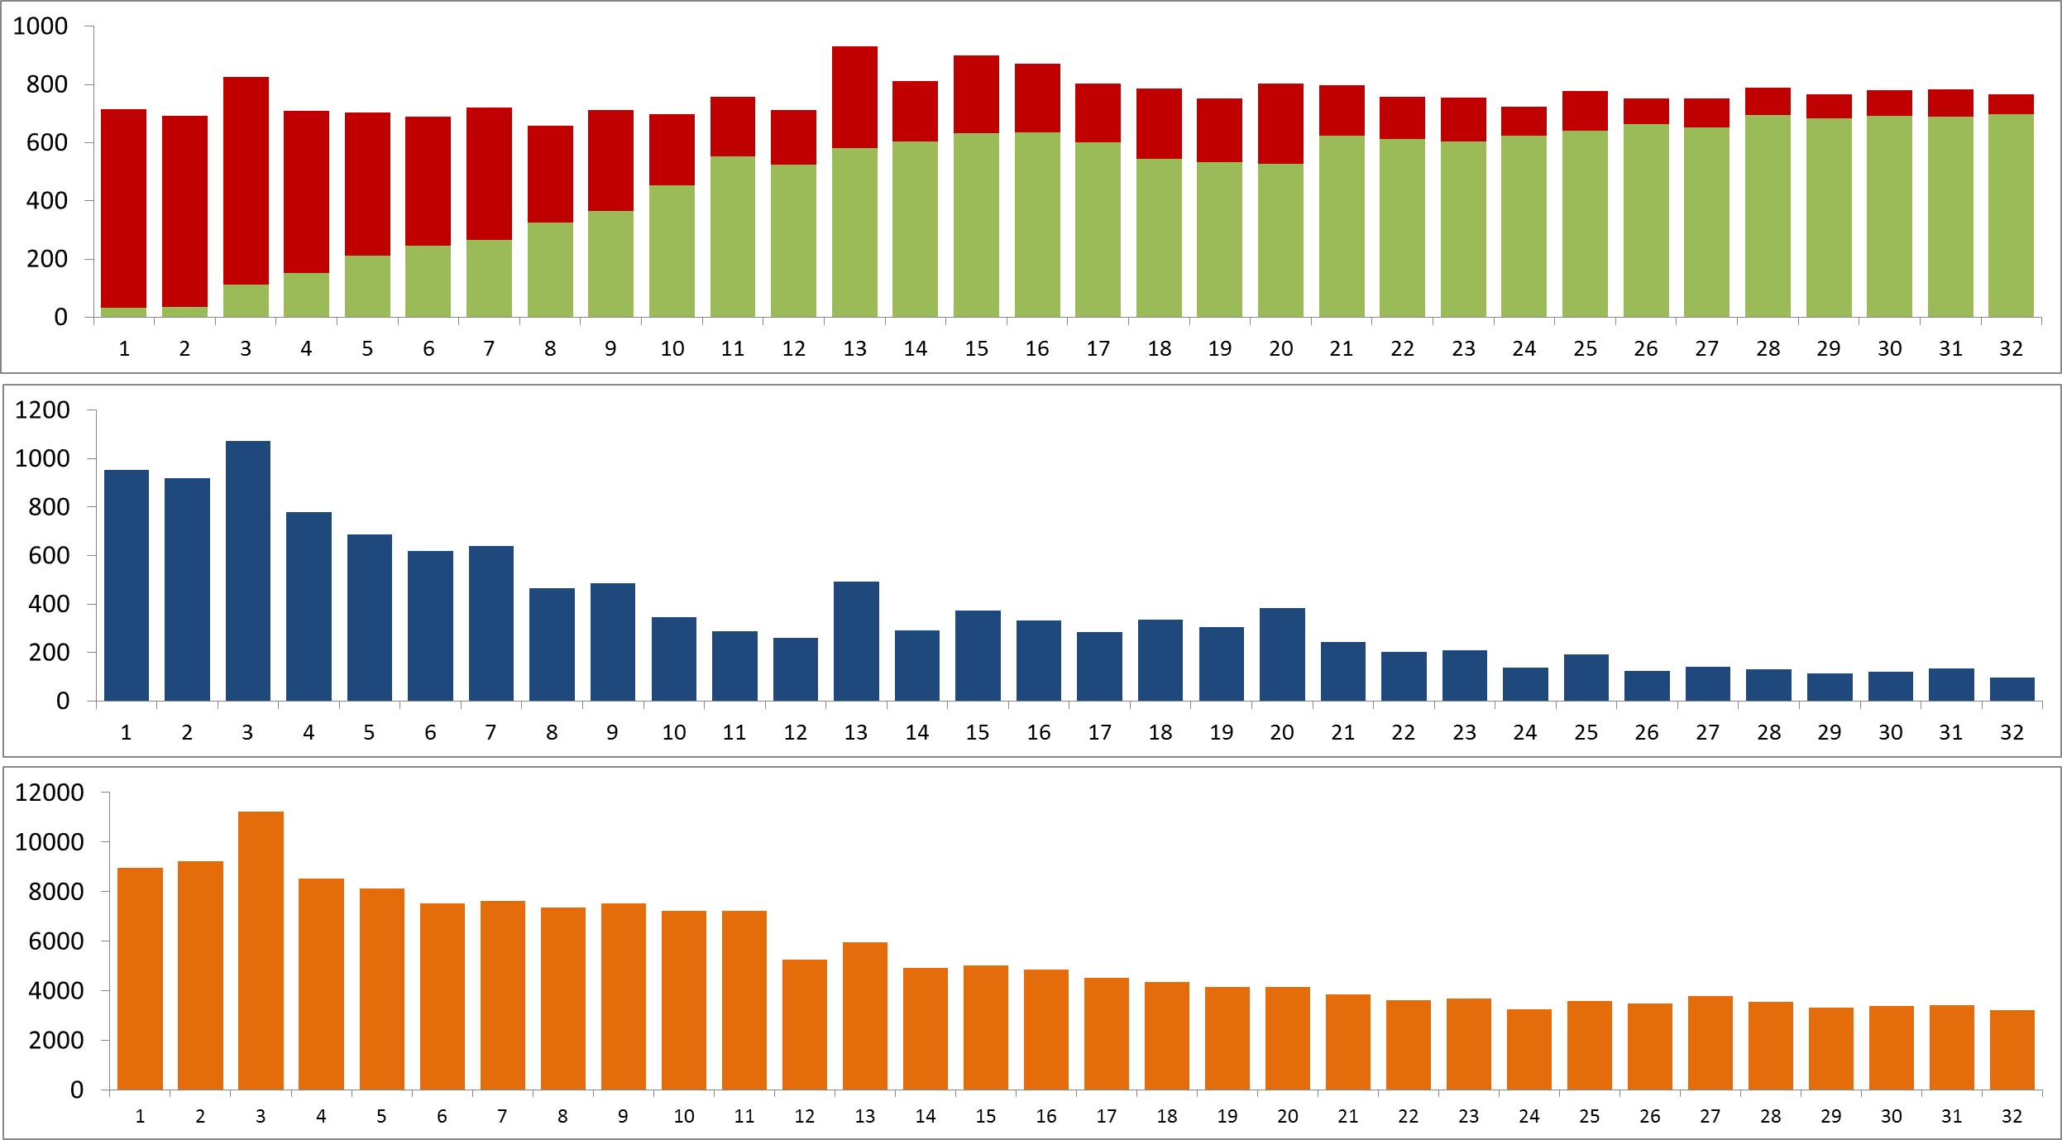
Prevention or correction?
Number of preventive X corrective actions
Downtimes due to corrective maintenance – repairs
Total maintenance cost

Slide 21
Eliminate process problems

Slide 22
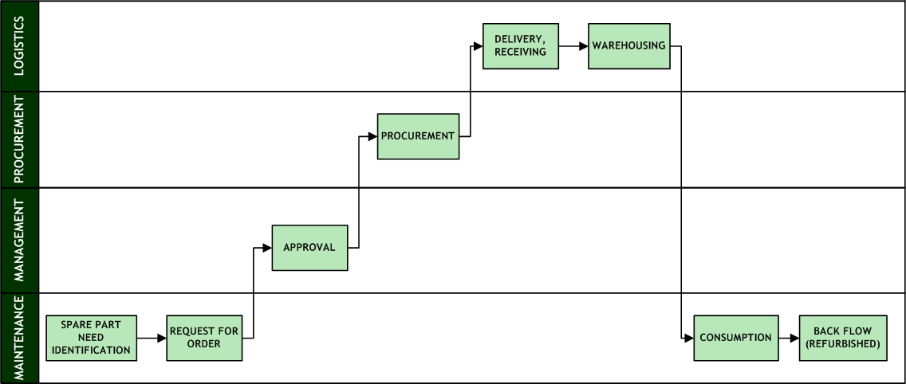
LIFE CYCLE OF A SP IN A COMPANY

Slide 23
Eliminate process problems
SP NEED IDENTIFICATION
There is no direct responsibility of maintenance engineers/technicians for “their” items and spare parts levels.
REQUEST FOR ORDER
RFO created by someone else, not by the technician who had identified the need.
The step of creating RFO may not be necessary in the process.
RFO APPROVAL
How often are RFOs approved? Who approves?
Is RFO approved by means of IS workflow or by signing a paper copy? Alternatively, are both ways needed?
After RFO is approved, the issued order must be approved again.
Too many approvers, complicated approval procedure and hierarchy of responsibilities.
Approving on high levels of management.

Slide 24
Eliminate process problems
PROCUREMENT
Insufficient information available to procurement, poor spare parts identification – the buyer hardly knows what should be bought, additional communication with maintenance technician is needed.
Missing or incomplete procurement specification in the IS.
RECEPTION
Problems with missing (undelivered) documentation for the received material (certificates, declarations).
Only “paper-based” archiving of spare parts documentation.
Problems to find documentation when needed.
WAREHOUSING
Insufficient identification of spare parts in the warehouse.
Problems with finding items stored in the warehouse.
Inventory count discrepancies, physical stock different from information system data.
Non-real value of stock in the information system.
Existence of out-of-system stocks.

Slide 25
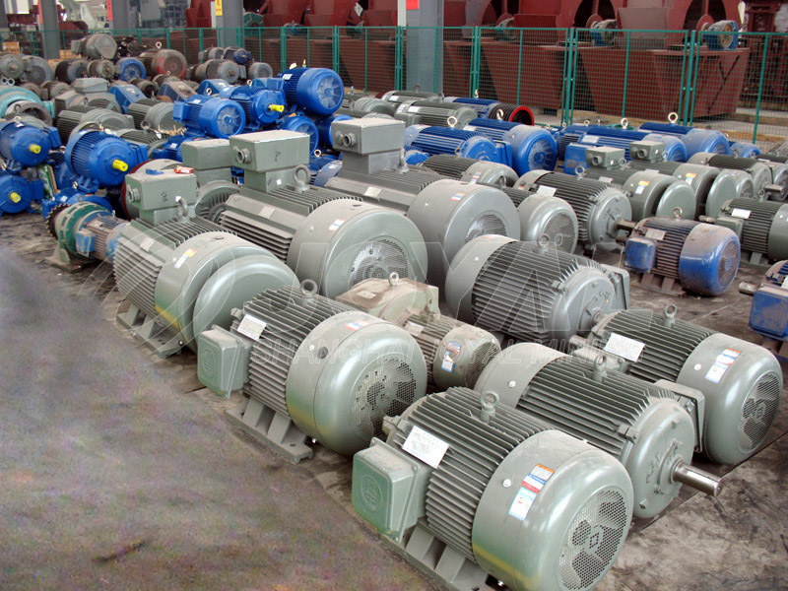

Slide 26
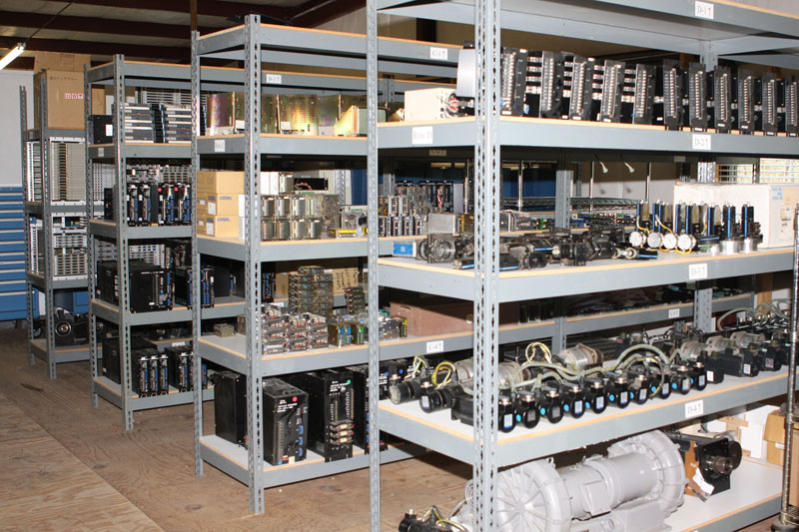

Slide 27
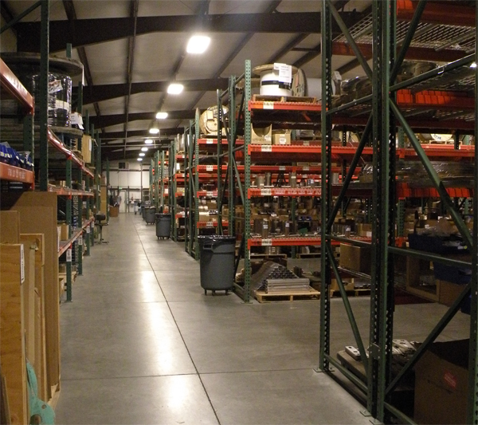

Slide 28
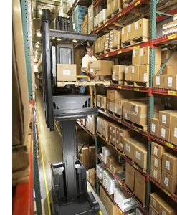

Slide 29
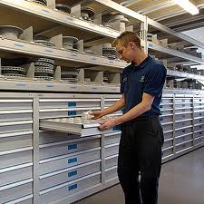
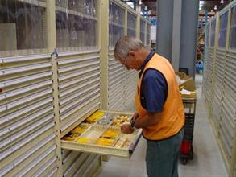

Slide 30
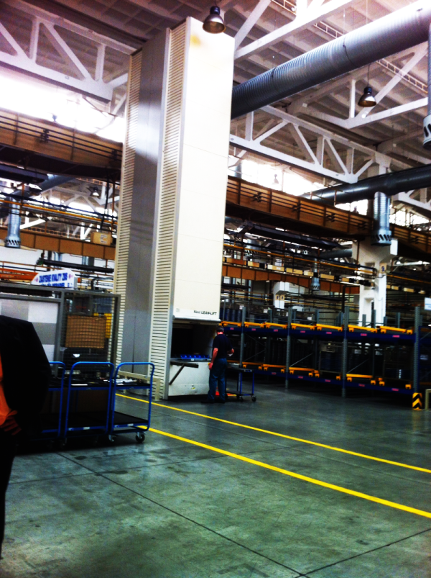

Slide 31
Eliminate process problems
CONSUMPTION
Slow spare part issues in case of sudden need.
Issued spare parts are not consumed in fact. What happens then?
Consumption of external material even in case the part is on stock.
WAREHOUSE RETURNS AND REFURBISHED SPARE PARTS
Refurbished parts return to warehouse while new are bought.
Accounting price of refurbished items is much higher (or lower) than the non-realistic value of items on stock.
Problematic or impossible returns of parts issued but not consumed.
Insufficient control of parts dismantled from the maintained object (the information system has no information about these).

Slide 32
Segment your spare parts portfolio

Slide 33
Strategic segmentation of spare parts
BUY
BUY
WHEN?
HOW MANY?
TYPE OF FORECAST
BUY
BUY
CONSIDER CONSIGNATION
CONSIGNATION
HOW MANY?
CONSIDER CONSIGNATION
CONSIGNATION
CONSUMPTION FREQUENCY
BUY BACK
CONSIDER CONSIGNATION
WHEN?
VALUE
BUY
CONSIGNATION

Slide 34
Evaluate spare parts criticality

Slide 35
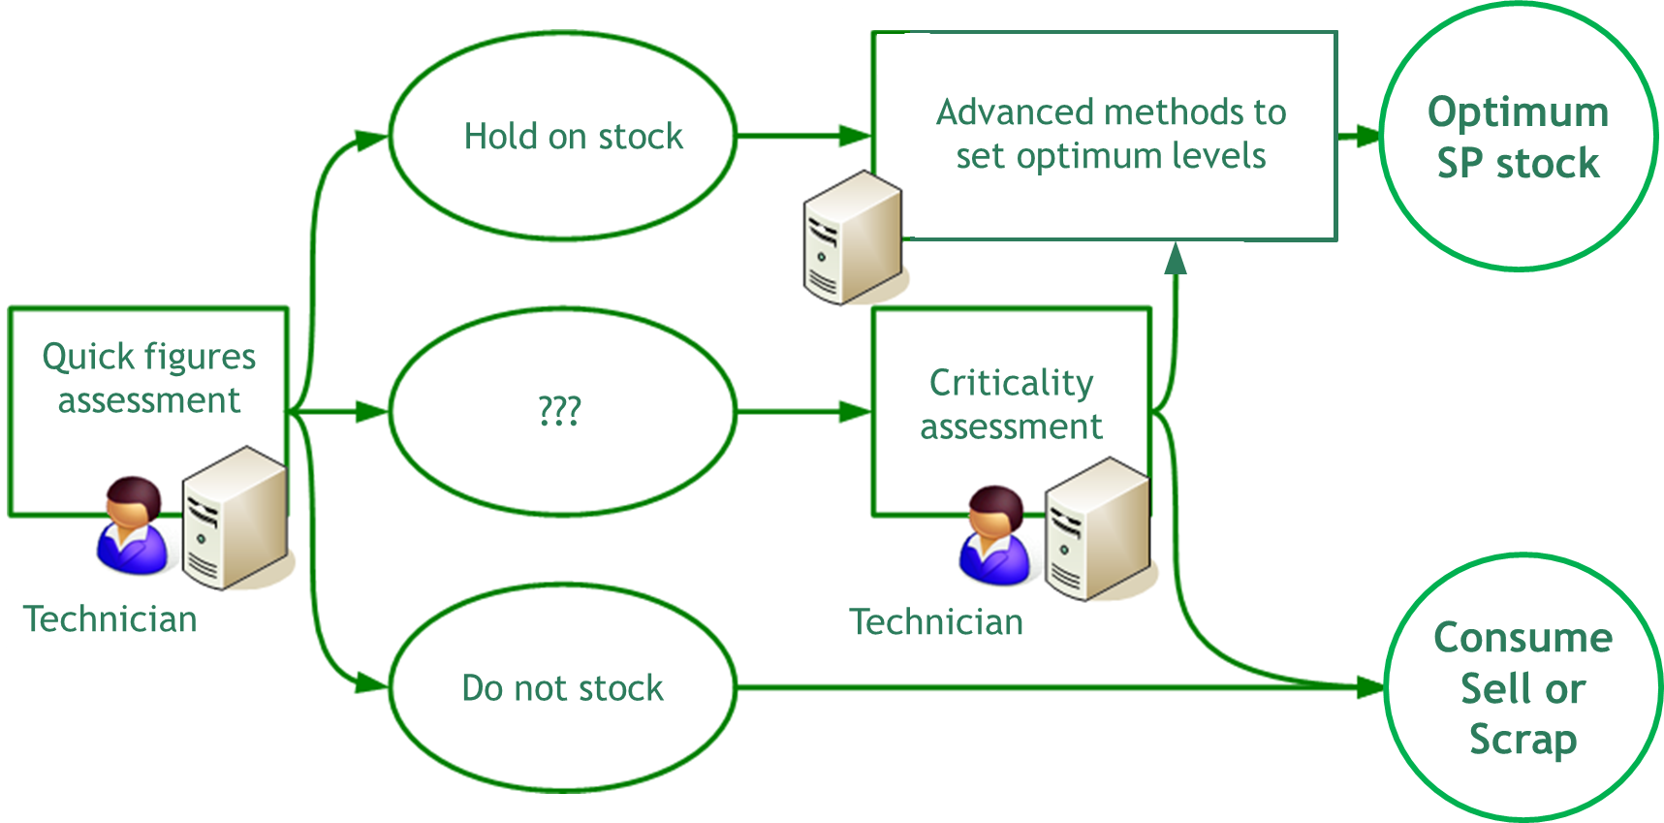
Criticality assessment phases
Advanced methods to set optimal levels
Optimum
SP level
Hold on stock
Preliminaryassessment
Potentially critical part
Criticality assessment
Technician
Technician
Consume
Sell or
Scrap
Do not stock

Slide 36
Evaluate spare parts criticality
Price
% cost of capital
Part lifespan
Failure probability
Failure characteristics
Failure anticipation
Cost of inventory holding
Failure probability
Delivery time
Repairability
Possibility of maintenance planning
Effects of failure
Technical places
Consequences of unavailability
Leadtime and other parameters
Impacts of spare part unavailability

Slide 37
Spare parts management starts with good forecasting

Slide 38
Quantitative methods x Common sense
Quantitative methods
Common sense

Slide 39
Quantitative methods x Common sense
Unexplained / Random
Minimize
Common sense
Make efficient
Uncertainty of future consumption
Quantitative methods
Maximize

Slide 40
Forecasting step-by-step
1
Visualisation of time series
For better understanding of the time series
2
Calculation of forecasts using all available methods
3
Calculation of accuracy
Absolute and relative errors, evaluation on testing season
4
Selection of the best method
Best accuracy and reliability
Notes:
39

Slide 41
Which method is the best for spare parts?
???
Notes:
40

Slide 42
Use special methods for intermittent demand items

Slide 43
Spare parts – intermittent demand
QUESTION: What reorder level should be set in order to ensure required availability of a spare part?
Weekly spare part consumption (pieces)
Weekly consumption history (weeks)

Slide 44
Bootstrapping
Bootstrapping = random sampling from history of consumptions.
SP consumption for lead-time period is sampled from history
Sample 1: Consumption in 6 weeks = 5 pcs
Example: SP lead time is 6 weeks
Weekly SP consumption
Weekly consumption history (weeks)

Slide 45
Bootstrapping
Sample 2: Consumption in 6 weeks = 0 pcs
Vzorek 2: Spotřeba za 6 týdnů = 0 ks
Spare part consumption (pieces)
Weekly consumption history (weeks)

Slide 46
Bootstrapping
Sample 3: Consumption in 6 weeks = 12 pcs
Vzorek 3: Spotřeba za 6 týdnů = 12 ks
Weekly SP consumption
Weekly consumption history (weeks)

Slide 47
Bootstrapping
Sample 4: Consumption in 6 weeks = 2 pcs
Vzorek 4: Spotřeba za 6 týdnů = 2 ks
Weekly SP consumpiton
Weekly consumption history (weeks)

Slide 48
Example of 100 000 simulations of SP consumption
Target: SP availability (Service level) = 99%
Frequencies of consumption
(from simulation)
Cummulative probability of consumption
OPTIMUM INVENTORY= 9 PCS
Consumption during leadtime (pcs)

Slide 49
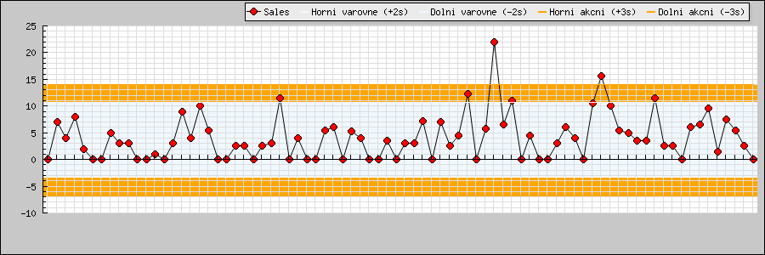
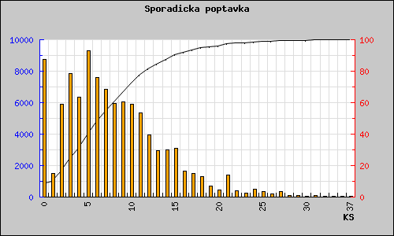
Bootstrapping application – a case study
Original inventory: 17 000 EUR (49 pcs)
Spare part lead-time: 32 days
Intermittent demand
Recommended inventory
29 pcs
10 000 EUR
99.9% availability
Savings
7 000 EUR

Slide 50
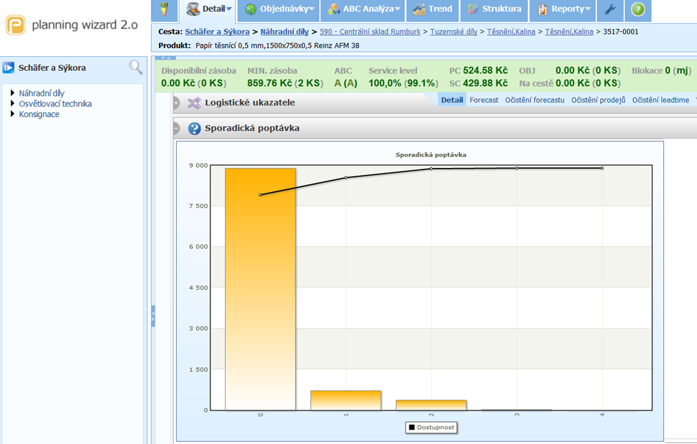

Slide 51
Life cycle thinking: Consider the whole life cycle of your assets

Slide 52
Life cycle thinking: Consider the whole life cycle of your assets

Slide 53
Life cycle thinking: Consider the whole life cycle of your assets
Bermuda triangle of asset management

Slide 54
COST
COST
PROCUREMENT
INSTALLATION
COST
PROFIT?
DISPOSAL
PROFIT
OPERATION
RENOVATION
ASSET LIFE CYCLE
MAINTENANCE
MAINTENANCE CREATES VALUE!
COST
COST

Slide 55
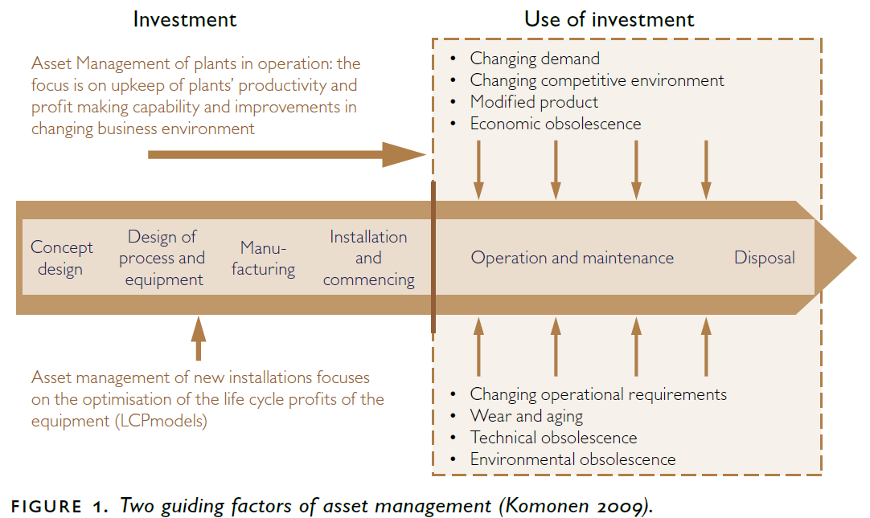
Asset life cycle (Kari Komonen, EFNMS EAMC)
INVESTMENT
UTILIZATION
$
$

Slide 56
COST
COST
PROCUREMENT
INSTALLATION
COST
PROFIT?
DISPOSAL
PROFIT
OPERATION
RENOVATION
ASSET LIFE CYCLE
MAINTENANCE
MAINTENANCE CREATES VALUE!
COST
COST

Slide 57
Efficient spare parts management Conclusions

Slide 58
Efficient spare parts management – 8 rules
Preventive maintenance
Processes without problems
Segment your SP portfolio
Assess the criticality
Good forecasting
Special methods for intermittent demand items
Asset life cycle
Good information system
Notes:
57

Slide 59
Good information system for spare parts management
Unexplained / Random
Forecast accuracy and reliability
Minimize!
Common sense
Input of technicians and procurement
Criticality analysis
Make efficient!
Quantitative methods
Forecasting
Inventory levels
Ordering
Maximize!

Slide 60
Spare parts management involves balancing the timely availability of spares and minimizing capital blocked in overall inventory. Poor spare parts management directly leads to poor asset availability and plant reliability. Organizations, faced with the complexity of spare parts optimization, must have better control over MRO inventory.
Comprehensive data analysis develops greater understanding and visibility of all aspects of spare parts management. The insight obtained by in-depth data analysis can help organizations build and execute better strategies.

Slide 61
Challenges in spare parts management:
Ensuring timely spares availability to ensure greater asset availability
Getting timely alerts on stock-outs of critical spares
Identifying exceptions, outliers and issues for better inventory control
Monitoring inventory turns, spillage and carrying costs
Understanding blocked capital and inventory carrying cost
Making informed financial planning and budgeting decisions
Optimizing overall MRO inventory

Slide 62
How data analysis helps in spare parts optimization?
Identification and management of slow moving, non moving and obsolete items
Understand physical placement options for items to increase store room efficiency
Monitoring of spare part availability for upcoming PM’s
Understand consumption patterns and capital investment by performing ABC Analysis
Critically rank and categorize items based on various procurement constraints and options
Manage inspections, cycle counts and expiry
Set min, max levels
Determine economic order quantity (EOQ)
Define stocking policies for capital and rotating assets or subassemblies
Provide supporting analysis for building comprehensive strategies, executing strategic action plans and monitoring outcomes for timely adjustments
Optimize inventory by balancing financial and reliability variables

Slide 63
Business Benefits
Increase productivity
Reduce compliance risks
Lower maintenance cost
Gain visibility across the enterprise with well defined performance metrics
Reduce unplanned downtime, increase reliability of critical equipments
Spare parts optimization
Determine root causes of non-conformities
Increased ROA

Slide 64
IT Benefits
Reusable DW data models, ETL, metrics, scorecards, reports, KPI’s and OLAP
Bridge gap between end user's perceived needs and actual business requirements
Awareness of data analysis capabilities
Improved data quality
Ability to integrate other data sources outside of EAM for more comprehensive reporting
Better leveraging of transaction data and IT infrastructure
Time to focus on other projects

Slide 65
Our methodology and analysis techniques
Determine Stock out Risk/Probability for critical assets spares using Weibull analysis
Identify bottlenecks in the spares supply chain process by applying six-sigma analysis.
Understand procurement efficiency by tracking KPIs for each PR
Optimize stock holding with FSN and ABC Analysis.
Forecast erratic spares demand by using Croston/ARIMA method.
Identify slow moving and non moving items.
Determine spare parts cost for budgeting purposes based on the Croston's Method.
Find optimum spare parts inventory level.
Understand demand patterns by classification based on Smooth. Irregular, Slow-moving. Mildly Erratic, Highly Erratic etc

Slide 66
Case study description (as heat exchanger)
Problem statement
Stepwise description
R script
graphs
Concluding statements

Slide 67
Design Thinking
Ask the participants what kind of problems related to their industry can be solved using this concept.

Slide 68
Question & Answers

Slide 69
THANK YOU
Copyright © 2016 Defour Analytics Pvt. Ltd

