Slide 1
OIL & GAS INDUSTRY CHALLENGES
Challenges

Slide 2
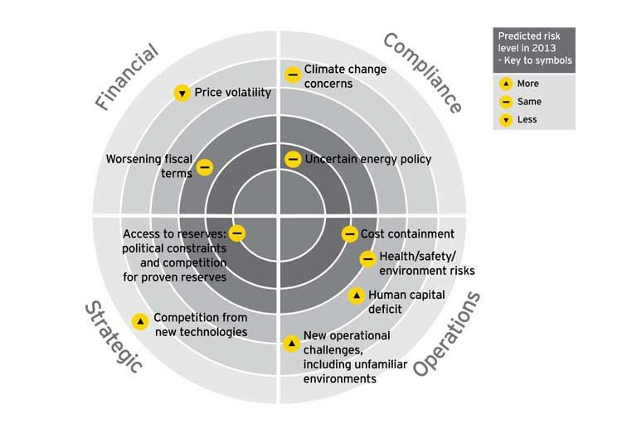
Challenges in oil & gas industry

Slide 3
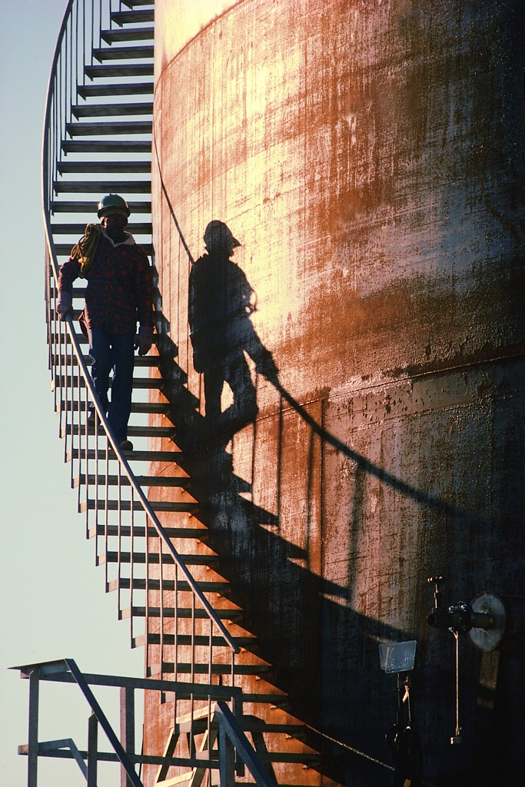
OIL & GAS INDUSTRY CHALLENGES
In a dynamic operating environment, daily operational decisions
can have significant and immediate impact on profitability, debt and cash flow.
Changing commodity markets can dramatically affect performance.
Significant capital requirements require ongoing evaluation of existing
and potential opportunities.
Integrate operational systems and data into planning systems to
allow the organization to proactively respond to changing
operating conditions.
Quickly assess new opportunities.

Slide 4
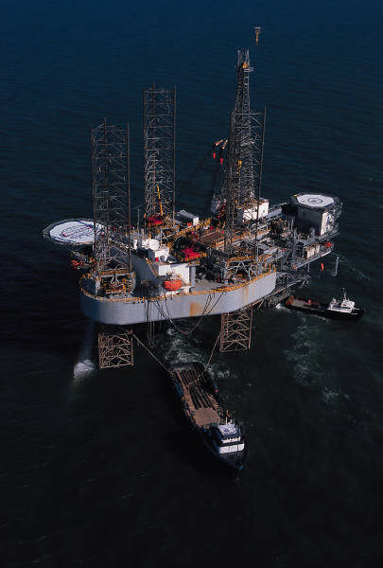
OIL & GAS INDUSTRY CHALLENGES
Predict and manage risk;
Reduce project complexity through interactive dashboards;
Control and manage project portfolios in real time;
Manage project change and quickly resolve issues;
Improve collaboration;
Implement earned-value management; and
Control contracts and documents.

Slide 5
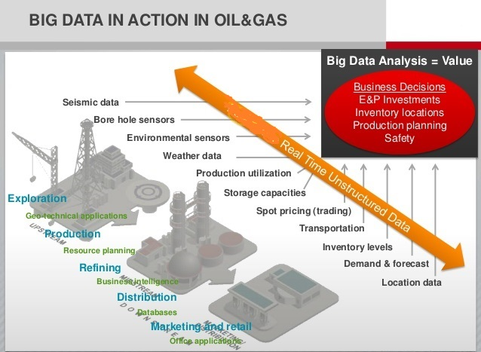
BIG DATA IN ACTION IN OIL & GAS

Slide 6
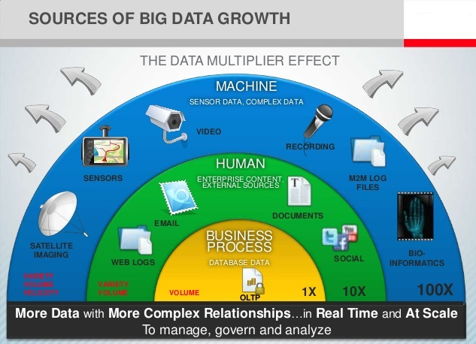
SOURCE OF BIG DATA

Slide 7

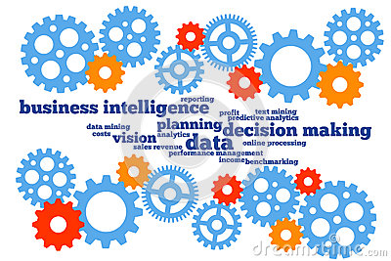
THROUGH ANALYTICS WHAT CAN BE DONE?
Capture real-time, accurate performance and maintenance data at the point of occurrence: platform, rig or field.
Put this information into the hands of decision
makers immediately- while it is still relevant.
Determine the “hot spot” for ensuring safety,
achieving planned productivity and minimize
cost of operations for predicable performance.

Slide 8
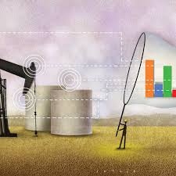
CRITICAL EXPECTATIONS FROM DATA ANALYTICS
The key to finding the ‘hot spot’ proactively around safety, productivity and cost:
Tracking data in real time and generating alerts
Predict the risk based on past performance
Prescribe corrective actions with actionable insights
Utilise dynamic optimization for improved yield and quality
Cross-functional visibility for early warning and mitigative actions
In typical industry the people, process and technology are well aligned to achieve proactive decision making hence alignment is a critical need.
The most of the oil and gas companies still relying on spreadsheets or paper-based systems for tracking and controlling their performance which needs to be enhanced for dynamic risk management.

Slide 9
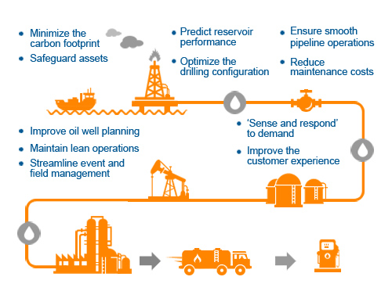
Major focus in the value chain

Slide 10
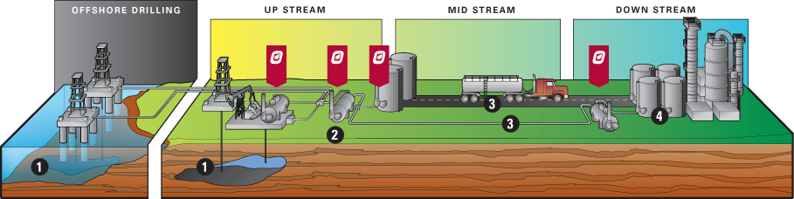
Focused scenarios for analytics
Asset performance | Logistic’ s planning | Yield maximization
Predictive maintenance | Opportunity loss reduction | Quality loss reduction
Production forecasting | Inventory optimisation | Lower safety / environmental incidents
Dynamic risk analysis | Demand planning | Cost reduction

Slide 11
THANK YOU.

