Slide 1
Business Analytics
Introduction to Analytics

Slide 2
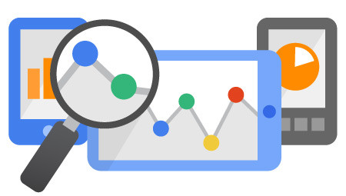
Introduction to Analytics
Definition
Analytics vs. Analysis
Business Analytics
Types of Analytics
Business Domains within Analytics
Challenges
Examples

Slide 3

What is Analytics?
Analytics is the discovery of meaningful patterns
Especially valuable in areas rich with recorded information.
Analytics relies on the simultaneous application of computer programming and quantitative techniques likes statistics and operations research to quantify performance.
Analytics may be used as input for human decisions or may drive fully automated decisions.

Slide 4
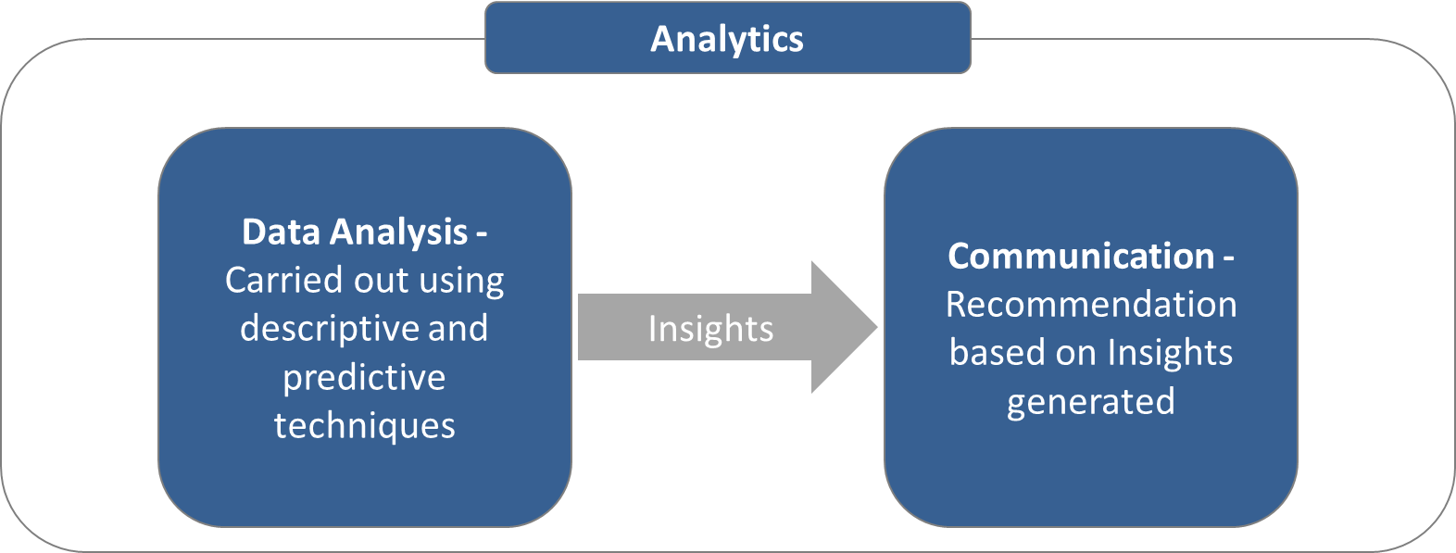
Analytics vs. Analysis
Data Analysis is used to generate Actionable Insights for decision making.
Analytics consists of entire methodology of Data Analysis, Insights generation and Communication.

Slide 5

Business Analytics
Business analytics refers to the skills, technologies, applications and practices for continuous iterative exploration and investigation of past business performance to gain insight and drive business planning
Focuses on developing new insights and understanding of business performance based on data and statistical methods
Makes extensive use of data, statistical and quantitative analysis, explanatory and predictive modeling and fact-based management to drive decision making

Slide 6
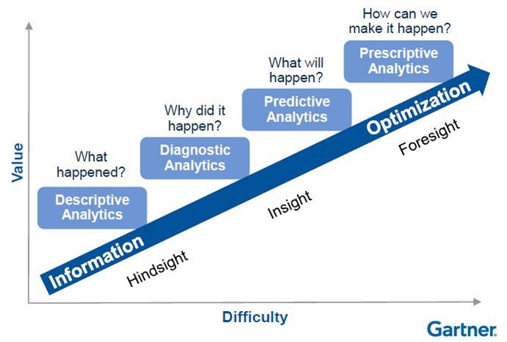

Types of Analytics

Slide 7
Basic domains within Analytics
Marketing Analytics
Financial Analytics
…
Asset Analytics
Operational & Performance Analytics
Sustainability Analytics
Supply Chain analytics
Energy Analytics
Risk & Fraud Analytics
Process Analytics
Customer & Allied Service Analytics
Compliance Analytics
Oil and Gas
Manufacturing
Supply Chain
Energy and Utilities
Chemical and Petrochemical
Pharma and Lifesciences

Slide 8
Challenges
Data volume and size
Computational power
Skilled professionals

Slide 9
Asset Performance Analytics
Analytics
Operations
Reliability
Design
Integrity
Predict asset operational performance
Predict process failures
Mathematical Simulation of data
Impact of process parameters on Quality
Reliability assessment and forecasting
Integrity tracking and hotspot identification
Corrosion Monitoring
Asset Lifecycle Tracking
Component failure rate detection and prediction
Spare part reliability and demand analytics

Slide 10
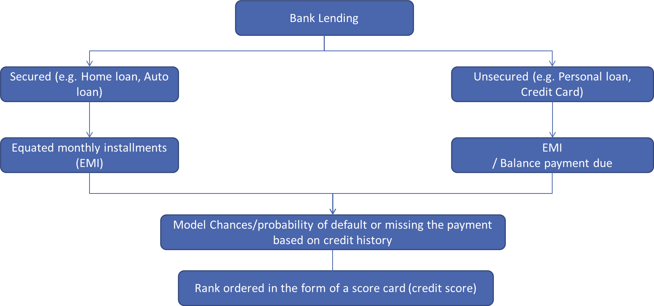
Example - (Risk Analytics in Retail Banking)
Predictive Models in banking industry is widely developed to bring certainty across the risk scores for individual customers.
Credit Scores are built to predict individual's delinquency behavior and also scores are widely used to evaluate the credit worthiness of each applicant and rated while processing loan applications.
Notes:
This needs to change by Domain

Slide 11
Gartner- References
Business analytics
Data science
Magic quadrant to be inserted

Slide 12
What is R?
R is a programming language and software environment for statistical computing and graphics supported by the R Foundation for Statistical Computing.
The R language is widely used among statisticians and data miners for developing statistical software and data analysis.
It is being used by a growing number of data analysts inside corporations and academia.
It is becoming their lingua franca partly because data mining has entered a golden age, whether being used to set ad prices, find new drugs more quickly or fine-tune financial models.
Companies as diverse as Google, Pfizer, Merck, Bank of America, the InterContinental Hotels Group and Shell use it.
The source code for the R software environment is written primarily in C, Fortran, and R.

Slide 13
Why 'R' ?
R is a statistical tool/platform/programming language which is free and open-source. It is built by academicians/statisticians who continuously provide libraries (customized functions) for new and emerging statistical techniques.
Cutting-edge statistics with 'R'- It is important to take notice of quite a few packages that are not available in any other statistical tool in the market currently.
R has powerful graphics capabilities. A graph gallery of R’s graphics possibilities can be seen here (http://addictedtor.free.fr/graphiques/thumbs.php?sort=votes)
R is already being used by some Bigshots- Companies like Google and Facebook (to name a few) are already using it for in-house analytics.
- An event was organized some time back where representatives from Google and Facebook discussed their experiences with R. The video of this event can be found here (http://www.lecturemaker.com/2009/02/r-kickoff-video/)

Slide 14
What is so cool about 'R'?
R can be used to provide analytics on the Web- Embeddings for Apache server are available which embed R on a server and a user can interact with it via a web browser. http://data.vanderbilt.edu/~hornerj/brew/useR2007.rhtml is an example of such a setup.
R can be embedded in EXCEL- This may require an intermediate-advanced degree of familiarity with R and VBA, but for seasoned VBA users, embedding R in EXCEL will provide them with a whole new range of statistics and graphic capabilities not seen in current versions of EXCEL.
'R' can be used to display animations- http://www.yihui.name/r/stat/multivariate_stat/kmeans/index.htm This site displays animations made using R to illustrate key statistical concepts.
Community support in R is very mature and most newbies get a great deal of help by posting to the r-help list. Responses come from professors/ statisticians/ programmers/ advanced users which fosters learning in a more holistic manner, since most newbies are instructed in how to solve their R programming issues with relevant insights into the statistics involved.

Slide 15
Limitations of Excel
1. Big Data Analysis
Memory Limitations
More often than not, the dreaded “Not Responding” message appears when trying to use Excel for analytics.
Excel Power Pivot is not a replacement for data warehouses or even mainstream data discovery tools.
While the spreadsheets are ideal for creating one time analysis , they become problematic as the data grows and evolves over time , As new rows and columns get added , The summary ranges and formulas may need to be modified or new ones created, the data and the formulas are not consistently updated , and these mistakes lead to bad results and decisions .
Connectivity Limitations
One of the significant differences between modern Excel and Power BI, and the other in-memory, data discovery analytics offerings is the lack of Power Pivot direct connectivity and a restrictive requirement to copy data to Excel.
Contemporary data discovery tools provide optional use of local, desktop in-memory data engines or direct data source connectivity to databases and data warehouses.
This one aspect alone separates the toys from the tools because we live in a world with billions of records and petabytes of data that continue to grow every single day.

Slide 16
Limitations of Excel
Visualization Limitations
Other common problems with using Excel 2013 Power BI include inflexible data visualizations, inadequate chart selections, and limited data point rendering capability.
If you can only view a small sampling of data in an Excel chart, you could be overlooking or missing critical decision-making information. Native Excel 2013 charts are incapable of plotting data sets of a few hundred records.
Although the brand name Power BI infers a strong analytic solution, Power BI is not powerful when compared to leading data discovery offerings available on the analytics market today.
Analytics with Large Data Sets
When using a data discovery tool that is capable of rendering large data sets, minor market shifts and outlier situations—which otherwise could go undetected until it is too late—can be quickly seen and acted upon.
Present-day analytic needs far surpass what can actually be done with Excel Power BI. For competitive analytic depth and breadth, data savvy organizations increasingly rely on dedicated solutions.

Slide 17
Limitations of Excel
2. Enterprise Dashboards
Another typical mistake is trying to use Excel and Power BI to replace enterprise dashboard applications.
Excel dashboards are expensive with regards to development inefficiency, security, reliability, and capability. What might literally take a few seconds with two or three clicks in a data discovery tool can take hours or longer to generate with Excel and VBA.
3. Visualized Map Data
If you always have reliable Internet connectivity, need only basic data mapping, and don’t want to share your maps with others, Power Map may be a perfect option.
But if you require offline maps, advanced map displays with WMS, custom shapes, indicators, and layering, or if you want to distribute your maps, then data discovery tools are a much better fit for the task.
Most data discovery solutions have exceptional, fully interactive, geospatial mapping like automatic geocoding, custom shapes, spatial searching, clustering, geofencing, distance and route calculations, and choropleth mapping.

Slide 18
Why R and not other general purpose languages?
Data mining algorithms can be developed in C / C++ / Java / MATLAB, but for data science R / Python are more convenient i. e. flexible and easy to use language.
The main issue is that it (C++ / Java) has no vectorized operations, so you need to write lots of loops. R and python (with numpy) are better choices.
In R or Python there are libraries that gives solid foundation for all numerical, statistical and matrix computations free of charge. There is just NO comparable library of this kind and scale in C/C++.
All tools in C are tiny separated packages, each one living in its own world, with no easy way to integrate all of them together.
R / Python, unlike C/C++, features an interactive interpreter, where you can easily play and experiment with datasets, keeping all structures permanently in memory, without the need to restart the entire code again and again from scratch after every modification.
Interactive interpreter helps also with visualizations.
Java doesn’t provide the same quality of visualisations as R and Python do, and it isn’t the best for statistical modelling.
Notes:
Because time is gold, and it is much fast and easy to write some prototype in Python or R. But if have "need for speed" in the production phase, then you will translate the prototype to a more performant language: Java is the first option, C++ the second. Now Scala is gaining momentum.

Slide 19
When to use R / Python
On the web, you can find many numbers comparing the adoption and popularity of R and Python as the ultimate choice for Data Analytics.
While these figures often give a good indication on how these two languages are evolving in the overall ecosystem of computer science, it’s hard to compare them side-by-side.
The main reason for this is that you will find R only in a data science environment; whereas a general purpose language, Python, on the other hand, is widely used in many fields, such as web development, app development and many more.

Slide 20
When to use R / Python
When and how to use R?
R is mainly used when the data analysis task requires standalone computing or analysis on individual servers.
It’s great for exploratory work, and it's handy for almost any type of data analysis because of the huge number of packages and readily usable tests that often provide you with the necessary tools to get up and run quickly.
R can even be part of a big data solution.
When and how to use Python?
You can use Python when your data analysis tasks need to be integrated with web apps or if statistics code needs to be incorporated into a production database.
Being a fully fledged programming language, it’s a great tool to implement algorithms for production use.

Slide 21
About defour

