Slide 1
Business Analytics
Understanding Data

Slide 2
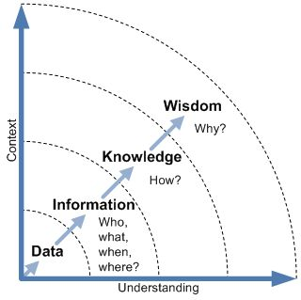
2.Data
Population vs. Sample
Analyzing Data
Identify Types of Data Variables
Summarizing data
Identify Measures of central tendency
Describe Measures of spread
Identify Skewness of data distribution
Data Collection and Management Framework
Data Collection
Data Dictionary
Outlier Treatment
Missing Value Imputation
Business Data Types

Slide 3
Population vs. Sample
Population
Not to be confused with literal meaning of "population" which means number of people living in a defined geographical region.
The "population" in statistics includes all members of a defined group that we are studying or collecting information on for data driven decisions.
Example:
Current inflation rates of EU countries.
All the votes casted in an electoral poll.
Sample
It is a part of the "population".
Can be biased or un-biased (also know as random sample).
Example: (Component reliability )
Current inflation rates of EU countries having per capita income of less than 20000 Euros per annum.
A portion of votes collected to predict the election outcome through "Exit Poll".
Population
Sample1
Sample2
Sample3
Notes:
http://www.dissertation-statistics.com/population-sample.html

Slide 4
Typical Data Analysis Approach
Identify Data Variable Types
Summarize Data
Analyze Data Central Tendency
Analyze Data Spread
Analyze Data Skewness

Slide 5
Identify Data Variable Types

Slide 6
Types of Data Variables (I)
Data consists of a combination of "variables" which actually contain the values
Variables at a high level are of two types depending on the kind of values they store:
Numerical
Categorical
Numerical variables
Discrete
Arises from counting
can take only a set of particular values including negative and fractional values
Examples: Credit score, number of credit cards owned by a person, number of states in a country, charge on electron etc.
Continuous
Arises from measuring
Can take any value with in a specified range
Examples: Height, Amount of money, Age etc.
Categorical variables
Binary (or Dichotomous)
Has only two categories
Examples: yes/no, male/female, pass/fail etc.
Nominal
Has several unordered category
Examples: Type of bank account, type of insurance policy etc.
Ordinal
Has several ordered category
Examples: questionnaire responses such as "strongly in favour / … / strongly against".

Slide 7
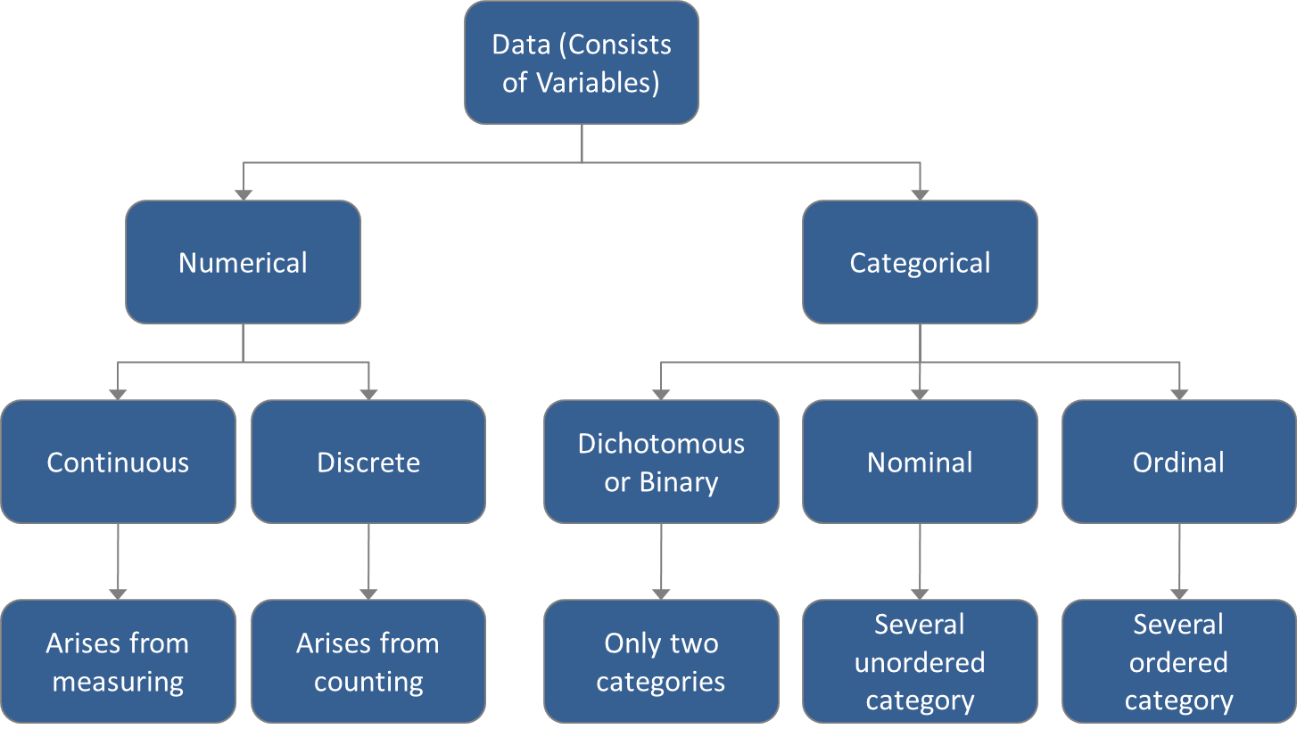
Types of Data Variables (II)

Slide 8
Types of Data variables (Data snapshot)
Sl # | Name of Manufacturer | Manufacturer ID | Number of Equipment's | Annual Equipment Failures | Manufacturer Type | Manufacturer Category | Annualized Maintenance cost | Failure Rate
1 | Josh | 111669 | 5 | 42 | LOCAL | Medium | 88,001 | Low
2 | Janice | 146861 | 6 | 25 | LOCAL | Large | 592,489 | Low
3 | Dandre | 171690 | 3 | 50 | IMPORTED | Small | 272,304 | Low
4 | Aiden | 161721 | 6 | 37 | IMPORTED | Large | 726,593 | Low
5 | Celine | 170359 | 7 | 50 | LOCAL | Medium | 612,075 | Low
6 | Emilio | 175646 | 5 | 41 | IMPORTED | Medium | 490,356 | Low
7 | Joaquin | 180732 | 2 | 62 | LOCAL | Small | 164,732 | Low
8 | Justus | 113136 | 7 | 26 | LOCAL | Medium | 510,321 | Low
9 | Chaya | 169254 | 4 | 24 | IMPORTED | Medium | 358,534 | Low
10 | Justyn | 149771 | 4 | 35 | IMPORTED | Large | 140,400 | Low
11 | Jadon | 166226 | 7 | 36 | IMPORTED | Medium | 105,259 | Low

Slide 9
Types of Data variables
Variable Name | Name of Manufacturer | Manufacturer ID | Number of Equipment's | Annual Equipment Failures | Manufacturer Type | Manufacturer Category | Annualized Maintenance cost | Failure Rate
Value Stored | Name of the individual manufacturer | Unique identifier | 1, 2, 3… | 18, 19, 20… | Local/Imported | Small / Medium / Large | Amount | Low(<25%) / Medium(<50%) / High(<75%) / Very High(>75%)
Variable Type | ? | ? | ? | ? | ? | ? | ? | ?
Remarks

Slide 10
Case: Types of Data variables (Revisited)
Variable Name | Name of Manufacturer | Manufacturer ID | Number of Equipment's | Annual Equipment Failures | Manufacturer Type | Manufacturer Category | Annualized Maintenance cost | Failure Rate
Value Stored | Name of the individual manufacturer | Unique identifier | 1, 2, 3… | 18, 19, 20… | Male / Female | Married / Divorced / Never Married | Amount | Low(<25%) / Medium(<50%) / High(<75%) / Very High(>75%)
Variable Type | -- | -- | Numerical (Discrete) | Numerical (Discrete) | Categorical (Binary) | Categorical (Nominal) | Numerical (Continuous) | Categorical (Ordinal)
Remarks | Identifier | Identifier | Arises from counting. Takes certain discrete values in a given range | Arises from counting. Takes certain discrete values in a given range | Only two categories | Several ordered category | Takes many values in a given range | Several ordered category

Slide 11
Summarize Data

Slide 12
Summarizing Data
There are various ways to summarize data. Some of them are
Frequency distribution
Grouped frequency distribution
Cumulative frequency distribution
Stem leaf diagram
Line plots
…

Slide 13
Summarizing Data - Frequency distribution
A technique to summarize discrete data
A simple process which involves counting of distinct discrete values
The representation can be either tabular or graphical
Example: Number of Failures out of total critical equipment's
Tabular representation
Graphical representation - Bar Chart
No. of failures | No. of equipments
1 | 136
2 | 44
3 | 13
4 | 8
5 | 4
6 | 9
7 | 2
8 | 1
9 | 1
11 | 2
12 | 5
13 | 1
15 | 2

Slide 14
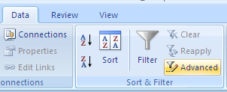
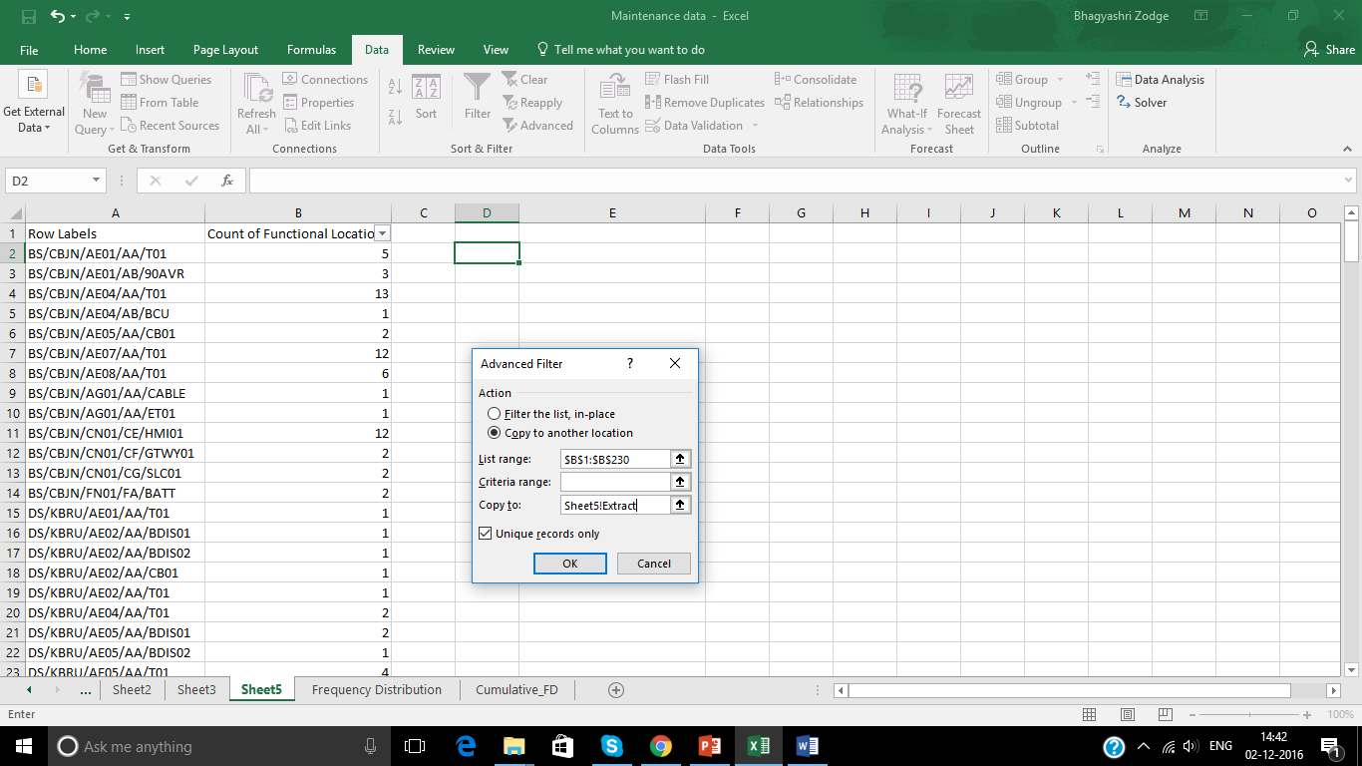
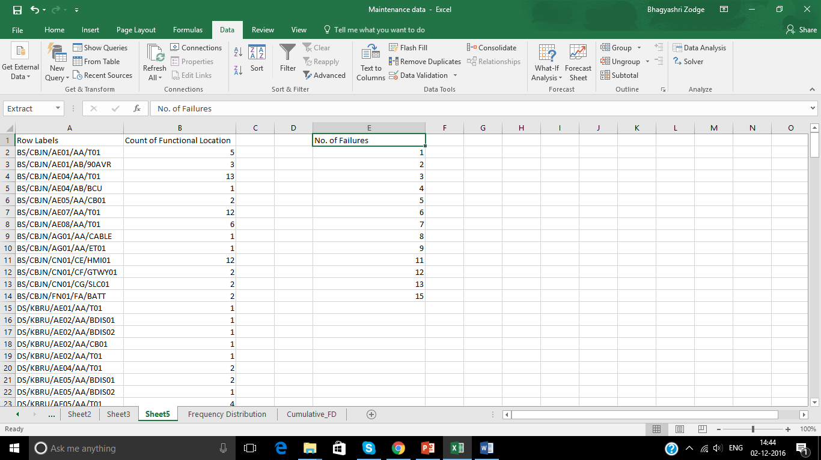
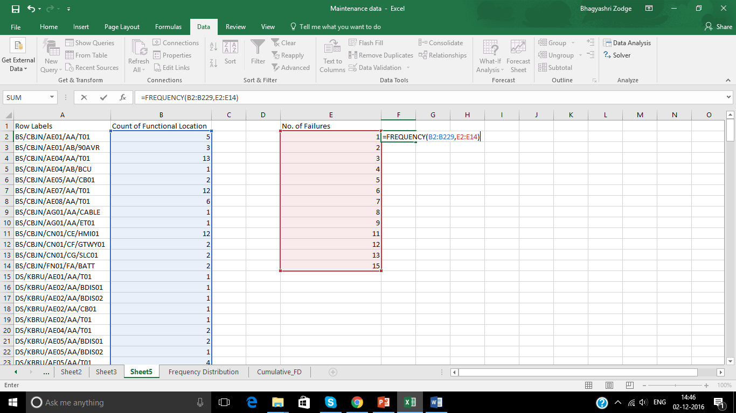
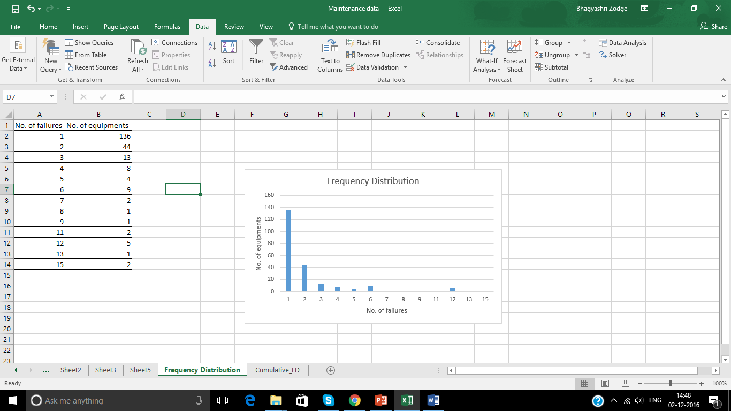
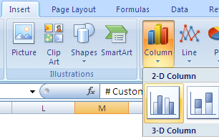
Summarizing Data-Frequency distribution
1
2
3
4
7
6
5

Slide 15
Summarizing Data - Grouped Frequency distribution
A technique to summarize continuous data or discrete data having large number of observations and an extended range
A simple process which involves counting of values falling under the different intervals (grouped)
Example and illustration 2.2: Number of customers falling under different Salary groups
Graphical representation - Bar Chart

Slide 16
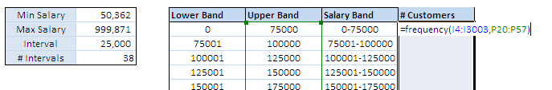
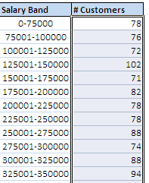
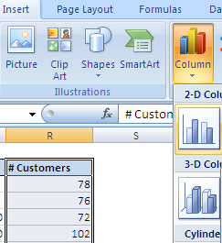
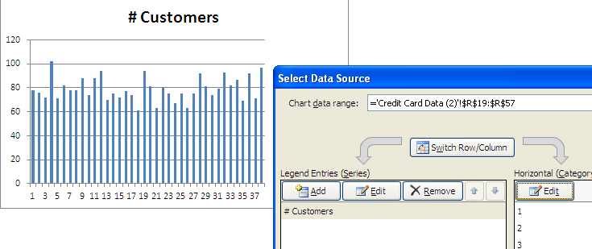
Summarizing Data – Grouped Frequency distribution
1
2
1. Press “ctrl+alt+enter”
5
5.Observe the difference between horizontal axes of two charts
4
3
4.From “Edit” select the salary bands as horizontal axis

Slide 17
Summarizing Data - Cumulative Frequency distribution
Cumulative frequencies are obtained by accumulating the frequencies to give the total number of observations up to and including the value or group in question.
Example and illustration 2.3: Cumulative number of cards in the sample of 3000 individuals
Tabular representation
Graphical representation
No. of failures | No. of equipments
1 | 136
2 | 44
3 | 13
4 | 8
5 | 4
6 | 9
7 | 2
8 | 1
9 | 1
11 | 2
12 | 5
13 | 1
15 | 2

Slide 18
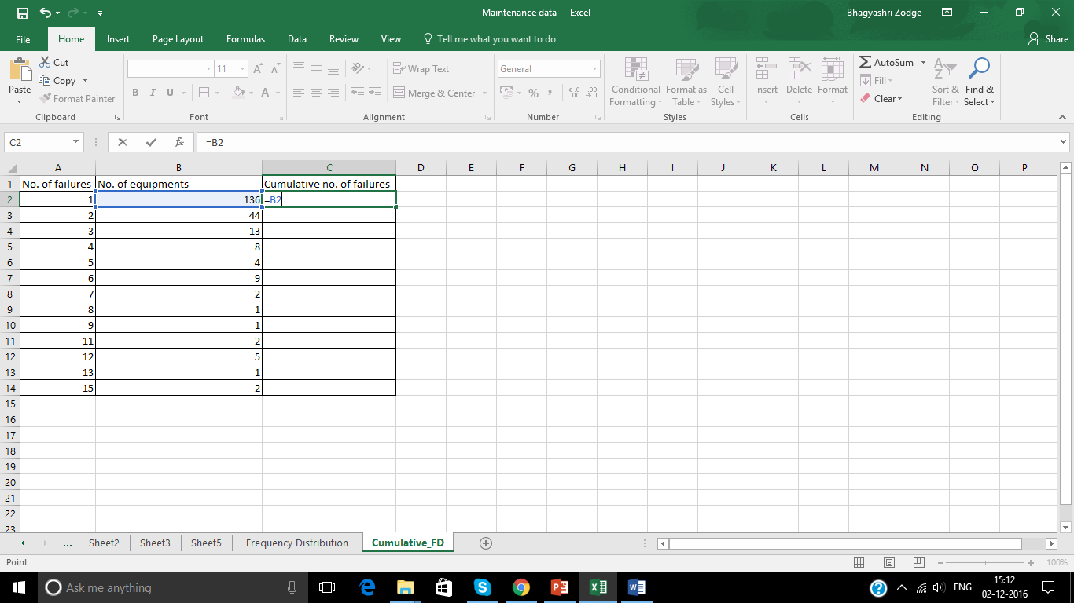
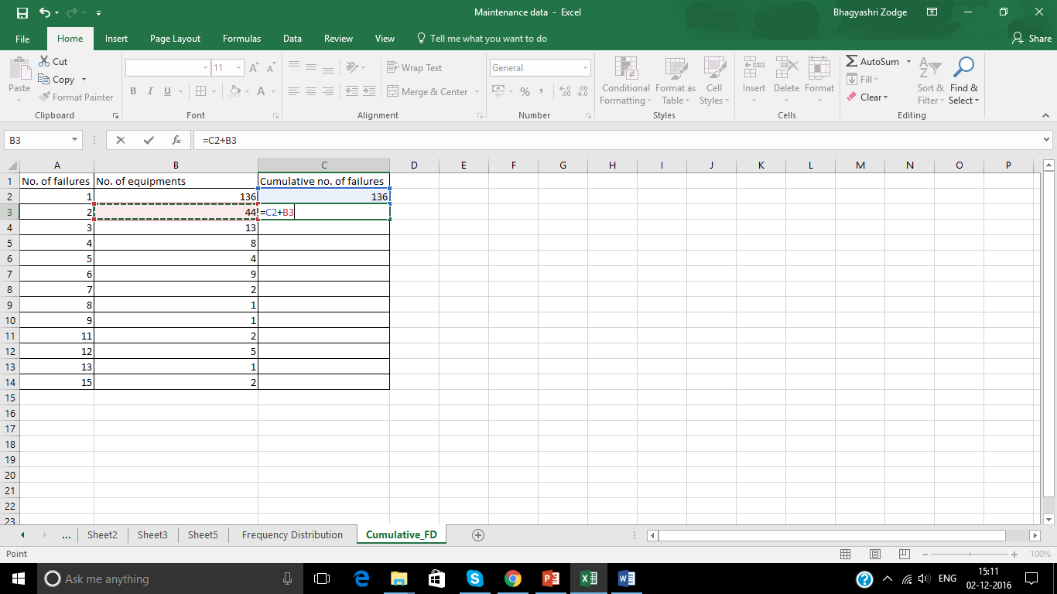
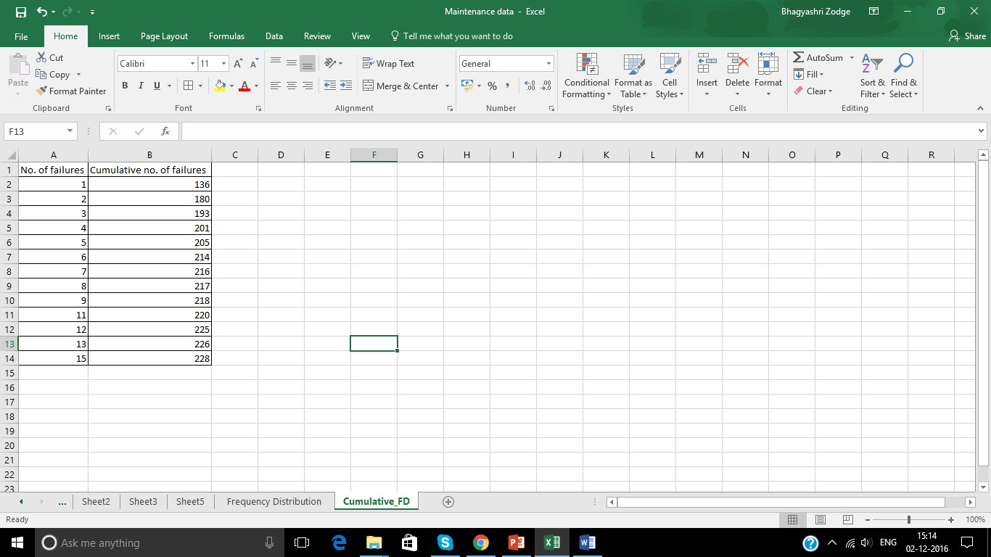
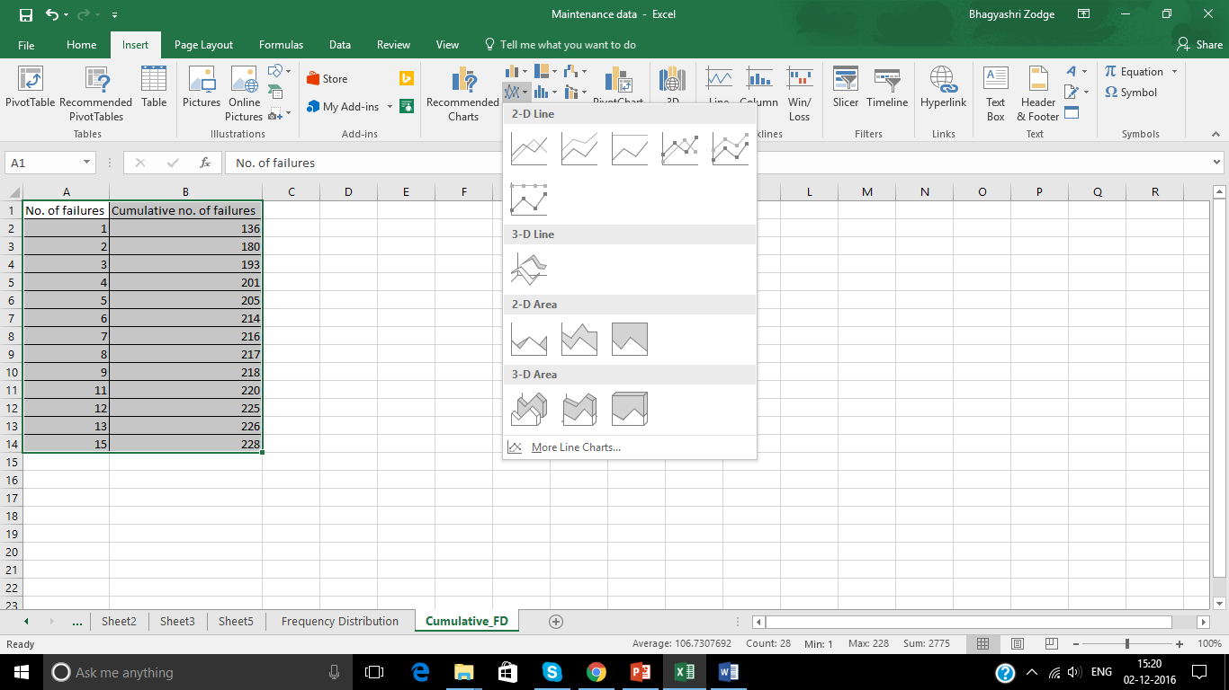
Summarizing Data - Cumulative Frequency distribution
1
2
3
5
4

Slide 19
Analyze Data Central Tendency

Slide 20
Measures of Central Tendency/Location
Mean
Mode
Median
There are a number of different quantities, which can be used to estimate the central point of a sample.
These are called measures of central tendency, or measures of location.
Just different ways of calculating the "average" value of dataset

Slide 21
Mean- Measure of Central Tendency/Location
By far the most common measure for describing the location of a set of data is the mean.
For a set of observations denoted by x1, x2,….,xn the mean is defined by
<x> = (x1 + x2 + … + xn)/n (also denoted by x-bar i.e. ).
For a frequency distribution with values x1, x2, … xn and corresponding frequency values f1, f2, …,fn it is defined as
<x> = (f1 * x1 + f2 * x3 + …. + fn * xn)/(f1 + f2 + … + fn).
It can be calculated simply in excel by simply giving the command :
=AVERAGE(range of cell whose average/mean is to be calculated)

Slide 22
Median- Measure of Central Tendency/Location
Another useful measure of location.
The median is a value, which splits the data set into two equal halves.
So that half the observations are less than the median and half are greater than the median.
If n is odd, then the median is the middle observation.
If n is even, then the median is the midpoint of the middle two observations i.e. (n + 1) / 2th observation.
One of the potential advantages of the median for certain data sets is that it is robust or resistant to the effects of extreme observations.
It can be calculated in excel simply by giving command :
=MEDIAN(Range of cell whose median is to be calculated)

Slide 23
Mode- Measure of Central Tendency/Location
A third measure of location is the mode.
Defined as the value which occurs with the greatest frequency or the most typical value.
Excel has inbuilt function “Mode” for granular data
For summarized data it can be find easily by visual inspection
Here, Mode = 4

Slide 24
Analyze Data Spread

Slide 25
Measure of Spread
Variance
Range
Inter Quartile Range
Standard Deviation
The central tendency of a data set is usually the main feature of interest.
Another feature of interest is the spread (or variability or dispersion or scatter)
Meaning how widely spread the data are about the mean (or other measure of location).

Slide 26
Variance and Standard Deviation
The most commonly used measure of spread is the standard deviation.
Essentially it is a measure of how far on average the observations are from the mean.
For a data set having values x1, x2,…,xn (or xi where i=1,2,…,n) and mean of <x> variance is calculated as
For granular data: Variance (σ²) = ∑(xi - <x>)²/n
For summarized frequency table: Variance (σ²) = ∑{fi*(xi - <x>)²}/n
Standard deviation is positive square root of variance denoted by σ
For a sample variance is calculated as
Variance (s²) = ∑(xi - <x>)²/(n-1)
Dividing by (n −1) makes the sample variance an unbiased estimator of the population variance.
To calculate variance in excel :
= VAR(Range of cell whose variance is to be calculated)
To calculate standard deviation in excel :
= STDDEV(Range of cell whose std deviation is to be calculated)

Slide 27
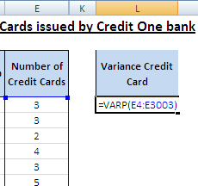
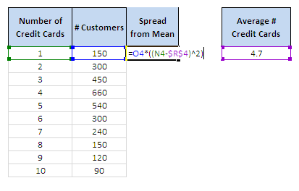

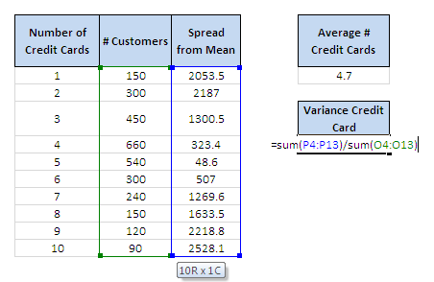

Variance and Standard Deviation
1. Using Excel function for granular data
2. For summarized data in form of frequency table
1
2

Slide 28
Range
The range is a very simple measure of spread defined, as its name suggests, by the difference between the largest and smallest observations in the data set.
Range = max(xi) – min(xi)
A poor measure of the spread of the data as it relies on the extreme values
Which aren't necessarily representative of the data as a whole.

Slide 29
Inter quartile Range
Similar to Range but is not affected by the data extremes.
Just as the median divides a set of data into two halves, the quartiles divide a set of data into four quarters. They are denoted by Q1, Q2 and Q3.
Q2 is just the median, while Q1 is called the lower quartile and Q3 the upper quartile.
Q1 can be defined to be the (n + 2) / 4th observation counting from below and Q3 as the same counting from above, with relevant interpolation if needed.
The Inter quartile range is defined as Q3 − Q1.

Slide 30
Analyze Data Skewness

Slide 31
Symmetry and skewness
It deals with the shape of the distribution of a data set, that is, whether it is symmetric or skewed to one side or the other.
The approximate shape of a distribution can be determined by looking at a histogram.
Symmetrical:
Mean = Median = Mode
Positively Skewed:
Mean > Median > Mode
Negatively Skewed:
Mean < Median < Mode

Slide 32
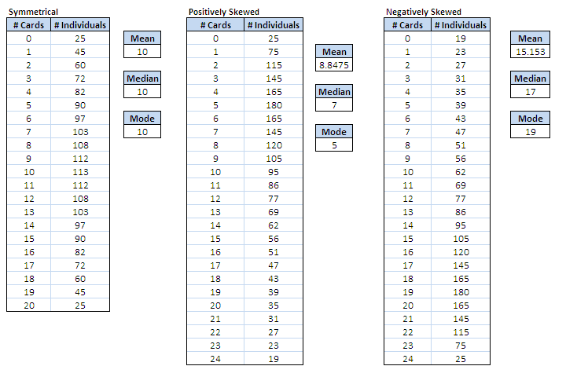
Skewness

Slide 33
Data Collection and Management

Slide 34
Data Collection and Management Framework
Data collection mechanism
Maintaining a data dictionary
Missing value imputation
Outlier treatment
At a high level, from an analyst's perspective data collection and management framework will involve following components

Slide 35
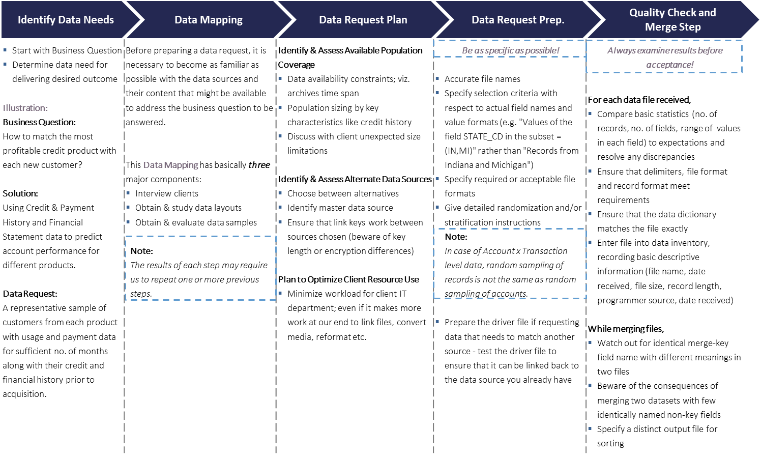
Data Collection - quick background

Slide 36
Data Dictionary
A comprehensive data dictionary should be maintained and updated as and when any new information is gathered.
USE: It can go a long way in helping us understand the data better. For instance, it can help us to revisit old information and see what our initial hypothesis was and how it is changing with the new updated information.
Maintain labels of as many variables as possible
If possible, one should also try to capture the business sense of these variables
Wherever things are not clear, it should be noted down so that it can be clarified with the client later on
Clear Definition of Unique Identifier and its Meaning:
Ascertain the level at which data is to be rolled up / down. For instance,
Individual level
Individual x Account level
Individual x Month level
Individual x Account x Month level, etc.
Identify unique key of every dataset. Few examples below:
Payment data may be at transaction level
Demographic data at individual level
Census data at zip code level
Dependent Variable Definition and Meaning: This is a very crucial step in modeling exercise as wrong definition can lead to completely wrong conclusions. In absence of a clear definition at this stage, it may be defined later after some actual data analysis.
Variable Classification:
Performance variables, e.g. spend, number of transactions
Credit Attributes, e.g. total credit line, FICO score
Census level, e.g. population, location attributes such as income levels
Maintain meaning of all Potential Predictors
Demographic variables, e.g. age, gender

Slide 37
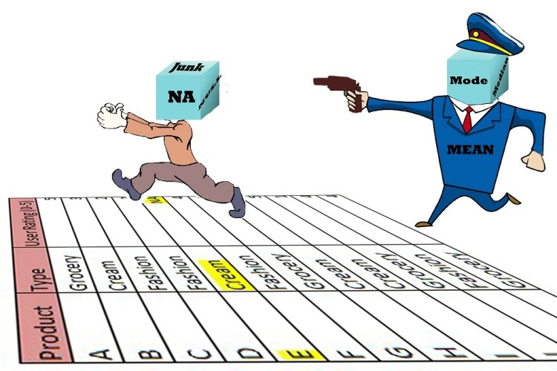
Missing Value Imputation
Missing Value Imputation Techniques
Impute Missing Values with ZERO
Impute Missing Values with MEDIAN
Impute Missing Values with MEAN
Impute Missing Values with MODE
Information based Segmentation
Non-Missing Dummy Creation
Imputation and Non-Missing Dummy Creation
Impute based on Bivariate Graphs
Impute using Regression on other Non-Missing Predictors
DNI
Multiple Imputation
There are a variety of techniques for missing value imputation; but these should be considered more as scenario-specific than just being a set of pure alternative choices.
Notes:
Ref http://www.analyticskhoj.com/wp-content/uploads/2015/12/Missing-Value-imputation-basic-way-750x500.jpg

Slide 38
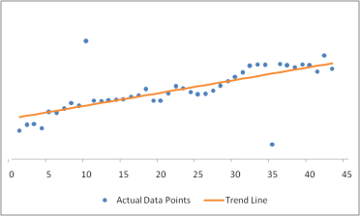
Outlier Treatment
An outlier is a single observation "far away" from rest of the data.
Reasons for outliers:
Errors
Data errors
Sampling error
Standardization failure
Faulty distributional assumptions
Human Error
Genuine Outliers
Why do we care about outliers?
Outliers are BAD
The presence of outliers can lead to inflated error rates and substantial distortions of results that can lead to wrong conclusions and inferences.
Outliers are GOOD
The outliers can provide useful information in the data, for example, a spike in spend behavior of some customers may prove to be the deciding factor in marketing response campaigns. So care should be taken while dealing with outliers.
In short, outliers are important and hence should not be ignored.
Outlier
Techniques for outlier detection / treatment:
Capping and Flooring Technique
Exponential Smoothing Technique
Sigma Approach
Robust Regression Technique
Mahalanobis Distance Technique
Outlier

