Slide 1
Clustering
Understanding Cluster Analysis

Slide 2
Clustering
What is clustering?
When to use cluster analysis?
Application of cluster analysis
K means (In detail)
Types of cluster analysis
Copyright © 2016 Defour Analytics Pvt. Ltd

Slide 3
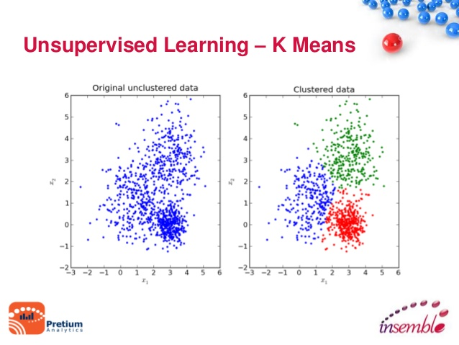
What is Cluster Analysis?
It is a descriptive analysis technique which groups objects (respondents, products, firms, variables, etc.) so that each object is similar to the other objects in the cluster and different from objects in all the other clusters.

Slide 4
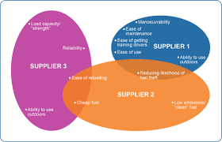
When to use cluster analysis?
The essence of all clustering approaches is the classification of data as suggested by “natural” groupings of the data themselves.
Simply put when you desire the following then use Cluster analysis.
Taxonomy development(segmentation)
Data simplification
Relationship identification

Slide 5
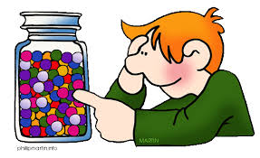
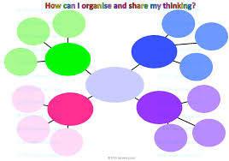
Applications of Cluster Analysis
Understanding
Group genes and proteins that have similar functionality, or group stocks with similar price fluctuations
Summarization
Reduce the size of large data sets

Slide 6
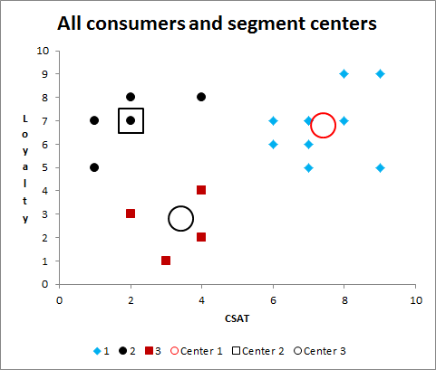
Example
Cluster analysis is a popular classification technique frequently used to analyse market research data which divides the data into groups.
Data appears in rows and columns. Rows can then be clustered with respect to columns or columns with respect to rows.
For example, clustering techniques can be used to identify demographic or psychographic characteristics of consumers with similar purchasing histories, or to isolate differences between groups of products. Market researchers can then study the individual clusters of consumers or products in more detail in order to maximize results from future marketing strategies

Slide 7
Industry related examples
Cluster analysis of 3D seismic data for oil and gas exploration.
The cluster analysis of chemically reactive factors of air environment at industrial territories in the informational system of monitoring.
Cluster Analysis of Fuel Price History

Slide 8
Types of Clustering
A clustering is a set of clusters.
Hierarchical clustering
A set of nested clusters organized as a hierarchical tree
Partitional Clustering
A division data objects into non-overlapping subsets (clusters) such that each data object is in exactly one subset

Slide 9
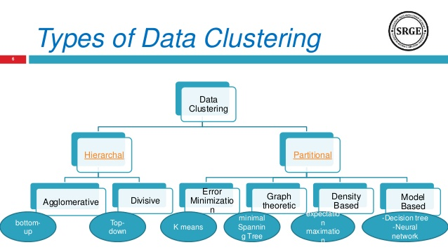
Types of clustering
TYPES
METHODS
ALGORITHMS

Slide 10
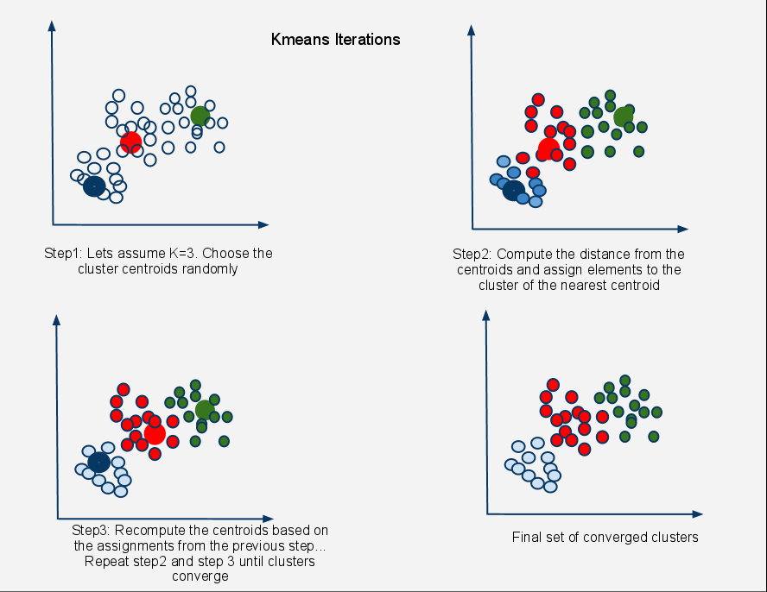
K-means Clustering
Partitional clustering approach
Each cluster is associated with a centroid (center point) Each point is assigned to the cluster with the closest centroid
Number of clusters, K, must be specified
The basic algorithm is very simple

Slide 11
K-means Clustering – Details
Initial centroids are often chosen randomly.
Clusters produced vary from one run to another.
The centroid is (typically) the mean of the points in the cluster.
‘Closeness’ is measured by Euclidean distance, cosine similarity, correlation, etc.
K-means will converge for common similarity measures mentioned above

Slide 12
K-means Clustering – Details
Most of the convergence happens in the first few iterations.
Often the stopping condition is changed to ‘Until relatively few points change clusters’
Complexity is O( n * K * I * d )
n = number of points,
K = number of clusters,
I = number of iterations,
d = number of attributes

Slide 13
Evaluating K-means Clusters
Most common measure is Sum of Squared Error (SSE)
For each point, the error is the distance to the nearest cluster
To get SSE, we square these errors and sum them.
x is a data point in cluster Ci and mi is the representative point for cluster Ci can show that mi corresponds to the center (mean) of the cluster

Slide 14
Evaluating K-means Clusters
Given two clusters, we can choose the one with the smaller error
One easy way to reduce SSE is to increase K, the number of clusters
A good clustering with smaller K can have a lower SSE than a poor clustering with higher K

Slide 15
Energy Meter
An electric meter is a device that measures the amount of electric energy consumed by a residence, a business or electrically powered devices.
Electric utilities install meter at the customer premises to measure electric energy delivered to their customers for billing purpose.
They are calibrated in billing units and the most popular and accepted unit is measured in kilo watt hour (KWH).

Slide 16
Types of energy meter
Is classified in accordance with several factors such as
Types of display - Analog or digital
Type of metering point – Grid, primary / secondary transmission and local distribution.
End applications - Domestic, commercial industrial
Technical application – 3 phase, single phase, LT, HT and accuracy class meter.

Slide 17
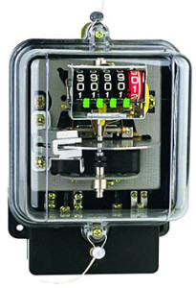
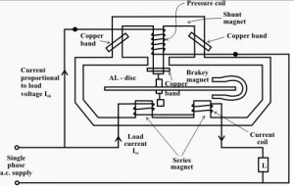
Meter Data

Slide 18
Problem statement.
Our objective is to : -
To find clusters of high, low, medium consumers on daily basis. (weekdays / weekends)
To forecast what is going to be consumption for next 7 days and/or next month.
What should be the demand forecast? (Identify the shortage day and provide back up)
Identify spike. (outlier detection)
Able to satisfy the demand.

Slide 19
Stepwise description of actions to be taken on data
1. Variable identification
Variable categorization (e.g. Numeric, Categorical, Discrete, Continuous etc.)
Conversion of non-numeric variables to numeric form
Creation of Data Dictionary
2. Running the K means analysis using R
Importing data
Selecting the variables
Deciding on the number of clusters to be created
Running the analysis
Interpreting the results

Slide 20
R Script (K means clustering)
> setwd("C://R")
> library(amap)
> md=read.csv("md.csv")
> View(md)
> md1=md[,c(5,6,7)]
> View(md1)
> k1=Kmeans(md1,3,iter.max=200,nstart=1,method=c("euclidean"))
> k1$centers
> k1$size
> k1$withinss
> k1$cluster
> cluster_output=k1$cluster
> write.csv(cluster_output,"cluster_output.csv")
> library(ggplot2)
> ggplot(md1, aes(KVARH,KVARH.1,KWH)) + geom_point()
> k1$cluster <- as.factor(k1$cluster)
> ggplot(md1, aes(KVARH,KVARH.1,KVAH, color = k1$cluster)) + geom_point()

Slide 21
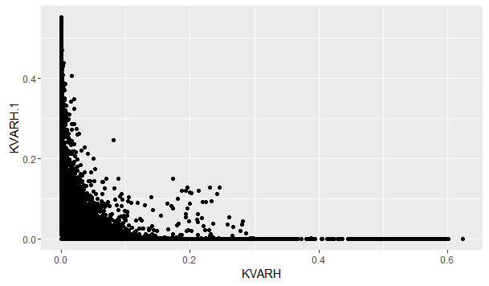
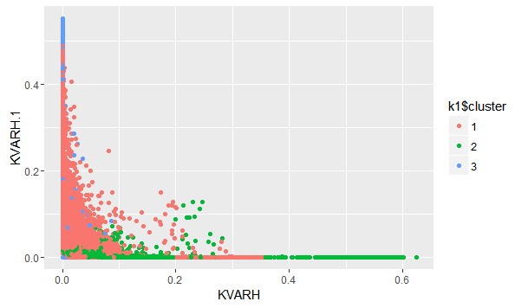
Cluster Graph
Clustering based on individual consumption pattern (Day wise)
Before clustering
After clustering

Slide 22
Decision derived
Further analysis into the clustered groups gives the result that
Cluster 1 – High consumer group
Cluster 2 – Low consumer group
Cluster 3 – Medium Consumer group
Based on the Groups we get, we can take decisions on how to treat each of the group in a way that it is helpful to the concerned department. Also studying the trend of each of the cluster and forecasting their respective performance (through Time Series) can give us insights as to how each group may behave in coming time and treat them accordingly.

Slide 23
Design Thinking
Ask the participants what kind of problems related to their industry can be solved using this concept.

Slide 24
Question & Answers

Slide 25
THANK YOU
Copyright © 2016 Defour Analytics Pvt. Ltd

