Slide 1
Decision Tree
Understanding Tree Analysis

Slide 2
Regression
What is Decision tree?
Why decision tree?
Constructing decision tree
Random forest and CART (In detail)
Types of decision tree
Copyright © 2016 Defour Analytics Pvt. Ltd

Slide 3
Definition of decision tree
A decision tree is a natural and simple way of inducing following kind of rules :
If (Age is x) and (income is y) and (family size is z) and (credit card
spending is p) then he will accept the loan.
It is powerful and perhaps most widely used modeling technique of all.
Decision trees classify instances by sorting them down the tree from the root to some leaf node, which provides the classiﬁcation of the instance.

Slide 4
Why decision tree?
Decision Trees
To Classify
Response variable has only two categories
Response variable has multiple categories
To Predict
Response variable is continuous
Linear relationships between predictors and response
Nonlinear relationships between predictors and response
Use standard Regression tree
Use c4.5 implementation
Use standard classification tree
Use c4.5 implementation

Slide 5
Decision tree terms
Root Node
Condition Check
Leaf Node(Decision Point)
Leaf Node(Decision Point)
Condition Check
Branch
Branch

Slide 6
Industry related examples
Decision trees can be helpful for analysing many types of decisions involving complex variables.
Examples include
Assessing the asset performance and asset behaviour
Understanding customer complaint behaviour
deciding whether to replace wireline logs with logs acquired while drilling
evaluating water flood programs
optimizing workovers
choosing the best offshore platform topsides configuration.

Slide 7
Types of Decision Tree Algorithms
Decision trees used in data mining are of two main types:
Classification tree analysis is when the predicted outcome is the class to which the data belongs.
Regression tree analysis is when the predicted outcome can be considered a real number (e.g. the price of a house, or a patient’s length of stay in a hospital).
Some techniques, often called ensemble methods, construct more than one decision tree:
Bagging decision trees - an early ensemble method, builds multiple decision trees by repeatedly resampling training data with replacement, and voting the trees for a consensus prediction.
Random Forest - uses a number of decision trees in order to improve the classification rate.
Boosted Trees - can be used for regression-type and classification-type problems.

Slide 8
Types of Decision Tree Algorithms
There are many specific decision-tree algorithms. Notable ones include:
1. ID3 (Iterative Dichotomiser 3)
2. C4.5 (successor of ID3)
3. CART (Classification And Regression Tree)
4. CHAID (Chi-squared Automatic Interaction Detector). Performs multi-level splits when computing classification trees.
5. MARS - extends decision trees to handle numerical data better.

Slide 9
Constructing a decision tree
Two Aspects
Which attribute to choose?
Information Gain
Entropy
Where to stop?
Termination criteria

Slide 10
Calculation of entropy
Entropy is a measure of uncertainty in the data
Entropy(S) = ∑_{(i=1 to l)}-|S_{i}|/|S| * log₂(|S_{i}|/|S|)
S = set of examples
S_{i} = subset of S with value v_{i} under the target attribute
l = size of the range of the target attribute

Slide 11
Entropy
Let us say, I am considering an action like a coin toss. Say, I have five coins with probabilities for heads 0, 0.25, 0.5, 0.75 and 1. When I toss them which one has highest uncertainty and which one has the least?
H = − 𝑖𝑝𝑖 log2 𝑝𝑖
Information gain = Entropy of the system before split – Entropy
of the system after split

Slide 12
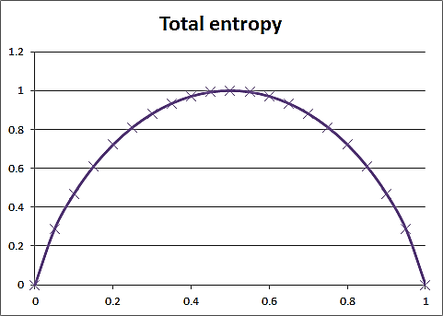
Entropy: Measure of Randomness

Slide 13
Termination criteria
All the records at the node belong to one class.
A significant majority fraction of records belong to a single class.
The segment contains only one or very small number of records.
The improvement is not substantial enough to warrant making the split.

Slide 14
Pruning trees
The decision trees can be grown deeply enough to perfectly classify the training examples which leads to overfitting when there is noise in the data.
When the number of training examples is too small to produce a representative sample of the true target function.
Practically, pruning is not important for classification.

Slide 15
Approaches to prune tree
Three approaches
– Stop growing the tree earlier, before it reaches the point
where it perfectly classifies the training data,
– Allow the tree to over fit the data, and then post-prune the
tree.
– Allow the tree to over fit the data, transform the tree to
rules and then post-prune the rules.

Slide 16
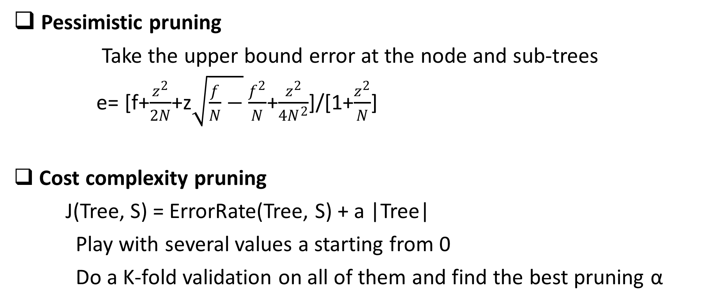
Tree Pruning
Pessimistic pruning
Take the upper bound error at the node and sub-trees
e= [f+$\frac{z^{2}}{2N}$+z$\sqrt{\frac{f}{N}−}\frac{f^{2}}{N}$+$\frac{z^{2}}{{4N}^{2}}$]/[1+$\frac{z^{2}}{N}$]
Cost complexity pruning
J(Tree, S) = ErrorRate(Tree, S) + a |Tree|
Play with several values a starting from 0
Do a K-fold validation on all of them and find the best pruning α

Slide 17
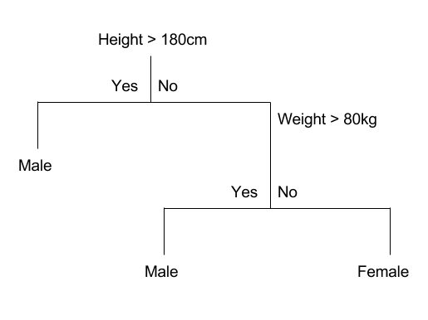
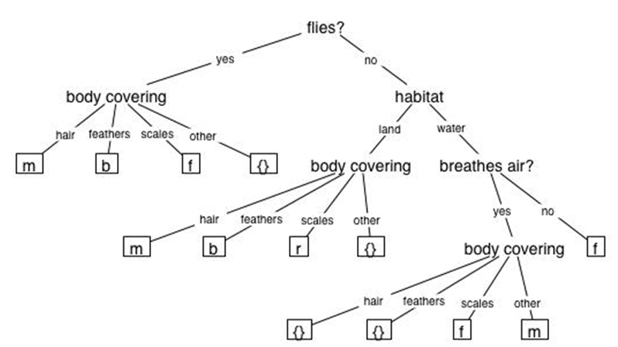
Two most popular decision tree algorithms
Cart
–Binary split
–Gini index
–Cost complexity pruning
C4.5
–Multi split
–Info gain
–pessimistic pruning

Slide 18
Random Forest
Random Forest is considered to be a panacea of all data science problems. On a funny note, when you can’t think of any algorithm (irrespective of situation), use random forest!
Random Forest is a versatile machine learning method capable of performing both regression and classification tasks. It also undertakes dimensional reduction methods, treats missing values, outlier values and other essential steps of data exploration, and does a fairly good job. It is a type of ensemble learning method, where a group of weak models combine to form a powerful model.

Slide 19
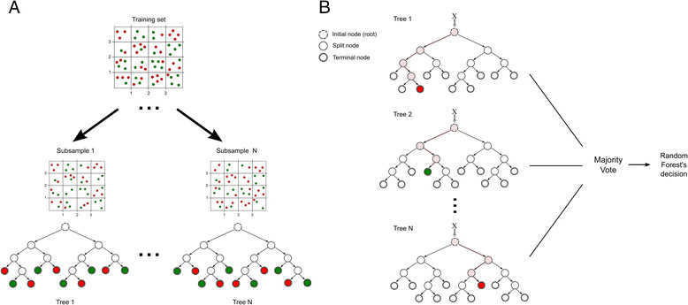
Random Forest
In Random Forest, we grow multiple trees as opposed to a single tree in CART model. To classify a new object based on attributes, each tree gives a classification and we say the tree “votes” for that class. The forest chooses the classification having the most votes (over all the trees in the forest) and in case of regression, it takes the average of outputs by different trees.

Slide 20
Random Forest Algorithm
It works in the following manner. Each tree is planted & grown as follows:
Assume number of cases in the training set is N. Then, sample of these N cases is taken at random but with replacement. This sample will be the training set for growing the tree.
If there are M input variables, a number m<M is specified such that at each node, m variables are selected at random out of the M. The best split on these m is used to split the node. The value of m is held constant while we grow the forest.
Each tree is grown to the largest extent possible and there is no pruning.
Predict new data by aggregating the predictions of the ntree trees (i.e., majority votes for classification, average for regression).

Slide 21
CART
A non-parametric technique,using the methodology of tree building.
Data mining tools like SAS E-Miner; R and SPSS has extended algorithm to handle nominal, ordinal and continuous dependent variables.
One or more independent variables. Predictor variables can be continuous, ordinal, or nominal.
One dependent variable. The target variable can be categorical or continuous.

Slide 22
CART Algorithms
It makes use of Recursive Partitioning
Take all of your data.
Consider all possible values of all variables.
Select the variable/value (X=t1) that produces the greatest “separation” in the target.
(X=t1) is called a “split”.
If X< t1 then send the data to the “left”; otherwise, send data point to the “right”.
Now repeat same process on these two “nodes”. You get a “tree”
Note: CART only uses binary splits (Unlike CHAID which produces non-binary trees as well)
“Separation” defined in many ways.
Regression Trees (continuous target): use sum of squared errors.
Classification Trees (categorical target): choice of entropy, Gini measure, “twoing” splitting rule.

Slide 23
Customer Complaint Management
It’s an online system where customer’s can log their complaints enabling them to see the resolution of their complaints.
This system helps the customer satisfaction index.
This system also measure the stipulated time to close the complaint.
Through analysis of this system service provider can measure the cross functional department’s performance, SLA monitoring, identify hidden opportunities, spot the critical issues and optimize the process.
Through which the binding factor for customer engagement is improved.

Slide 24
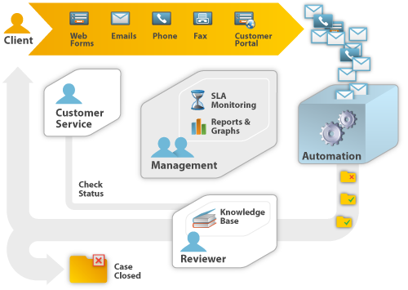
Types of complaint management system

Slide 25
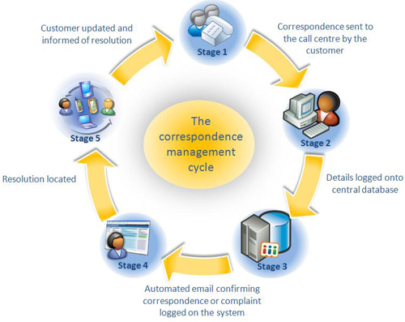
Complaint Management Process

Slide 26
Problem Statement
What are the chances that the complaint call time will get violated?
Based upon the call closure time, is the performance good or bad?
i . e . If call is getting closed within 5 to 10 hours – performance is good.
If call takes more than 10 hours to close the complaint – performance is bad.

Slide 27
Stepwise description of actions to be taken on data

Slide 28
R script
library(data.table)
library(reshape2)
library(randomForest)
library(party)
setwd("C://R")
cm=read.csv("cm.csv")
cm$VIOLATED=factor(cm$VIOLATED)
cm$Closure.Range=factor(cm$Closure.Range)
cm$STATE=factor(cm$STATE)
cm$ITEM_CODE=factor(cm$ITEM_CODE)
fit=ctree(VIOLATED~Closure.Range+STATE+ITEM_CODE,data=cm)
plot(fit)

Slide 29
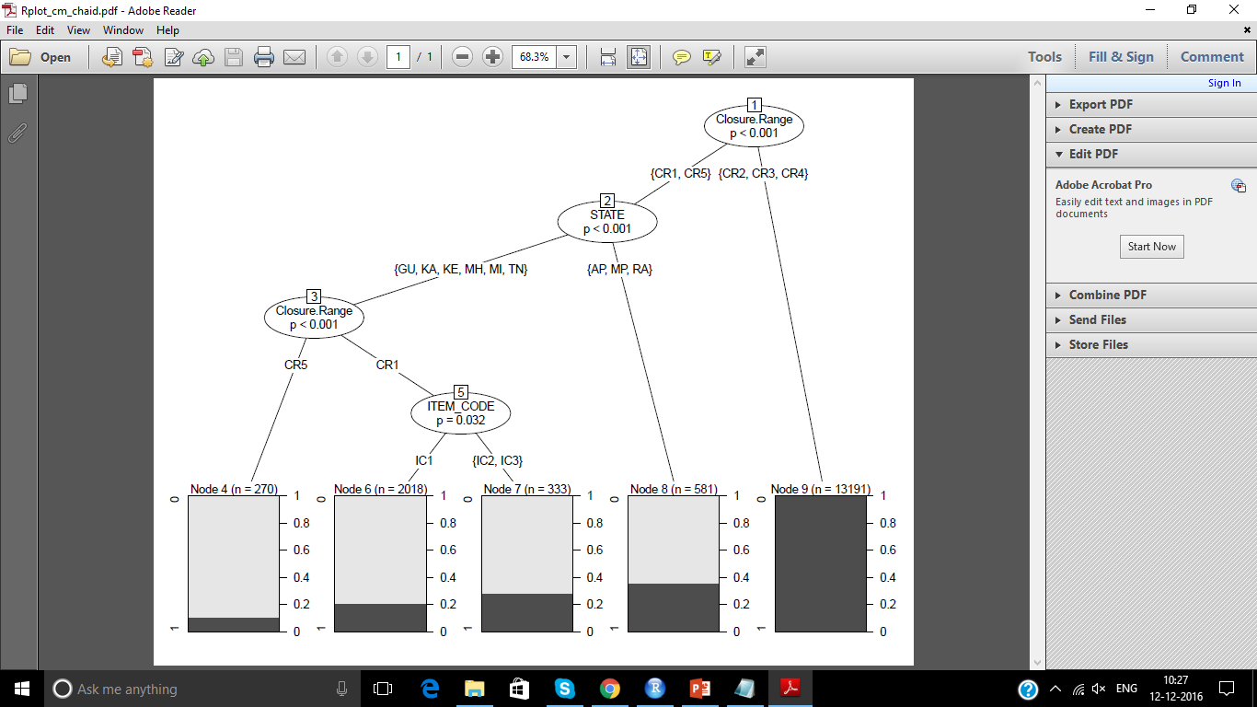
CHAID Decision Tree

Slide 30
Concluding statement

Slide 31
Design Thinking
Ask the participants what kind of problems related to their industry can be solved using this concept.

Slide 32
Question & Answers

Slide 33
THANK YOU
Copyright © 2016 Defour Analytics Pvt. Ltd

