Slide 1
Time Series
ARIMA Modeling

Slide 2
Concepts
Models of time series
Moving averages (MA) and autoregressive (AR) processes
Mixed models (ARMA/ARIMA)
The Box-Jenkins model building process
Model identification
Autocorrelations
Partial-autocorrelations
Model estimation
The objective is to minimize the sum of squares of errors
Model validation
Certain diagnostics are used to check the validity of the model
Model forecasting

Slide 3
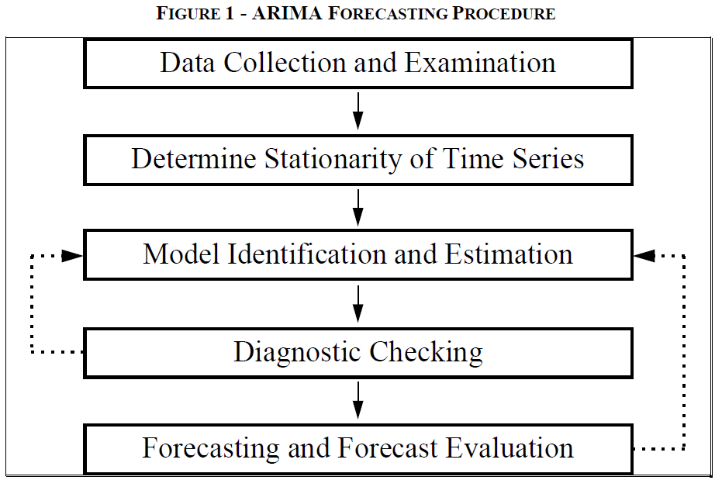
Figure 1 – Arima Forecasting Procedure

Slide 4
Industry related examples
Production and Utilization of Gas.
Natural gas prices.
Estimation and Forecast of the Models for Stock Market Performance of the Oil & Gas Companies.
Oil Sales forecasting using ARIMA models.
Modelling and forecasting future values for monthly crude oil exportation.

Slide 5
Some basic concepts Autoregressive (AR) and moving average (MA)
Two basic types of time series models exist,
Autoregressive
Moving average models.
So, what’s the big difference?
The AR model includes lagged terms of the time series itself.
The MA model includes lagged terms on the noise or residuals.
How do we decide which to use?
ACF and PACF

Slide 6
Autocorrelation functions (ACFs) and Partial-autocorrelation functions (PACFs)
The autocorrelation function (ACF) is a set of correlation coefficients between the series and lags of itself over time.
The partial autocorrelation function (PACF) is the partial correlation coefficients between the series and lags of itself over time.
Amount of correlation between a variable and a lag of itself that is not explained by correlations at all lower-order-lags
Correlation at lag 1 “propagates” to lag 2 and presumably to higher- order lags
PA at lag 2 is difference between the actual correlation at lag 2 and expected correlation due to propagation of correlation at lag

Slide 7
Autoregressive (AR) models
An autoregressive model of order “p” AR(p)
X _{t} = β₁ X _{t −1} + β₂ X _{t −2} + ... + β _{p} X _{t − p} + e_{t}
Current value of X_{t} can be found from past values, plus a random shock e_{t}
Like a multiple regression model, but X_{t} is regressed on past values of X_{t}
The AR(1) Model
A simple way to model dependence over time is with the “autoregressive model of order 1”
This is a OLS model of X_{t} regressed on lagged X_{t-1}
X _{t} = β₀ + β₁ X _{t −1} + e_{t}
What does the model say for the t+1 observation?
^{X} t +1 ^{= β}0 ^{+ β}1 ^{X} t ^{+ e}t +1
The AR(1) model expresses what we don’t know in terms of what we do know at time t.

Slide 8
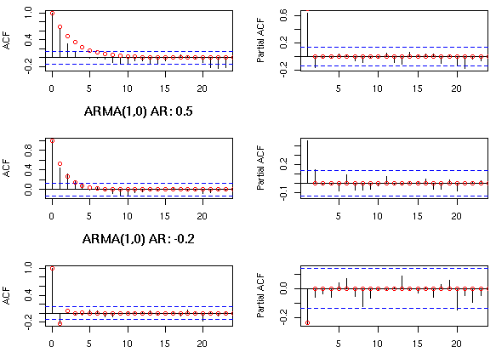
Identifying an AR process
The autocorrelations of a pure AR(p) process should decay gradually at increasing lag length. Hence, using an autocorrelogram it is not possible to differentiate between a pure AR(3) model or a pure AR(4) model. However, the partial autocorrelations of a pure AR(p) process do display distinctive features. The partial autocorrelogram should ‘die out’ after p lags. Thus, the partial autocorrelogram of a pure AR(3) process should die out after 3 lags, whereas that of a pure AR(4) process would die out after 4 lags.
ACF and PACF for an AR(1) process

Slide 9
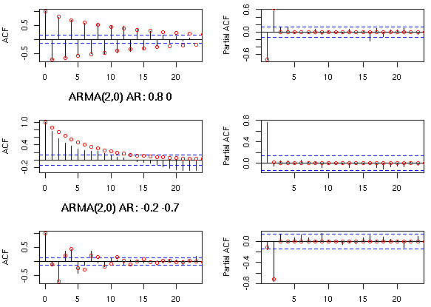
ACF and PACF for an AR(2) process

Slide 10
Moving-average (MA) models
A moving-average model of order “q” MA(q)
X _{t} = e_{t} + β₁e_{t −1} + β₂e_{t −2} + ... + β_{q} e_{t −q}
Current value of X_{t} can be found from past shocks/error (e), plus a new shock/error (e_{t}).
The time series is regarded as a moving average (unevenly weighted, because of different coefficients) of a random shock series e_{t} .
The MA(1) model
A first order moving average model would look like:
X _{t} = e_{t} + β₁e_{t −1}
If β₁ is zero, X depends purely on the error or shock (e) at the current time, and there is no temporal dependence.
If β₁ is large, previous errors influence the value of X_{t}
If our model successfully captures the dependence structure in the data then the residuals should look random.

Slide 11
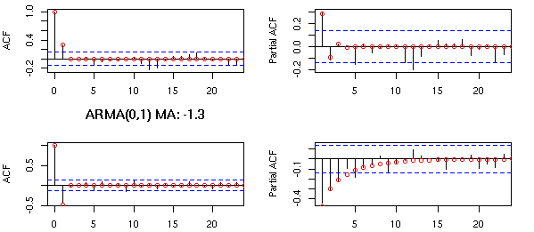
Identifying a MA process
The behaviour of correlograms and partial autocorrelograms for pure MA(q) processes is the reverse of that for pure AR processes. The autocorrelogram of a pure MA(q) process should ‘die out’ after q lags. The partial autocorrelogram of a pure MA process, on the other hand, only decays slowly over time (similar to the behaviour of the autocorrelogram of a pure AR process). Thus, it should be impossible to distinguish between the PACF of an MA(3) and MA(4) process, whereas the ACF of the MA(3) process should decay to zero after 3 lags and the MA(4) process after 4 lags.
ACF and PACF for an MA(1) process

Slide 12
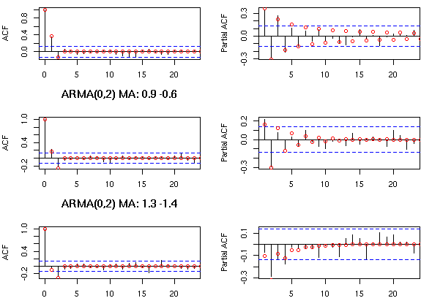
Identifying a MA process (contd…)
ACF and PACF for an MA(2) process

Slide 13
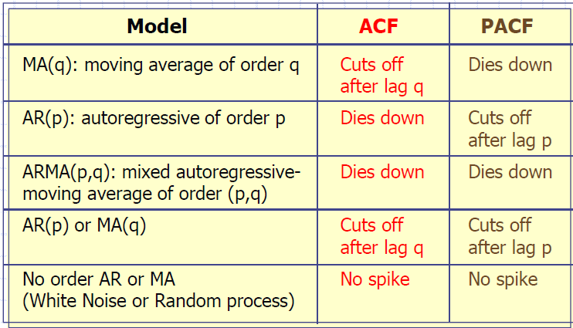
General Theoretical ACF and PACF of ARIMA Models

Slide 14
ARMA models
ARMA models are only suited for time series stationary in mean and variance
A mixture of these two types of model would be referred to as an autoregressive moving average model (ARMA)n,q, where n is the order of the autoregressive part and q is the order of the moving average term.
Mixed ARMA models "An ARMA process of the order (p, q)"
X _{t} = β₁X_{t −1} + ... + β _{p} X_{t − p} + α₁e_{t −1} + α₂e_{t −2} + ... + α_{q} e_{t −q}
Just a combination of MA and AR terms.
Sometimes you can use lower-order models by combining MA and AR terms.
Lower order models are better.
What If there is Trend and Seasonality ?? --- Will discuss

Slide 15
How do we choose the best ARMA model?
In most cases, the best model turns out a model that uses either only AR terms or only MA terms.
It is possible for an AR term and an MA term to cancel each other’s effects, even though both may appear significant in the model.
If a mixed ARMA model seems to fit the data, also try a model with one fewer AR term and one fewer MA term.
As with OLS, simpler models are better.

Slide 16
ARIMA Model
"Type of ARMA model that can be used with some kinds of non-stationary data“
"Useful for series with stochastic trends. First order or “simple” differencing“
Series with deterministic trends should be differenced first then an ARMA model applied
"The “I” in ARIMA stands for integrated, which basically means you’re differencing"
The ARIMA Model - Typically written as ARIMA(p, d, q) where:
"p is the number of autoregressive terms"
"d is the order of differencing"
"q is the number of moving average terms"
e.g. ARIMA(1,1,0) is a first-order AR model with one order of differencing

Slide 17
Which ARIMA(p,d,q) model do I use?
Plot the data.
Look to see if the data is stationary, that is they are scattered randomly about a constant mean level. Also look at the ACF and PACF (stationarity is implied by the ACF or PACF dropping quickly to zero).
If there is non-stationarity, such as a trend (we’re ignoring seasonal behavior for the moment!), difference he data. Practically, at most two differences need to be taken to reduce a series to stationary. Verify stationarity by plotting the differenced series and looking at the ACF and PACF.
Once stationary is obtained, look at the ACF and PACF to see if there is any remaining pattern. Check against the theoretical behavior of the MA and AR models to see if they fit. This will give you an ARIMA model with either no MA or no AR component i.e. ARIMA(0,d,q) or ARIMA(p,d,0).
If there is no clear MA or AR model, an ARMA model will have to be considered. These can in general not be guessed from the ACF and PACF, other methods are needed, based on the ideas of minimizing Information Criterion (AIC or BIC).

Slide 18
Seasonal ARIMA Model
ARIMA models cannot really cope with seasonal behavior. Hence we introduce seasonal ARMA model denoted by ARMA (P,Q)h. Seasonal ARMA can be of two types-
Seasonal ARMA (ARMA (p,q)) – Only seasonal components
Mixed seasonal ARMA (ARMA(p,q)(p,q)s. Combination of normal ARMA and seasonal ARMA.
In case trend and seasonality both are present. We will use ARIMA model instead of ARMA. The idea behind the seasonal ARIMA is to look at what are the best explanatory variables to model a seasonal pattern.
You can use ACF and PACF to identify P or Q:
For ARIMA(0, 0, 0)(P, 0,0)s , you should see major peaks on the PACF at s, 2s, ....Ps. On the ACF, the coefficients at lags s, 2s, ....Ps, ... should form an exponential decrease, or a damped sine wave.
ARIMA(0, 0,0)(0,0,Q)s , you should see major peaks on the ACF at s, 2s, ....Qs. On the PACF, the coefficients at lags s, 2s, ....Qs,... should form an exponential decrease, or a damped sine wave.
Using the AIC as the selection criterion, we select the ARIMA model with the lowest value of the AIC.

Slide 19
The Box-Jenkins model building process
Box and Jenkins (1976) proposed a modelling strategy for pure time series forecasting
Model identification
Autocorrelations
Partial-autocorrelations
Model estimation
The objective is to minimize the sum of squares of errors. Fitting many different possible models and using a goodness of fit statistic (AIC) to select “best” model
Model validation
Certain diagnostics are used to check the validity of the model
Examine residuals, statistical significance of coefficients.
Two methods:
Examine residuals
AIC or SBC
Model forecasting
The estimated model is used to generate forecasts and confidence limits of the forecasts
AIC- The Akaike Information Criterion is a function to determine the best model. Lower the AIC is better the model

Slide 20
ARIMA Model building
Auto Regressive Integrated Moving Average Method
Identification
Determination of p, d and q

Slide 21
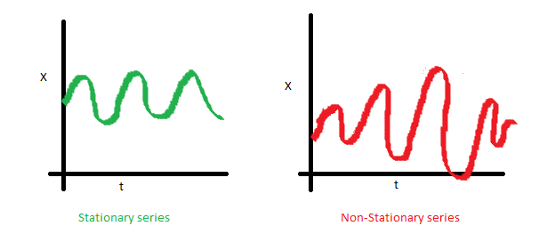
ARIMA MODEL
A non seasonal ARIMA model is classified as an "ARIMA(p,d,q)" model, where:
p is the number of autoregressive terms,
d is the number of non seasonal differences needed for stationarity, and
q is the number of lagged forecast errors in the prediction equation.
Stationary Series: A stationary series has no trend, its variations around its mean have a constant amplitude. A non stationary series is made stationary by differencing

Slide 22
To identify an ARIMA(p,d,q) we use extensively
the autocorrelation function
{ρ_{h} : -∞ < h < ∞}
and
the partial autocorrelation function,
{Φ_{kk}: 0 ≤ k < ∞}.

Slide 23
Identification of an ARIMA process
Determining the values of p,d,q
Steps for ARIMA MODEL
Visualization
ACF and PCF plot
Seasonal variation modelling
Stationary check
Identifying p,d,q for non seasonal series
Model development
Validating accuracy
Selecting best model

Slide 24
If the process is non-stationary then first differences of the series are computed to determine if that operation results in a stationary series.
The process is continued until a stationary time series is found.
This then determines the value of d.

Slide 25
Identification
Determination of the values of p and q.

Slide 26
To determine the value of p and q we use the graphical properties of the autocorrelation function and the partial autocorrelation function.
Again recall the following:

Slide 27
Time Series Models : Type 2• Autoregressive (AR) process: series current values depend on its own previous values• Moving average (MA) process: The current deviation from mean depends on previous deviations• Autoregressive Moving average (ARMA) process Venkat Reddy Data Analysis Course• Autoregressive Integrated Moving average (ARIMA)process.• ARIMA is also known as Box-Jenkins approach. It is popular because of its generality; It can handle any series, with or without seasonal elements, and it has well-documented computer programs

Slide 28
ARIMA (p,d,q) modelingTo build a time series model issuing ARIMA, we need to study the timeseries and identify p,d,q• Identification: • Determine the appropriate values of p, d, & q using the ACF, PACF, and unit root tests Venkat Reddy Data Analysis Course • p is the AR order, d is the integration order, q is the MA order• Estimation : • Estimate an ARIMA model using values of p, d, & q you think are appropriate.• Diagnostic checking: • Check residuals of estimated ARIMA model(s) to see if they are white noise; pick best model with well behaved residuals.• Forecasting: • Produce out of sample forecasts or set aside last few data points for 25 in-sample forecasting.

Slide 29
Slide 26 picture

