Slide 1
Time Series
Forecasting using Time Series Techniques

Slide 2
Forecasting using Time Series Techniques
Simple Moving Average
Weighted Moving Average
Simple Exponential Smoothing
Double Exponential Smoothing
Triple Exponential Smoothing
Time Series Models Comparison

Slide 3
Which technique to choose?
The methods to trace the accuracy and reliability of forecasted results along with comparisons and prioritizing the best among various forecasting technique suiting to the underlying historical data are:
Mean Absolute Percentage Error (MAPE)
Root Mean Square Error (RMSE)

Slide 4
Industry related examples
Consider as a use-case an oilfield with several Electrical Submersible Pumps (ESPs), each instrumented with sensors that continually measure electrical properties of the pump (the streams of sensor data), which are then relayed to a central location. Then by demonstrating a time-series analysis, failure detection and failure prediction from the streams of sensor data can be obtained.
The method involves identifying “shapelets” – short instances that are particularly distinct – in the streams of sensor data.
Time Series Analysis of Petroleum Product Sales.
A manager of a private company would need forecast of an hourly volume and type of gas produced and utilized in order to schedule staff and equipment efficiently.
Forecasting can also be an important part of a process control system through monitoring key processes. It may be possible to determine the optimal time and extent of control action; for example, a chemical processing unit may become less efficient as hours of continuous operation increase. Forecasting the performance of the unit will be useful in planning the shutdown time and overhaul schedule.

Slide 5
Simple Moving Average Method
What is Simple Moving Average?
Simple Moving Average is calculated by adding observations for last K time periods in time series and divide that sum by K.
Ft+1=(Yt+Yt-1+Yt-2+Yt-3+……Yt-K+1)/K
Equal weightage is given to all observations in last K periods. Smaller the value of K, the greater weight is given to each period. Greater the value of K, the smaller weight is given to each period.
How to decide ideal value of K in the above Simple Moving Average formula?
Short term simple moving average responds quickly to changes in sales given in underlying data while Long term simple moving average are comparably slow to react
Continued…

Slide 6
Simple Moving Average Method
Method to determine better K value:
There are two methods to compare the output values of Simple Moving Average for different values of K:
Root Mean Square Error: The formula for calculating RMSE is given by
RMSE= √{[(y1-f1)^2+(y2-f2)^2+…..(yk-fk)^2]/K}
Yk-Actual Sales value in period n
fK-Forecasted sales value in period n
K-Number of periods
Smaller the value of RMSE, better is the forecasting model.
Mean Absolute Percentage Error: The formula for calculating MAPE is given by
MAPE=[abs(y1-f1)/y1+abs(y2-f2)/y2+………..abs(yk-fK)/yn]/K
Yk-Actual Sales value in period n
fK-Forecasted sales value in period n
K-Number of periods
Smaller the value of MAPE, better is the forecasting model.
Continued…

Slide 7
Simple Moving Average Method
Using Simple Moving Average Techniques:
Recent data should have more impact on forecasted sale. But SMA assigns equal weight to recent & historical data
SME does not address trending and seasonality factors in the forecasted output.

Slide 8

Weighted Moving Average Method
What is Weighted Moving Average?
In Weighted Moving Average, a weight is assigned to each term to be averaged. These particular weights signifies the relative importance of each term on the average. The sum of all the associated weights should be equal to 1. So WMA has overcome the shortcoming of SME where each term to be averaged has equal weights without addressing the recency factors. The formula for WMA is:
Ft+1=(Wt*Yt+Wt-1*Yt-1+Wt-2*Yt-2+Wt-3*Yt-3+……Wt-k+1*Yt-K+1)
Wt-Weight assigned to Sales in time period t
Yt- Actual Sales in time period t
How to decide better weights in the above Weighted Moving Average formula?
Higher the weight associated with the recent terms, quicker the response to the change in sales happen to the forecasted output.
Continued…

Slide 9
Weighted Moving Average Method
Method to determine better Weights:
There are two methods to compare the output values of Weighted Moving Average for different values of Weights:
Root Mean Square Error: The formula for calculating RMSE is given by
RMSE= √{[(y1-f1)^2+(y2-f2)^2+…..(yk-fk)^2]/K}
Yk-Actual Sales value in period n
fK-Forecasted sales value in period n
K-Number of periods
Smaller the value of RMSE, better is the forecasting model.
Mean Absolute Percentage Error: The formula for calculating MAPE is given by
MAPE=[abs(y1-f1)/y1+abs(y2-f2)/y2+………..abs(yk-fK)/yn]/K
Yk-Actual Sales value in period n
fK-Forecasted sales value in period n
K-Number of periods
Smaller the value of MAPE, better is the forecasting model.
Continued…

Slide 10
Weighted Moving Average Method
Using Weighted Moving Average Techniques:
Ideally recent data should have more impact on forecasted sale. And WMA assigns more weight to recent sales data & less weight to the historical sales data
WMA does not address trending and seasonality factors in the forecasted output.

Slide 11
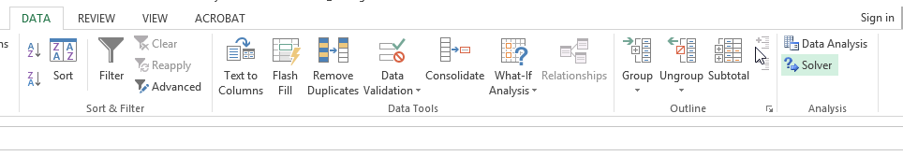
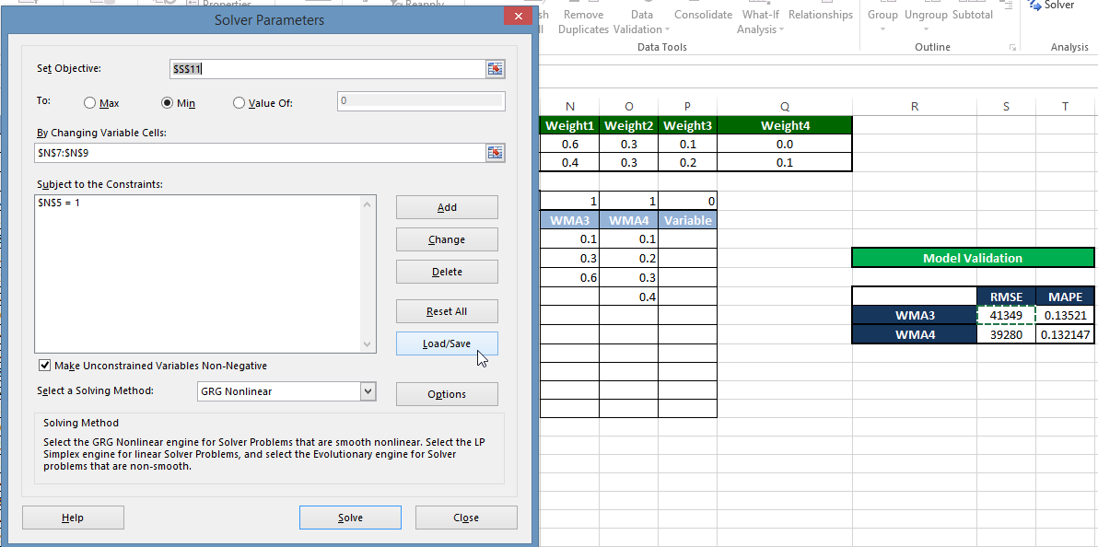
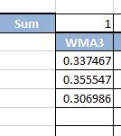
Best Combination of Weights
Using Solver to find out best combination to minimize RMSE/MAPE
Best combination for 3 month WMA

Slide 12

Single Exponential Smoothing Method
What is Single Exponential Smoothing ?
Exponential smoothing is simply an adjustment technique which takes the previous period's forecast, and adjusts it up or down based on what actually occurred in that period. It accomplishes this by calculating a weighted average of the two values. The formula takes the form:
F_{t+1} = α *D_{t} + ( 1 - α)* F_{t}
Ft- Forecasted Sales in t period
Dt- Actual Sales in t period
α – Data Smoothing Factor
α should lie in between 0 and 1 so that a part of difference between previous actual sale and forecasted sale is used in updating. If α is close to 1 then it has less smoothing effect and give greater weight to the recent changes in data. If α is close to 0 then it has greater smoothing effect and less responsive to recent changes in data.
How to decide better data smoothing factor in the above Simple Exponential Smoothing formula?
Continued…

Slide 13
Single Exponential Smoothing Method
Method to determine better α :
There are two methods to compare the output values of Simple Exponential Smoothing for different values of α :
Root Mean Square Error: The formula for calculating RMSE is given by
RMSE= √{[(y1-f1)^2+(y2-f2)^2+…..(yk-fk)^2]/K}
Yk-Actual Sales value in period n
fK-Forecasted sales value in period n
K-Number of periods
Smaller the value of RMSE, better is the forecasting model.
Mean Absolute Percentage Error: The formula for calculating MAPE is given by
MAPE=[abs(y1-f1)/y1+abs(y2-f2)/y2+………..abs(yk-fK)/yn]/K
Yk-Actual Sales value in period n
fK-Forecasted sales value in period n
K-Number of periods
Smaller the value of MAPE, better is the forecasting model.
Continued…

Slide 14
Single Exponential Smoothing Method
Using Simple Exponential Smoothing Techniques:
Ideally recent data should have more impact on forecasted sale. And SES gives a lot of flexibility in assigning weights to the recent and old data by adjusting the values of α.
SES addresses only smoothing factor but not trending and seasonality factors in the forecasted output.

Slide 15
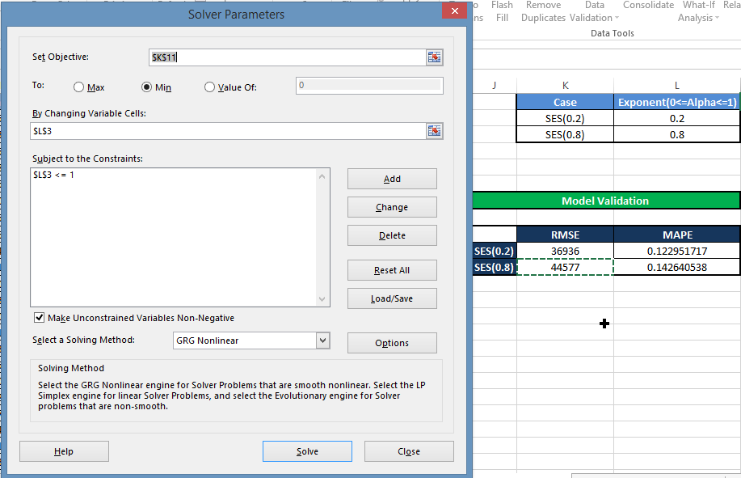
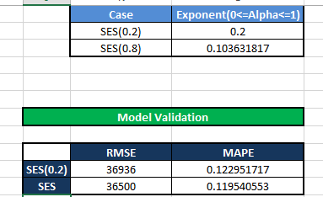
Optimum value of α
Use solver to find optimum value of α to minimize RMSE/MAPE
Result

Slide 16
Double Exponential Smoothing Method
What is Double Exponential Smoothing ?
Simple exponential smoothing (SES) does not do well when there is a trend in the data. Double exponential smoothing performs better forecasting if data has trending factor in historical sales data. It basically uses two parameters – α (data smoothing factor) and β (trend smoothing factor). The formula for double exponential smoothing is given by:
when t=1 S1=X0,b1=X1-X0
when t > 1 St=α*Xt+(1- α)*(St-1+bt-1),
bt=β*(St-St-1)+(1-β)*bt-1
Xt+1=St+bt
α - Data Smoothing Factor
β - Trend Smoothing Factor
St - Smoothing component of forecasted value
bt - Trending component of forecasted value
Xt+1 – Forecasted value
α should lie in between 0 and 1
β should lie in between 0 and 1
How to decide better combination of data smoothing factor and Trend Smoothing Factor in the Double Exponential Smoothing formula?
Continued…

Slide 17
Double Exponential Smoothing Method
Method to determine better α and β combination :
There are two methods to compare the output values of Double Exponential Smoothing for different values of α and β :
Root Mean Square Error: The formula for calculating RMSE is given by
RMSE= √{[(y1-f1)^2+(y2-f2)^2+…..(yk-fk)^2]/K}
Yk-Actual Sales value in period n
fK-Forecasted sales value in period n
K-Number of periods
Smaller the value of RMSE, better is the forecasting model.
Mean Absolute Percentage Error: The formula for calculating MAPE is given by
MAPE=[abs(y1-f1)/y1+abs(y2-f2)/y2+………..abs(yk-fK)/yn]/K
Yk-Actual Sales value in period n
fK-Forecasted sales value in period n
K-Number of periods
Smaller the value of MAPE, better is the forecasting model.
Continued…

Slide 18
Double Exponential Smoothing Method
Using Double Exponential Smoothing Techniques:
DES gives a lot of flexibility in controlling the data and trend smoothing by controlling values of α and β
DES addresses smoothing of data and trend factor but not seasonal factors in the forecasted output.

Slide 19
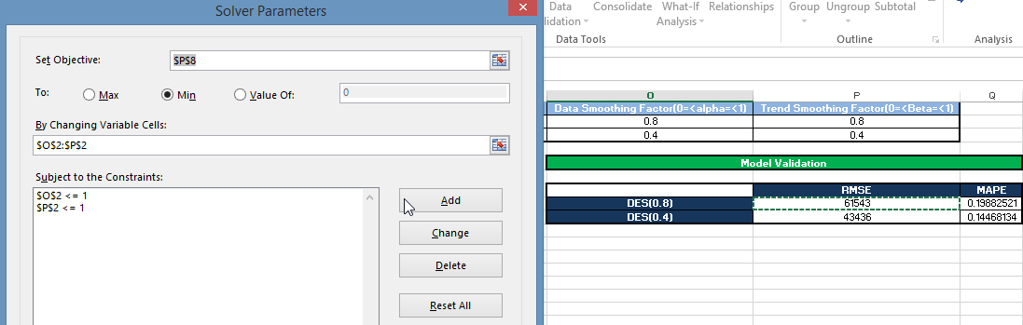
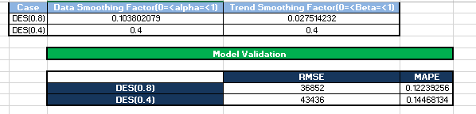
Optimum Value of α and β
Solver will help us to find best combination of α and β to minimize RMSE/MAPE
Best Combination

Slide 20
Triple Exponential Smoothing Method
What is Triple Exponential Smoothing ?
Double exponential smoothing (DES) does not do well when there is a trend and seasonality both in the data. In such situations, several methods were devised under the name “triple exponential smoothing“ .
Triple exponential smoothing is given by the formulas:
St=αXt/Ct-L+(1-α)(St-1+bt-1),
bt=β(St-St-1)+(1-β)*bt-1
Ct=ϒ(Xt/St)+(1-ϒ)*Ct-L
Ft+1=(St+bt)*Ct-L
St- Data Smoothing Component of Forecasted Value
bt- Trend Smoothing Component of Forecasted Value
Ct- Season Smoothing Component of Forecasted Value
α- Data Smoothing Factor (0< α <1)
β- Trend Smoothing Factor (0< β <1)
ϒ- Season Smoothing Factor (0< ϒ <1)
How to decide better combination of data smoothing factor, trend smoothing factor and season smoothing factor in the Triple Exponential Smoothing formula?
Continued…

Slide 21
Triple Exponential Smoothing Method
Method to determine better α, β and ϒ combination :
Root Mean Square Error: The formula for calculating RMSE is given by
RMSE= √{[(y1-f1)^2+(y2-f2)^2+…..(yk-fk)^2]/K}
Yk-Actual Sales value in period n
fK-Forecasted sales value in period n
K-Number of periods
Smaller the value of RMSE, better is the forecasting model.
Mean Absolute Percentage Error: The formula for calculating MAPE is given by
MAPE=[abs(y1-f1)/y1+abs(y2-f2)/y2+………..abs(yk-fK)/yn]/K
Yk-Actual Sales value in period n
fK-Forecasted sales value in period n
K-Number of periods
Smaller the value of MAPE, better is the forecasting model.

Slide 22
Triple Exponential Smoothing Method
Using Triple Exponential Smoothing Techniques:
TES gives a lot of flexibility in controlling the data, trend and season smoothing by controlling values of α, β and ϒ
TES addresses smoothing of data, trending and season factor

Slide 23
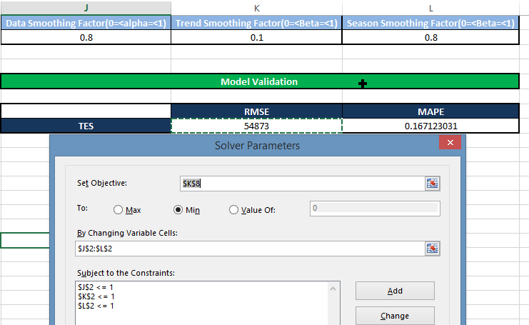
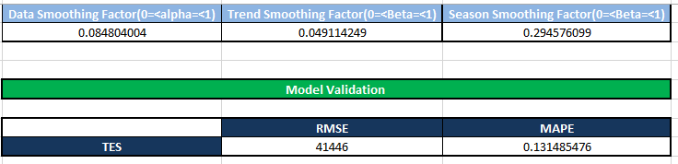
Optimizing α, β and ϒ
Optimizing α, β and ϒ to minimize RMSE/MAPE
Result
Continued…

Slide 24
Energy Meter
An electric meter is a device that measures the amount of electric energy consumed by a residence, a business or electrically powered devices.
Electric utilities install meter at the customer premises to measure electric energy delivered to their customers for billing purpose.
They are calibrated in billing units and the most popular and accepted unit is measured in kilo watt hour (KWH).

Slide 25
Types of energy meter
It is classified in accordance with several factors such as
Types of display - Analog or digital
Type of metering point – Grid, primary / secondary transmission and local distribution.
End applications - Domestic, commercial industrial
Technical application – 3 phase, single phase, LT, HT and accuracy class meter.

Slide 26
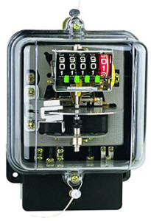
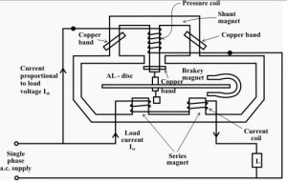
Energy Meter

Slide 27
Problem statement.
Our objective is to : -
To find clusters of high, low, medium consumers on daily basis. (weekdays / weekends)
To forecast what is going to be consumption for next 7 days and/or next month.
What should be the demand forecast? (Identify the shortage day and provide back up)
Identify spike. (outlier detection)
Able to satisfy the demand.

Slide 28
R Script
Graphs
Concluding Statement

Slide 29
Design Thinking
Ask the participants what kind of problems related to their industry can be solved using this concept.

Slide 30
Question & Answers

Slide 31
THANK YOU
Copyright © 2016 Defour Analytics Pvt. Ltd

