Slide 1
Visual Basic for Applications

Slide 2

Recap
VBA editing window
Modules
Option Explicit
Sub_procedure
Common errors when compiling or executing
Variables
Declaring a variable
Naming Excel ranges

Slide 3

Agenda
Repeat statements
1) For … Next statement 2) Message Box 3) Input Box 4) While… Wend statement
Combine condition and repeat statements
1) For … Next & If… Then combined 2) Objects 3) Cells object 4) With statement 5) Constants 6) Command continuation on next line 7) While… Wend & Select Case combined

Slide 4
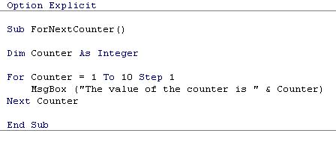
For… Next statement
The For… Next statement is based on a “counter” that goes from one value to another with specified size of the steps, executing a certain piece of VBA code for each number. As always, let’s start directly with an example.
The first example we will build shows you explicitly how the counter changes. Open an empty Excel workbook, go to the VBA editor, open a new module and type the following:

Slide 5
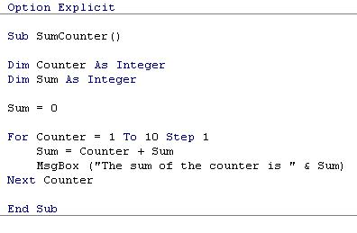
Message Box
The Message Box is a very versatile tool in VBA programming that you can use for all kinds of purposes.
When you type the MsgBox command you will see many more options, especially on the format of the box and what buttons you want to show. The VBA Help has a comprehensive explication of the different options available.

Slide 6
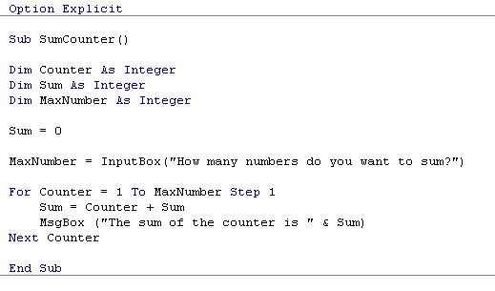
Input Box
Another VBA element closely linked to the Message Box is the Input Box.
Instead of showing a result the Input Box is used to obtain an input value from the user.
In this case we do not fix the number of iterations in the For… Next statement, but let the user choose in an input box.
The value obtained in the input box is assigned to the variable “MaxNumber”.

Slide 7
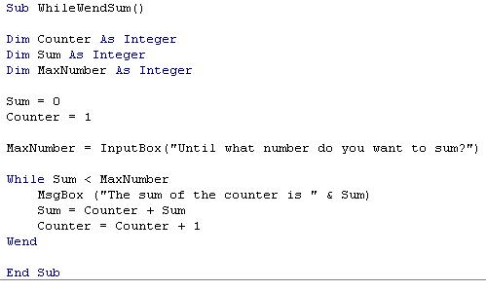
While… Wend statement
In contrast with the For…Next the While… Wend statement does not perform a certain piece of code a predefined amount of times, but instead keeps performing the code until a predefined test is met.
While the For…Next statement says “perform action x ten times”, the While… Wend statement says “keep performing action x until y=z”.

Slide 8
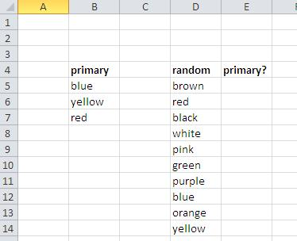
Combine condition and repeat statements
The example we will work with are two lists of colours.
the first contains the three primary colours
the second a list of random colours.
We will make a macro that will indicate of the second list if a colour is primary or not.
To start the example, open a new Excel workbook and enter the following data on the first sheet:
The macro will fill in column E, either “yes or “no”, depending if the colour is in the primary colours list or not.

Slide 9
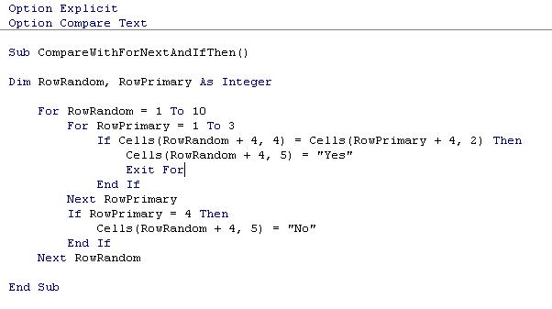
For… Next & If… Then

Slide 10
Objects
VBA is an object based programming language.
An object is a pre-defined entity with its own characteristics and methods (actions).
Ex. Activesheet, Range and Selection, etc.
Whenever you use an object, you first write the name of the object, then a dot followed by the characteristic or method you want to refer to.
Some examples:
Range(“B3”).Select (object is range(“B3”) the method (action) is to select)
Sheet1.Range(“B3”).Value (object is Range(“B3”)of Sheet1 and we want to refer to the value it contains)
Sheet5.Cells(5,5).ClearContents (object is the cell in row 5, column 5 of Sheet5 and the method used is to clear the contents of the cell)

Slide 11
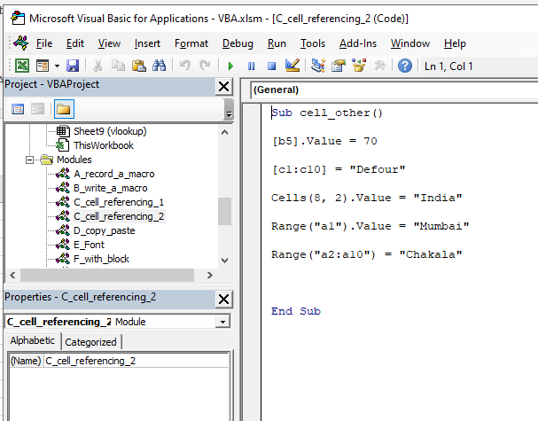
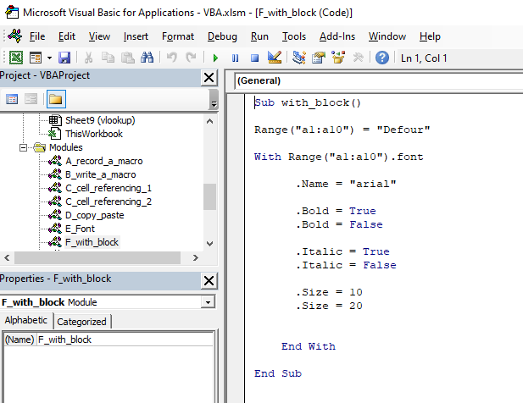
Cells object & With statement

Slide 12
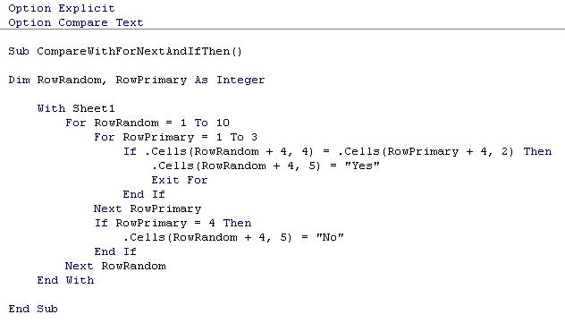
Cont..

Slide 13
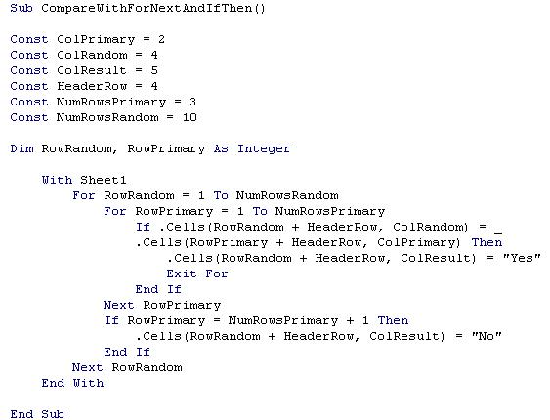
Constants

Slide 14
Command continuation on next line
When writing code in VBA and you find one command line becomes too long as you cannot see all of it anymore, or when printing it would run of the page.
then you can use the “_” symbol to spread the command over two lines.
You cannot just use enter to divide your command without further warning as the editor expects to find complete commands on one line.
The “_” tells the editor the command continues on the following line.
As in the example above, the correct use is to put first a space, followed by the “_” symbol, and then press enter.

Slide 15
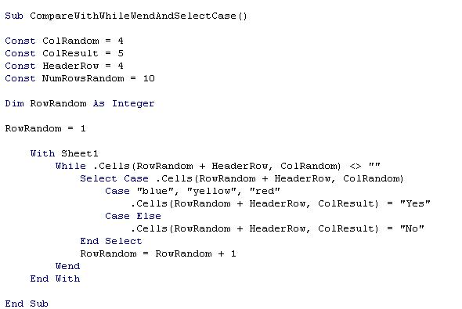
While… Wend & Select Case combined

Slide 16
Recap
Repeat statements
1) For … Next statement 2) Message Box 3) Input Box 4) While… Wend statement
Combine condition and repeat statements
1) For … Next & If… Then combined 2) Objects 3) Cells object 4) With statement 5) Constants 6) Command continuation on next line 7) While… Wend & Select Case combined

Slide 17
Demo

Slide 18
Thank You!

