Slide 1
Visual Basic for Applications

Slide 2

Introduction to VBA
It is basically a programming language that is built into these products to simplify time-consuming or complicated tasks.
VBA offers a lot of flexibility to the Microsoft products as It opens a lot of possibilities and is a powerful tool to use.
It can also be used to make sophisticated workbooks in Excel.
It helps to integrate user-defined functions into a spreadsheet or workbook.
It has a series of features that help to simplify complicated operations in Excel.

Slide 3
What is VBA
An abbreviation for Visual Basic for Applications
Official name is “Visual Basic, Applications Edition.”
VBA is Microsoft’s common application programming (macro) language for Word, Excel, Access, etc.
Also being implemented in other Microsoft applications such as Visio ans is at least partially implemented in some other applications such as AutoCAD.
VBA and VB have a lot in common, but they are different. VB is a programming language that lets you create standalone executable programs.

Slide 4
What can you do with VBA
Write Macros to Automate Labour-Intensive and Repetitive Tasks.
Create User-defined functions to achieve Complicated functionality.
Create Standard windows Menu/ Tool Bars for Interface
Interact with other windows programs (like Matlab)
I/O with External files
Database Operation……

Slide 5
Object Based Programming Language
C++ Java, etc. are OOP (Object Oriented Programming) Language.
VBA is an Object Based Programming Language.
What is Object?

Slide 6
Object Based Programming Language
Concepts – Containers or Collections
A Group of Similar Objects share common properties, methods and Events.
Such as workbook, worksheets, etc.
Worksheets is a collection of all the worksheet objects in the specified or active workbook.
Worksheets (1) refers to the 1st worksheet of current active workbook.
Worksheets (“test_1”) refers to the worksheet named “test_1.”

Slide 7
Object Based Programming Language
Concepts – Referring to
Use brackets () to refer to member object worksheets (“test_1”)
Use dot . To refer to child object or object’s properties and methods
Ex.
Worksheets(“test_1”).Range(“A1:B3”).Font.Bold

Slide 8
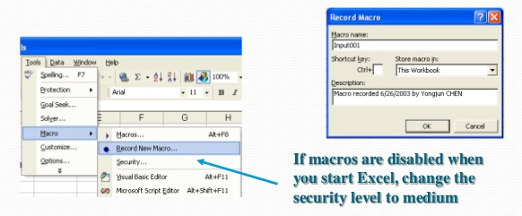
How to record a Macro
Similar to audio/ video recorder
Record all the steps you conduct and write them in VBA code

Slide 9
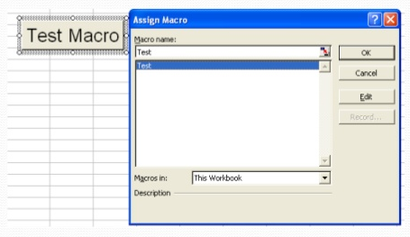
Assign Macro to An Event

Slide 10


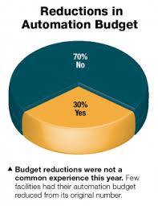

Use Cases
(1)
(2)
Tender automation.
Project finance modelling.
(3)
(4)
Budget automation.
Reporting automation.

Slide 11
Demo
How to Record A Macro
How to Write a Macro
How to start VBA
How to customize developer tab
Prepare dialogue box
Colour cell with code

Slide 12
Thank You!

