Slide 1
Visual Basic for Applications

Slide 2

Recap
Introduction to VBA
Benefits of VBA
What is Macro and its use
OOPs Introduction
Use cases
Introduction of Developer tool bar
Details of VBA in Excel
How to Record a Macro
How to write a Macro

Slide 3

Agenda
Cell Referring
Copy, paste, paste-special
Dot operator (Font operations)
Borders, Color indexing
Use of Button to run a Macro

Slide 4
VBA Cell References – Referencing Files and Worksheets
To know which data it needs to manipulate, you need to tell Excel where to find the data.
Workbook (Excel File) > Worksheet > Range or Cell
To highlight the data in the model, the proper method to use is “Select” or “Activate”.
ActiveWorkbook.Sheets(“sheet3”).Range(“A42:D45”).Select
ActiveWorkbook.Sheets(“sheet3”).Range(“A42:D45”).Activate
Uses:
To refer to a workbook: Workbooks(“NameOfFile.xls”).
Use the specific name of the file, followed by the extension.
To refer to the current workbook the macro is located in: ThisWorkbook
To refer to the active workbook: ActiveWorkbook
To refer to a worksheet: Worksheets(“Sheet1”) or Sheets(“Sheet1”)
Use the name of the sheet.
To refer to the active worksheet: ActiveWorksheet

Slide 5
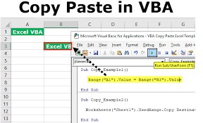
Copy, paste, paste-special
To copy the data in the model, the method to use is “Copy”.
ActiveWorkbook.Sheets(“sheet3”).Range(“A1”).Copy
Mostly use for looping work.
We can copy the data, Formats, Formulas or only data from particular range in Excel Workbook to another range or Sheet or Workbook.
Paste Special – Formats and Formulas
Paste Formats
Paste Formulas
Paste Formulas and Number Formats

Slide 6
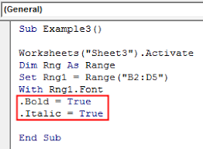
Dot operator (Font operations)
Excel VBA uses dot notation to separate the various things you can access and manipulate with the programming language.
Dot notation is hierarchical, and usually starts with an object.
Ex.
In Excel, an object is the thing you're trying to manipulate, such as a worksheet. After the object, you type a dot

Slide 7
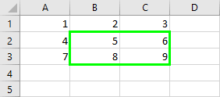
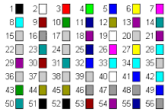
Borders, Color indexing
We use borders in excel to highlight our data, in any dashboard
Borders are a property in VBA which can be accessed by using the range method
Uses: To make the reports looks appealing to the end user or readers.
Formatting through VBA coding requires a considerable amount of VBA coding language.
VBA Color Index is a function by which we can change the color of the cell or text.
There are total 1 to 56 colour which can be use with colour indexing & for coding but with name we can use std. 8 colours only.

Slide 8
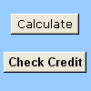
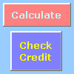
Use of Button to run a Macro
Use to set up to automate the printing of a worksheet, filtering data, or calculating numbers
In general, a Form control button and an ActiveX control command button are similar in appearance and function.
However, they do have a few differences, which are explained in the given sections.
Both these buttons are also known as a push button.
Button (Form control)
Command button (ActiveX control)

Slide 9
Demo
Cell Referring
Copy, paste, paste-special
Dot operator (Font operations)
Borders, Color indexing
Use of Button to run a Macro

Slide 10
Thank You!

