Slide 1
Visual Basic for Applications

Slide 2

Recap
Cell Referring
Copy, paste, paste-special
Dot operator (Font operations)
Borders, Color indexing
Use of Button to run a Macro

Slide 3

Agenda
1) VBA editing window
2) Modules
3) Option Explicit
4) Subprocedure
5) Common errors when compiling or executing
6) Variables
7) Declaring a variable
8) Naming Excel ranges

Slide 4
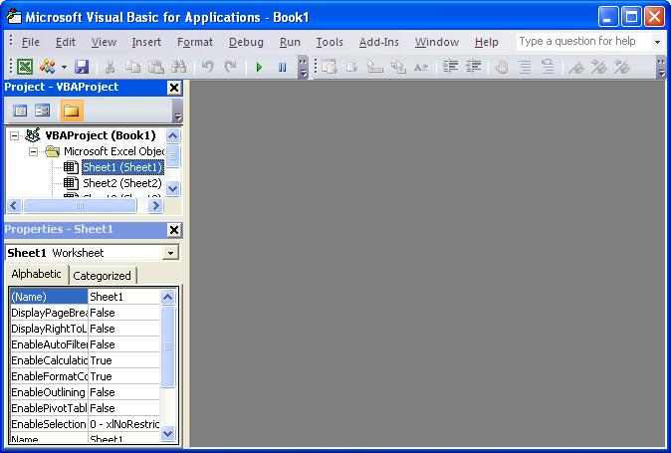
VBA editing window
Open a new Excel workbook and access the VBA editing window by pressing Alt+F11
Or by going to the “Developer” ribbon and choose “Visual Basic” ("Editor" on a Mac).
The VBA editing window shows empty as below.

Slide 5
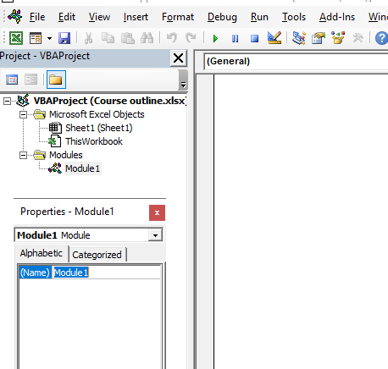
Modules
To start working on a new macro we first need to create a module.
A module is a sheet in which you can type the programming code.
Create a new module by clicking the “Insert” -> “Module”.
A clean sheet now appears in the main window.
Depending on your settings it possibly states “Option Explicit” at the top.
To rename the module press F4 (F6 for Mac users) or go to "View -> Properties Window".
Modules

Slide 6
Option Explicit
“Option Explicit” is a module-level statement, which means it holds for all the programming you do in this module. Writing Option Explicit at the top of a module means you have to define (“declare”) all variables used in the module. This is good programming practice as it prevents possible mistakes in your macros.
If it isn’t there you can type it on the first line of the empty sheet. If typed correctly it turns blue. All reserved keywords recognised by the editor turn blue. Also the first letters of each reserved keyword should turn to capital letters. The term “reserved keyword” means that Option Explicit is something that has a predefined function in Excel VBA and can only be used for the predefined purpose. So in case you wanted to use a reserved keyword the colour and capitalising let you know you have spelled it correctly. If you didn’t want to use a reserved keyword it indicates you would need to use other words.
If you want Option Explicit automatically in your newly created modules, then go in the VBA editor to "Tools -> Options -> Editor" (on Mac: "Excel -> Preferences... -> Editor") and tick “Require variable declaration” (recommended).

Slide 7

Subprocedure
In the module you have to write the programming within different groups of code.
Generally the objective of a group of code is either to execute an action or to return a value.
The type of code that executes and action is a “Subprocedure”, while a “Function” returns a value (like the functions in the Excel worksheet).
When writing a macro the main basis will be the subprocedure which we will see first.
To start a new subprocedure type “sub” (anywhere below Option Explicit) followed by a space and the name of the subprocedure. In this case type “sub WrittenMacro” and hit enter. The result on your screen should be the as per given in fig.:

Slide 8
WrittenMacro
The VBA editor immediately created the “End Sub” line when you hit enter.
In case of WrittenMacro it deliminates the prgramming code you want to execute when running the WrittenMacro routine: anything written between the “Sub” and “End Sub” lines.
Imagine you would have several subprocedures then it enables you to execute only a specific part of your code.
In contrast to "End Sub" appearing automatically here, in subsequent chapters you will see that for most statements in Excel VBA you not only need to indicate where it starts but also where it ends.

Slide 9
Variables
Variables are another vital element of programming in Excel VBA.
A variable is a named storage location that has one particular value.
You could think of it as a drawer that has a name on it.
For example, in my desk I have a drawer with “Greeting” on it. Inside the drawer is a note with one particular greeting, e.g. “Hello”, “Good morning”, “Good evening”, etc.
Variables are a very convenient way to transport data through a macro. The variable (the drawer) remains the same and can be reused endlessly while we can keep changing its contents.

Slide 10
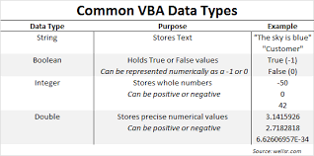
The most commonly used data types
Integer: small whole numbers, between -32,768 to 32,767. Use the Long data type for possible greater Integer values (also Excel dates are Long).
Single: non-rounded numbers with some forty digit precision, use the Double type for more precision (more than 300 digits).
Boolean: contains either TRUE or FALSE.
String: text, all words and numbers are seen as text.
Variant: the variant data type can hold any type of data. If you do not assign a data type when declaring a variable it will automatically become a Variant.

Slide 11
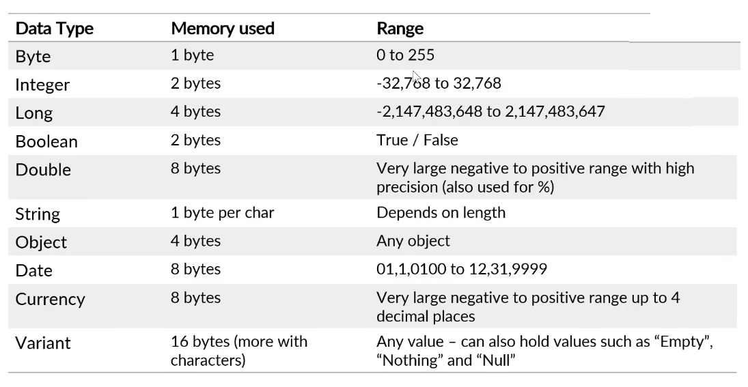
Data Types For Variable

Slide 12
Declaring a variable
Once we know the type of variable we want to create we can define the variable, called “declaring” in Visual Basic.
There are three statements that can be used to declare a variable:
DIM
PUBLIC
PRIVATE
Dim: can be used to declare a variable in a subprocedure or at the module level. If used to declare a variable in the subprocedure then the variable can only be used within that subprocedure. If declared at the module level the variable can be used in any subprocedure in that module, but not by any subprocedures in other modules in the workbook.
Public: is only used at the module level and makes the variable available to all procedures in all modules of the workbook.
Private: is applied to declare variables at the module level that can only be used within that module. Therefore it is the same as using the Dim statement at module level (Dim is more commonly used in that case, though Private would arguably result in more transparent code).

Slide 14
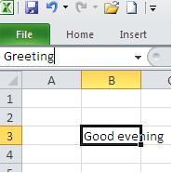
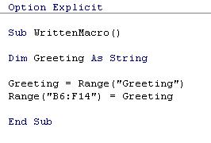
Naming Excel Ranges

Slide 15
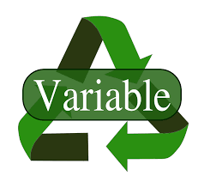
Use of Variable
Use less Memory Space
Easy to work with
Reduces your longer work
Time saving
Easily replaceable
Mostly use for faster output

Slide 16
Demo

Slide 17
Thank You!

