Slide 1


Slide 2
Brief About AngularJs
Open Source Javascript MVC/MVVM framework.
Helps manage complexity of your client-side Javascript code.
Extend HTML vocabulary with your own elements and
attributes.
Built-in HTTP and more importantly REST API web service
integration.
Includes its own client-side templating language.
Two-way data binding to allow the Model to be used as the source of
truth.
Has client-side routing to enable creating single page apps (SPA) Sponsored by Google, lots of contributions by Google employees, but on Github as public repo.

Slide 3
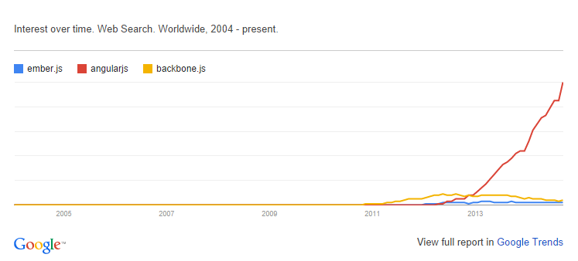
Comparison with others

Slide 4
MVC
MVC architecture
Model (Data)
View (UI)
Notifies
Notifies
Changes
Controller (Logic)

Slide 5
Directives
Directives
Attribute
CSS
Comment
Element directives

Slide 6
Directives
Type | Usage
A | <div book></div>
C | <div class="book"></div>
E | <book data="book_data"></book>
M | <!--directive:book -->

Slide 7
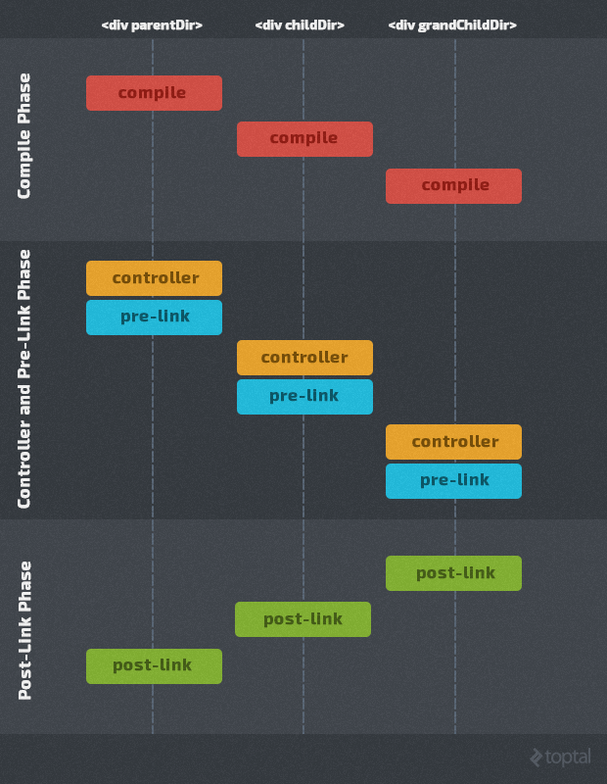
Directives Function Exe

Slide 8
Form Validations
Property | Class | Description
$valid | ng-valid | Boolean Tells whether an item is currently valid based on the rules you placed.
$invalid | ng-invalid | Boolean Tells whether an item is currently invalid based on the rules you placed.
$pristine | ng-pristine | Boolean True if the form/input has not been used yet.
$dirty | ng-dirty | Boolean True if the form/input has been used.
$touched | ng-touched | Boolean True if the input has been blurred.

