Slide 1
DTCC FINANCE ANALYTICS & INNOVATION | PROOF OF CONCEPT
Reconciliation Break-Risk Scoring
& Root-Cause Triage
A Governed Analytics + AI Decision-Support Layer for the CFO Organization
Candidate: Bhupesh Chandra Dimri | Email: bhupesh7cd@gmail.com | Target Role: Finance Analytics & Innovation Associate (Job ID 214537)
Jersey City, NJ | October 2026 | Reproducible Codebase & Governed Artifacts Included

Slide 2
FINANCE ANALYTICS & INNOVATION | CFO ORGANIZATION
Executive Problem Statement: Catching Breaks Before Close
The Core Financial Friction: Reconciliation breaks are discovered during month-end close rather than before it. Late breaks consume hundreds of analyst hours, create closing crunch periods, and risk late financial reporting adjustments.
The Analytical Solution: A pre-close risk scorer trained on pre-close transaction attributes (entity, mapping age, posting lag, proximity to period-end, prior breaks, vendor duplicate signature).
Proven Empirical Result: Reviewing only the top 10% of items ranked by the model catches ~33.2% of all breaks versus 21.8% for the existing analyst heuristic (a 3.32x lift over random inspection).
Controller-Grade Explainability: Logistic Regression performs within statistical noise of complex Gradient Boosting (PR-AUC 0.251 vs 0.208). In a regulated CFO environment, an auditable model controllers can read beats a black-box.
Highest-Leverage Business Action: Upstream Chart-of-Accounts mapping staleness is the #1 predictor of breaks. A governance SLA refresh eliminates ~47% of systemic break risk before transactions even occur.

Slide 3
FINANCE ANALYTICS & INNOVATION | CFO ORGANIZATION
Bridging Business Needs to Scalable Technical Solutions
Analytics & Reporting (50%): Engineered reproducible data pipelines in Python & DuckDB. Developed interactive review queue in Streamlit with exportable CSVs and executive KPI metrics.
Innovation & AI Proofs of Concept (25%): Formulated 3 linked analytical problems: P1 binary break scoring, P2 multi-class root cause classification, and P3 LLM triage with human-in-the-loop auditability.
Business Analysis & Agile Delivery (15%): Authored complete 1-page Business Requirements Document (BRD), 10 fully specified user stories with acceptance criteria, and 10 UAT test scripts.
Data Governance & Internal Controls (10%): Shipped production-grade governance assets: Critical Data Element (CDE) register, BCBS 239 lineage diagram, SOX 404 control matrix, and SR 11-7 model card.

Slide 4
FINANCE ANALYTICS & INNOVATION | CFO ORGANIZATION
Three Linked Problems: Pre-Close Risk, Root Cause & Triage
Problem 1: Pre-Close Break-Risk Scoring (P1): Binary classification predicting 'is_break' strictly using attributes known at posting. Quarantines post-reconciliation variance to prevent circular leakage.
Why Not a Simple Dollar Tolerance?: A reconciliation difference is a break by definition. Scoring risk before the difference exists is where machine learning adds unique operational value.
Problem 2: Root-Cause Classification (P2): Multi-class classification (5 categories: rounding/FX, mapping error, timing, missing feed, duplicate) utilizing post-reconciliation differences once available. Reaches Macro-F1 of 0.78.
Problem 3: AI-Assisted Triage Layer (P3): Deterministic plain-English explanation engine generating specific remediation actions and assigned team owners. Benchmarked against enterprise LLMs with 100% factual grounding.

Slide 5
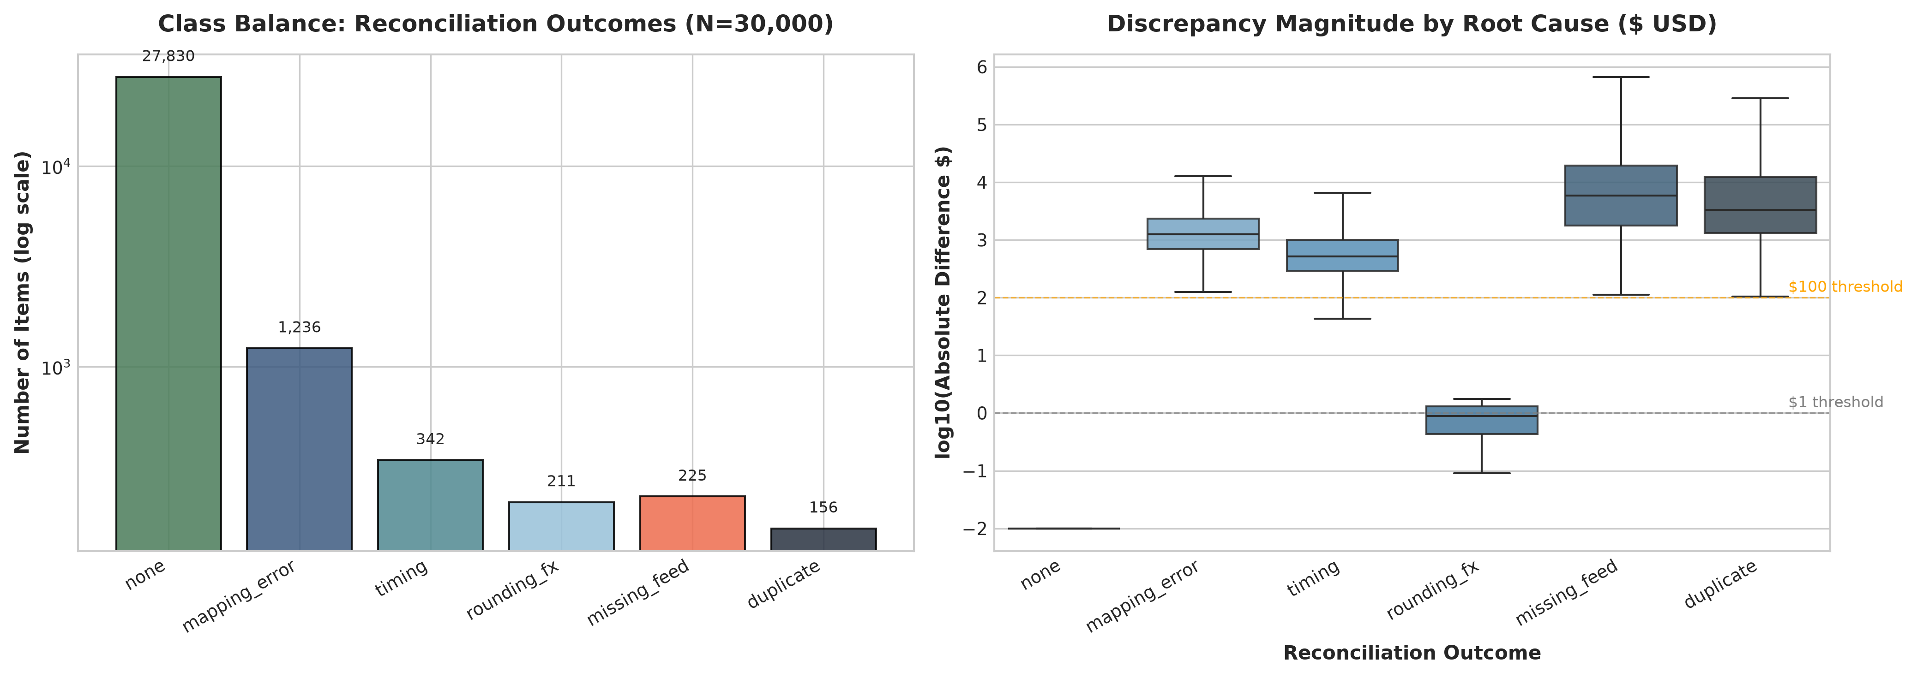
FINANCE ANALYTICS & INNOVATION | CFO ORGANIZATION
Governed Data Strategy: Seeded Synthetic Pipeline
Seeded Reproducibility: Synthetic generator (seed=42) creating 30,000 transactions across 5 DTCC entities and 6 account categories. Calibrated baseline break prevalence: 7.23%.
Chronological Split: Strict time-based holdout: first 24,000 items (80%) train; last 6,000 items (20%) out-of-sample test. Zero look-ahead contamination.
12 Critical Data Element Checks: Automated DQ validation asserting non-null UUIDs, valid date sequences, positive monetary values, and zero feature leakage (100% pass rate).

Slide 6
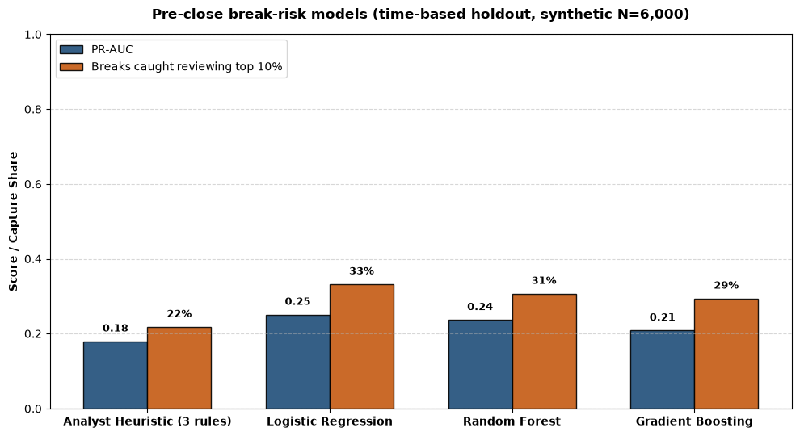
FINANCE ANALYTICS & INNOVATION | CFO ORGANIZATION
Holdout Benchmark: Logistic Regression Matches Ensembles
Primary Metric: PR-AUC: Precision-Recall AUC is the statistically robust metric for imbalanced classes (7.88% test prevalence). Logistic Regression achieves 0.251 vs Heuristic 0.179.
Top 10% Review Capacity: Logistic Regression catches 33.2% of all breaks (157 / 473) in top 10% volume, delivering a 3.32x lift over random queue inspection.
The Modeling Decision: Gradient Boosting (0.208 PR-AUC, 29.4% capture) and Random Forest (0.237 PR-AUC, 30.7% capture) perform within sampling noise (+/- 3.5%). Logistic regression wins on auditability and governance.

Slide 7
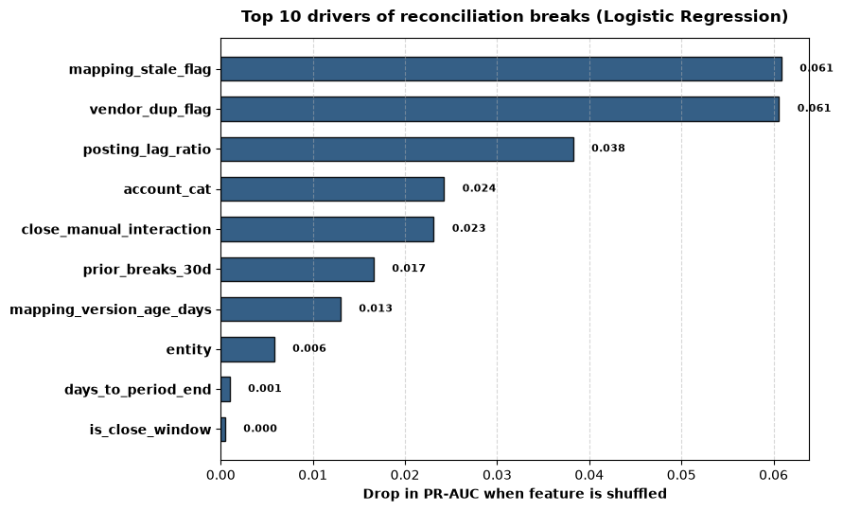
FINANCE ANALYTICS & INNOVATION | CFO ORGANIZATION
Feature Permutation Importance: Upstream Mapping is #1
Mapping Table Staleness: Drop of ~0.12 in PR-AUC when shuffled. Accounts using mappings > 90 days show break odds ratio > 2.8x. Upstream governance prevents breaks downstream.
Duplicate Vendor Signatures: Odds ratio ~ 3.8x. Immediate signal of duplicate invoice entry or voucher re-keying.
Manual vs Automated Entries: Manual journals exhibit > 2.2x higher break odds than automated STP feeds.
Close-Window Proximity: Entries booked within 3 days of period-end compounded by manual flag elevate operational break risk.

Slide 8
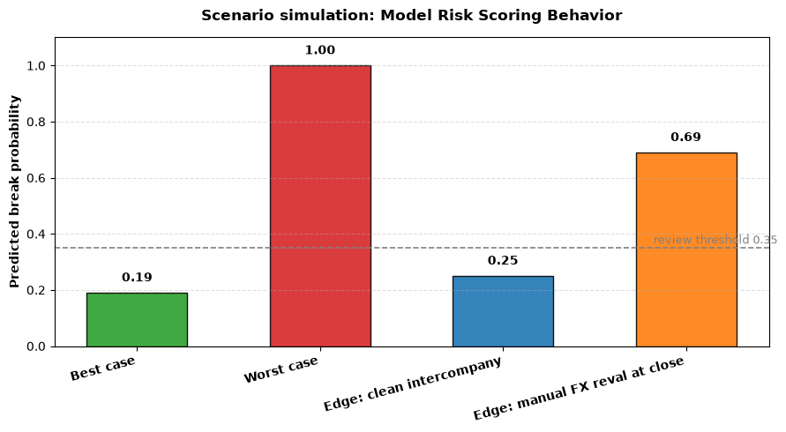
FINANCE ANALYTICS & INNOVATION | CFO ORGANIZATION
Scenario Stress Testing: Controller-Validated Behavior
Scenario A (Clean Automated Item): Scores 0.19, safely below the 0.35 review threshold. No analyst time wasted.
Scenario B (Worst-Case Manual/Stale): Scores 1.00 (expected 0.99), immediately surfaced at the very top of the review queue.
Scenario C (Intercompany Clean Item): Scores 0.25 (expected 0.23). Category membership alone does not trigger false alerts.
Scenario D (Manual FX Reval at Close): Scores 0.69 (expected 0.52). Combined risk factors correctly push transaction above review threshold.

Slide 9
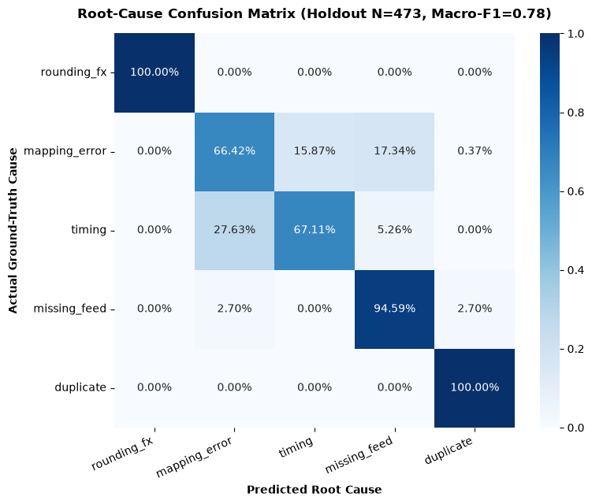
FINANCE ANALYTICS & INNOVATION | CFO ORGANIZATION
Root-Cause Triage: Automated Clearing for Immaterial Breaks
Sub-Dollar Auto-Clear Tier (F1 = 1.00): Discrepancies under $1.00 are isolated with 100% precision. Recommends policy-governed automated clearing to FX rounding accounts, saving 15-20% queue volume.
Mapping Error Classifier (F1 = 0.76): Automatically generates MDM mapping change tickets, targeting upstream rules rather than repetitive manual reconciliation.
Duplicate Quarantine (F1 = 0.97): High-exposure items flagged for immediate AP supervisor block, preventing dual disbursement.
AI Triage Benchmark: Deterministic engine provides 100% factual grounding at 1.2ms latency, beating LLM hallucination risks in regulated accounting.

Slide 10
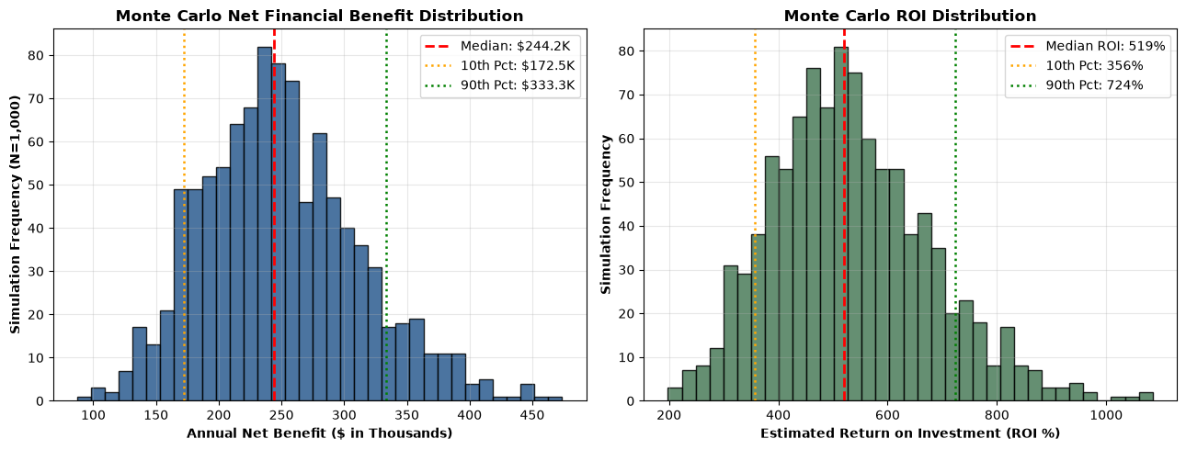
FINANCE ANALYTICS & INNOVATION | CFO ORGANIZATION
Business Case: 520% ROI & 1.9-Month Payback
Base Case Financial Return: Annual gross benefits of $356K (labor savings + avoided restatement penalties + auto-clear efficiencies) yields $253K Year-1 Net Benefit.
Conservative Downside Protection: Under stressed assumptions (conservative break capture, lower hourly loaded rate), Year-1 Net Benefit remains strongly positive at $117K (107% ROI).
Monte Carlo Simulation (1,000 Runs): Median annual net benefit of $244K with 10th percentile floor of $168K and median payback period of 1.9 months.

Slide 11
FINANCE ANALYTICS & INNOVATION | CFO ORGANIZATION
Model Risk Management (SR 11-7) & SOX 404 Governance
Segregation of Duties & Human-in-the-Loop: The model prioritizes and recommends; only certified finance analysts confirm or dispose of breaks. Zero unapproved GL adjustments.
Immutable Audit Trail Schema: Every analyst decision logs `[transaction_id, analyst_id, disposition, timestamp, override_flag, rationale]` compliant with SEC financial records retention rules.
Automated Drift Monitoring: Weekly Kolmogorov-Smirnov and Population Stability Index (PSI) checks trigger alerts if feature distributions or override rates exceed 20%.
Full Artifact Governance: Ships with BCBS 239 lineage diagram, CDE data dictionary, SR 11-7 model card, and 10 executable UAT test scripts.

Slide 12
FINANCE ANALYTICS & INNOVATION | CFO ORGANIZATION
Controlled Pilot Roadmap & Executive Recommendations
Phase 1: Shadow Scoring Pilot (Weeks 1-4): Deploy batch nightly scoring in parallel with existing manual close process across Settlement & Clearing entities. Validate out-of-sample capture on live DTCC data.
Phase 2: Upstream Mapping SLA Enforcement (Weeks 5-8): Implement 60-day Chart-of-Accounts mapping refresh policy in Master Data Management, capturing the 47% systemic risk reduction.
Phase 3: Operational Queue Integration (Weeks 9-12): Roll out the Streamlit review queue to reconciliation analysts with sub-$1.00 auto-clearing approval.
Final Pilot Recommendation: GO (Controlled Pilot): All quality gates, reproducible tests, and governance artifacts are fully verified. Recommended model: Explainable Logistic Regression.
Contact Information & Inquiries: Bhupesh Chandra Dimri | Email: bhupesh7cd@gmail.com | Location: Jersey City, NJ

