Slide 1

NAAC ACCREDITED A+ GRADE
Tulsiramji Gaikwad-Patil College of Engineering & Technology
TEAM MEMBERS
Department of Information Technology • (An Autonomous Institute), Nagpur
Bhupesh Indurkar
Vivek Rathod
Dhrup Sonkar
Momita Lande
Shreya Satpute
Sachin Limbule
ZENIVA
A RAG-Enhanced LLM Framework for Personalized Ayurvedic Patient Classification and Doctor–Patient Interaction
GUIDE
Prof. Jayesh Fating
RAG • LLM • NLP • TTS • Hospital ERP & Pharmacy
PROJECT TYPE
Pure Software Research Project
ZENIVA | Dept. of Information Technology
1 / 14

Slide 2
AGENDA
Presentation Roadmap
01
Problem Statement
07
Comparative Analysis & Software Stack
02
Literature Survey & Research Gap
08
Expected Outcomes
03
Aim & Objectives
09
Implementation Timeline
04
Proposed System Architecture
10
Conclusion & Future Scope
05
RAG Working
11
Our Idea — Visualization
06
Doctor Portal: Hospital ERP & Pharmacy
ZENIVA | Dept. of Information Technology
2 / 14

Slide 3





THE CHALLENGE
Problem Statement
Patients often search for health information using natural language but may receive generic or poorly contextualized information. Ayurvedic knowledge can contain specialized terminology requiring careful explanation, and users may have difficulty finding a suitable qualified practitioner. Text-only interaction can also be less convenient for users who prefer listening.
Generic, poorly contextualized information
Specialized Ayurvedic terminology
Zeniva addresses these issues by combining symptom understanding, preliminary classification, RAG-based knowledge retrieval, personalized guidance, TTS output and doctor recommendation in one software platform. Security is required to protect patient information against interception, unauthorized access and inappropriate disclosure.
Hard to find a qualified practitioner
Text-only interaction limits listeners
Practitioner tools: the Doctor Portal adds a Hospital ERP & Pharmacy to manage patients, prescriptions and dispensing.
ZENIVA | Dept. of Information Technology
3 / 14

Slide 4

PRIOR WORK
Literature Survey & Research Gap
Source | Focus | Contribution | Limitation / Gap
Lewis et al., NeurIPS 2020 | Retrieval-Augmented Generation | Shows grounding LLM output in retrieved documents reduces hallucination | Not applied to a domain-specific, Ayurvedic healthcare setting
Vaswani et al., NeurIPS 2017 | Transformer architecture | Foundational attention-based model underlying modern LLMs | General-purpose; no healthcare, RAG or security framing
OWASP TLS Cheat Sheet | Transport-layer security | Defines secure TLS configuration practices for web/API traffic | Generic guidance, not woven into an AI health platform
OWASP Password Storage | Credential security | Recommends Argon2id / bcrypt-class password hashing | Needs RBAC and session controls layered on top for healthcare use
NIST SP 800-52 Rev.2 | TLS implementation | Federal guidelines for selecting and configuring TLS versions | Not tailored to patient – AI conversational systems
Research Gap
No existing system combines RAG-grounded LLM guidance for the Ayurvedic domain, source-transparent responses, TTS-based humanized delivery, and a defense-in-depth security architecture (authentication, RBAC, encryption, audit logging and AI/RAG-specific controls) inside one pure-software healthcare platform. This is the white space Zeniva targets.
ZENIVA | Dept. of Information Technology
4 / 14

Slide 5






PURPOSE
Aim & Objectives
AIM
To build Zeniva, a pure software, RAG-enhanced LLM platform that delivers grounded, source-transparent Ayurvedic health guidance — spoken aloud through TTS — within a secure, human-in-the-loop doctor–patient system.
Symptom Analysis
RAG-based Ayurvedic Guidance
Personalized Response
Process free-text symptoms, duration and lifestyle context using NLP.
Build a curated Ayurvedic knowledge base and retrieve relevant content via RAG.
Generate LLM responses that prioritise retrieved evidence over unsupported claims.
Text to Speech (TTS)
Doctor Connect
Security by Design
Convert AI-generated responses into speech for a natural, accessible and humanized interaction.
Recommend qualified practitioners, support consultation workflows, and give doctors a Hospital ERP & Pharmacy module.
State Council MCIM Verification, OTP Auth, SHA-256 Audit Trail
ZENIVA | Dept. of Information Technology
5 / 14

Slide 6
HOW IT WORKS
Proposed System Architecture
Presentation Layer
Application Layer
NLP & Classification
RAG
LLM
Patient Portal
Authentication
Symptom Extraction
Knowledge Base
Grounded Response Generation
Doctor Portal
User Management
Duration Analysis
Embeddings
Admin Dashboard
Appointments
Context Modeling
Semantic Search
Chat Interface
Hospital ERP & Pharmacy
DATA + SECURITY LAYER
RECOMMENDATION & CONSULTATION
TTS
SAFETY / CONTENT CHECK
Database
Encryption
RBAC
Audit Logs
Wellness Guidance
Doctor Matching
Text → Spoken Audio
Guardrails · filters · escalation
Flow: Presentation → Application → NLP → RAG → LLM → Safety → TTS → Recommendation → Data/Security
ZENIVA | Dept. of Information Technology
6 / 14

Slide 7




CORE RESEARCH CONTRIBUTION
RAG Working
1
2
3
4
Curate & Clean
Embed
Query & Retrieve
Ground & Generate
Ayurvedic reference material is collected, cleaned and segmented into passages.
Passages are converted into vector embeddings and stored in a vector database.
The patient's query is embedded and matched against the knowledge base via vector search.
Retrieved passages are supplied to the LLM as context; the model is instructed to prioritise this evidence and avoid unsupported claims.
Why RAG Matters
Keeps answers grounded in a curated, trusted Ayurvedic source instead of the model's unverified memory
Communicates uncertainty and avoids unsupported medical claims
A “View Sources” control shows the exact knowledge used to build each response
System instructions stay separated from retrieved content to resist prompt injection
Keeps the assistant’s guidance clearly distinct from a professional diagnosis
ZENIVA | Dept. of Information Technology
7 / 14

Slide 8



DOCTOR PORTAL
Hospital ERP & Pharmacy
Hospital ERP
Pharmacy Management
Patient registration & digital health records
OPD appointment & schedule management
Doctor, staff & department management
Billing, invoicing & payments
Reports & analytics dashboard
Medicine & herbal formulation inventory
Prescription-linked dispensing
Stock, batch & expiry alerts
Purchase orders & supplier tracking
Sales billing & stock reports
Consultation
e-Prescription
Pharmacy Dispensing
Billing & Records
Role-based access, encrypted records and audit logging apply to every ERP & Pharmacy action.
ZENIVA | Dept. of Information Technology
8 / 14

Slide 9
POSITIONING & STACK
Comparative Analysis & Software Stack
Capability | Zeniva | Generic AI Chatbot | Static Ayurveda Website
Response grounding | RAG-grounded, source-cited | Ungrounded, memory-based | Fixed articles only
Personalisation | Symptom & lifestyle aware | Limited context | None
Voice output | TTS in patient's language | Usually text-only | Not applicable
Doctor connection | Built-in recommendation & consent flow | Not included | Separate directory, if any
Practitioner tools | Doctor Portal with Hospital ERP & Pharmacy | Not included | Not applicable
Security depth | Defense-in-depth + AI/RAG controls | Varies by vendor | Basic web security
Suggested Software Stack
Frontend
Backend
LLM
RAG framework
Embeddings
React.js / HTML / CSS / JS
Python + FastAPI
Llama / Qwen / Mistral
LangChain / LlamaIndex
Sentence Transformers
Vector DB
App database
TTS
Auth & sessions
Hospital ERP & Pharmacy
FAISS / ChromaDB
PostgreSQL / MySQL
Cloud or open-source TTS engine
JWT / secure server sessions
Web modules · FastAPI · PostgreSQL
ZENIVA | Dept. of Information Technology
9 / 14

Slide 10

DELIVERABLES
Expected Outcomes
Working Prototype
Source-Transparent Answers
Preliminary Classification
A functional Zeniva assistant covering symptom intake, RAG-grounded response and TTS playback.
A “View Sources” experience showing the exact knowledge used for each response.
NLP-driven symptom structuring feeding a preliminary health category.
Security Architecture in Place
Doctor Recommendation Engine
Architecture Research Paper
TLS, RBAC, encryption at rest, secure sessions and audit logging implemented end to end.
Practitioner matching by specialisation, experience and availability.
A conference/journal submission documenting the RAG + security.
Doctor Portal with Hospital ERP & Pharmacy
A unified module for patient records, appointments, prescriptions, medicine inventory and billing — integrated into the Zeniva website.
ZENIVA | Dept. of Information Technology
10 / 14

Slide 11
PROJECT ROADMAP
Implementation Timeline
1
2
3
4
5
6
PHASE 1
PHASE 2
PHASE 3
PHASE 4
PHASE 5
PHASE 6
Research & Requirements
NLP & Classification
Knowledge Base & RAG
LLM Integration & Safety
TTS & Security Hardening
Testing, Evaluation & Docs
Literature review, knowledge-base scoping, security requirement gathering
Symptom entity extraction pipeline and preliminary classification model
Curate Ayurvedic content, build embeddings and vector search pipeline
Grounded response generation, safety/content checks, “View Sources”, UI and Doctor Portal with Hospital ERP & Pharmacy
Voice output integration; auth, RBAC, encryption and audit logging
RAG/LLM/security evaluation, usability testing, final report and paper
ZENIVA | Dept. of Information Technology
11 / 14

Slide 12


WHERE THIS LEADS
Conclusion & Future Scope
Zeniva shows that a pure-software, RAG-grounded LLM platform can deliver personalised, source-transparent Ayurvedic guidance — spoken through TTS — while a defense-in-depth security architecture protects patient data and qualified practitioners, supported by an integrated Hospital ERP & Pharmacy, stay central to care.
AI-Based Patient Progress Tracking
Doctor Feedback
Explainable AI
Zeniva monitors symptoms and wellness over time to identify whether the patient is improving, stable, or worsening.
Doctors can review the AI assessment and use their feedback to improve future system performance.
Zeniva explains why each Ayurvedic recommendation is suggested based on the user's symptoms and relevant knowledge.
Family/Caregiver Access
Deeper Hospital ERP & Pharmacy Integration
Users can optionally share selected health information, appointments, and reminders with trusted family members or caregivers.
Link AI recommendations to prescriptions, pharmacy stock and billing for a seamless care-to-dispensing workflow.
ZENIVA | Dept. of Information Technology
12 / 14

Slide 13
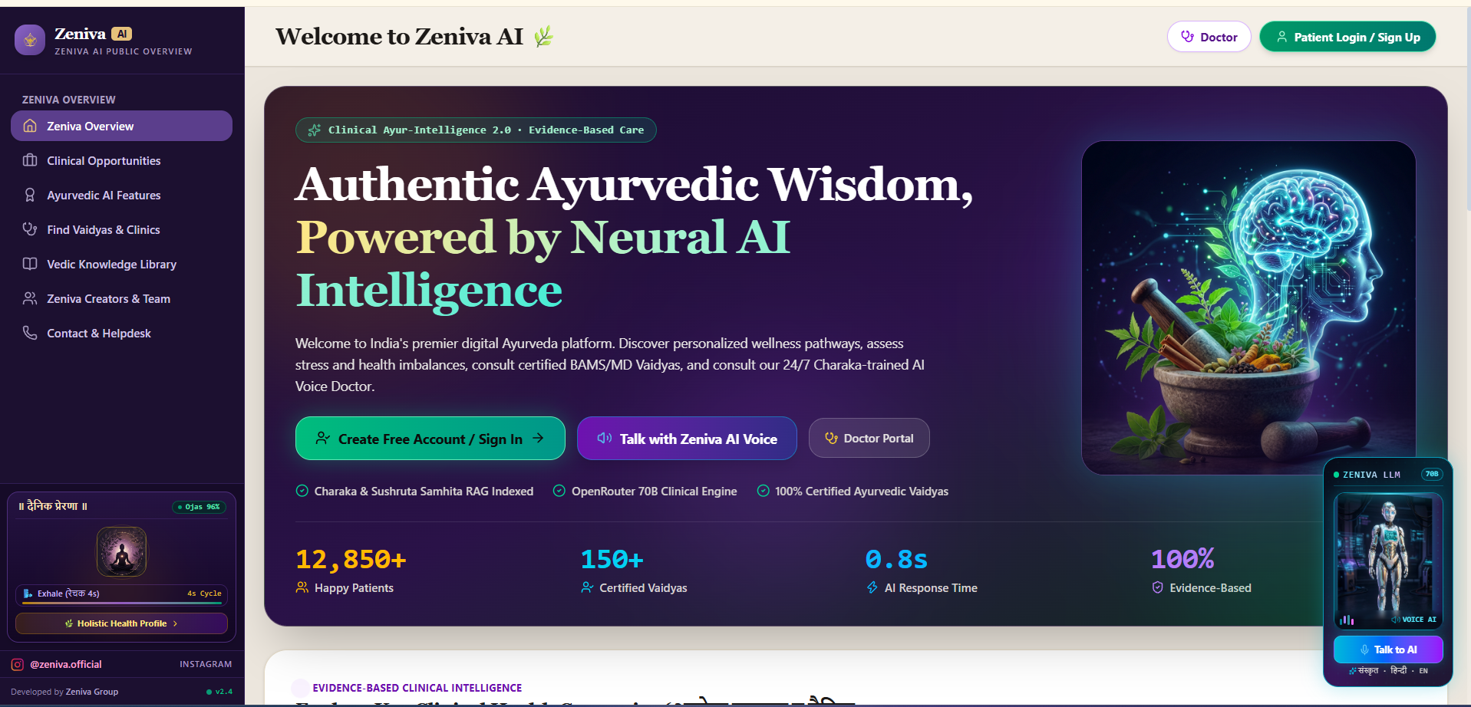
OUR IDEA
Visualization
12,850+
Happy Patients
150+
Certified Vaidyas
0.8s
AI Response Time
100%
Evidence-Based
Zeniva AI public overview: Patient Login, Talk with Zeniva AI Voice and the Doctor Portal — now including Hospital ERP & Pharmacy.
ZENIVA | Dept. of Information Technology
13 / 14

Slide 14
Thank You
Questions & Discussion — Zeniva
Department of Information Technology
Tulsiramji Gaikwad-Patil College of Engineering & Technology
TEAM MEMBERS
Bhupesh Indurkar • Vivek Rathod • Dhrup Sonkar
Momita Lande • Shreya Satpute • Sachin Limbule
ZENIVA | Dept. of Information Technology
14 / 14

