Slide 1

Name :BHUPINDER SINGH Class: D4CSE
UNIVERSITY ROLL : 1311037

Slide 2

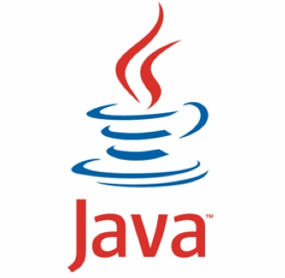
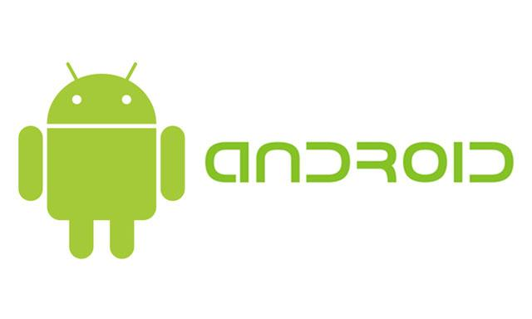

Pandasofts
6 month industrial training
on

Slide 3
ABOUT JAVA
JAVA is a developed technology in the modern IT industry. Java trained professionals are few in numbers. So there is demand high in the IT industry.
In the modern IT world, Java is a high demanding technology because it has some unique features. You will find Java technology in almost all the gadgets that are used daily. Java is an object oriented programming language which is independent of any platform. The best features of this programming language is it does not requires any other software or platform for functioning much like the other programming languages.
Notes:
i

Slide 4
Get An Idea about java
Originally, this independent programming language was named as OAK. It was created by a professional of the Sun Micro System, James Gosling. He is regarded as the “god father of Java”. The technology is primarily designed for the embedded system devices like the mobile phones. However, with advancement and change in time, Java has become a reliable source of application, developments.
Sun Microsystems released the first public implementation as Java 1.0 in 1995.

Slide 5
Features of java
Simple
Object-Oriented
Platform independent
Secured
Robust
Architecture neutral
Portable
Dynamic
Interpreted
High Performance
Multithreaded

Slide 6
History of Android
The history and versions of android are interesting to know. The code names of android ranges from A to N currently Nougat. Let's understand the android history in a sequence.
Initially, Andy Rubin founded Android Incorporation in Palo Alto, California, United States in October, 2003.
In 17th August 2005, Google acquired android Incorporation. Since then, it is in the subsidiary of Google Incorporation.
The key employees of Android Incorporation are Andy Rubin, Rich Miner, Chris White and Nick Sears.
Originally intended for camera but shifted to smart phones later because of low market for camera only.
Android is the nick name of Andy Rubin given by co-workers because of his love to robots.
In 2007, Google announces the development of android OS.
In 2008, HTC launched the first android mobile.

Slide 7
About Android
It is a open source software platform and operating system for mobile devices
Based on the Linux kernel
Developed by Google and later the Open Handset Alliance (OHA)
Allows writing managed code in the Java language
Android has its own virtual machine i.e. DVM (Dalvik Virtual Machine),which is used for executing the android application.
Google purchased the initial developer of the software , android incorporated in 2005.

Slide 8


Slide 9
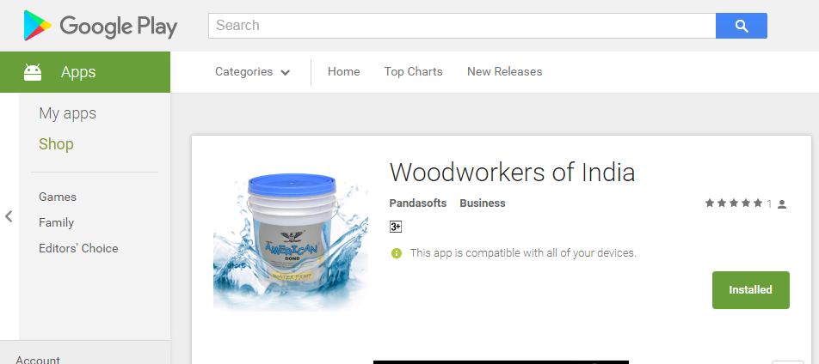
Woodworkers Of India
Woodworkers of India is launch for a company called Nikil Chemicals.
With the help of this application, all registered carpenters, dealers and distributors can connect to Nikil chemicals to get latest details related to their accounts.

Slide 10
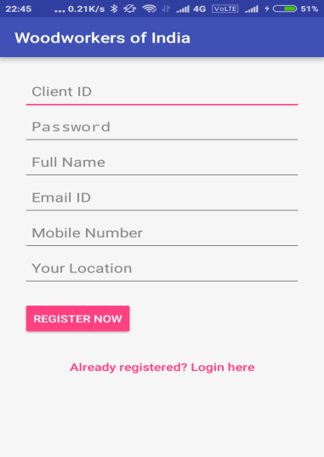
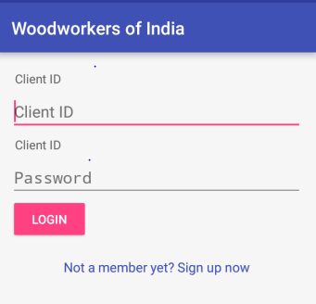
HOW It Works
A user (Carpenter, Dealer, and distributor) is provided with a unique ID by the company.
User then download this app and signup using information like client id, password, full name, email id, mobile number and location.
If already registered then he has to fill only client id and password.

Slide 11
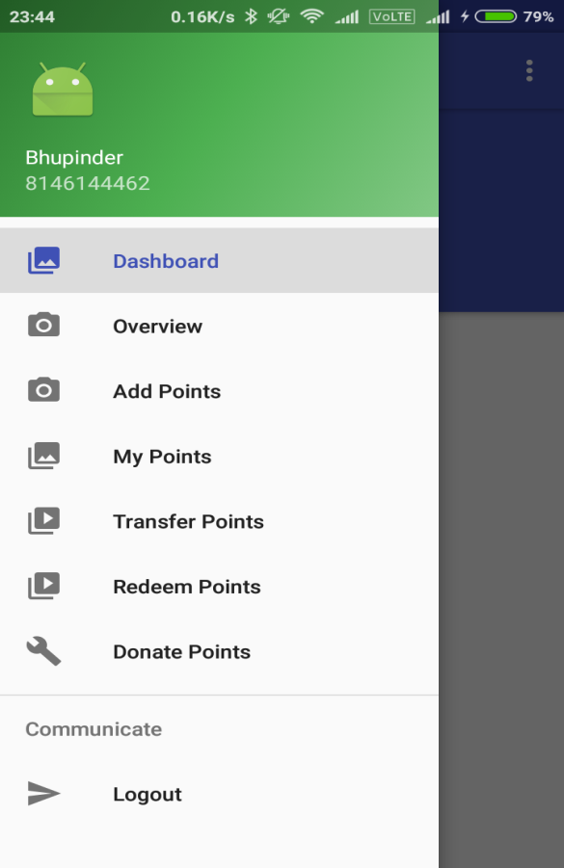
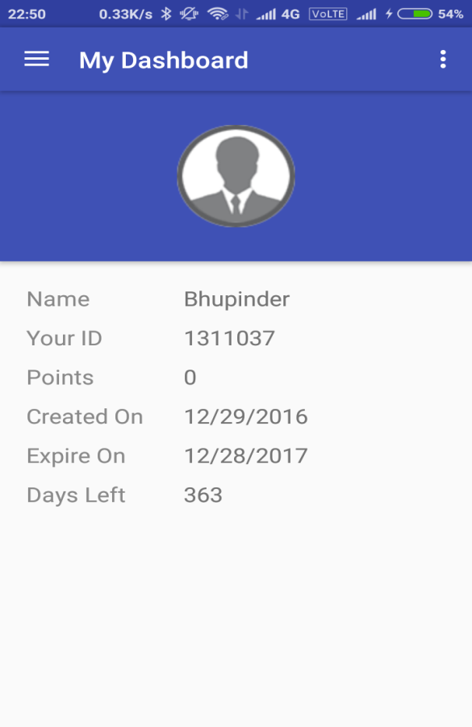
Application Pages
In the app there are different pages like:
Dashboard
Overview
Add Points
My points
Transfer Points
Redeem Points
Donate Points
Logout

Slide 12
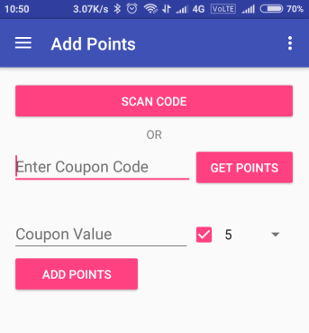
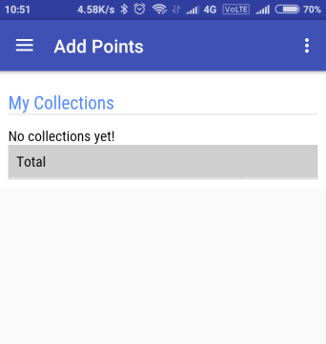
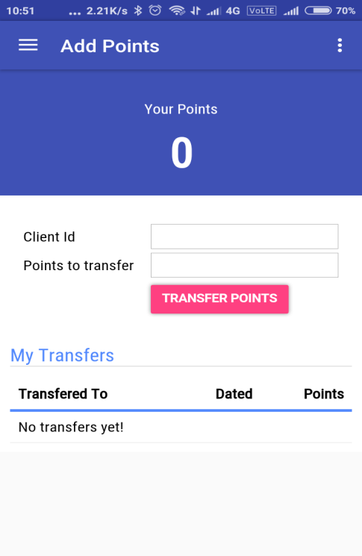
Add points, My points, Transfer points

Slide 13
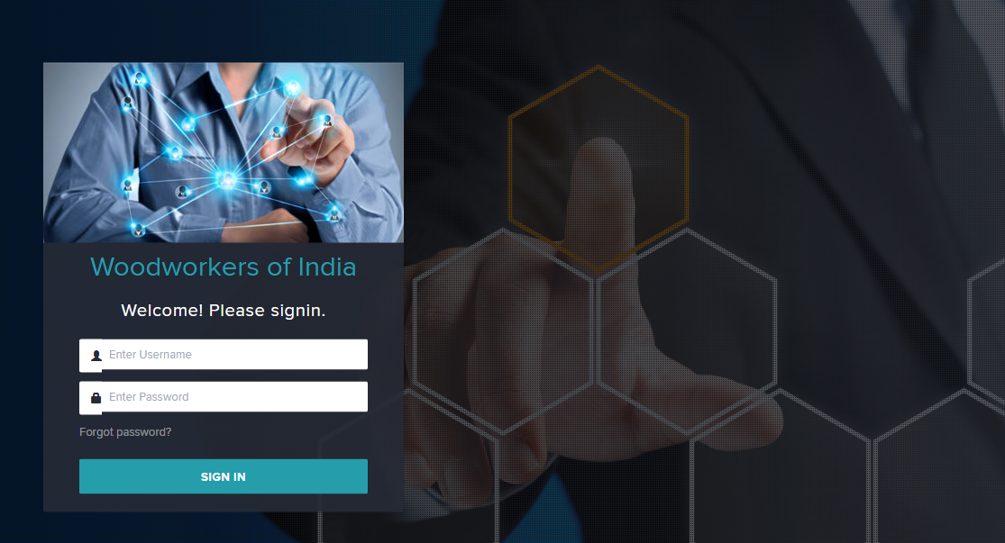
Website
Website : nikil.pandasofts.com

Slide 14
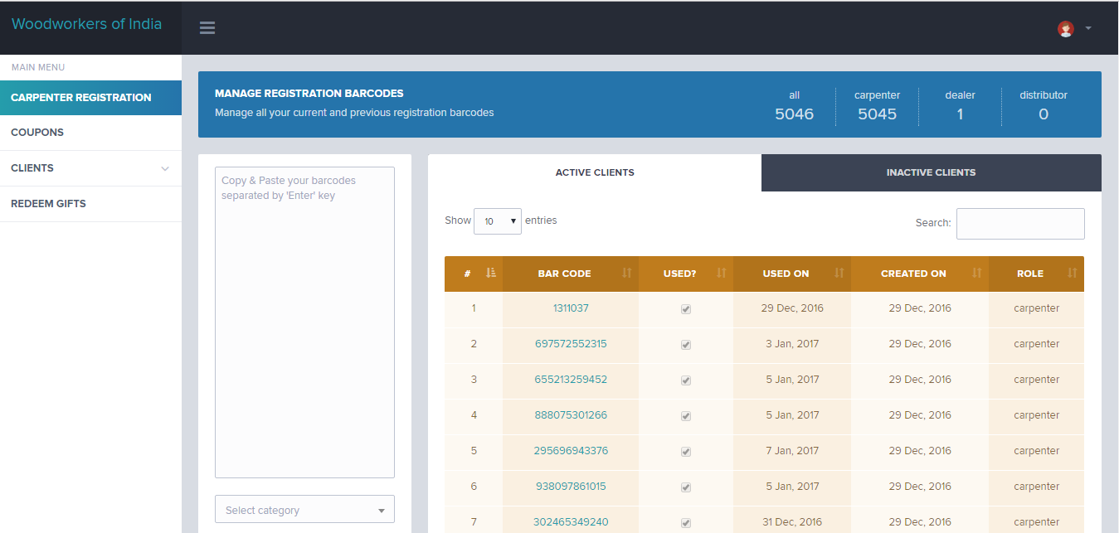
Registration
Company can access all the clients and link with them.

Slide 15
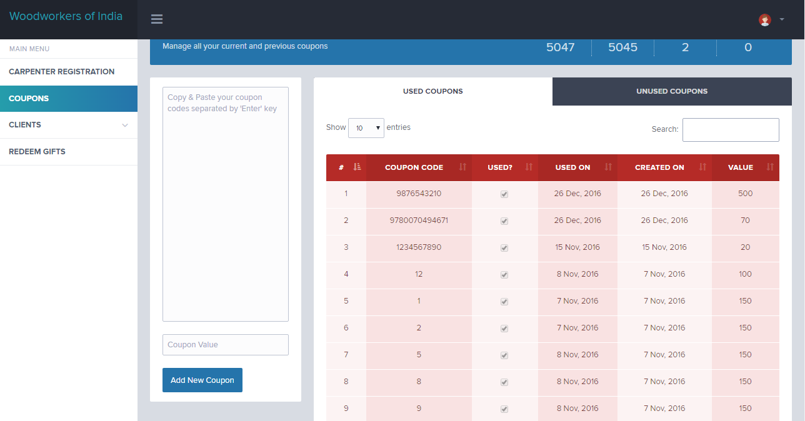
Generate coupon code

Slide 16


