Slide 1

Java - I
Final Project :
Team Members :
Brahm Aggarwal
Sahar Aghbabaei
Manu Anmol
Bhupinder Kaur
Martha Merry
Automated Teller Machine

Slide 2
Table of Contents
Introduction
Objective and Scope
Case Tools, Libraries Used
Software Development Life Cycle
OOPS
ACTORS
Implementation : DEMO

Slide 3


Intro
The program will control a simulated automated teller machine (ATM)
Banking is one of the many salient aspects of an individual life. The major objective of this project is to develop a banking/atm machine software which simplifies the banking solutions for clients and businesses. Java programming language is the main fundamental building block of this web application.

Slide 4
Objective :
To make the bank transaction in the most efficient manner
To enable more people, have access to ATM banking facility.
To encourage the transition to cashless society.
o Reduce the risk involved in carrying huge sum of money about by making
deposit in ATM.
People can save and withdraw the money at any time by themselves and reduce staff work through ATM banking.

Slide 5
Scope :
The program enables customers to complete simple bank account services via automated teller
machine (ATMs) that may be located off premise and that need not be owned and operated by the customer’s bank. The ATM identifies a customer by a account number and PIN. It collects information about a simple account transaction (e.g., deposit,
withdrawal, transfer, bill payment), communicates the transaction information to the customer’s bank, and dispenses cash to the customer.
The bank provides their own software for their own computers.

Slide 6
Case Tools
• Java Eclipse IDE
Classes Used from In-Built Library :
• FileNotFoundException
• Formatter
• FormatterClosedException
• InputMismatchException
• Scanner
• io.File

Slide 7
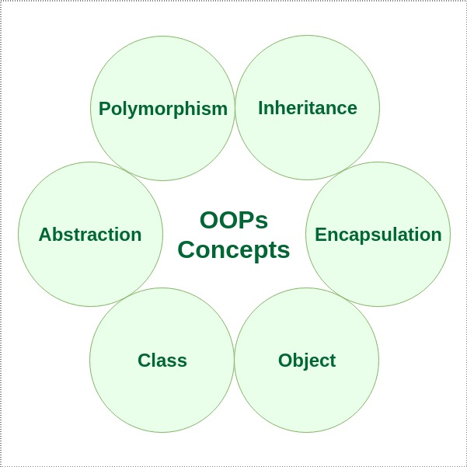

Slide 8
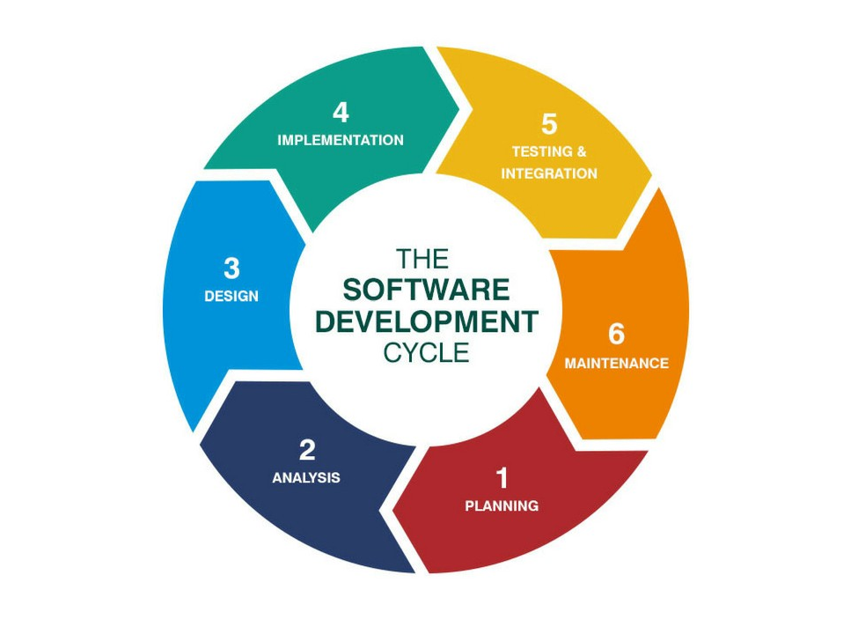

Slide 9
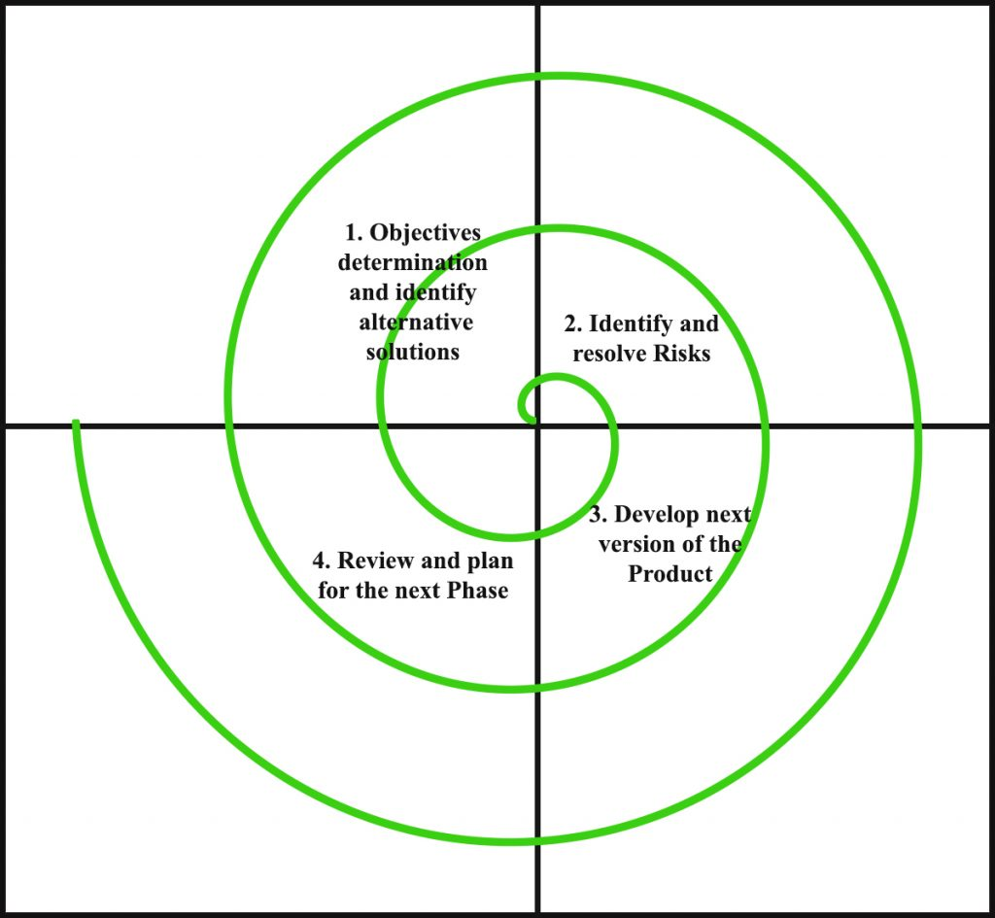
Model Used:
Spiral

Slide 10
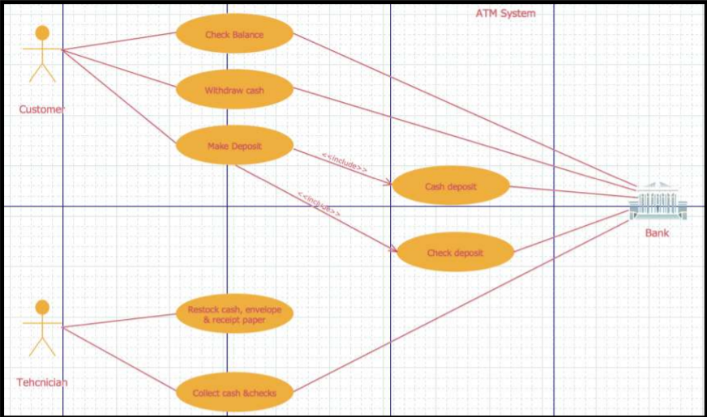
Actors :

Slide 11
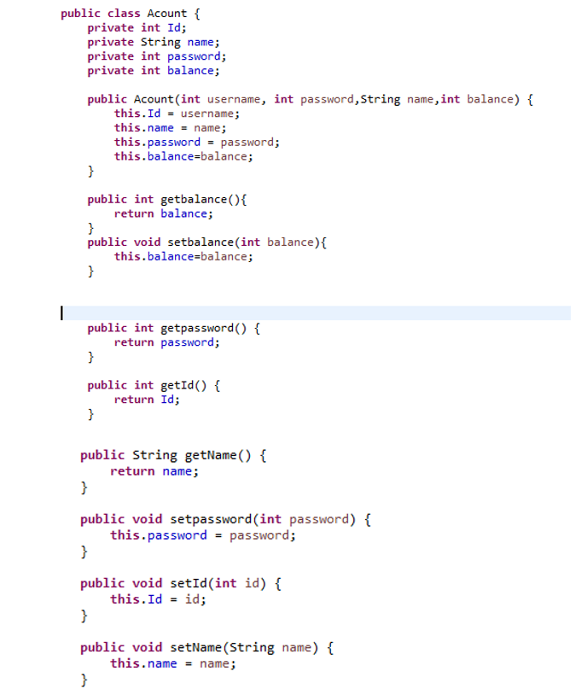
Implementation :
Account Class:
Account class consists of the variables that define a particular individual account; Id, Name, Password and Balance. These variables are private and cannot be accessed outside the class, in order to access the outside the class Getter and Setter methods have been defined.

Slide 12
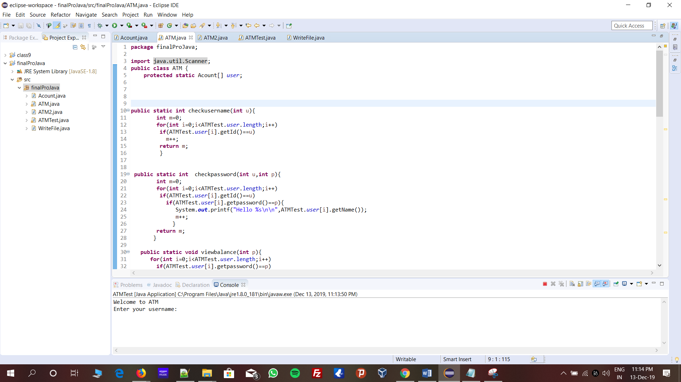
Implementation :
2.ATM Class :
This class includes definition and implementation of all the banking transaction which includes checking if the username is correct, checking if the password entered by the user matches to the respective username, option for viewing balance, option for cash transfer to another bank account (another object), option to withdraw the money from the account and update the account with new balance and option to deposit the money from the account and update the account with new balance.

Slide 13
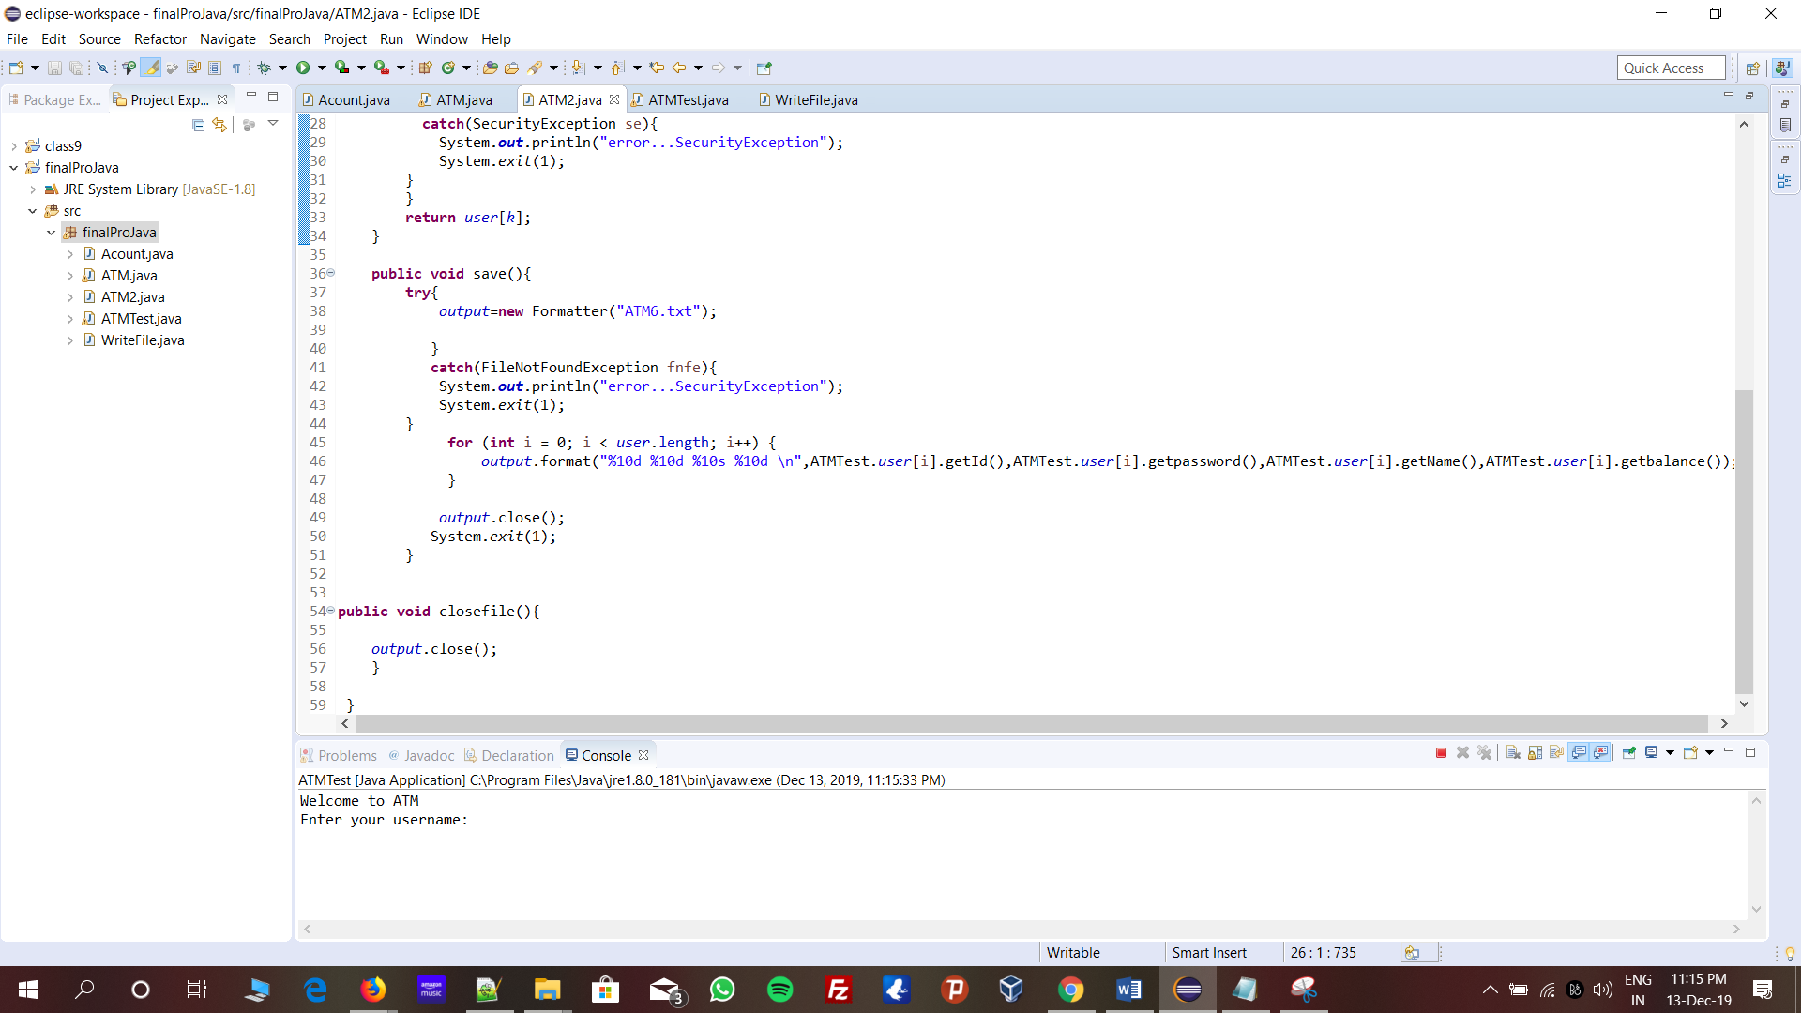
Implementation :
3. ATM2 Class:
This class is responsible for reading and displaying the information of a user present in the text file, it is also responsible for saving the changes made to the file. There is a possibility of Security Exception being throwed in the ‘Account read’ method which has been handled using the try and catch keywords in the method

Slide 14
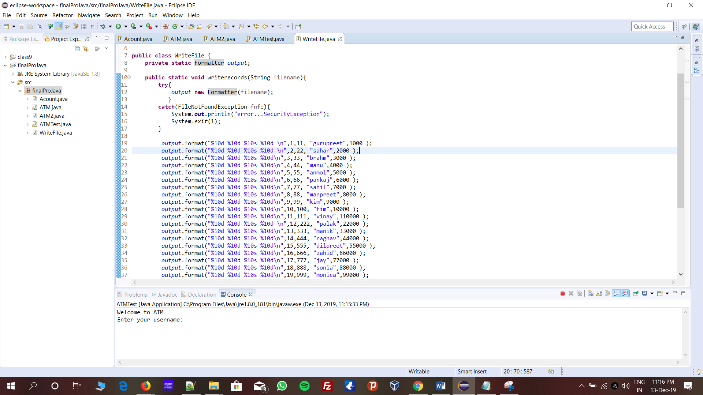
Implementation :
4. WriteFile Class :
This class is responsible for writing the account details of every person into the text file ‘ATM6.txt’ and closing the file after the write operation.

Slide 15
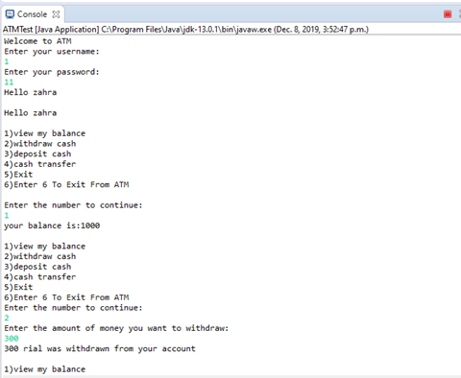
DEMO :
5. ATMTest Class :
This is class where all the methods are being called and tested. This is the final representation of the software system and displays the functionality of the software. Moreover, there is an exception which arises known as ‘InputMismatchException’ this exception occurs whenever the user tries to input a datatype which differs from the original datatype of the variable. This exception has been handled using ‘try and catch’.

Slide 16
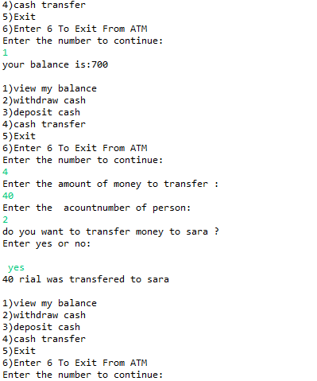
DEMO :
5. ATMTest Class :
This is class where all the methods are being called and tested. This is the final representation of the software system and displays the functionality of the software. Moreover, there is an exception which arises known as ‘InputMismatchException’ this exception occurs whenever the user tries to input a datatype which differs from the original datatype of the variable. This exception has been handled using ‘try and catch’.

Slide 17

Thank you.
References :
https://docs.oracle.com/javase/tutorial/java.html

