Slide 1

Interview
Entrevoir ( French)
to have a glimpse of
Notes:
Self explanatory

Slide 2

7 MOST IMPORTANT SOFT SKILLS WHICH CORPORATES LOOK FOR
Interpersonal skills
Team Spirit
Social Grace
Business etiquette
Negotiation skills
Behavioural traits such as attitude, motivation & time management
Knowledge and skills for the position applied

Slide 3
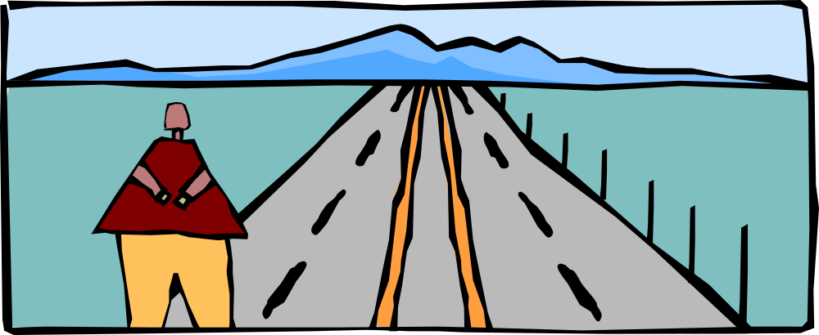
Interviewing is a two-way street
Employers are attempting to determine if you are an appropriate fit for the job and their culture
You decide if the environment is right for you.

Slide 4
Preparatory phase
Presentability
Do Your Homework
Attitude
Be Short and Focused
Eye Contact
Simple Questions
Attentive Listening
Maintain the three C's during the interview: be Cool, Calm and Confident
Exhibit confidence and energy
Be realistic in responses
Notes:
Talk about building brand.
A great place to work for top professionals

Slide 5
Facing Interviews
Introduce yourself. Or tell us about your self. Or Can I know about your professional and personal self?
What do you want to be doing in 2/5/10 years time?
Or:
Where do you want to be in 2/5/10 years time?
Notes:
Talk about building brand.
A great place to work for top professionals

Slide 6
Facing Interviews
Give an example of :
When you had to settle a dispute between two individuals
What is your ideal job?

Slide 7
Facing Interviews
Why do you want this job?
What are your strengths?
What are your weaknesses ?
What would your references say about you?

Slide 8
Facing Interviews
How do you handle tension/stress?
Tell me about a big challenge or difficulty you've faced; how did you deal with it?
What type of people do you get on with most/least?

Slide 9
Facing Interviews
How do you plan and organize your work?
How do you like to be managed /not like to be managed?
Any team work your effort has led to success.
What personal goals do you have and how are you going about achieving them?

Slide 10
Facing Interviews
Why should we appoint you?
What can you do for us that other people cannot?
What makes you mad?

Slide 11
What should you ask
About the company
What is expected the position for which they are hiring.
What is the career path
What is the company culture

Slide 12
Why is Body language important
Out of what we communicate –
4% - is what we express by speech
38% - is on tone, speed of words that we utter
58% - body language

Slide 13
This reveals the unsaid words
Positive Signals
Leaning forward = interest
Smiling = friendly
Nodding = attentive and alert
Eye contact = curious and focused
Negative Signals
Crossed arms = defensive
Fidgeting hands or tapping feet = nervous or bored
Lack of eye contact = untrustworthy
Leaning back= discomfort

Slide 14
General Interview Strategies
Be prepared to talk about yourself and your experiences
-Master the art of storytelling
-Provide specific and concrete examples of your results/accomplishments
-Remain positive, enthusiastic, poised, and confident throughout the interview process

Slide 15
General Interview Strategies
Remember an interview is a formal conversation--avoid filler words like “Um”, “Ah”, & “You know”
Avoid indecisive phrases like: “I think,” “I guess,” “probably,” or “pretty good”
Think before speaking
Avoid long verbose answers--limit your response to 1-2 minutes
If you do not hear or understand a question, ask them to repeat or clarify it for you

Slide 16

General Interview Strategies
Remain calm, relaxed, and be yourself
Try to focus on the message you are trying to convey--NOT how well you are doing!

Slide 17
Final Thoughts- Suggestions
Remember that only 15% of the success of an interview is out of your control
Conduct a test run the day before the interview
Practice! Practice! Practice!
•Obtain a list of practice interview questions and jot down short answers
• Stand in front of a mirror and rehearse your answers
•Schedule an appointment for a mock interview with Career Services
Get a good night’s sleep-be well rested and alert for the interview
Be relaxed and be yourself!

Slide 18
Questions ??

Slide 19
Answering questions
Notes:
Talk about building brand.
A great place to work for top professionals

