Slide 1
Dynamic Programming

Slide 2
Maximum Sum Sub-Array
Given an array
31 | -41 | 59 | 26 | -53 | 58 | 97 | -93 | -23 | 84
Each sub-array has a sum. What is the maximum such sum possible.
Maximum Sum for any sub Array ending at i^{th} location
31
0
59
85
32
90
187
94
71
155
Maximum so far
31
31
59
85
85
90
187
187
187
187

Slide 3
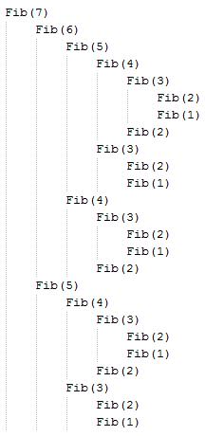
Fibonacci Sequence
Execution Trace:
F_{n} = F_{n-1} + F_{n-1}
F₁ = 1
F₂ = 1
Naïve Recursive Function
int Fib(int n){
if(n==1 || n==2)
return 1;
return Fib(n-1)+Fib(n-2);
}
1,1,2,3,5,8,13,21,34,55,89,…

Slide 4
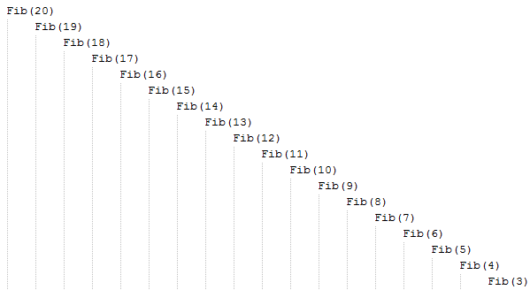
Fibonacci Sequence (Doing it Cleverly)
int fib[100];
memset(fib,0,sizeof(fib));
fib[1]=fib[2]=1;
int Fib(int n){
int x,y;
if(n==1 || n==2)
return 1;
if(fib[n-1])
x = fib[n-1];
else
x = fib[n-1] = Fib(n-1);
if(fib[n-2])
y = fib[n-2];
else
y = fib[n-2] = Fib(n-2);
return x+y;
}
What would you do if you were to compute
all the fibonacci numbers between 1 and n?

Slide 5
Longest Non Decreasing Subsequence
Given an array
1 | 2 | 5 | 2 | 8 | 6 | 3 | 6 | 9 | 7
Find a subsequence which is non decreasing and of maximum length
1-5-8-9 Forms a non decreasing subsequence
So does 1-2-2-6-6-7 but it is longer
Our aim is to find the longest such subsequence

Slide 6
Longest Non Decreasing Subsequence
1 | 2 | 5 | 2 | 8 | 6 | 3 | 6 | 9 | 7
Length of LNDS ending at i^{th} Loc
1
2
3
3
4
4
4
5
6
6
for(i=0;i<100;i++){
max= 0;
for(j=0;j<i;j++){
if(A[i] >= A[j] && L[j] > max)
max = L[j];
}
L[i] = max+1;
}

Slide 7
Longest Common Subsequence
A | B | C | B | D | A | B
B | D | C | A | B | A
Find a string such that it is a subsequence in both of the arrays
and its length is longest
CAB is a subsequence of both the arrays
BDAB is also a subsequence of both the arrays, but is longer

Slide 8
Practice Problems
http://www.spoj.pl/problems/COINS/
http://www.spoj.pl/problems/AIBOHP/
http://www.spoj.pl/problems/IOIPALIN/
http://www.spoj.pl/problems/ADFRUITS/
http://www.spoj.pl/problems/NY10E/
http://www.spoj.pl/problems/EDIST/
http://www.spoj.pl/problems/RENT/
http://www.spoj.pl/problems/BABTWR/

