Slide 1

Dynamic Programming - II

Slide 2
Integer Knapsack Problem
http://en.wikipedia.org/wiki/Knapsack_problem

Slide 3
Subset Sum Problem
Given a set of n numbers ai sum up to M, and any K ≤ M, whether there is a subset of the numbers such that they sum up to (hit) K??

Slide 4
Solution Subset Sum problem
1 int m[M+10];
2 for(i=0; i<M+10; i++)
3 m[i]=0;
4 m[0]=1;
5 for(i=0; i<n; i++)
6 for(j=M; j>=a[i]; j--)
7 m[j] |= m[j-a[i]];

Slide 5
Variants of subset sum
Subset sum with multiple supplies: Each ai can be used as many times as you like in the sum, are we going to hit K?
Coin change: Now think ai’s are coins, you want to make an exact change of K. Maybe there are multiple ways you can do this, then you want to minimize (or maximize) the number of coins you use.

Slide 6
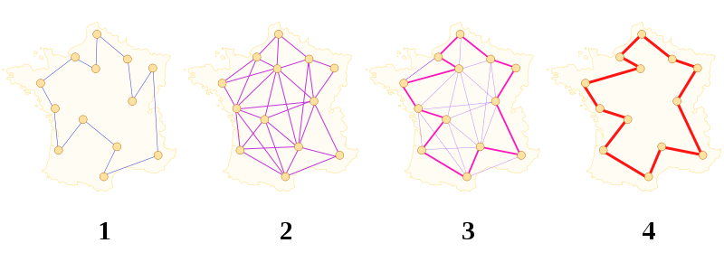
Travelling salesman problem
Given a weighted graph G = (V, E) , find a tour of minimum weight passing through all the vertices.

Slide 7
Some Bitwise Tricks
We can Represent a set of ‘n’ elements as an ‘n’ bit number.
Check if element ‘I’ is present in set ‘n’
  N & (1<<I) = 0 if I is not present in N
  = 1 otherwise
Find the resulting set when we add ‘I’ to set ‘n’
New set = (N | (1<<I))
Iterating through all the subsets of size <= ‘n’
for(i=0;i<(1<<n);i++)

Slide 9
Solution to TSP
Naïve Algorithm: O(n!)
Can we do any better??
There is anO((n^2)*(2^n)) DP solution.
Sketch:-
Pick a vertex as home vertex ‘h’.
Compute f(s,w) – tour of minimum size which starts at ‘h’ and ends at w and covers vertices from set ‘s’.
Initialize f({v}, v} = w(h,v) for all (h,v) in E
f(s, v) = min {f(s-{v},w)+w(v,w)} w in ‘s’ , and (v,w) in E

Slide 10
Practice problems
http://code.google.com/codejam/contest/dashboard?c=90101#s=p2
http://community.topcoder.com/stat?c=problem_statement&pm=11511&rd=14545
http://pclub.in/index.php/wpc-archives/16-kodefest-solutions/86-problem-d
http://www.codechef.com/MARCH10/problems/N1
http://www.spoj.pl/problems/MINUS/

Slide 11
Practice problems continued…
http://www.spoj.pl/problems/MIXTURES/
http://www.spoj.pl/problems/PIGBANK/
http://www.spoj.pl/problems/GNYR09F/
http://www.spoj.pl/problems/THREECOL/
http://www.spoj.pl/problems/SCUBADIV/
DP Problems list – http://apps.topcoder.com/forums/;jsessionid=D8D13FEF20BC2CEA4BE0F93BA57FE142?module=Thread&threadID=674592&messageID=1237516&mc=7&view=tree#1237516

Slide 12
Topcoder tutorial on DP: http://community.topcoder.com/tc?module=Static&d1=tutorials&d2=dynProg
http://en.wikipedia.org/wiki/Computing_the_permanent

