Slide 1
Segment Trees

Slide 2
Longest Non Decreasing Subsequence (Revisited)
1 | 2 | 5 | 2 | 8 | 6 | 3 | 6 | 9 | 7
Length of LNDS ending at i^{th} Loc
1
2
3
3
4
4
4
5
6
6
This runs in O(n²). Can we do better?
Challenge: Given a value of a[i] we need to find the maximum length possible among
all subsequences ending at any value less than equal to a[i] quickly.
Possible with small change in algorithm and usage of STL, refer to the link
http://www.algorithmist.com/index.php/Longest_Increasing_Subsequence
We will look at another way of doing it in a restricted setting when all elements
in the initial array are not really large say bounded by 1e6.

Slide 3
Find the Max value among the first i elements of an array
3 | 4 | 1 | 7 | 13 | 5 | 21 | 6 | 23 | 16
Naïve Approach: Just scan till the ith index and output the maximum.
Cost of operations:
Finding maximum O(1) Updating an element in initial array O(n)
Another Approach: Maintain another array,
each index storing the maximum value up to that index.
3 | 4 | 4 | 7 | 13 | 13 | 21 | 21 | 23 | 23
Cost of operations:
Finding maximum O(1) Updating an element in initial array O(n)
This works well if the number of query operations are large and very few updates
If the number of query and updates are equal
then it is as good/bad as a naïve way of doing it.
Can we perform both the operations in O(log n) time once given the array

Slide 4
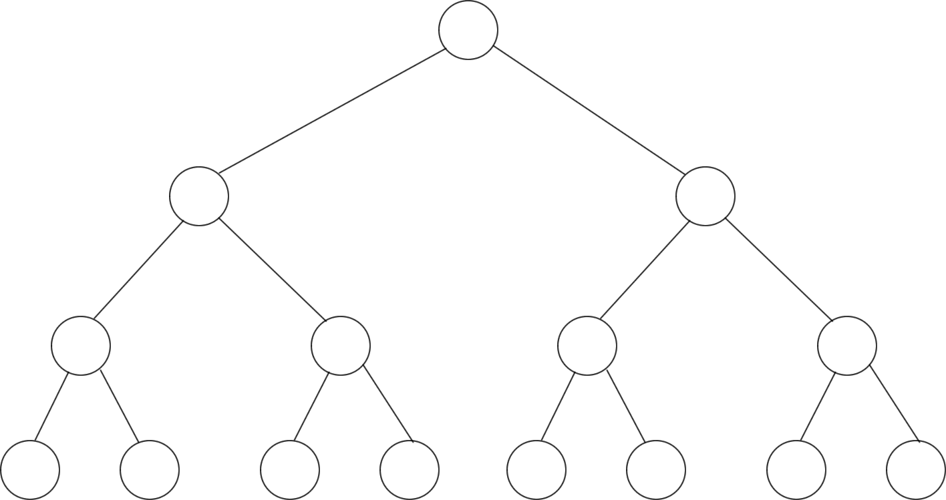
A Basic Segment Tree
9
7
13
5
9
10
16
5
7
9
6
10
13
16
11
Leaf Nodes are the elements in the array.
Each internal node represents some merging of the leaf nodes
Fill each node with the maximum value in the left sub array.

Slide 5
Querying
Start at leaf
Max: 1
Coming from Right Val > Max
Max: 3
Coming from Right Val > Max
Max: 13
Coming from Right Val < Max
Max: 13
9
Start at leaf
Max: 9
Coming from left No Action
Max: 9
Coming from Right Val < Max
Max: 9
Coming from left No Action
Max: 9
7
13
5
9
10
3
5
7
9
6
10
13
3
1
To find the maximum value stored up to the i^{th} index do the following
Start at the i^{th} leaf with max set to the value in the leaf, keep traversing till the root.
If you had reached the parent from the left child don’t take any action
otherwise if the max value in the left sub-tree is greater than max update max

Slide 6
Updating an element in an array and precomputing – Just the reverse of querying.
For each operation we need to travel till the root of the tree.
Height of tree is bounded by O(log n) hence each operation can be done in O(log n)
If the query range is from i^{th} index to the end of the array just do the reverse of what we had done
What if the query range is any segment in between the array?
Update the i^{th} leaf keep with value ‘v’ traversing till the root.
If you had reached the parent from the right child don’t take any action
otherwise if the value in the node is less than ‘v’ update it with ‘v’

Slide 7
Segment Tree
Start Here Recursively
query on both sub-trees they return
Max value in the range l to r in them
Compare both and
hence maximum value is 16
16
Returns 9
Returns 16
Within range
Return max (13) in this sub-tree
9
16
Out of range
Return 0
Within range
Return max (9) in this sub-tree
Returns max(16,0)
7
9
13
16
5
7
9
6
10
13
16
11
Returns 16
Returns 0
Leaf Nodes are the elements in the array.
Each internal node stores maximum value among all its children.

Slide 8
Querying
Query(root,l,r)
How to represent the tree
How to check if the range is between left and right
I think it will be pretty tough to code this
It is very simple to code a segment tree
Demo
query(node,l,r){
if range of node is within l and r
return value in node
else
return max(query(left-child,l,r),query(right-child,l,r))
}
range of node is the [left most leaf,right most leaf] in the sub-tree rooted at node.

Slide 9

Representation of the tree
Number each node in the tree level by level
Observe that for each node the left child is 2*i and right child is 2*i+1
For each node the parent is i/2
Just use an array to represent the tree, operate on indices to access parents and children
For ease of access ignore the 0-indexed element in the array
1
2
3
4
5
6
7
8
9
10
11
12
13
14
15

Slide 10
Updates as well as queries on intervals (On Board)
Read http://translate.googleusercontent.com/translate_c?act=url&hl=en&ie=UTF8&prev=_t&rurl=translate.google.com&sl=auto&tl=en&twu=1&u=http://e-maxx.ru/algo/segment_tree&usg=ALkJrhgDDakTy9AeCVpP7dGwJoPxR--qSw before attempting any of the problems
Read about Binary indexed trees http://community.topcoder.com/tc?module=Static&d1=tutorials&d2=binaryIndexedTrees

Slide 11
Practice Problems
http://www.spoj.pl/problems/GSS1/
http://www.spoj.pl/problems/GSS3/
http://pclub.in/index.php/wpc-archives/16-kodefest-solutions/89-problem-g
http://www.spoj.pl/problems/HORRIBLE/
http://www.spoj.pl/problems/TEMPLEQ/
http://www.codechef.com/problems/FLIPCOIN/
http://www.codechef.com/problems/MULTQ3

