Slide 1
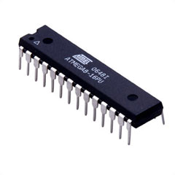
Advanced Features of Atmega8 Microcontroller

Slide 2
TOPICS TO BE COVERED
Timers/counters
ADC

Slide 3
TIMERS/COUNTERS

Slide 4
WHAT ARE TIMERS?
Timer counts the time sequence or the clock pulses of the microcontroller.
They are set of registers integrated in most of the microcontroller.

Slide 5
Number of Timers in Atmega8
There are three timers/Counters in Atmega8
Timer 0 Timer 1 Timer 2

Slide 6
Number of Timers in Atmega8
There are three timers/Counters in Atmega8
Timer 0 Timer 1 Timer 2
8-bit 16-bit 8-bit

Slide 7

Registers of Timers/Counters
There are four registers to control the operation & data storage.
TCNT_{x}= Timer Counter Register
TCCR_{x}= Timer/Counter Control Register
TIMSK= Timer Interrupt Mask Register
TIFR= Timer Interrupt Flag Register

Slide 8
TIMER/COUNTER 0 REGISTER

Slide 9
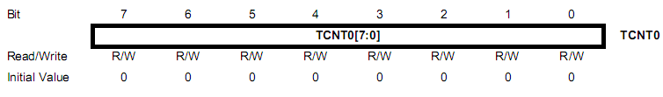
TCNT_{x}
This magical 8 bit register increases its own value with a fix rate. This register don’t require CPU to increase its value. TCNTx keeps the count value from 0-255, it must be initialized in program code. When the count value reaches maximum, it raises a interrupt bit in another register and reset to 0 on overflow

Slide 10
Timer Frequency and Prescaling
Timer frequency is the rate by which TCNT_{x} register increases its own value.
A prescalar measures an output clock/ time related to an input clock/time by a fractional scale factor.
Notes:
A scalar that extends the upper frequency limit of a counter by dividing the input frequency by a precise amount, generally 10 or 100 Read more: http://www.answers.com/topic/prescaler#ixzz1LZU5xX4A

Slide 11
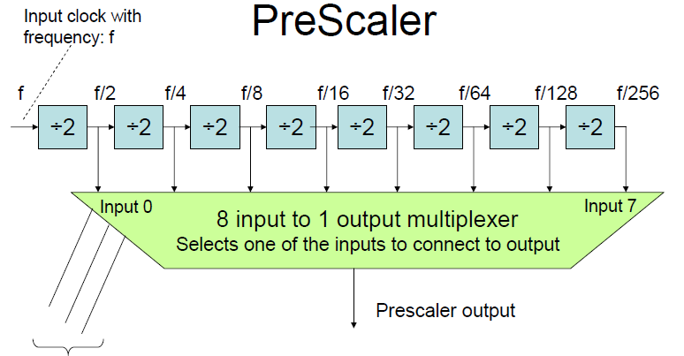
CS0, CS1. CS2: Prescalar select inputs.
Notes:
If prescalar is disabled, input(f) is directly connected to the counter.

Slide 12
TIMER/COUNTER CONTROL REGISTER
The timer control register controls Timer Frequency, this is achieved by setting the prescalar value.
CS00-CS02 are used to select PRESCALER value and hence determines the frequency of the timer.

Slide 13
PRESCALAR
TIMER FREQUENCY =CPU CLOCK FREQUENCY / PRESCALER

Slide 14
Calculate TCNT0 Value
TIMER FREQUENCY =CPU CLOCK FREQUENCY / PRESCALER
Timer 0 is a 8bit Timer ,so max value of TCNT0 256
TCNT0 = 255 – ( Timer FREQ * Req. Time Delay)
E1 : No Prescaling = 1 , CPU Freq. = 1MHZ ,Req. Time Delay = 100us
Timer Freq. = 1*10^6(Hz)/1( prescaler)
= 1MHZ
TCNT0 value= 255 –( 1*10^6*(100us*10^ -6)sec)
= 255 - 100 = 155+1(Extra clock)

Slide 15
TIMER INTERRUPT MASK REGISTER
Bit 0 or TOIE0 bit of TIMSK is used to enable/disable overflow interrupt of TIMER0.
Storing 1 at this place will Enable the overflow interrupt of TIMER0.
Storing 0 at this place will Disable the overflow interrupt of TIMER0.
Other bits are used for other timers.

Slide 16
OVERFLOW MODE
Once the timer reaches it highest counts and if it not resets it is said to be in Overflow Mode.
For this mode we have to set 3 registers
TCNT0 (To initialize counter)
TCCR0 (To set Prescalar)
TIMSK (To enable overflow interrupt)
Notes:
Bit 7 - OCF2: Timer/Counter2 Output Compare Flag
The OCF2 bit is set after the count TCNT2 the value of the output compare register (OCR2) is achieved. A forced output compare (FOC1A) sets the flag OCF1A not. The bit is automatically cleared when the corresponding interrupt routine is executed.Alternately, the flag will be deleted, in which one logical "1" written in the flag. Bit 6 - TOV2: Timer/Counter2 Overflow Flag
This flag is set when an overflow occurs in Timer/Counter2. The bit is automatically cleared when the corresponding interrupt routine is executed.Alternatively, the flag will be deleted, in which one is a logic "1" written in the flag. In PWM mode, the bit is set if Timer/Counter2 reverses its count direction at 00h.
Bit 1 - Res: Reserved Bit
This bit is reserved and is always read as 0. Bit 0 - TOV0: Timer/Counter0 Overflow Flag
The TOV0 bit is set when an overflow occurs in Timer/Counter0. The bit is automatically cleared when the corresponding interrupt routine is executed.Alternatively, the flag will be deleted, in which one is a logic "1" written in the flag. The interrupt is executed if the I-bit in SREG are set and the bit in TOIE0 TIMSK TOV0 and the flag is set by the overflow.

Slide 17
Program for creating 1 sec delay using OVERFLOW mode
#include<avr/io.h>
#include<avr/interrupt.h>
volatile uint8_t count;
main()
{
int second=0;
char buffer[10];
TCCR0=0b00000011; //to set the prescalar to64
TIMSK |=(1<<TOIE0); //for enabling overflow interrupt
TCNT0=0; //for initialization of Timer count

Slide 18
Contd…
count=0;
sei(); //Enable Global Interrupt
while(1);
} //main close
ISR(TIMER0_OVF_vect) // interrupt service routine
{
if(count==61) // if count reaches 1 sec
{
second++;
sprintf(“seconds:%d”, second);
lcd_puts(buffer); // for printing seconds on LCD
count=0; // reset the count variable
}
else
count++;
} //ISR function close

Slide 19
Description of program
if(count==61) // if count reaches 1 sec
61 is decided by clock frequency and the prescalar.
Formula for calculating number of interrupts for 1 second time duration is :
Timer frequency= CPU clock frequency/Prescalar
No of overflow interrupts= Timer frequency/256
In our case:
Timer frequency=1000000/64= 15625
No of interrupts=15625/256 = 61.035≈ 61

Slide 20
THANK YOU

