Slide 1

SILVER OAK COLLEGE OF ENGINEERING & TECHNOLOGY
DEPARTMENT OF COMPUTER ENGINEERING
Smart Campus
(Smart Attendance System)
Group Members
Patel Dhruv Amitbhai
Patel Dhruv Balvantbhai
Patel Harsh
Patel Hemraj
Patel Megh
Internal Faculty Guide
Rashmi Hirani

Slide 2
Table of content
SR NO. | TITLE
 | ABSTRACT
1 | INTRODUCTION
2 | OVERVIEW
3 | THE PROPOSED SYSTEM
 | Block Diagram
 | Face Detection
 | Face Recognition
4 | CHARACTERISTICS OF PROPOSED SYSTEM
5 | REQUIREMENTS
6 | CONCLUSION
7 | REFERENCES

Slide 3
Abstract
Smart Attendance Management System (SAMS) is an application developed for daily student attendance in colleges or schools. This project attempts to record attendance through face detection. The aim of the project is to create software for attendance management system that is totally automated. There will be capturing device which will capture each and every student face when they enter class. The algorithm used to detect face is Voila Jones. The software used to detect faces from image is MATLAB. Histogram of Oriented Gradients (HOG) is used as recognition feature and for classification the algorithm used is Error Correcting Output Coding (ECOC) which uses Support Vector Machine as a binary classifier. The administrator maintains the database. Before end of the lecture, attendance is uploaded to the system and faculty can check, edit and generate a list of defaulters.

Slide 4
Introduction
Attendance is defined as the action or state of going regularly to or being present at a place or event. Attendance of every student is being maintained by schools and colleges. The manual attendance record system is inefficient and more time is required to record as well as calculate the attendance of each student. Hence a system is needed which will solve the issue of manual attendance. While we move towards the digital era, is being accelerated every hour, biometrics technologies have started affecting people’s daily life at each and every instance. Biometrics technologies uses characteristics such as fingerprints, faces recognition, retinal patterns, palm prints, voice, hand written signatures, and so on for authentication. The biometric personal authentication uses data taken from measurements. Such data is unique to the individual and remains so throughout one’s life. It is important to identify the correct tools to use in commercial and scientific studies. Barcode readers, Radio Frequency Identification (RFID) system, Bluetooth and NFC (Near Field Communication) are just a few of the examples of such tools. However, they are expensive and therefore they had limited use. Hence a system which does not require a special infrastructure is developed using Biometric Facial Detection and Recognition system – SAMS.

Slide 5
Overview
Existing System
The existing system largely consists of physical register where the supervisor manually inputs the attendance record of all students. Other technologies which have been developed to replace this manual system include fingerprint, retina scan, voice recognition etc. The problem with existing system is that the manual system is time consuming and the advanced technologies are too expensive to be implemented on a large scale in any organization.

Slide 6
Proposed System
The following system eliminates the tedious task of manually maintaining the attendance records by automating it. The administrator fills up the details of the teachers and students at the start of the semester. Class list is generated automatically. These details can be used for further semesters with little changes.
SAMS allows easy attendance management using the Face Detection, which is one of the most acceptable techniques. One live capturing device which continuously capture photos of faces it detects, needs to be installed at certain place from where all students pass (i.e. Door) which oversees all students, gets online before 5 mins of class begin and stays active for 15 mins. After that, capturing device gets offline. So whoever comes late more then 10 mins of lecture time, gets absent.

Slide 7
Proposed System Cont.
Device then forward all captured images to MATLAB. MATLAB software, which sorts all faces of students and detects it in its database which contain images of all the students and their personal details. These images are then compared with the images of student stored in the database using face recognition algorithm and record of attendance gets maintained.
The MATLAB is accessible to faculty with credential. But, what if only half face of a particular student is seen or his face is not clear in the original image. The faculty can manually mark the attendance as well as sort problem in detection or capturing image of those students by assessing MATLAB with credentials. It keeps record of video for month and image for 5 days. This is how record of attendance is kept in our system.

Slide 8
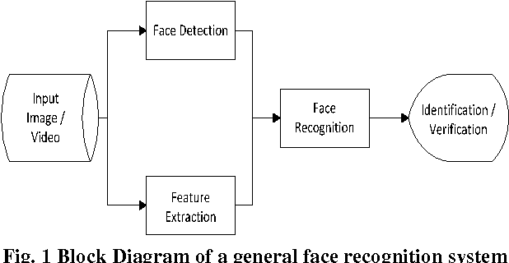
Proposed System Cont.
Block Diagram

Slide 9
Proposed System Cont. Face Detection
The Viola Jones object detection framework is used to detect faces in the image. The main characteristics of Viola–Jones algorithm which makes it a good detection algorithm are:
Robust
Real-Time
Face detection but not Recognition.
The algorithm has mainly four main stages:
Haar feature Selection.
Creating internal image.
Adaboost training algorithm.
Cascading classifier.

Slide 10
Proposed System Cont. Face Recognition
Histogram of Oriented Gradients (HOG), is a feature descriptor. It is used in computer vision and image processing for the purpose of object detection. The technique counts occurrences of gradient orientation in the localized portion of an image. It is better than any edge descriptor as it uses magnitude as well as angle of the gradient to compute the features.

Slide 11
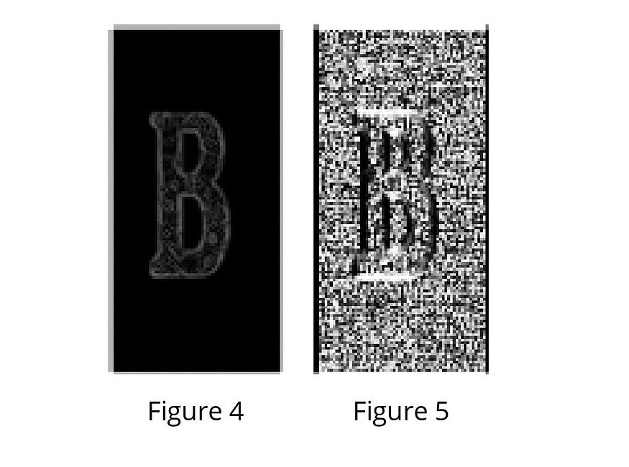
Proposed System Cont. How HOG Works
Take the input image you want to calculate HOG features of.
The gradient of the image is calculated. The gradient is obtained by combining magnitude and angle from the image.
Figure 4 : Visualization of magnitude of the image.
Figure 5 : Visualization of angle of the image.

Slide 12
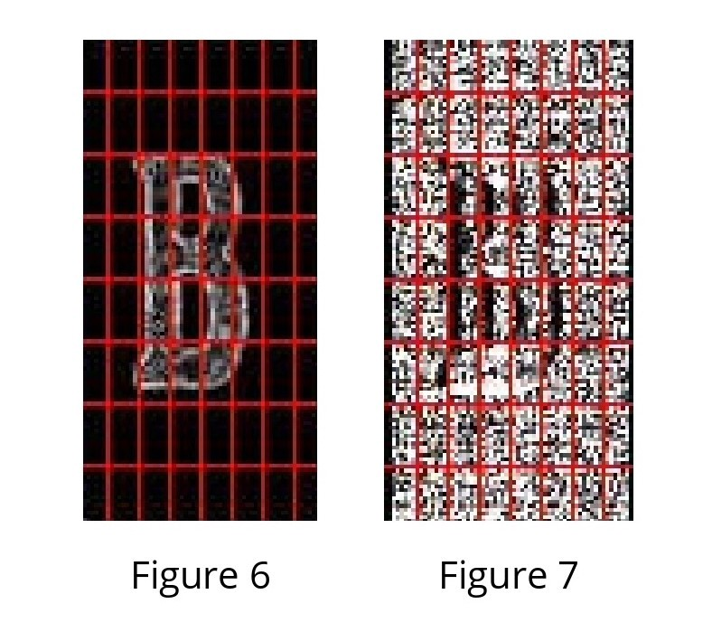
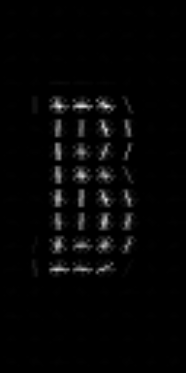
Proposed System Cont. How HOG Works cont.
After obtaining the gradient of each pixel, the gradient matrices are divided into 8x8 cells to form a block. (Figure 6 & 7)
HOG features of the selected image are obtained. (Last Figure)

Slide 13
Proposed System Cont. Error Correction Output Coding (ECOC)
Error-Correcting Output Coding (ECOC) is an ensemble method designed for multi-class classification problem. In multi-class classification problem, the task is the decision of one label from k > 2 possible choices. For example, in digit recognition task, we need to map each hand written digit to one of k= 10classes. Some algorithms, such as decision tree, naive bayes and neural network, can handle multi class problem directly. ECOC is a meta method which combines many binary classifiers in order to solve the multiclass problem. It uses the SVM (Support Vector Machine) binary classifier.

Slide 14
Proposed System Cont. ECOC cont.
In machine learning, SVM are supervised learning models with associated learning algorithms that analyse data and recognize patterns, used for classification and regression analysis.
An SVM model is a representation of the examples as points in space, mapped so that the examples of the separate categories are divided by a clear gap that is as wide as possible.
It is basically used for Face recognition classifier.

Slide 15
Characteristics of proposed system
Automation
Reports are generated easily
Fast and time efficient
Less work done by faculty
Broad access network
Virtual technology

Slide 16
Requirements
Software
Hardware
Operating System - Windows XP or higher
Programming language – MATLAB
Development Kit used – MATLAB R2014b
Any device capable of capturing live video and image.

Slide 17
Conclusion
This project demonstrates real time attendance marking and management. It will help in many ways. We are successfully starting work on it. It wont only help faculty to take attendance but also check total attendance of students.
SAMS can be improved by adding more images and variable poses of the students to make recognition full proof. The Web based architecture can be utilized further by maintaining the databases on a remote server.

Slide 18
Reference
Books
Face verification using error correcting output codes. In: Computer Vision and Pattern Recognition (CVPR01), IEEE Press. pp. 755- 760.
Navneet Dalal and Bill Triggs: Histograms of oriented gradients for human detection. In: IEEE Computer Society Conference on Computer Vision and Pattern Recognition (CVPR). pp. 886–893. (2005)
Viola, Jones: Robust Real-time Object Detection, IJCV 2001
Nirmalya Kar and Ashim Saha; Study of implementing automated attendance system using face recognition technique
Websites
Http://www.xiphiastec.com/
https://towardsdatascience.com/hog-histogram-of-oriented-gradients-67ecd887675f

Slide 19
Thank You..! Any Questions?

