Slide 1
Implementing
Doubly Linked Lists
In Haskell
Brian Hurt

Slide 2
Slides:
https://github.com/bhurt/presentations/dllist.odp

Slide 3
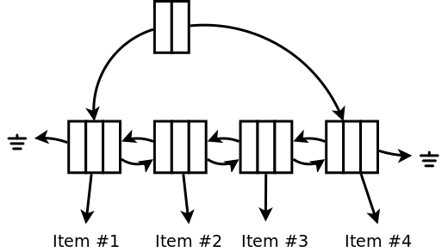
Doubly Linked Lists

Slide 4
Advantages of Doubly Linked Lists
It's a sequence-like thing (list/array/etc.)
Fast add/get/remove first and last elements.
Fast concat
Can walk the sequence
  And add/remove elements in the middle

Slide 5


Slide 6
data Dlist a = Dlist {
dlistHead :: IORef (Maybe (DlistElem a)),
dlistTail :: IORef (Maybe (DlistElem a))
}
data DlistElem a = DlistElem {
prev :: IORef (Maybe (DlistElem a)),
datum :: a,
next :: IORef (Maybe (DlistElem a))
}

Slide 7
makeDlist :: IO (Dlist a)
makeDlist = ...
append :: Dlist a -> a -> IO ()
append = ...
prepend :: a -> Dlist a -> IO ()
prepend = ...
getFirst :: Dlist a -> IO (Maybe a)
getFirst = ...
getLast :: Dlist a -> IO (Maybe a)
getLast = ...

Slide 8
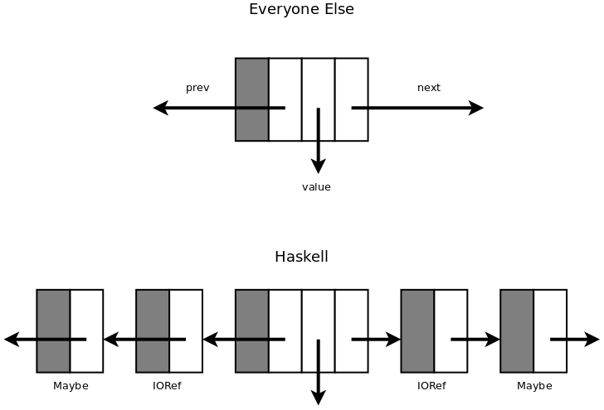

Slide 9
makeDlist :: IO (Dlist a)
makeDlist = ...
append :: Dlist a -> a -> IO ()
append = ...
prepend :: a -> Dlist a -> IO ()
prepend = ...
getFirst :: Dlist a -> IO (Maybe a)
getFirst = ...
getLast :: Dlist a -> IO (Maybe a)
getLast = ...

Slide 10
Is
Haskell
Just
Broken?
(hint: no)

Slide 11
Problem
≠
Solution

Slide 12
What do we want?
It's a sequence-like thing (list/array/etc.)
Fast add/get/remove first and last elements.
Fast concat
Can walk the sequence
  And add/remove elements in the middle
Immutable and pure
Reasonable memory usage

Slide 13
data Dohicky a = ...
empty :: Dohicky a
isEmpty :: Dohicky a -> Bool
append :: Dohicky a -> a -> Dohicky a
prepend :: a -> Dohicky a -> Dohicky a
getFirst :: Dohicky a -> Maybe (a, Dohicky a)
getLast :: Dohicky a -> Maybe (Dohicky a, a)
concat :: Dohicky a -> Dohicky a -> Dohicky a

Slide 14
Dohicky
=
Deque

Slide 15
Implementing
Doubly Linked Lists
In Haskell
Brian Hurt
Deques

Slide 16
class Deque d where
empty :: d a
isEmpty :: d a -> Bool
append :: d a -> a -> d a
prepend :: a -> d a -> d a
getFirst :: d a -> Maybe (a, d a)
getLast :: d a -> Maybe (d a, a)
concat :: d a -> d a -> d a

Slide 17
Solution #1:
Two Lists

Slide 18
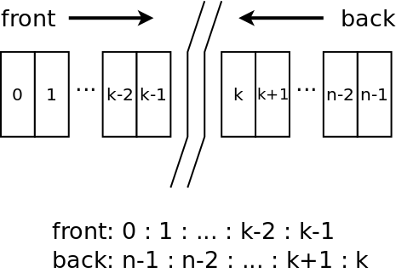

Slide 19
data TwoLists a = TwoLists {
front :: [a],
back :: [a]
}

Slide 20
instance Deque TwoLists where
-- empty :: TwoLists a
empty = TwoLists [ ] [ ]
-- isEmpty :: TwoLists a -> Bool
isEmpty (TwoLists [ ] [ ]) = True
isEmpty _ = False

Slide 21
-- prepend :: a -> TwoLists a -> TwoLists a
prepend x deque
= TwoLists (x:front deque) (back deque)
-- append :: TwoLists a -> a -> TwoLists a
append deque x
= TwoLists (front deque) (x : back deque)

Slide 22
-- getFirst :: TwoLists a
-> Maybe (a, TwoLists a)
getFirst (TwoLists [ ] [ ]) = Nothing
getFirst (TwoLists (x:fs) bs)
= Just (x, (TwoLists fs bs))
getFirst (TwoLists [] bs)
= getFirst $ TwoLists (reverse bs) [ ]

Slide 23
-- getLast :: TwoLists a
-> Maybe (TwoLists a, a)
getLast (TwoLists [ ] [ ]) = Nothing
getLast (TwoLists fs (x:bs))
= Just $ (TwoLists fs bs, x)
getLast (TwoLists fs [ ])
= getLast $ TwoLists [ ] (reverse fs)

Slide 24
-- concat :: TwoLists a -> TwoLists a
-> TwoLists a
concat deque1 deque2 =
TwoLists
(front deque1
++ reverse (back deque1))
(back deque2
++ reverse (front deque2))

Slide 25
Inserting
Into a
Deque

Slide 26
type InsertPoint d a = (d a, d a)
MakeInsertPoint ::
Deque d => d a -> InsertPoint d a
makeInsertPoint deque = (empty, deque)

Slide 27
hasNext :: Deque d => InsertPoint d a -> Bool
hasNext (past, future) = not (isEmpty future)
next :: Deque d => InsertPoint d a
-> Maybe (a, InsertPoint d a)
next (past, future) =
case getFirst future of
Nothing -> Nothing
Just (x, fut) ->
Just (x, (append past x, fut))

Slide 28
insert :: Deque d => a -> InsertPoint d a
-> InsertPoint d a
insert x (past, future) =
((append past x), future)
removeLast :: Deque d =>
InsertPoint d a -> InsertPoint d a
removeLast (past, future) =
case getLast past of
Nothing -> error "No past element!"
Just (p, _) -> (p, future)

Slide 29
toDeque :: Deque d => InsertPoint d a -> d a
toDeque (past, future) = concat past future

Slide 30
The problem with Two Lists:
getFirst (TwoLists [ ] [ ]) = Nothing
getFirst (TwoLists (x:fs) bs)
= Just (x, (TwoLists fs bs))
getFirst (TwoLists [ ] bs)
= getFirst $ TwoLists (reverse bs) [ ]

Slide 31
Solution #2:
(2,3,4) Finger Trees

Slide 32
Based on:
Finger Trees: A Simple General-purpose Data Structure
Ralf Hinze, Ross Paterson
http://www.soi.city.ac.uk/~ross/papers/FingerTree.html

Slide 33
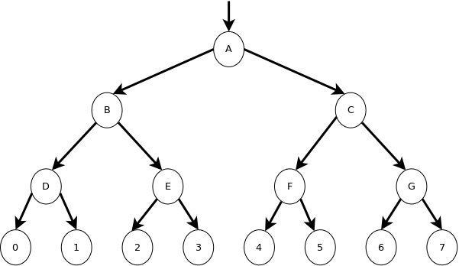

Slide 34
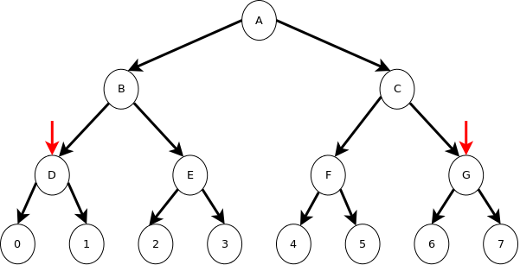

Slide 35
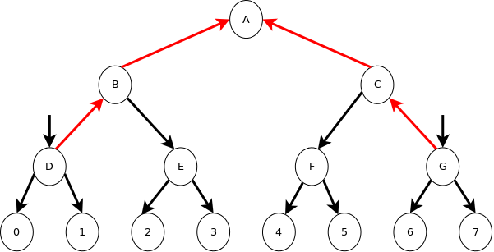

Slide 36
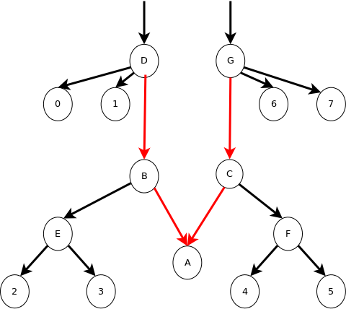

Slide 37
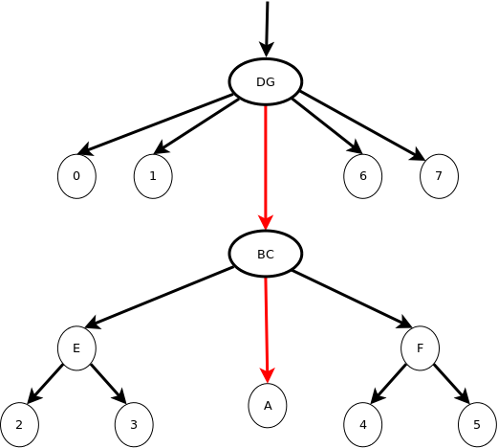

Slide 38
data FingerTree a =
Empty
| Single a
| Deep [a] (FingerTree (Node a)) [a]
data Node a = Node2 a a

Slide 39
Balancing
The Tree

Slide 40
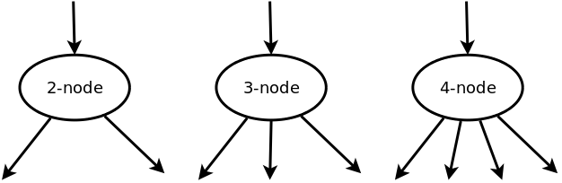
(2,3,4) Trees

Slide 41
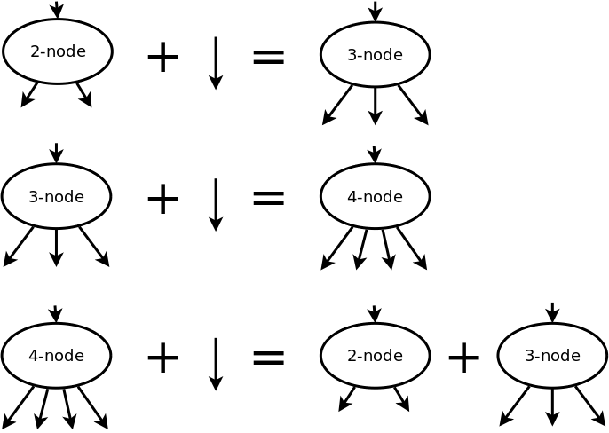

Slide 42
If you split the root node,
you add a new level
above the root node.
Therefor, (2,3,4) trees always have the same number
of levels on all spines.

Slide 43
data Node a = Node2 a a
data Digit a =
Digit1 a
| Digit2 a a
| Digit3 a a a
data FingerTree a =
Empty
| Single a
| Deep (Digit a) (FingerTree (Node a))
(Digit a)

Slide 44
prepend :: a -> FingerTree a
-> FingerTree a
prepend x Empty = Single x
prepend x (Single y)
= Deep (Digit1 x) Empty (Digit1 y)

Slide 45
prepend x (Deep (Digit1 y) t r)
= Deep (Digit2 x y) t r
prepend x (Deep (Digit2 y z) t r)
= Deep (Digit3 x y z) t r
prepend x (Deep (Digit3 y z w) t r)
= Deep (Digit2 x y)
(prepend (Node2 z w) t)
r

Slide 46
getFirst :: FingerTree a
-> Maybe (a, FingerTree a)
getFirst Empty = Nothing
getFirst (Single x) = Just (x, Empty)
getFirst (Deep (Digit2 x y) t r)
= Just (x, Deep (Digit1 y) t r)
getFirst (Deep (Digit3 x y z) t r)
= Just (x, Deep (Digit2 y z) t r)

Slide 47
getFirst (Deep (Digit1 x) t r)
= Just (x, reducedQueue)
where
reducedQueue =
case getFirst t of
Just ((Node2 y z), t') ->
Deep (Digit2 y z) t' r
Nothing -> reducedRight

Slide 48
reducedRight =
case r of
Digit2 y z ->
Deep (Digit1 y) Empty
(Digit1 z)
Digit3 y z w ->
Deep (Digit1 y) Empty
(Digit2 z w)
Digit1 y -> Single y

Slide 49
An easier implementation:
import Data.Sequence

Slide 50
An Idea:
data Node a = Node3 a a a
data Digit a =
Digit1 a
| Digit2 a a
| Digit3 a a a
| Digit4 a a a a

Slide 51
What we have:
It's a sequence-like thing (list/array/etc.)
Fast add/get/remove first and last elements.
Fast concat
Can walk the sequence
  And add/remove elements in the middle
Immutable and pure

Slide 52
Final
Thought

Slide 53
fini

Slide 54
Finger Trees:
“Finger Trees: A Simple
General-purpose Data Structure”
Ralf Hinze, Ross Patersonhttp://www.soi.city.ac.uk/~ross/papers/FingerTree.html
Data.Sequence
Slides:
https://github.com/bhurt/presentations/dllist.odp

