Slide 1
Going to the Extreme:
The
Ultimate
“Real”
Object Oriented
Programming Language

Slide 2
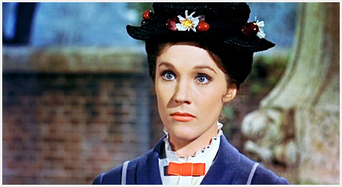
Gives “medicine” to kids...
… who then spend the next 2 hours tripping.

Slide 3
Where we are now

Slide 4
How programs work

Slide 5
The Best Programs Are...
Composed of several components
Most (all) of which are small
Are simple and easy to understand
And can be understood completely in isolation
Which are then composed into larger, more complex structures

Slide 6
Watch this again

Slide 7
This is what
“Object Oriented Programming”
Is supposed to let you do.

Slide 8
What Does
“Object Oriented”
Mean?

Slide 9
Object Orientation
You have objects
That you can send messages to (a.k.a. call methods on)

Slide 10
Real Object Orientation
You have objects
That you can send messages to (a.k.a. call methods on)
And everything is an object

Slide 11
Sandi Metz:
“Nothing is Something”
RailsConf 2015
https://www.youtube.com/watch?v=OMPfEXIlTVE

Slide 12
“All I want to do is
Send messages to Objects”
- Sandi Metz

Slide 13
Most of us are
Not really doing
“Object Oriented Programming”

Slide 14
Implementing Booleans
By Only Sending Messages
To Objects
(Java Version)

Slide 15
public interface Boole {
public void onTrue(Runnable r);
public void onFalse(Runnable r);
}
/* Java provides this */
public interface Runnable {
public void run();
}

Slide 16
public class Truth implements Boole {
public void onTrue(Runnable r) {
r.run();
}
public void onFalse(Runnable r) {
}
}

Slide 17
public class Falsehood
implements Boole
{
public void onTrue(Runnable r) {
}
public void onFalse(Runnable r) {
r.run();
}
}

Slide 18
public void If(
Boole test,
Runnable onTrue,
Runnable onFalse)
{
test.onTrue(onTrue);
test.onFalse(onFalse);
}

Slide 19
If(
new Truth(),
new Runnable() {
public void run() {
System,out.println("It's true!");
}
},
new Runnable() {
public void run() {
System.out.println("It's false!");
}
}
);

Slide 20
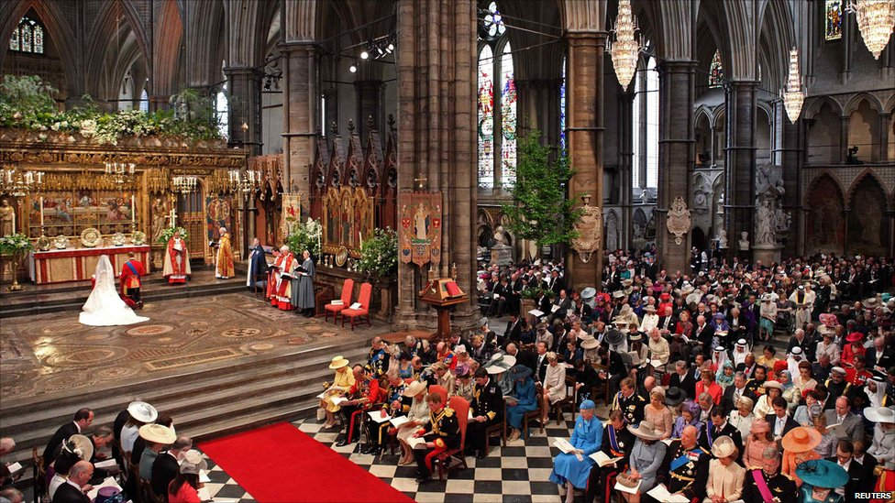
Java
It's All About The Ceremony

Slide 21
Problem #1:
Immutability
(cause Parallelism and stuff)

Slide 22
public interface Boole {
public <A> A doTest(
A onTrue,
A onFalse);
}

Slide 23
public class Truth
implements Boole
{
public <A> A doTest(
A onTrue,
A onFalse)
{
return onTrue;
}
}

Slide 24
public class Falsehood
implements Boole
{
public <A> A doTest(
A onTrue,
A onFalse)
{
return onFalse;
}
}

Slide 25
public void <A> A If(
Boole test,
Callable<A> onTrue,
Callable<A> onFalse)
{
return test.doTest(onTrue,
onFalse)
.call();
}
/* Java provides this */
public interface Callable<A> {
public A call();
}

Slide 26
Problem #2:
The Naming Problem

Slide 27
You want to pass
Object X
Which implements method foo
To Code Y
Which calls method bar

Slide 28
Naming
Things
Sucks

Slide 29
We
Suck
At
Naming
Things

Slide 30
Just Consider
Length
Count
Size
NumMembers
Cardinality
Capacity

Slide 31

Now we're ready to debate what names to use...

Slide 32
'So much complexity in software comes from trying to make one thing do two things.'
-- Ryan Singer

Slide 33
"It is bad when one thing becomes two. One should not look for anything else in the Way of the Samurai. It is the same for anything that is called a Way.”
Ghost Dog: Way of the Samurai

Slide 34
The “Doit” Class
A class with only one member function,
Which might as well be called
“doit”

Slide 35
Doit Classes Are Common
Runnable
Callable
Boole
MouseClickEvent
Etc.

Slide 36
Proposal:
Just make all classes Doit classes.
Then we can just call every method “doit”.
Naming problem: Solved.

Slide 37


Slide 39
interface Doit<A, B> {
B doit(A a);
}

Slide 40
Wait- doit() only takes one argument!
How do we implement a function of two arguments?

Slide 41
We return a new object which takes the second object.

Slide 42
interface Boole<A>
extends Doit<A, Doit<A, A> >
{
}

Slide 43
class Truth<A> implements Bool<A> {
public Doit<A, A> doit(final A a) {
return new Doit<A, A>() {
public A doit(final A b) {
return a;
}
};
}
}

Slide 44
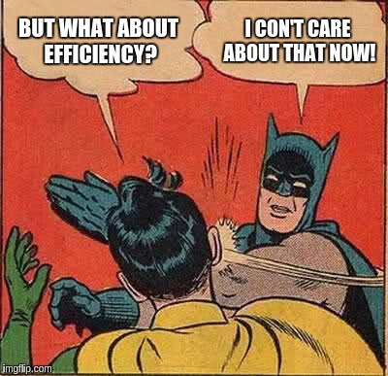

Slide 45
There is an awful lot of ceremony...

Slide 46
Ditch the Types
class Truth {
public doit(a) {
return new class() {
public doit(b) {
return a;
}
};
}
}

Slide 47
Ditch Java Cruft
class Truth
doit(a) =
new class()
doit(b) = a;

Slide 48
Ditch “class”
(everything is an object)
Truth =
doit(a) =
doit(b) = a;

Slide 49
Replace doit(x) = … with
\x -> ...
Truth = \a -> ( \b -> a )
Falsehood = \a -> ( \b -> b )

Slide 50
Ditch the parens
Truth = \a -> \b -> a
Falsehood = \a -> \b -> b

Slide 51
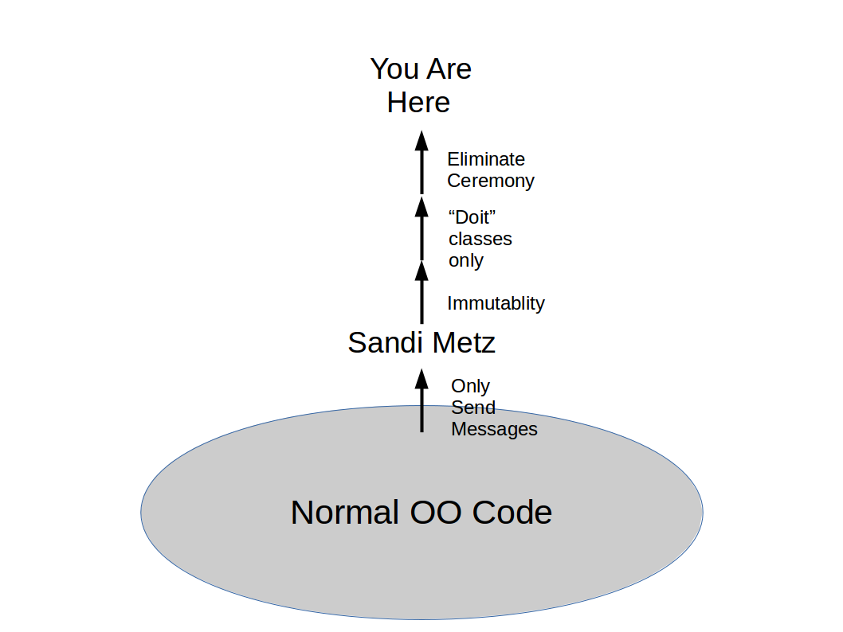

Slide 52
“Here” is:
The
Ultimate
“Real”
Object Oriented
Programming Language

Slide 53
“Here” is: The Lambda Calculus!
Classes
Objects
Sending a Message
Nouns carrying Verbs
Functions
Closures
Applying Arguments
Verbs carrying Nouns

Slide 54
Haskell
Is The
Ultimate
“Real”
Object Oriented
Programming Language

Slide 55
Thanks you,
And good night.

Slide 56
Sandi Metz: Nothing Is Something
https://www.youtube.com/watch?v=OMPfEXIlTVE
That Video:
https://www.youtube.com/watch?v=lwoSFQb5HVk

