Slide 1
Numerical Methods,
Numerical Magic
Notes:
Thanks to Gershom for the title

Slide 2
Thesis:
Haskell has many features
that can be used for abstraction.
Including some you might not
have recognized as such.
These features are applicable to real-world problems, and not just “academic” problems.
Notes:
By real world problems, we mean numerical problems

Slide 3
Prerequisites
Algebra
A little Calculus
  “I took a course on that back in college, and kinda vaguely rember it” is good enough.
A little Haskell
Notes:
Staying in the shallow end

Slide 4
Fixed Point Iteration

Slide 5
Fixed Point Iteration
For given f, find x such that f(x) = x
  Start with an initial guess x0
  New guess xi+1 = f(xi)
  Stop when done

Slide 6
Example
myfunc x = 1 + 1/(x+1)
myfunc(3.0) = 1.25
myfunc(1.25) = 1.4444444444444444
myfunc(1.4444444444444444) =
1.4090909090909092
…
myfunc(sqrt 2.0) = sqrt 2.0

Slide 7
Problem breaks into three parts
Generating the infinite sequence of guesses
Terminating the infinite sequence of guesses
Getting the answer of the now finite sequence of guesses.

Slide 8
Lists instead of Loops
Haskell
Lists
Computing the nth element
Truncating the list
Taking the last element of the list
Everyone Else
Loops (for/while)
Body of the loop
Loop test
Side effect of the last iteration

Slide 9
Generating an Infinite List
Prelude provides:
  iterate :: (a → a) → a → [a]
Which is exactly what we want.
Notes:
What is prelude?
Learn your prelude!

Slide 10
Generating an Infinite List
Generating the infinite list is just:
  mylist :: [Double]
  mylist = iterate myfunc 3.0
  where
  myfunc x = 1.0 + (1.0 / (x + 1.0))
Notes:
We haven't done any computation yet!
Myfunc is the same as before

Slide 11
Waddaya mean “done”?!
Too many iterations
  How many is too many?
You've found an answer
  xi+1 ≈ xi
You've started diverging
  |(xi+2 – xi+1)| / |(xi+1 – xi)| > ε

Slide 12
Stopping at “too many iterations”
Prelude provides function:
  take :: Int → [a] → [a]
Which is exactly what we want.
mylist2 = take 50 mylist

Slide 13
Useful Function
truncate2 :: (a → a → Bool) → [a] → [a]
truncate2 test (x1 : x2 : xs) =
if (test x1 x2) then
x1 : (truncate2 f (x2 : xs))
else
[ x1, x2 ]
truncate2 _ xs = xs

Slide 14
Truncate on convergence
TruncateOnConvergence
:: (Ord a, Num a) => a -> [a] -> [a]
truncateOnConvergence epsilon lst
= truncate2 notConverged lst
where
notConverged x1 x2
= abs (x2 - x1) > (abs x1 * epsilon)
mylist3 = TruncateOnConvergence 1e-10
mylist2

Slide 15
Homework assignment:
Write a “truncate3” function
And use it to terminate
on divergence

Slide 16
Getting the answer
The last element of the truncated list is our answer.
Prelude defines:
last :: [a] -> a
which is exactly what we want.
Our answer is:
last mylist3

Slide 17
Getting the last element:
Danger Will Robinson!
What does:
  last $ take 100000000 $ iterate (+1) 1
evaluate to?

Slide 18
Getting the last element:
Danger Will Robinson!
What does:
  last $ take 100000000 $ iterate (+1) 1
evaluate to?
Correct answer:
Segmentation fault (stack overflow)!
We are building up a huge unevaluate thunk:
  ((((…(1+1)+1)+1)+1)....)+1)

Slide 19
Useful Function
last' :: [a] -> a
last' [] = error "empty list"
last' [x] = x `seq` x
last' (x:xs) = x `seq` last' xs
Now:
last' $ take 100000000 $ iterate (+1) 1
returns 100000000
Watch Your Thunks!

Slide 20
“Chinese Menu” programming
Choose one from column A:
  Fixed point iteration
  Newton's Method
  Secant Method
  Interval halving
  Etc.
Choose one (or more) from column B:
  Stop on too many iterations
  Stop on having converged
  Stop on diverging
  Etc.

Slide 21
Aitken's Delta-Squared Method
Assume we have the sequence:
Then:
Some arithmetic gives us:

Slide 22
Aitken's Delta Squared Method
aitkens :: Fractional a => (a -> [a]) -> a -> [a]
aitkens f x =
case f x of
(p0 : p1 : p2 : _) ->
let p = (p2*p0 – p1*p1)
/(p2 - 2*p1 + p0)
in
p : aitkens f p
xs -> xs
Notes:
Note type: aitkens maps generators

Slide 23
Our answer then becomes:
last'
(take 50
(truncateOnConvergence 1e-12
(aitkens (iterate f) 3.0)))
where
f x = 1.0 + (1.0/(x + 1.0))

Slide 24
Fast
Automatic
Differentiation

Slide 25
Four Function Calculator
data Expr =
Plus Expr Expr
| Minus Expr Expr
| Times Expr Expr
| Divide Expr Expr
| Const Double
| Var

Slide 26
Implementation
eval :: Expr -> Double -> Double
eval (Plus g h) x = (eval g x) + (eval h x)
eval (Minus g h) x = (eval g x) - (eval h x)
eval (Times g h) x = (eval g x) * (eval h x)
eval (Divide g h) x = (eval g x) / (eval h x)
eval (Const c) _ = c
eval Var x = x
deriv :: Expr -> Double -> Double
deriv = ???

Slide 27
Chain Rule

Slide 28
If:
f(x) = g(x) * h(x)
Then:
f(g,h) = g * h
df/dg = h
df/dh = g
df/dx = dg/dx*h + g*dh/dx

Slide 29
Naive Implementation
deriv :: Expr -> Double -> Double
deriv (Times g h) x = df_dx
where
df_dx = (df_dg * dg_dx) + (df_dh * dh_dx)
df_dg = eval h x
dg_dx = deriv g x
df_dh = eval g x
dh_dx = deriv h x
deriv (Const _) _ = 0.0
deriv Var _ = 1.0

Slide 30
Problem
What happens when
f(x) = g(x) * h(x)
h(x) = p(x) * q(x)
?
p(x) and q(x) get evaluated twice!
  Once evaluating h(x) for df/dx
    df/dg = h(x)
  Once calculating dh/dx
Leads to exponential blow-up!

Slide 31
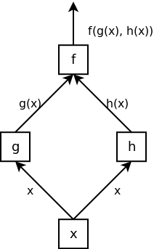
Values Flow Up

Slide 32
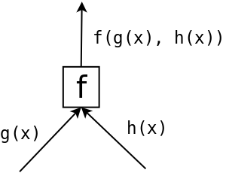
Values Flow Up

Slide 33
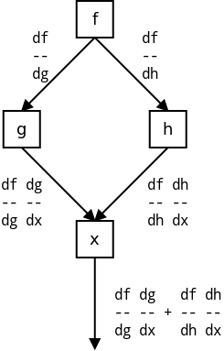
Derivitives Flow Down

Slide 34
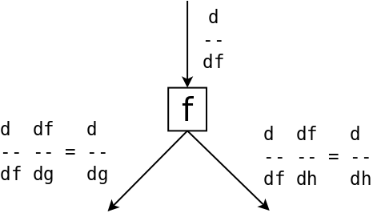
Derivitives Flow Down

Slide 35
Laziness + Closures FTW
We return the eval'd value and a closure to calculate the derivative
Allows us to capture the (lazily evaluated) intermediate results

Slide 36
evalDeriv' (Times g h) x = (f_x, df_dx)
where
(g_x, dg_dx) = evalDeriv' g x
(h_x, dh_dx) = evalDeriv' h x
f_x = g_x * h_x
df_dg = h_x
df_dh = g_x
df_dx de_df = (dg_dx (de_df * df_dg))
+ (dh_dx (de_df * df_dh))
...

Slide 37
evalDeriv' :: Expr -> Double
-> (Double, (Double -> Double))
evalDeriv' = ...
evalDeriv :: Expr -> Double
-> (Double, Double)
evalDeriv e x = (r, (de_dx 1.0))
where
(r, de_dx) = evalDeriv' e x

Slide 38
Expr is hard-coded to use Doubles,
And only allows a single variable (x).
Can we do better?

Slide 39
Differently Typed Expressions
data Expr a =
Plus (Expr a) (Expr a)
| Minus (Expr a) (Expr a)
| Times (Expr a) (Expr a)
| Divide (Expr a) (Expr a)
| Const a
| Var String
evalDeriv :: Fractional a => Expr a -> Map String a
-> (a, Map String a)

Slide 40
Expr's “act like” Numbers
instance Num (Expr a) where
(+) = Plus
(-) = Minus
…
Allowing us to write code like:
var “x” * var “y” + 3

Slide 41
Further Possibilities
Data.Typeable provides:
  typeOf :: Typeable a => a -> TypeRep
TypeRep implements Show
  Returns the string representation of the type
  show (typeOf (undefined :: Double))
  returns “Double”
Allows for:
toHaskell :: Typeable a => Expr a -> String

Slide 42
Conclusion
Haskell provides many tools for abstraction
Many of these tools are not normally considered “abstraction tools”
Rather than providing a single “big” abstraction mechanism, Haskell provides a host of “little” abstraction mechanisms
The power of Haskell's abstraction mechanisms is (still!) largely untapped.

Slide 43
fini

