Slide 1
Hidden Haskell Gems 1:
Wrangling Monad
Transformer Stacks

Slide 2
Slides:
https://github.com/bhurt/presentations/blob/master/hsgems.odp

Slide 3
Hidden Haskell Gems:
Libraries (and tricks and the like)
which are neither large enough
nor theoretically interesting enough
to be as publicized as maybe they should be.

Slide 4
Epsiode 1:
Monad Transformer Stacks

Slide 5
Q:
How do you large-scale structure Haskell programs?

Slide 6
Q:
How do you large-scale structure Haskell programs?
A:
Define your monads!

Slide 7
A Monad is:
A computation
Returning a value of a given type
In a domain where some condition holds true
That enforces a sequence on effects

Slide 8
Example Monads
The domain where you can do I/O and arbitrary side effects
The domain where you might error out- instead of producing a value, you generate an error
You have a pool of database connections
You have a specific database connection to use
You are in a transaction in the database

Slide 9
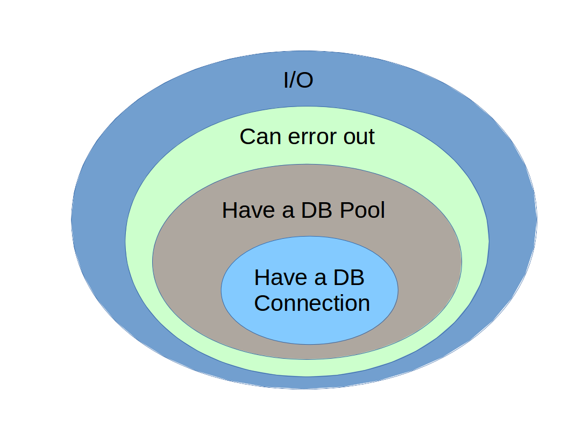

Slide 10
Monad Transformers:
Monads that stack on top of other monads.

Slide 11
Examples
type WithErr a =
ExceptT String IO a
type WithPool a =
ReaderT DBPool WithErr a
type WithConn a =
ReaderT DB.Connection WithPool a

Slide 12
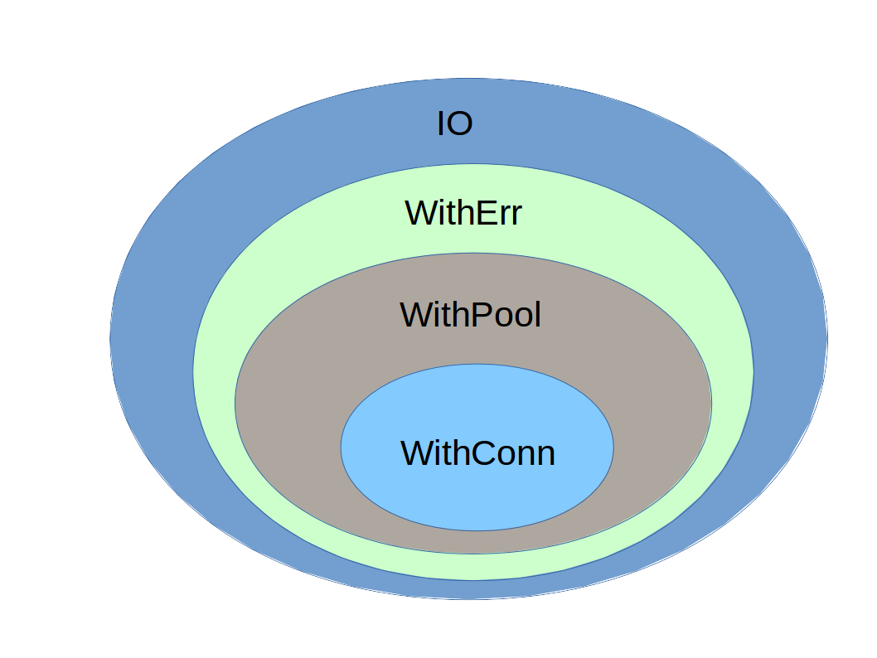

Slide 13
Trick #1:
Generalized Newtype Deriving

Slide 14
The idea:
Use newtype instead of type
  Acts as simple type alias “under the hood”
  Opaque type to the code – allows for “access control”
Use GeneralizedNewtypeDeriving
  Allows us to inherit type class implementations

Slide 15
Example
{-# LANGUAGE GeneralizedNewtypeDeriving #-}
module DBTrans where
newtype WithTrans a = WithTrans (WithDBConn a)
deriving (Functor, Applicative, Monad)
inDBTrans :: WithTrans a -> WithConn a
inDBTrans = do
...

Slide 16
Don't
Make
Edward
Kmett
Sad

Slide 17
The
lift-lift-lift
Problem

Slide 18
What we'd like to write:
printMessage :: WithConn ()
PrintMessage =
putStrLn "We got here!"

Slide 19
What we have to write:
printMessage :: WithConn ()
printMessage =
lift $ lift $ lift $
putStrLn "We got here!"

Slide 20
This Sucks
Ugly as heck: lift $ lift $ lift
How many lifts do I need again?
If the definition of WithConn changes (transformers are added/removed), the code has to be fixed
Applies to every IO function
printMessage works in lots of other places: WithConn, WithErr, IO, etc.

Slide 21
MonadIO
Control.Monad.IO.Class
In
transformers
By Andy Gill & Ross Paterson

Slide 22
Key Function:
liftIO :: MonadIO m => IO a -> m a
All standard transformers
Implement MonadIO
Including ReaderT & ExceptT

Slide 23
Now we can write:
import Control.Monad.IO.Class
printMessage :: MonadIO m => m ()
printMessage =
liftIO $ putStrLn "We got here!"

Slide 24
Much Better
liftIO always adds the right number of lifts
  Even when that number changes
  Even when we humans don't remember/don't know what that number is
Much less ugly
Works everywhere- IO, Base, WithEnv, WithConn, more...

Slide 25
Upside:
Haskell-98 compliant
Downside:
Only works on monad stacks on top of IO
Only goes from the base to the top

Slide 26
MonadBase
Control.Monad.Base
In
transformers-base
By Mikhail Vorozhtsov & Bas van Dijk

Slide 27
Key Function:
liftBase :: MonadBase b m
=> b a -> m a

Slide 28
Upside:
Works with any monad as the base.
Downside:
GHC Specific: Multiparameter type classes
(with functional dependencies)
Only goes from the base to the top

Slide 29
Multiparameter Type Classes
With Functional Dependencies
class MonadBase b m | m -> b
where
liftBase :: b a -> m a
“m determines b”
(i.e. this acts like a normal,
single-parameter type class)

Slide 30
MonadStack
Control.Monad.MonadStack
In
MonadStack
By Brian Hurt

Slide 31
Key Function:
liftFrom :: MonadStack m n
=> m a -> n a

Slide 32
Upside:
From any monad in the stack up
Only need to implement MonadTrans to use.
Downside:
GHC Specific: true Multiparameter type classes
(without functional dependencies)
Only works on “real” monad transformers.

Slide 33
MonadCompose
Control.Monad.Lifter
In
MonadCompose
By James Candy

Slide 34
Key Function:
lf :: Lifter m n => m a -> n a

Slide 35
Upside:
Most general
(works on MonadPlus instances, etc).
Downside:
Multiparameter type classes
+ OverlappingInstances
+ UndecidableInstances

Slide 36
The problem with
Multiparameter Type Classes
It is very easy to define
Multiple different implementations
For any given pair of types

Slide 37
What happens then?
Without OverlappingInstances and UndecidableInstances:
Error
With OverlappingInstances and UndecidableInstances:
Compiler picks one.

Slide 38
My Advice
Always derive MonadTrans, MonadIO
Derive MonadBase unless you know you need non-GHC support
MonadTrans gives you MonadStack if needed
Derive MonadCompose if needed
Don't feel bad about deriving multiple of these

Slide 39
Sometimes you need to go down
Not just up.

Slide 40
Given:
Control.Exception.catch ::
Exception e =>
IO a -> (e -> IO a) -> IO a
How do you call this with a WithTrans a?

Slide 41
MonadControl
Control.Monad.Trans.Control
In
monad-control
By Bas van Dijk & Anders Kaseorg

Slide 42
The Key Part
class MonadBase b m =>
MonadBaseControl b m | m -> b
where
type StM m a
restoreM :: StM m a -> m a
LiftBaseWith :: (RunInBase m b -> b a) -> m a
type RunInBase m b =
forall a . m a -> b (StM m a)

Slide 43
class MonadBase b m =>
MonadBaseControl b m | m -> b
where
type StM m a
restoreM :: StM m a -> m a
LiftBaseWith :: (RunInBase m b -> b a) -> m a
type RunInBase m b =
forall a . m a -> b (StM m a)
m is a monad transformer stack
on top of base b

Slide 44
class MonadBase b m =>
MonadBaseControl b m | m -> b
where
type StM m a
restoreM :: StM m a -> m a
LiftBaseWith :: (RunInBase m b -> b a) -> m a
type RunInBase m b =
forall a . m a -> b (StM m a)
Holds the “packed down”
State of Monad m with result a

Slide 45
class MonadBase b m =>
MonadBaseControl b m | m -> b
where
type StM m a
restoreM :: StM m a -> m a
LiftBaseWith :: (RunInBase m b -> b a) -> m a
type RunInBase m b =
forall a . m a -> b (StM m a)
Unpack and restore an StM
Making it the current monad state

Slide 46
class MonadBase b m =>
MonadBaseControl b m | m -> b
where
type StM m a
restoreM :: StM m a -> m a
LiftBaseWith :: (RunInBase m b -> b a) -> m a
type RunInBase m b =
forall a . m a -> b (StM m a)
The key function

Slide 47
class MonadBase b m =>
MonadBaseControl b m | m -> b
where
type StM m a
restoreM :: StM m a -> m a
LiftBaseWith :: (RunInBase m b -> b a) -> m a
type RunInBase m b =
forall a . m a -> b (StM m a)
Given a function that takes a
“pack down” function...

Slide 48
class MonadBase b m =>
MonadBaseControl b m | m -> b
where
type StM m a
restoreM :: StM m a -> m a
LiftBaseWith :: (RunInBase m b -> b a) -> m a
type RunInBase m b =
forall a . m a -> b (StM m a)
… and returns an action in the base
monad that produces an a, ...

Slide 49
class MonadBase b m =>
MonadBaseControl b m | m -> b
where
type StM m a
restoreM :: StM m a -> m a
LiftBaseWith :: (RunInBase m b -> b a) -> m a
type RunInBase m b =
forall a . m a -> b (StM m a)
… return an action in the top
monad that produces an a.

Slide 50
class MonadBase b m =>
MonadBaseControl b m | m -> b
where
type StM m a
restoreM :: StM m a -> m a
LiftBaseWith :: (RunInBase m b -> b a) -> m a
type RunInBase m b =
forall a . m a -> b (StM m a)
The type of the “pack down” function

Slide 51
A Question
Why pass the “pack down” function into a closure? Why not just do:
class MonadBase b m =>
MonadBaseControl b m | m -> b
where
type StM m a
restoreM :: StM m a -> m a
packM :: m a -> b (StM m a)

Slide 52
Answer
The pack-down function depends upon the
current state of the monad stack-
i.e. it's only valid at one specific point in the
sequence of operations in the monad.
Passing it into a function gives us a scope
to tie the life time of the pack down function to.

Slide 53
Example
myCatch :: (Monad m, MonadBaseControl IO m,
Exception e)
=> m a -> (e -> m a) -> m a
myCatch act handler = do
st <- liftBaseWith go
restoreM st
Where
-- go :: RunInBase m IO -> IO (StM m a)
go run = catch (run act) (run . handler)

Slide 54
Example
myCatch :: (Monad m, MonadBaseControl IO m,
Exception e)
=> m a -> (e -> m a) -> m a
myCatch act handler = do
st <- liftBaseWith go
restoreM st
Where
-- go :: RunInBase m IO -> IO (StM m a)
go run = catch (run act) (run . handler)
m is a monad transformer stack
on top of IO

Slide 55
Example
myCatch :: (Monad m, MonadBaseControl IO m,
Exception e)
=> m a -> (e -> m a) -> m a
myCatch act handler = do
st <- liftBaseWith go
restoreM st
Where
-- go :: RunInBase m IO -> IO (StM m a)
go run = catch (run act) (run . handler)
We are lifting catch up the monad stack

Slide 56
Example
myCatch :: (Monad m, MonadBaseControl IO m,
Exception e)
=> m a -> (e -> m a) -> m a
myCatch act handler = do
st <- liftBaseWith go
restoreM st
Where
-- go :: RunInBase m IO -> IO (StM m a)
go run = catch (run act) (run . handler)
Our closure where we have
a pack-down function

Slide 57
Example
myCatch :: (Monad m, MonadBaseControl IO m,
Exception e)
=> m a -> (e -> m a) -> m a
myCatch act handler = do
st <- liftBaseWith go
restoreM st
Where
-- go :: RunInBase m IO -> IO (StM m a)
go run = catch (run act) (run . handler)
Use it to get an StM, which becomes
our new monad state

Slide 58
One small problem with this code...

Slide 59
It is
already
written
for you

Slide 60
LiftedBase
Control.Exception.Lifted
In
lifted-base
By Bas van Dijk & Anders Kaseorg

Slide 61
Lifted versions of...
Control.Exception
Control.Concurrent
Control.Concurrent.MVar
System.Timeout

Slide 62
What we've learned
Use monads to define the “regions” of our programs
Use GeneralizedNewtypeDeriving to derive lots of type classes for our new monads
A range of lifting options- MonadIO, MonadBase, MonadStack, MonadCompose
Use MonadBaseControl to lift monad combinators.
Except the common ones are already written in LiftedBase

Slide 63
I am looking for more gems!
Email me at bhurt42 at gmail,
Or post to the meetup group.

Slide 64
fini

