Slide 1
Haskell Hidden Gems 2:
Conduits
Brian Hurt

Slide 2
https://github.com/bhurt/presentations/blob/master/conduits.odp

Slide 3
Structure of a “Hidden Gems” talk:
I. What problem does the library solve?
II. How do you call/use the library?

Slide 4
Part I:
The Problem

Slide 5
The Problem
We want to write code that:

Slide 6
The Problem
We want to write code that:
  Processes a stream of data

Slide 7
The Problem
We want to write code that:
  Processes a stream of data
  Uses non-memory resources that needs timely finalization

Slide 8
The Problem
We want to write code that:
  Processes a stream of data
  Uses non-memory resources that needs timely finalization
  Handles more data than can fit in memory

Slide 9
The Problem
We want to write code that:
  Processes a stream of data
  Uses non-memory resources that needs timely finalization
  Handles more data than can fit in memory
  Can be reused in different contexts (can live in a library)

Slide 10
The Problem
We want to write code that:
  Processes a stream of data
  Uses non-memory resources that needs timely finalization
  Handles more data than can fit in memory
  Can be reused in different contexts (can live in a library)
  Is composable- a complex process can be made out of multiple simpler steps

Slide 11
Solution #1:
Live in IO, handle the exceptions
Write a function of type:
(resource -> IO a) -> IO a
Which manages cleaning up
(including on exceptions)
Examples:
Data.Pool.withResource
System.IO.withFile

Slide 12
Solution #1:
Live in IO, handle the exceptions
Problems:
Not composable
Not reusable

Slide 13
Solution #2:
Lazy I/O
Use unsafePerformIO or unsafeInterleaveIO
to do I/O in “pure” lazy values, pretending
the data all fits in memory.
Example:
Prelude.getContents

Slide 14
Solution #2:
Lazy I/O
Problems:
No guarantee of timely clean up
Also, unsafePerformIO

Slide 15
Solution #3:
Conduits

Slide 16
Part II:
How to use the Library

Slide 17
The main type
ConduitM i o m r

Slide 18
ConduitM
ConduitM i o m r
Input Type

Slide 19
ConduitM
ConduitM i o m r
Output Type

Slide 20
ConduitM
ConduitM i o m r
Containing Monad

Slide 21
ConduitM
ConduitM i o m r
Final Result Type

Slide 22
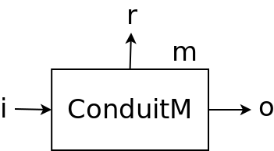
ConduitM i o m r

Slide 23
So, a conduit that:
Reads lines in
Converts them to floats
Lives in the IO monad
Returns a count of the number of lines
Has type:
ConduitM String Float IO Int

Slide 24
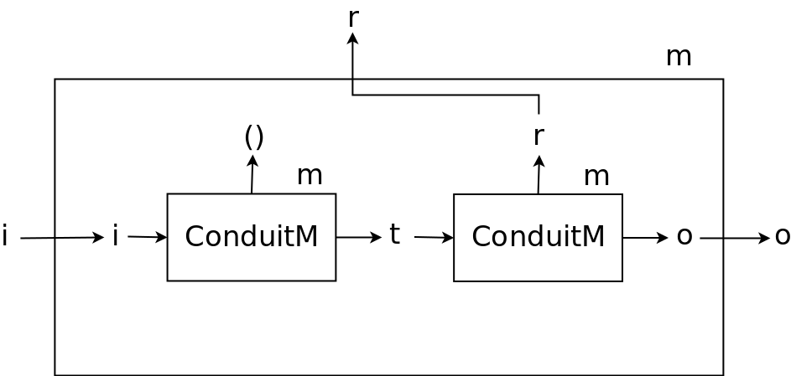
Combing two conduits into one

Slide 25
Combining two conduits into one
fuse ::
ConduitM i t m ()
-> ConduitM t o m r
-> ConduitM i o m r
Aka =$=
Aka $=
Aka =$

Slide 26
A conduit that doesn't take any inputs,
Only produces outputs,
Is a source:
type Source m o = ConduitM () o m ()
Example:
Reading from a file

Slide 27
A conduit that doesn't produce any ouputs,
Only taking inputs,
Is a Sink:
type sink i m r = ConduitM i Void m r
Example:
Writing to a file

Slide 28
A conduit that both consumes input and
produces output is just a conduit:
type conduit i m o =
ConduitM i o m ()
Example:
Uncompressing or compressing data

Slide 29
Notice:
aSource :: Source m a
aConduit :: Conduit a m b
(aSource =$= aConduit) :: Source m b

Slide 30
Notice:
aConduit :: Conduit a m b
aSink :: Sink b m r
(aConduit =$= aSink) :: Sink a m r

Slide 31
Notice:
aConduit :: Conduit a m b
anotherConduit :: Conduit b m c
(aConduit =$= anotherConduit)
:: Conduit a m c

Slide 32
Running a Conduit
($$) :: Source m a
-> Sink a m b
-> m b

Slide 33
We have programmed this way
Before
Unix Pipes
Java/C++ IO libraries
Python generators
Many, many more

Slide 34
Creating
Conduits

Slide 35
A
(ConduitM i o m)
Is a
Monad
(if m is a monad)

Slide 36
ConduitM i o m r
Now this r makes more sense!

Slide 37
ConduitM i o m r
The monad we're operating in

Slide 38
ConduitM i o m r
The type of the result of that computation

Slide 39
Two new types
For “inside” the monad

Slide 40
Consumer
type Consumer i m r =
forall o. ConduitM i o m r

Slide 41
Consumer
type Consumer i m r =
forall o. ConduitM i o m r
“The output might be of any type”
“I don't produce output- other code in the conduit might, but I don't”

Slide 42
type Consumer i m r =
forall o. ConduitM i o m r
“I don't produce output- other code in the conduit might, but I don't”
type Sink i m r = ConduitM i Void m r
“No code in the conduit produces any output”

Slide 43
Producer
type Producer m o =
forall i. ConduitM i o m ()

Slide 44
Producer
type Producer m o =
forall i. ConduitM i o m ()
“Other parts of the conduit might consumer input, but I don't”

Slide 45
type Producer m o =
forall i. ConduitM i o m ()
“Other parts of the conduit might consumer input, but I don't”
type Source m o =
ConduitM () o m ()
“No part of this conduit consumes input”

Slide 46
Sink & Source:
The whole conduit (“outside”)
Producer & Consumer:
One part of the conduit (“inside”)

Slide 47
Two Functions for Inside a Conduit
await :: Consumer i m (Maybe i)
Reads an input value
yield :: o -> Producer m o
Writes an output value

Slide 48
example :: ConduitM String Float IO Int
example = loop 0
where
loop cnt = do
mi <- await
case mi of
Nothing -> return cnt
Just line -> do
yield (read line)
go (cnt + 1)

Slide 49
Most of the common generic functions already exist
Data.Conduit.List: list-like functions (fold, unfold, map, filter, etc)
Data.Conduit.Lift: executing parts of conduits
Data.Conduit.Filesystem: reading/writing files
Network.HTTP.Client.Conduit: streaming HTTP input
Amazonka: Streaming S3 access
Many, many more

Slide 50
Also
ConduitM i o m
Is a Monad
So all of our standard monad, applicative, and functor tricks work

Slide 51
Example:
I want a source (or producer) that produces
The integers 1 to 1000, then stops.
mapM_ yield [1..1000]

Slide 52
Also
ConduitM i o
Is a monad transformer
lift :: m a -> ConduitM i o m a

Slide 53
Also
Any Produce is also a Source
Any Consumer is also a Sink

Slide 54
Problem:
I want to run a source until it produces
And element, and then stop, returning that element.
Solution:
mySource $$ await

Slide 55
Cleaning up

Slide 56
This doesn't work
myConduit :: MonadBaseControl IO m =>
ConduitM i o m ()
myConduit =
withFile "somefile.dat" WriteMode go
where
go :: FileHandle -> ConduitM i o m ()
go fileHandle = do
...

Slide 57
MonadBaseControl
Allows us to “lift” functions that operate on the base monad:
catch :: Exception e =>
(e -> IO a) -> IO a -> IO a
Becomes:
catch :: (Exception e,
MonadBaseControl IO m) =>
(e -> m a) -> m a -> m a

Slide 58
ConduitM i o
Does not implement
MonadBaseControl

Slide 59
We could:
myConduit :: FileHandle -> Conduit i o m ()
myConduit fileHandle = …
withFile “somefile.data” writeMode
(\fh -> … $= myConduit fh $$ …)
… yuck

Slide 60
Haskell Hidden Gems 2.5:
Monad-Resource
Brian Hurt

Slide 61
The problem
We want to register
Generic
Clean-up functions
To be executed on
Monad exit

Slide 62
The key players
type ResourceT m a
Monad Transformer
Holds register of cleanup actions
(of type IO ())
To be performed on exit

Slide 63
The key players
class MonadResource m
Type Class
All monad transformed stacks that
Have a ResourceT in them somewhere

Slide 64
The key players
runResourceT
:: MonadBaseControl m =>
ResourceT m a -> m a
Runs a ResourceT monad, and executes all
The cleanup functions on exit
(including on exceptions)

Slide 65
The key players
register
:: MonadResource m =>
IO () -> m ReleaseKey
Registers a cleanup action.

Slide 66
The key players
release
:: MonadResource m =>
ReleaseKey -> m ()
Executes a cleanup action early.

Slide 67
This Does Work
myConduit :: MonadResource m => ConduitM i o m ()
myConduit = do
fileHandle <- openFile "somefile.dat" writeMode
key <- register (hClode fileHandle)
...
-- Close the file early when we're exiting
release key
return ()
runResourceT (source $$ sink)

Slide 68
myConduit :: MonadResource m => ConduitM i o m ()
myConduit = do
fileHandle <- openFile "somefile.dat" writeMode
key <- register (hClode fileHandle)
...
-- Close the file early when we're exiting
release key
return ()
runResourceT (source $$ sink)
We are in MonadResource,
Not MonadBaseControl

Slide 69
myConduit :: MonadResource m => ConduitM i o m ()
myConduit = do
fileHandle <- openFile "somefile.dat" writeMode
key <- register (hClode fileHandle)
...
-- Close the file early when we're exiting
release key
return ()
runResourceT (source $$ sink)
runResourceT needs to be in MBC
But it's outside the conduit

Slide 70
myConduit :: MonadResource m => ConduitM i o m ()
myConduit = do
fileHandle <- openFile "somefile.dat" writeMode
key <- register (hClode fileHandle)
...
-- Close the file early when we're exiting
release key
return ()
runResourceT (source $$ sink)
This code has type:
MonadBaseControl m => ResourceT m a

Slide 71
myConduit :: MonadResource m => ConduitM i o m ()
myConduit = do
fileHandle <- openFile "somefile.dat" writeMode
key <- register (hClode fileHandle)
...
-- Close the file early when we're exiting
release key
return ()
runResourceT (source $$ sink)
We call openFile, not withFile
Which doesn't handle closing the file

Slide 72
myConduit :: MonadResource m => ConduitM i o m ()
myConduit = do
fileHandle <- openFile "somefile.dat" writeMode
key <- register (hClode fileHandle)
...
-- Close the file early when we're exiting
release key
return ()
runResourceT (source $$ sink)
But then immediately register the close

Slide 73
myConduit :: MonadResource m => ConduitM i o m ()
myConduit = do
fileHandle <- openFile "somefile.dat" writeMode
key <- register (hClode fileHandle)
...
-- Close the file early when we're exiting
release key
return ()
runResourceT (source $$ sink)
And we can close the file early
(if no one threw an exception)

Slide 74
myConduit :: MonadResource m => ConduitM i o m ()
myConduit = do
fileHandle <- openFile "somefile.dat" writeMode
key <- register (hClode fileHandle)
...
-- Close the file early when we're exiting
release key
return ()
runResourceT (source $$ sink)
Key point: only information leaking out
Is that a resource needs cleaning up!

Slide 75
ResourceT IO a
Is a very common
Monad transformer stack
To run conduits in

Slide 76
But it's better to be generic:
(MonadResource m, MonadIO m) => m a

Slide 77
Implementing
MonadResource

Slide 78
A Standard Pattern
newtype Foo m a = ...
deriving (MonadTrans, …)
class HasFoo m where ...
instance HasFoo (Foo m) where ...
instance (MonadTrans t, HasFoo m)
=> HasFoo (t m) where ...

Slide 79
A problem
Foo implements MonadTrans,
So both of these instances apply:
instance HasFoo (Foo m) where ...
instance (MonadTrans t, HasFoo m)
=> HasFoo (t m) where ...

Slide 80
Solution #1:
Incoherent Instances
This way lies madness
Or at least tears & recriminations

Slide 81
Solution #2:
Explicitly Resolve the Conflict
instance {-# OVERLAPPING #-}
HasFoo (Foo m) where ...
instance {-# OVERLAPPABLE #-}
(MonadTrans t, HasFoo m)
=> HasFoo (t m) where ...

Slide 82
Let's recap...

Slide 83
The problem
We want to write code that:
  Processes a stream of data
A Conduit processes a stream of data

Slide 84
The problem
We want to write code that:
  Uses non-memory resources that needs timely finalization
ResourceT allows us to register clean up functions, run at monad exit (if not sooner)

Slide 85
The problem
We want to write code that:
  Handles more data than can fit in memory
A conduit only has in memory the current hunk of data being worked upon.

Slide 86
The problem
We want to write code that:
  Can be reused in different contexts (can live in a library)
Living in a generic monad with type class constraints (MonadIO, MonadResource, etc) allows a Conduit stage to be reused in my different conduits.

Slide 87
The problem
We want to write code that:
  Is composable- a complex process can be made out of multiple simpler steps
A complicated ConduitM can be constructed by fusing multiple simpler ConduitM's together.

Slide 88
Conduit and ResourceT
Allows us to write code that:
  Processes a stream of data
  Uses non-memory resources that needs timely finalization
  Handles more data than can fit in memory
  Can be reused in different contexts (can live in a library)
  Is composable- a complex process can be made out of multiple simpler steps

Slide 89
fini

Slide 90
https://github.com/bhurt/presentations/blob/master/conduits.odp

