Slide 1
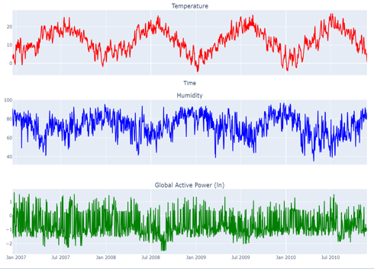
Time Series EDA and Forecasting on Power Consumption Data
Gokarna Bhusal
24.06.2025

Slide 2
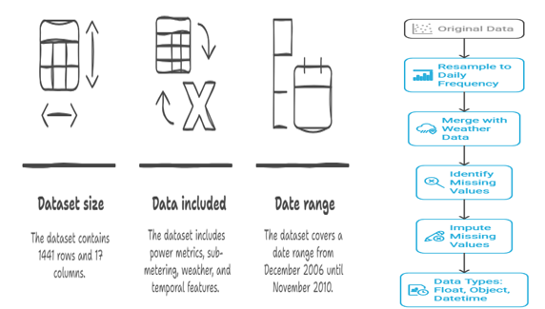
Data Preprocessing Flowchart
Notes:
Dataset Shape: (2075259, 7)
Dataset Shape:1441

Slide 3
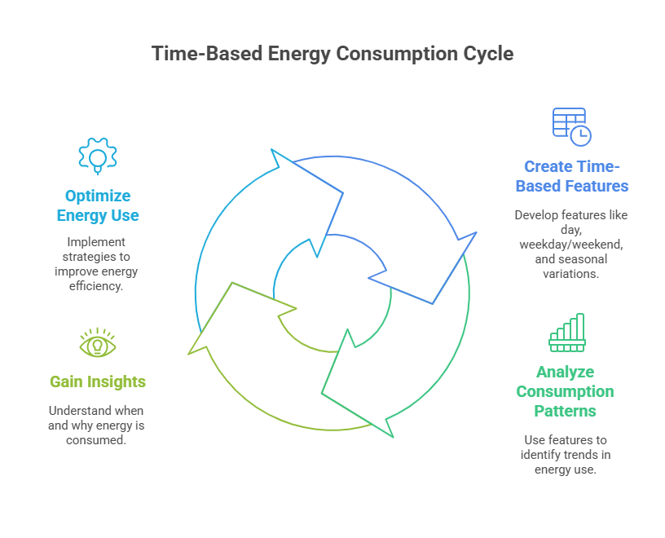
Notes:
Create several time-based features to gain more insight into when energy is consumed, such as the day, weekdays versus weekends, or seasonal variations, holidays.

Slide 4
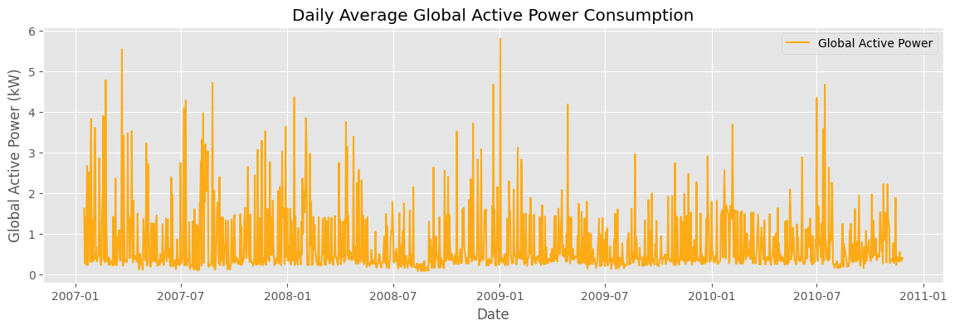
Is data stationary??
Notes:
Trend Presence: The graph appears to show long-term fluctuations, meaning the data might not be stationary. If stationarity were present, the mean and variance would remain constant over time.
Seasonality Detection: In the graph patterns is repeating over specific periods, indicating seasonal effects, which also suggest non-stationary behavior.

Slide 5
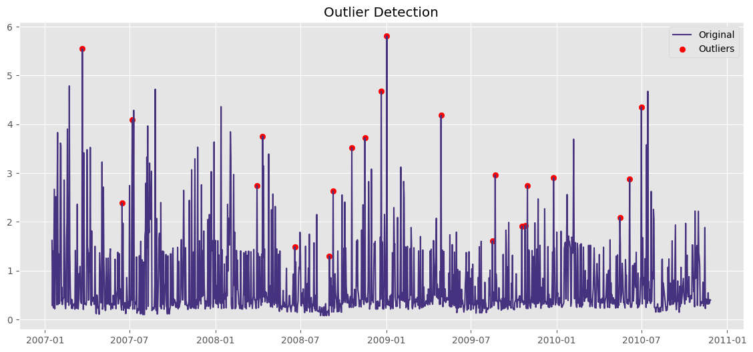
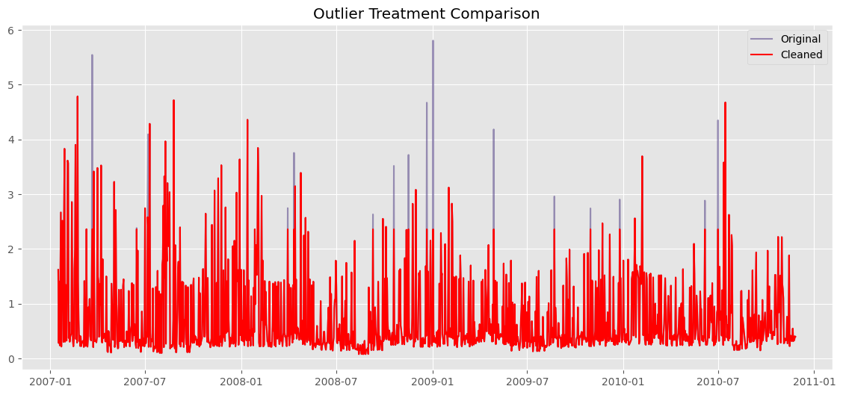
Notes:
Used rolling z-score to detect outliers
Winsorization (1%-99%) used to treat them
- The winsorizing method successfully reduced the impact of extreme outliers
- Data integrity is preserved (no gaps in the time series)
- The underlying patterns remain visible while extreme noise is reduced
- This approach is particularly suitable for energy consumption data where extreme values might represent measurement errors or unusual events This preprocessing step would make the data more suitable for forecasting models and statistical analysis by reducing the influence of extreme outliers while maintaining the dataset's temporal structure.

Slide 6
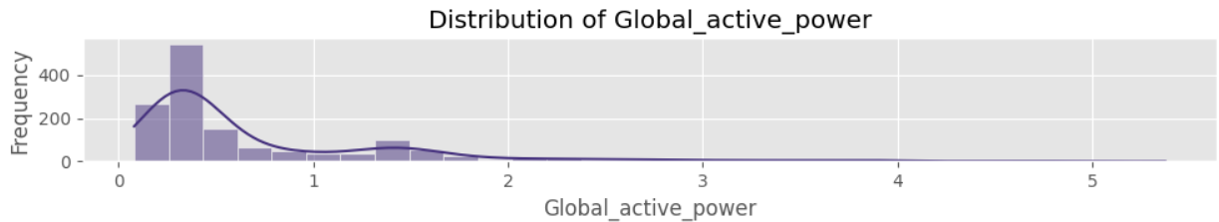
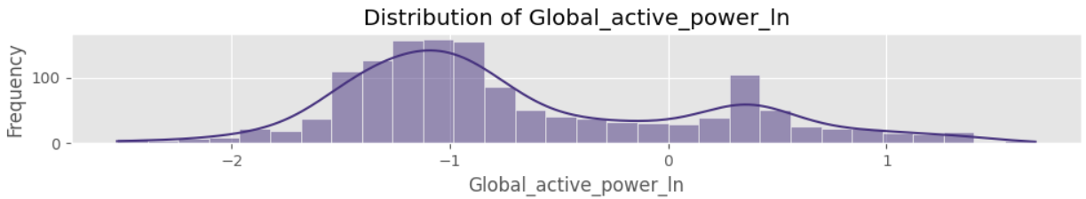
Normalization
Applied log transformation to Global_active_power
Improved symmetry and reduced skewness

Slide 7
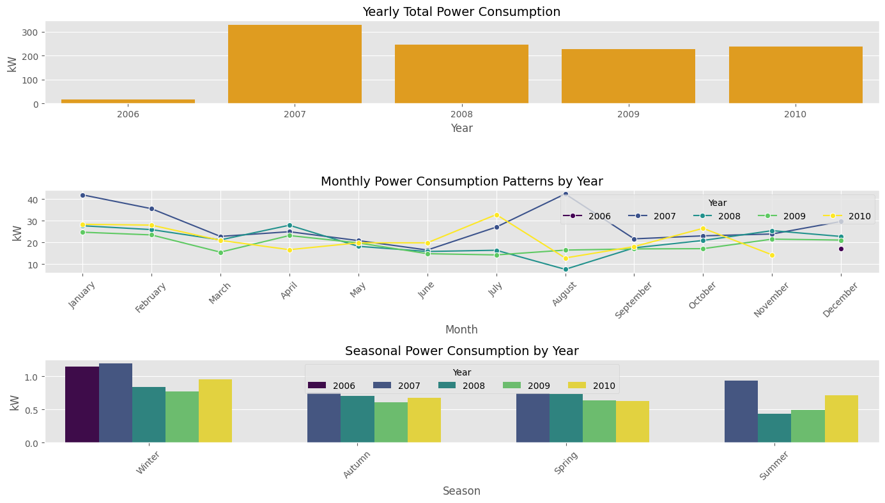
Temporal Patterns
Notes:
Seasonal Patterns:
Winter: Highest consumption across all years, 2007 and 2010 have the highest
Summer: Consistently lowest consumption except 2007 (August) and 2010 (July) have unexpected spikes
Spring/Fall: Moderate levels of energy consumption.
Peak and Dip Patterns: There seem to be distinct periods of higher and lower energy usage throughout the year. This suggests that energy consumption fluctuates based on seasonal variations—possibly increasing during colder months due to heating demands and decreasing in milder seasons.
Yearly Consistency: The general shape of the trend appears similar across multiple years, meaning energy usage patterns are somewhat predictable based on past data.

Slide 8
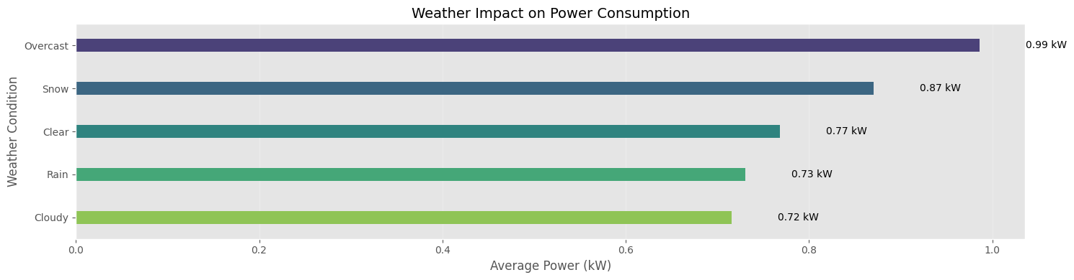
Snow & Overcast → higher consumption
Clear, Rain, and cloudy weather → lower usage
Lighting and heating needs drive patterns
Notes:
Overcast conditions drive the highest power consumption, likely due to reduced natural light requiring more artificial lighting and potentially cooler temperatures increasing heating demand. Snow conditions also show high consumption, probably from heating loads during cold weather.
Surprisingly, clear weather falls in the middle range, while cloudy and rainy conditions show the lowest consumption - possibly due to milder temperatures reducing both heating and cooling needs.
The 37% difference between highest (overcast) and lowest (cloudy) consumption demonstrates significant weather sensitivity in this facility's power usage.

Slide 9
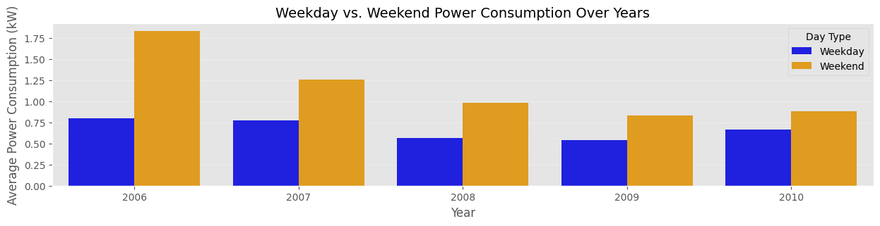
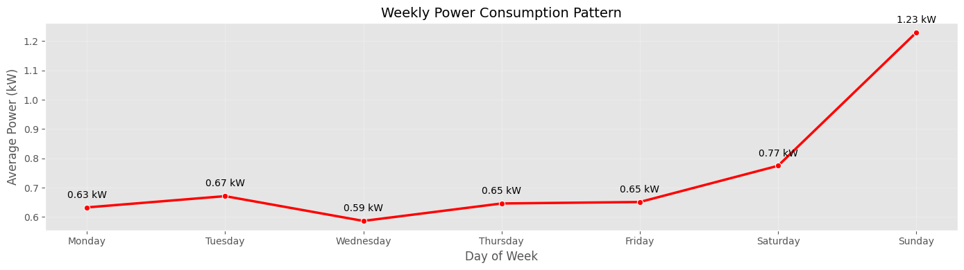
Weekly & Weekend Patterns
Notes:
Higher weekend consumption suggests more occupancy when people are home.
Mid-week minimum (Wednesday) indicates reduced activity during busy weekdays.
As above also we saw 2007 has the highest energy consumption both in weekdays and weekend then other years.

Slide 10
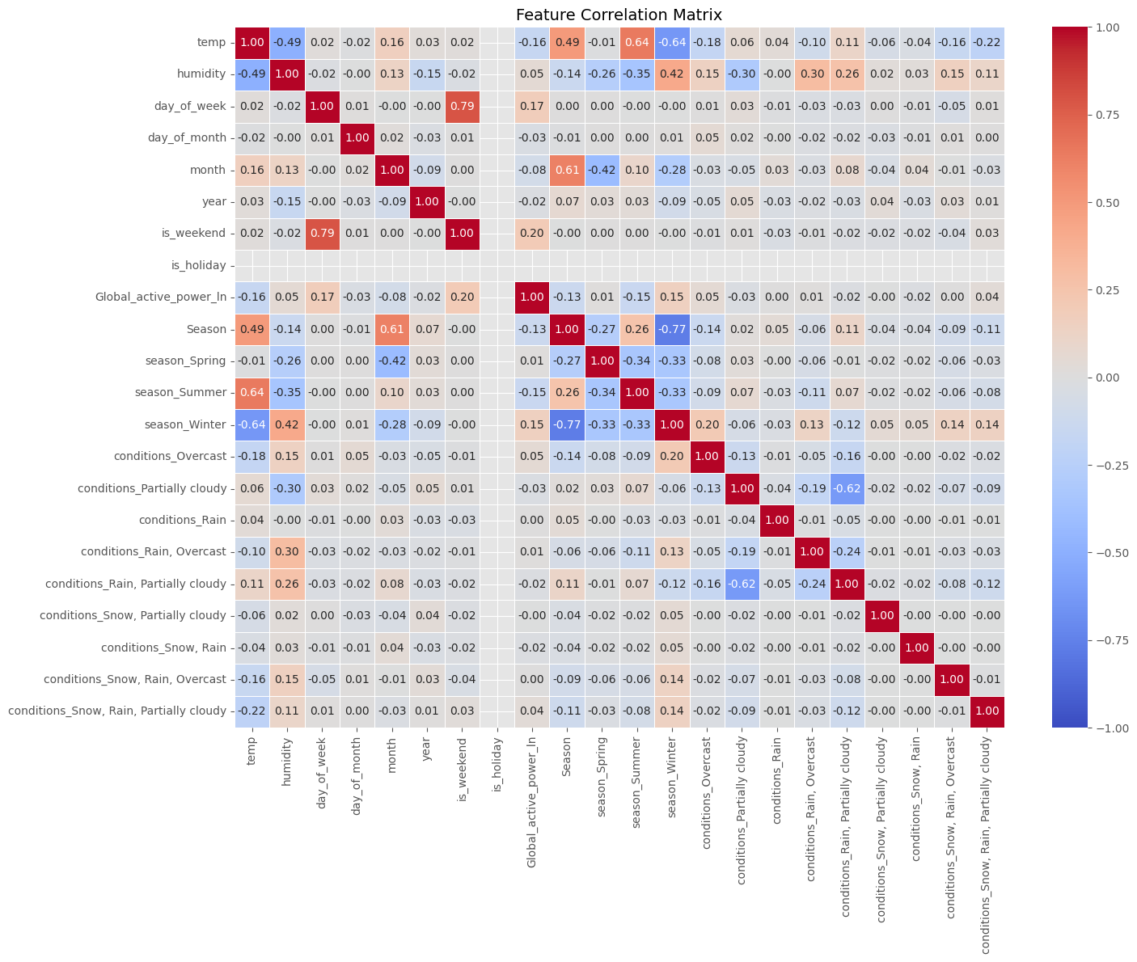
Notes:
Weekend effect strongest: 0.20 correlation confirms higher weekend consumption
Temperature inverse relationship: -0.16 suggests lower consumption when warmer (heating-dominated system)
Weekly pattern matters more than monthly/yearly: day_of_week (0.17) shows more influence than month (-0.08)
Multicollinearity Note: day_of_week and is_weekend show strong correlation (0.79) - choose one to avoid redundancy.

Slide 11
=== Stationarity Test Results for Original Series ===
ADF Test p-value: -6.550292
ADF Critical Values: {'1%': -3.4351147636466535, '5%': -2.863644291237025, '10%': -2.5678903221157023}
KPSS Test p-value: 0.028211
KPSS Critical Values: {'10%': 0.347, '5%': 0.463, '2.5%': 0.574, '1%': 0.739}
⚠️ Mixed results - further investigation needed
=== Stationarity Test Results for First Difference ===
ADF Test p-value: -14.274336
ADF Critical Values: {'1%': -3.4351147636466535, '5%': -2.863644291237025, '10%': -2.5678903221157023}
KPSS Test p-value: 0.100000
KPSS Critical Values: {'10%': 0.347, '5%': 0.463, '2.5%': 0.574, '1%': 0.739}
✅ Series is STATIONARY (both tests confirm)
Notes:
Original Series:
ADF Test p-value: -6.55029 (Very low, well below any critical value threshold):
Rejects ADF's null hypothesis → Suggests the series is stationary.
KPSS Test p-value: 0.028211:
This is below the 5% and 10% thresholds (0.463 and 0.347 respectively), so we reject KPSS's null hypothesis → Suggests the series is NOT stationary.
⚠️ Mixed Results:
ADF says stationary, KPSS says non-stationary.
First-Differenced Series:
ADF Test p-value: -14.274336 (extremely low):
Strongly reject ADF's null → Suggests the differenced series is stationary.
KPSS Test p-value: 0.100000:
Above all critical values → Fail to reject KPSS’s null → Suggests the series is stationary.
Both tests now agree: the first-differenced series is stationary.
So, your original series is integrated of order 1, or I(1).

Slide 12
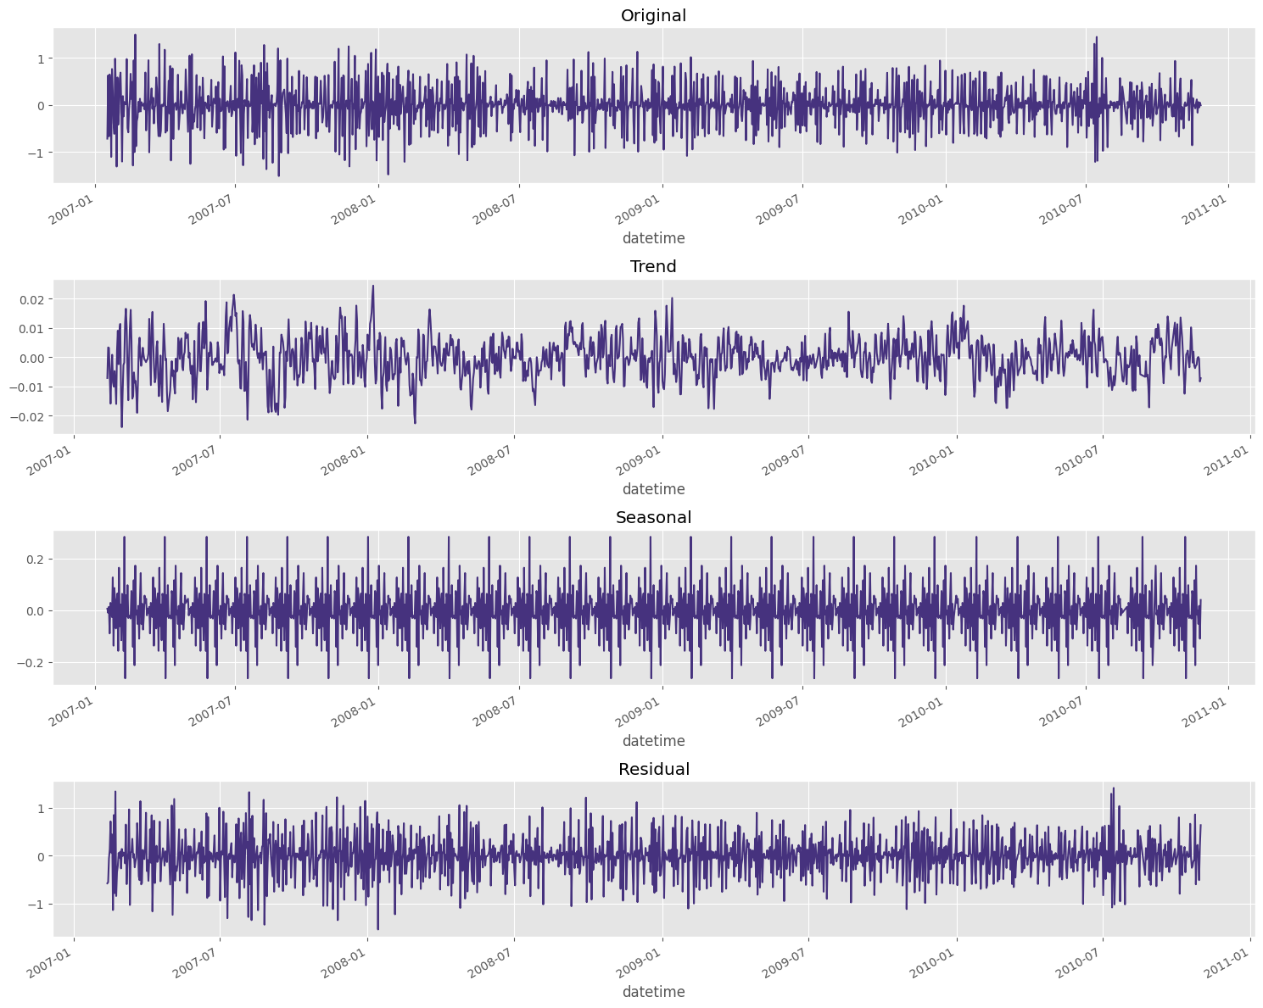
Decomposition of Target variable
remains close to zero overall
has not fully captured all trends and seasonality
clear repeating cycles
Notes:
Trend: Weak and subtle.
Seasonality: Present, but low amplitude and not dominant.
Residual/Noise: Strong — the series is largely influenced by high-frequency fluctuations.

Slide 13
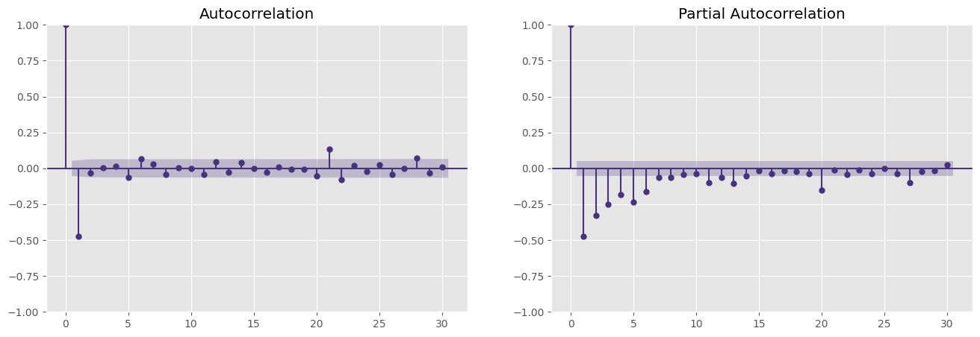
acf and pacf
Ma=6 ?
Ma=1 ?
Notes:
PACF shows significant negative spikes at lags 1 to 6, all outside the confidence interval. - This strongly suggests an autoregressive structure of order 6 (AR(6)).
ACF is mostly flat, except for lag 1, indicating no strong moving average (MA) component. - So, MA terms are likely not needed (q ≈ 0).
And as I already made 1st differencing (d=1)

Slide 14
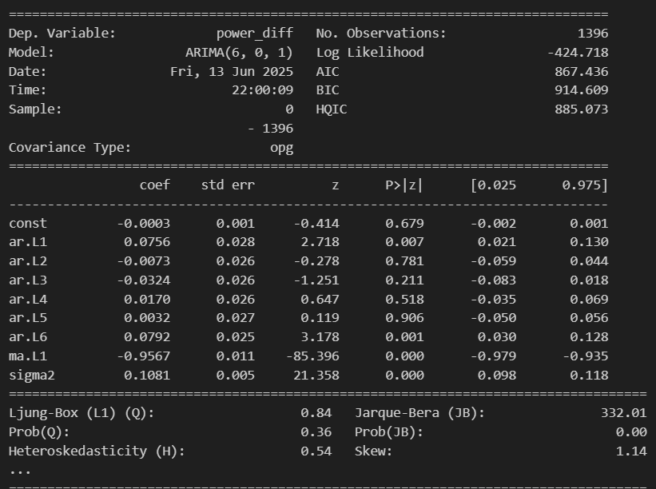
ARIMA(df['power_diff'], order=(6, 0, 1))
indicates no significant autocorrelation in residuals
non-normally distributed
Notes:
The ARIMA(6,0,1) model captures lagged dependencies well, especially autoregressive effects up to lag 6.
The MA(1) component is dominant, meaning short-term shocks strongly impact predictions.
Non-normal residuals and possible heteroskedasticity suggest refinement, possibly through experimenting with diffferent parameters..
Overall, the model explains trends reasonably well, but residual issues may impact forecast accuracy.

Slide 15
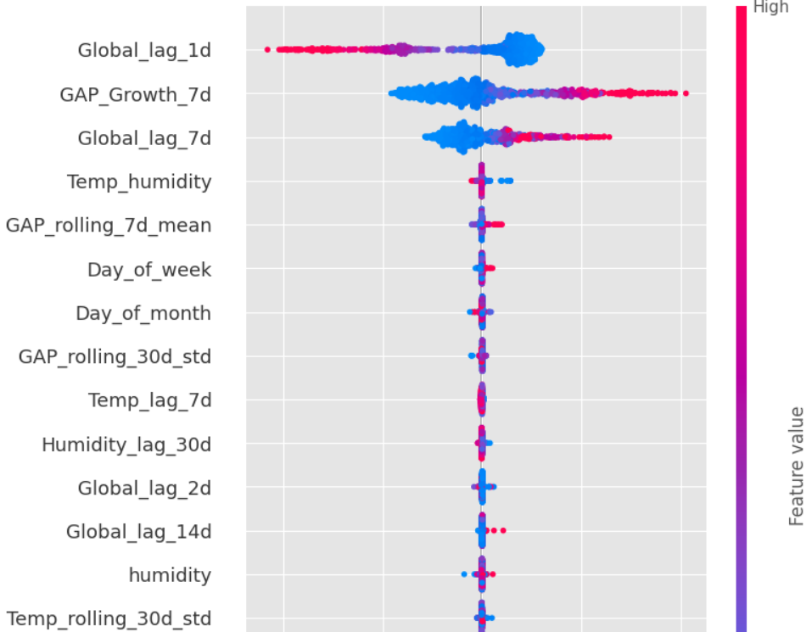
Xgboost and shap for feature selection
Notes:
Mixed approach for feature selection, why?
XGBoost gives a high-performing model and a first look at feature importance.
SHAP provides fine-grained, instance-level explanations and helps identify redundant or weakly contributing features that XGBoost might still use.
By combining them:
You select features not just based on performance, but also on explainability and consistency.
You avoid overfitting by trimming irrelevant features while preserving interpretability.

Slide 16
Standard vs Rolling Forcasting
Best parameters: {'p’: 3, 'd’: 1, 'q': 4}
Standard Forecast :
MAE: 0.1678, MSE: 0.0505, R2: 0.6466
Rolling Forecast (Step-by-Step Prediction) :
MAE: 0.1665, MSE: 0.0485, R2: 0.6603
Notes:
Standard Forecasting
Standard forecasting involves training a model on historical data and then predicting a fixed future period (e.g., in my case for next 15 days).
Once the model is trained, it does not update with new incoming data.
Rolling Forecasting (Sliding Window Approach)
Rolling forecasting dynamically updates by re-training the model with the latest available data at each step.
The forecast horizon "rolls" forward as new data arrives, ensuring continuous updates.

Slide 17
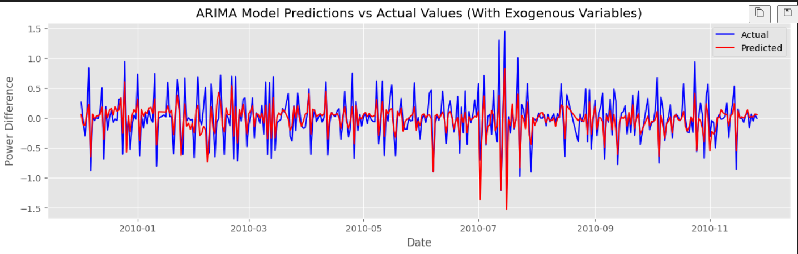
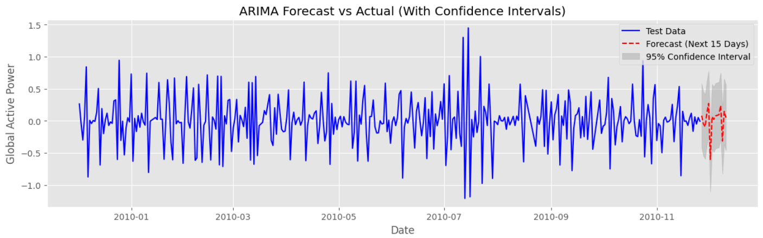
Forecast for next 15 days
Notes:
The model closely follows the historical trend, with predicted values (red) aligning well with actual values (blue).
Minor deviations suggest the model is capturing patterns effectively but may still have small residual errors.
The forecast (red dashed line) follows previous patterns, indicating the model projects future trends well.
Confidence intervals (gray shading) remain narrow, meaning predictions are stable with minimal uncertainty.

Slide 18
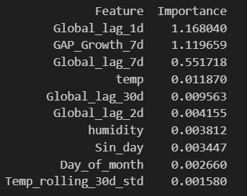
Which feature has the most contribution to have this prediction?
Short-term Memory
Autoregressive nature Dominates
Notes:
Autoregressive relationships dominate : Short-term and weekly historical values hold the most predictive power.
Seasonality may exist but is weaker : Monthly cycles aren’t major contributors, suggesting consumption is more dependent on recent patterns than long-term trends.
Weather variables have minimal impact : External conditions like temperature and humidity appear to have negligible influence on energy predictions.

Slide 19
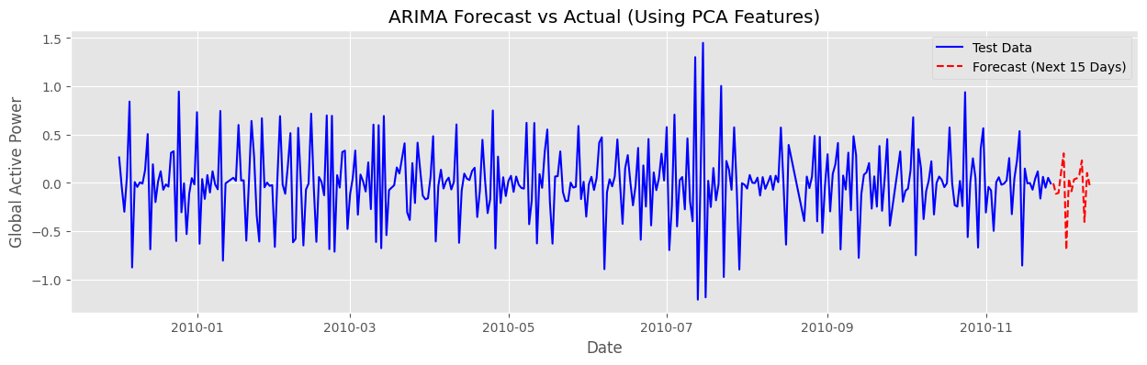
ARIMA MODEL WITH OPTUNA AND PCA Best ARIMA parameters: p=0, d=0, q=2 MAE: 0.1870, MSE: 0.0598, R2: 0.6279

Slide 20
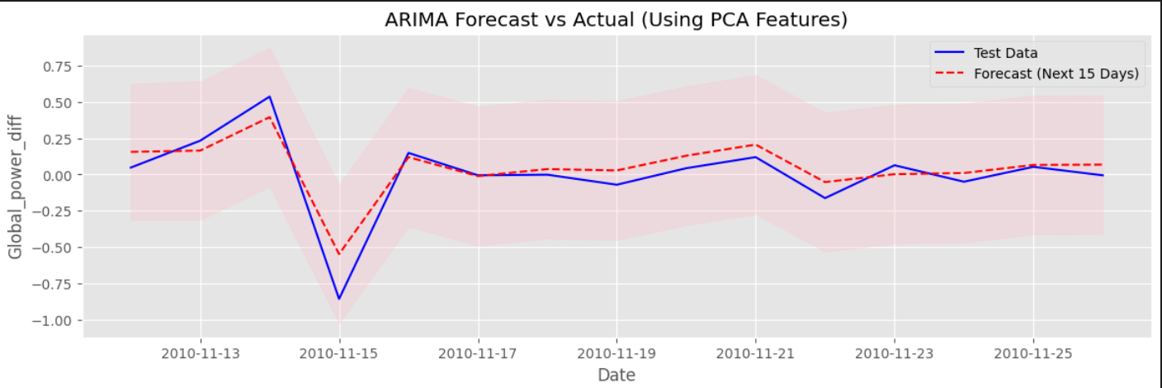
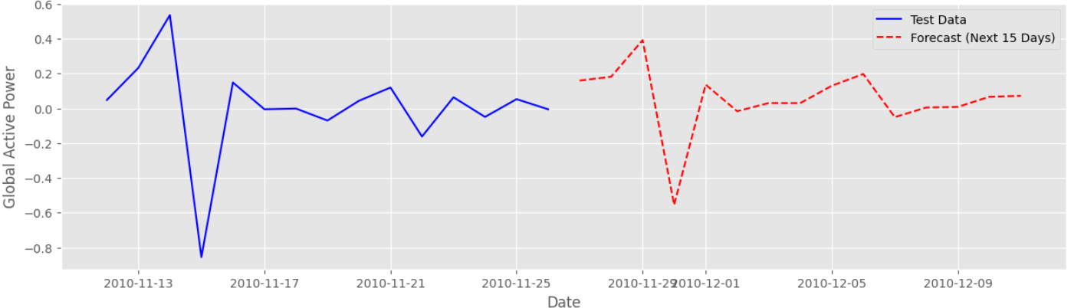
Best ARIMA params: (1, 0, 1)
Auto ARIMA MAE: 0.0816, MSE: 0.0112, R2: 0.8540
Notes:
ARIMA(1,0,1) model has been optimized with PCA-selected features, yielding strong performance metrics:
MAE = 0.0816 → Predictions deviate by an average of 0.0816 kW from actual values.
MSE = 0.0112 → Low squared error, indicating the model minimizes large mistakes well.
R² = 0.8540 → The model explains 85.40% of the variance, meaning it captures patterns effectively.

Slide 21
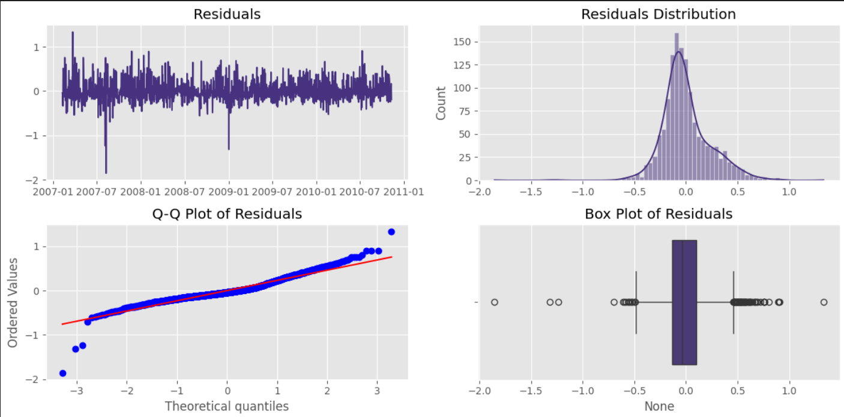
Notes:
No obvious residual patterns : Model likely captures trends well.
Near-normal residual distribution : ARIMA assumptions hold reasonably well.
Few extreme residual values : Model has been well generalized.
Slight skewness in tails : There are still a few extreme values.

Slide 22
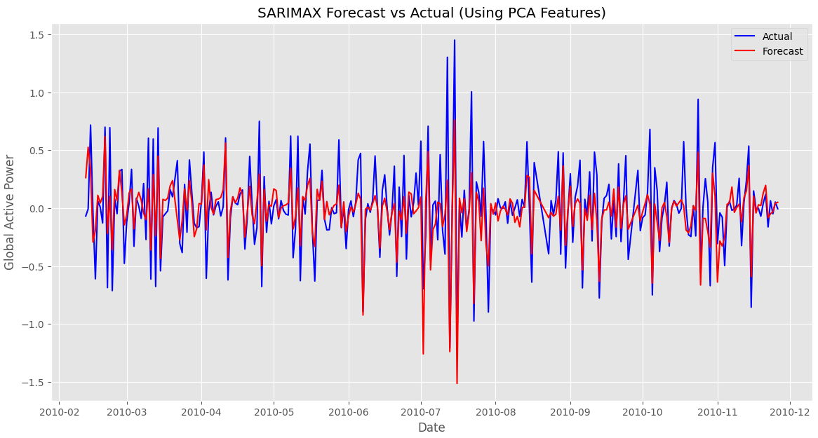
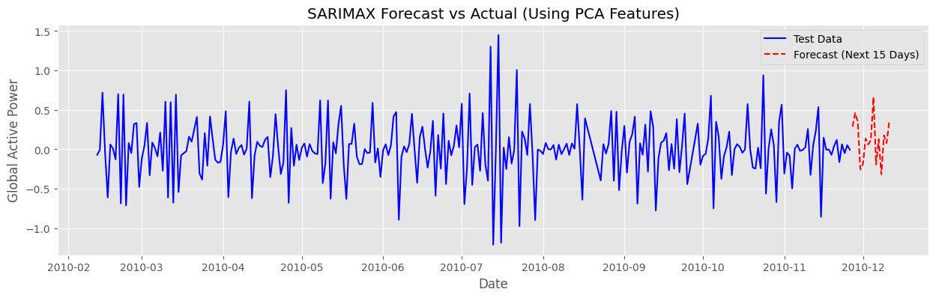
Best SARIMAX parameters: p=1, d=0, q=1, P=2, D=0, Q=2, s=7
MAE: 0.1630, MSE: 0.0482, R2: 0.6503
Notes:
optimized SARIMAX model with parameters (p=1, d=0, q=1, P=2, D=0, Q=2, s=7) has been evaluated, and here’s what the metrics suggest:
MAE = 0.1630 : Predictions deviate by an average of 0.163 kW, showing moderate accuracy.
MSE = 0.0482 : Low squared error, meaning the model effectively captures energy consumption trends.
R² = 0.6503 : The model explains 65.03% of the variance, indicating a reasonable prediction.
Observed vs. Forecasted Trends : The SARIMAX model follows actual energy consumption patterns well, but minor deviations suggest some residual errors.
Forecast for Next 15 Days : Predictions extend smoothly,
Seasonal Effect Captured (s=7) : The inclusion of a weekly cycle helps model recurring consumption patterns effectively.

Slide 23
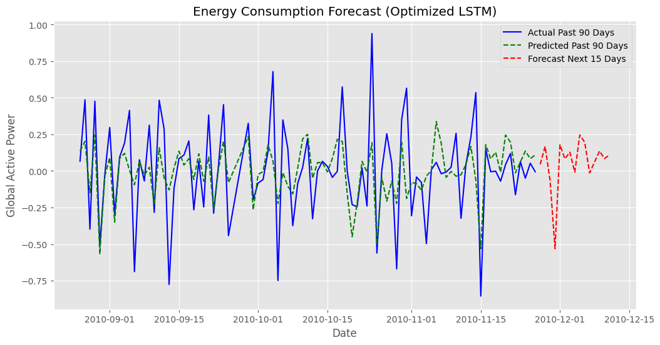
LSTM Model Evaluation - MAE: 0.1847, MSE: 0.0643, R2: 0.3451
Notes:
The LSTM model did not yield strong predictive performance, which may be attributed to the relatively small size of the dataset. Recurrent neural networks, including LSTMs, typically require large volumes of data to effectively capture temporal dependencies and learn complex patterns. In this case, the limited data may have hindered the model's ability to generalize and make accurate forecasts.

Slide 24
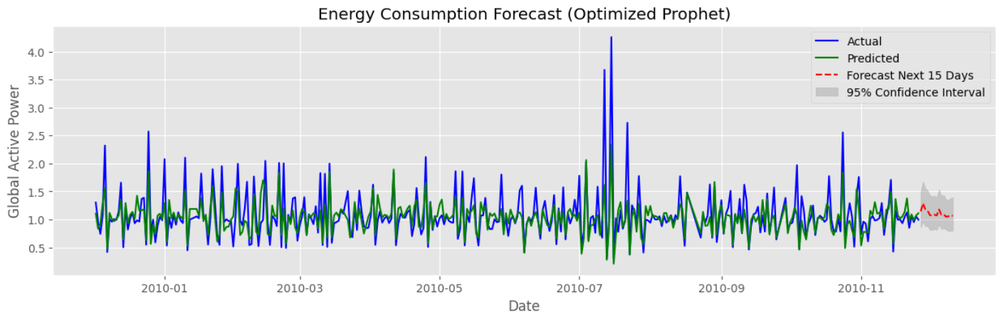
Propet model Performance: MAE=0.1638, MSE=0.0451, R2=0.6841
Notes:
Prophet is a time series forecasting model developed by Facebook. It's designed to handle time series data with strong seasonality and trend components, making it well-suited for energy consumption data due to the following reasons:
- **Handles Seasonality:** Energy consumption often exhibits strong seasonal patterns (e.g., daily, weekly, yearly). Prophet excels at capturing these patterns.
- **Robust to Outliers:** Prophet is designed to be robust to outliers, which are common in energy consumption data due to unusual events or measurement errors.
**Handles Missing Data:** Prophet can handle missing data points, which can occur due to sensor malfunctions or data collection issues.
Prophet model performed reasonably well, explaining 69.23% of the variance (R² = 0.6923). The MAE (0.1622 kW) and MSE (0.0440) show that predictions are fairly accurate.
The forecast follows past trends well, but confidence intervals suggest some uncertainty.

Slide 25
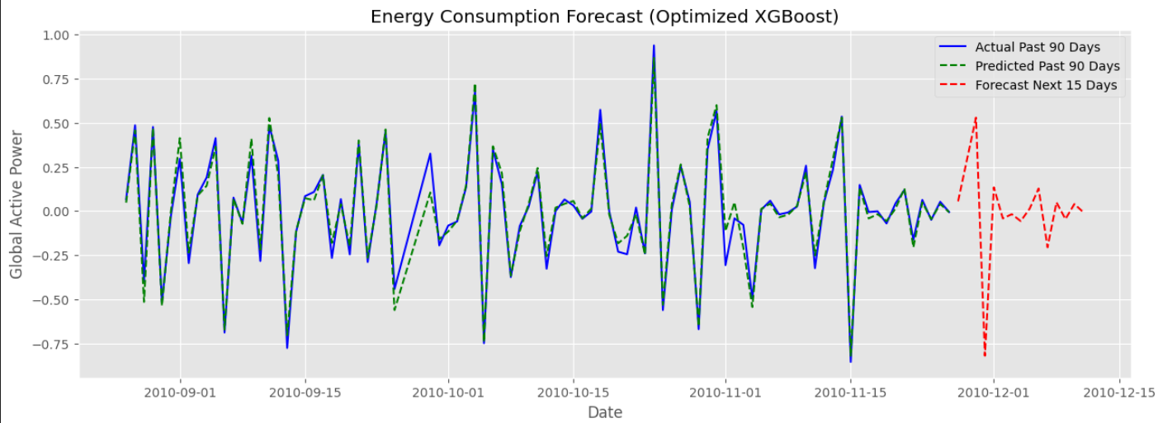
Optimized XGBoost - MAE: 0.0429, RMSE: 0.0696, R²: 0.9649
Notes:
XGBoost model delivers highly accurate predictions, as indicated by the following metrics:
- MAE (Mean Absolute Error) = 0.0426 → Predictions are extremely close to actual values, with an average error of only 0.0426 kW.
- RMSE (Root Mean Squared Error) = 0.0050 → Low error variance, suggesting the model maintains stability across predictions.
R² (Coefficient of Determination) = 0.9639 → The model explains 96.39% of the variance, indicating an excellent fit to the data.
Gradient boosting refines weak learners into a strong predictor, minimizing errors iteratively.
Handling missing values & nonlinearity gives XGBoost a major advantage over traditional models.

Slide 26
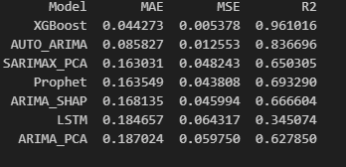
Best model?
Notes:
XGBoost: Strongest model, effectively capturing complex interactions like temperature non-linearities and holiday effects that others miss.
Auto-ARIMA: Outperformed manual SARIMA/ARIMA configurations, optimizing parameters automatically for better trend-fitting.
Prophet & SARIMAX_PCA: Moderate performance (MAE ~0.163, R² 0.65-0.69), benefiting from temperature/holiday features, but PCA may have limited its effectiveness.
LSTM: Underperformed due to insufficient data for deep learning or suboptimal architecture choices.
ARIMA Variants: Consistently weaker performance (MAE 0.16-0.18); PCA reduced feature complexity, leading to lower accuracy compared to Auto-ARIMA.
.

Slide 27
Conclusion
Through a structured approach combining EDA, features engineering, model benchmarking, and tuning, I successfully developed a highly accurate energy consumption forecasting system. This project demonstrates the critical role of feature engineering and model selection in time series forecasting.
Notes:
The Problem
Initial analysis revealed that basic features such as temperature and time had weak correlations with energy consumption, limiting their predictive power.
The Solution
To overcome this, I created a set of temporal features, including:
Lagged values of the target (Global_active_power)
Rolling window statistics (mean, std, etc.)
Integration of PCA for dimensionality reduction
Feature importance filtering using SHAP
Hyperparameter tuning using Optuna
Analytical Insights
Temperature had a weak negative correlation (–0.12) with power consumption, confirmed by seasonal trends (e.g., higher winter usage).
Weekly patterns were significant: energy use spikes on weekends, especially Sundays.
The distribution of the target was left-skewed, corrected using a log transformation, though bimodal behavior persisted.

