Slide 1
Traffic Accident Analysis in Belgium
A comprehensive analysis of traffic accident patterns
Identifying key trends and risk factors
2019-2023
Gokarna Bhusal
Syntra AB, Leuven
01.04.2025

Slide 2
Questions to be answered:
Which factors have the greatest influence on the number and severity of traffic accidents in Belgium?
How do traffic accidents differ by region and time, and are there any trends to be discovered?

Slide 3


Data source:
Open Data | Statbel
Original Data has 176277 rows and 35 columns
Clean/Validated Data has 176274 rows and 20 columns

Slide 4
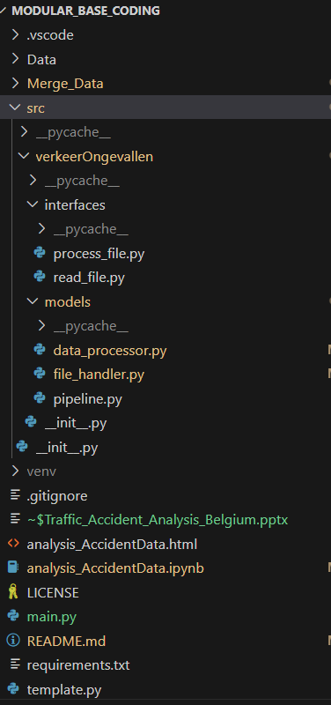
Project Structure and Approach
To handle the data efficiently, the project follows a modular codebase approach, which includes:
Modular Design: Code is organized into independent modules for scalability and reusability, such as:
Interfaces for file processing.
Models for data handling and pipelines.
Data Reading: Read data from multiple files and format
Validation and Preprocessing: Quality check.
Transformation: Saved cleaned data.

Slide 5
Yearly Accident Trends (2019-2023)
2019 | 2020 | 2021 | 2022 | 2023
37,718 | 30,250 | 34,659 | 37,650 | 36,855
Key Findings:
• Significant drop in accidents in 2020 (30,250) likely due to COVID-19 restrictions.
• Gradual recovery in accident numbers from 2021 onwards.
• 2019 and 2022 show similar accident rates (37,718 and 37,650).
• Slight decrease in 2023 compared to 2022

Slide 6
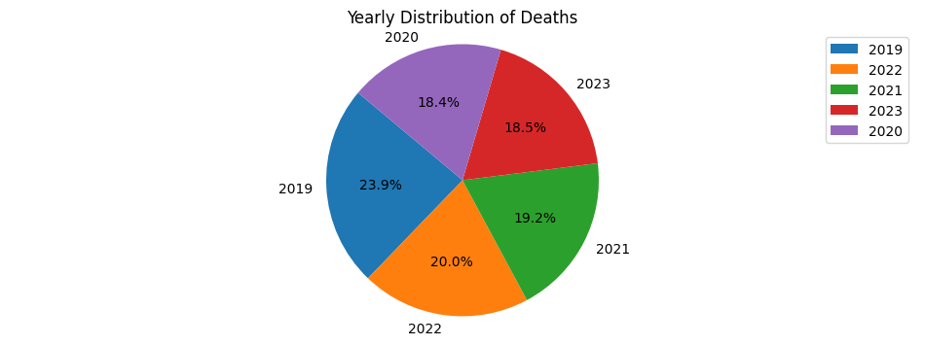
Year | 2019 | 2020 | 2021 | 2022 | 2023
Death | 1065 | 821 | 853 | 892 | 822
Observation:
The data indicates that 2019 and 2022 recorded the highest number of deaths. However, the overall trend shows a decline in numbers over the years, which is a positive sign in the context of fatality reduction.

Slide 7
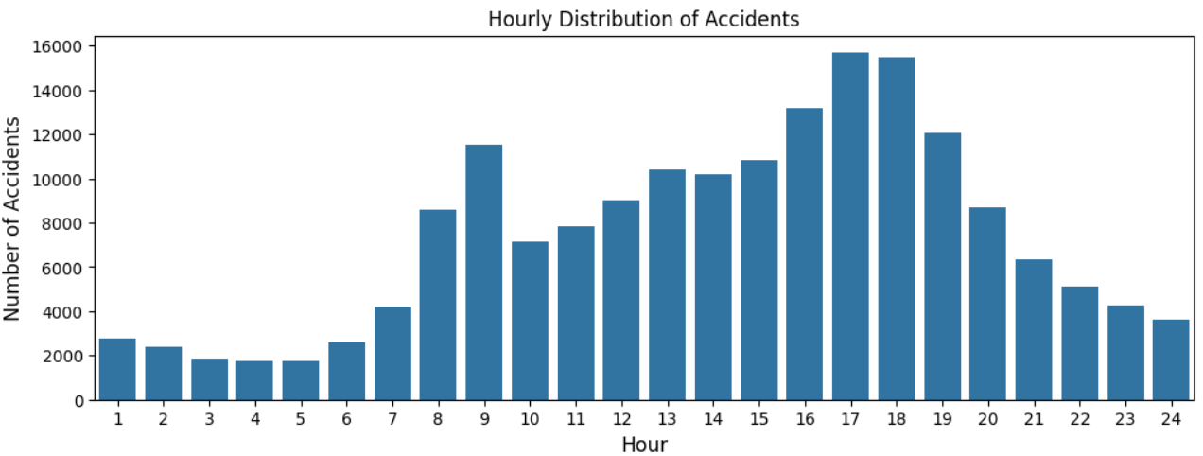
Key Findings:
• Peak accident hours: 16:00-19:00 (evening rush hour)
• Secondary peak: 8:00-9:00 (morning rush hour)
• Lowest accident rates: 2:00-5:00 (early morning hours)
• Clear correlation between traffic volume and accident frequency

Slide 8
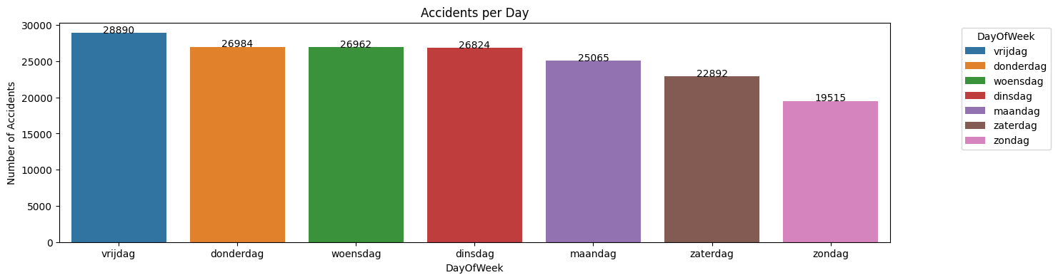
Daily Distribution of Accidents
Key Findings:
• Friday has the highest number of accidents (28,890).
• Weekdays (Monday-Friday) show consistently high accident rates.
• Weekend days have significantly fewer accidents.
• Sunday has the lowest accident rate (19,515)

Slide 9
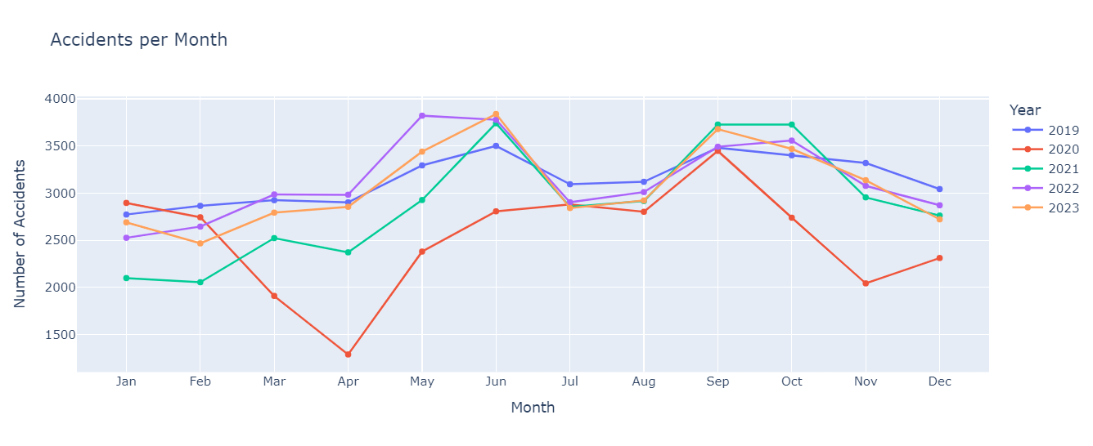
Monthly Distribution of Accidents
Key Findings:
• Highest accident rates in September (17,827) and June (17,666).
• Elevated accident rates in May and October.
• Lower accident rates in winter months (December-February).
• April shows the lowest accident rate among all months (12,401). 2020 because of lockdown(18 mar-4 mei) numbers were decreased.

Slide 10
Accidents by Region
Vlaams Gewest
Waals Gewest
Brussels Hoofdstedelijk
Gewest
Accidents:
109,211
Accidents:
49,281
Accidents:
18,640
Fatalities:
2352
Fatalities:
1986
Fatalities:
115
Serious Injuries:
10,667
Serious Injuries:
3,514
Serious Injuries:
795
Key Findings:
• Vlaams Gewest (Flanders) has the highest number of accidents (109,211) with (52.8%) death cases
• Waals Gewest (Wallonia) has a high fatality rate (44.6%) relative to accident numbers (49,281).
• Brussels has the lowest accident and fatality numbers, likely due to lower speeds and better urban traffic management.

Slide 11
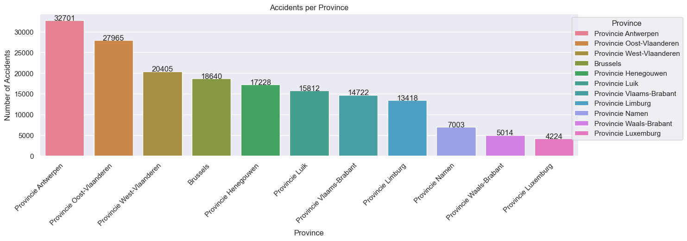
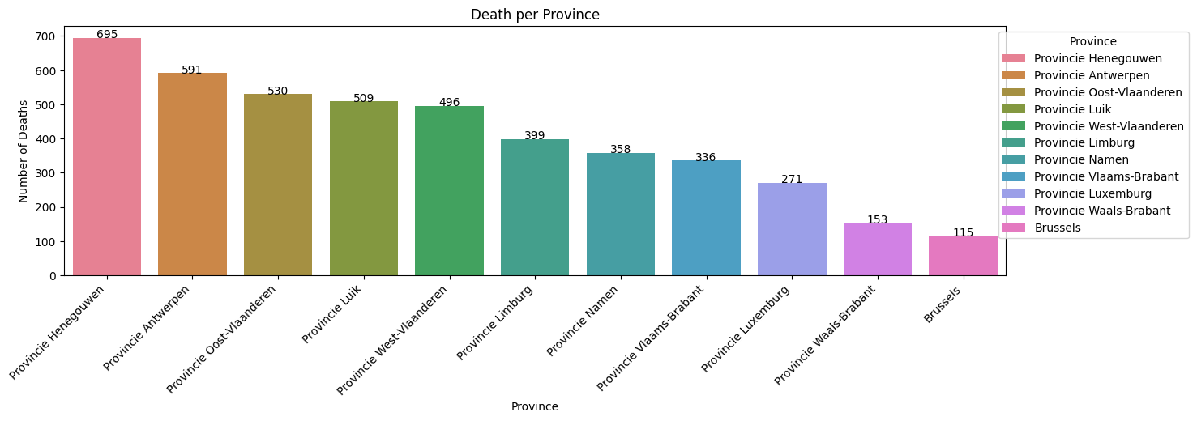
Top Provinces by Accident Count
Key Findings:
• Provincie Antwerpen has the highest number of accidents (32,701). However, deaths are relatively fewer (591, 1.80 %) than in Henegouwen.
• Provincie Henegouwen has a disproportionately high fatality rate (695, 4.03%) from total death cases despite having fewer accidents than other provinces.
• Brussels shows a low fatality rate (115(45+70)) relative to its accident count (18,640)
• The top three provinces (Antwerpen, Oost-Vlaanderen, West-Vlaanderen) account for 46% of all accidents.

Slide 12
Top 10 Municipalities by Accident Count
Key Findings:
MUNICIPALITY | ACCIDENTS | FATALITIES (On the spot) | SERIOUS INJURIES
Antwerpen | 12,283 | 34 | 806
Brussel | 6,302 | 16 | 282
Gent | 6,167 | 24 | 473
Luik | 3,749 | 25 | 130
Charleroi | 3,290 | 32 | 205
Brugge | 2,613 | 23 | 224
Leuven | 2,168 | 6 | 140
Anderlecht | 1,922 | 8 | 73
Sint-Niklaas | 1,906 | 10 | 170
Elsene | 1,729 | 3 | 67
• Antwerpen has significantly more accidents than any other municipality.
• Charleroi has a high fatality rate relative to its accident count.
• Large cities (Antwerpen, Brussel, Gent) account for a significant portion of all accidents.

Slide 13
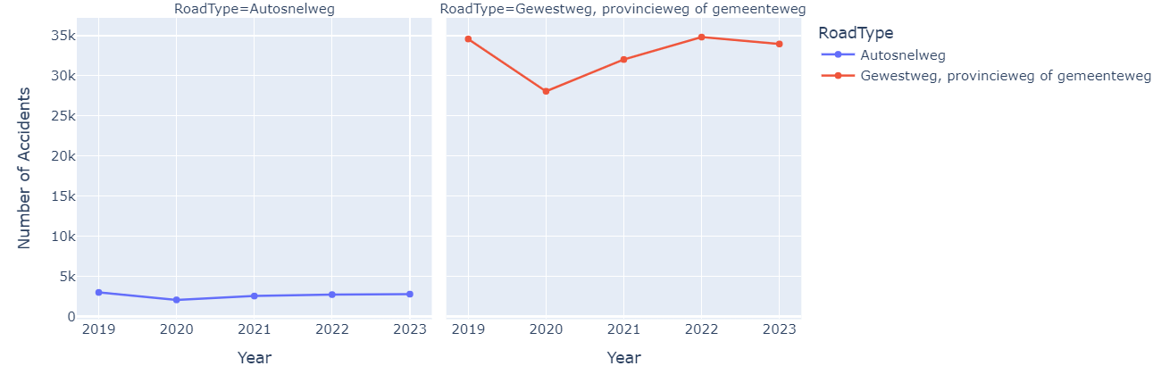
Accidents by Road Type

Slide 14
Accidents by Road Type
Highways (Autosnelweg)
Regional/Provincial/Municipal Roads
Total Accidents: 13,001(7.4%)
Fatalities: 355(On the spot)
Total death: 757 (17.1)
Chance of death: 5.82%
Serious Injuries: 1,062
Total Accidents: 163,471(92.6%)
Fatalities: 1,539(On the spot)
Total death: 3669 (82.89%)
Chance of death: 2.24%
Serious Injuries: 13,864
Yearly Trend (2019-2023):
Yearly Trend (2019-2023):
Key Findings:
• Regional/provincial/municipal roads account for 92.6% of all accidents.
• Highways have a higher fatality rate (2.7%/On the spot) than other roads (0.9%/On the spot).
• Both road types showed a significant decrease in accidents in 2020 due to COVID-19.
• Accident numbers have returned to pre-pandemic levels for both road types

Slide 15
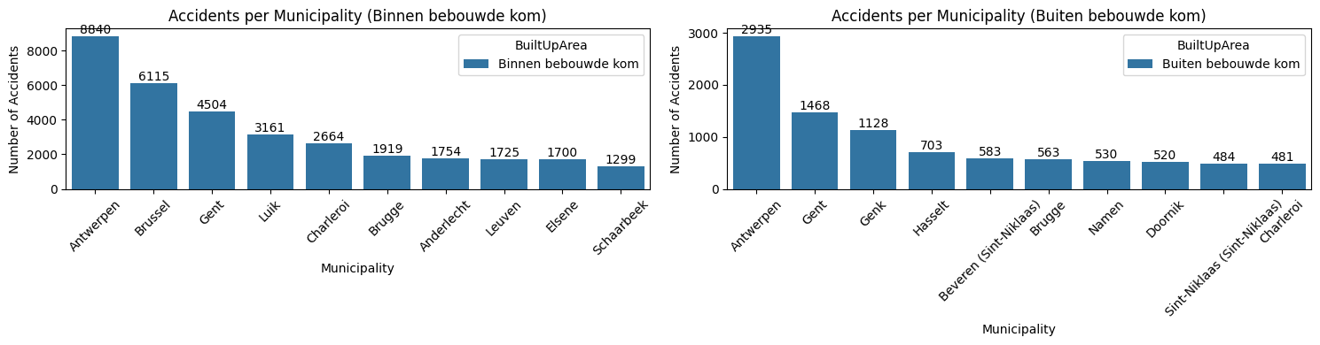
Accidents by Location

Slide 16
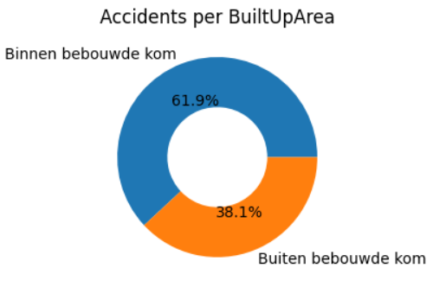
Accidents by Location
Within Built-up Areas
Outside Built-up Areas
64,623
accidents
105,060
accidents
Key Findings:
• 62% of accidents occur within built-up areas.
• Antwerpen has the highest number of accidents both within and outside built-up areas
• The distribution of accidents between built-up and non-built-up areas has remained consistent over the years

Slide 17
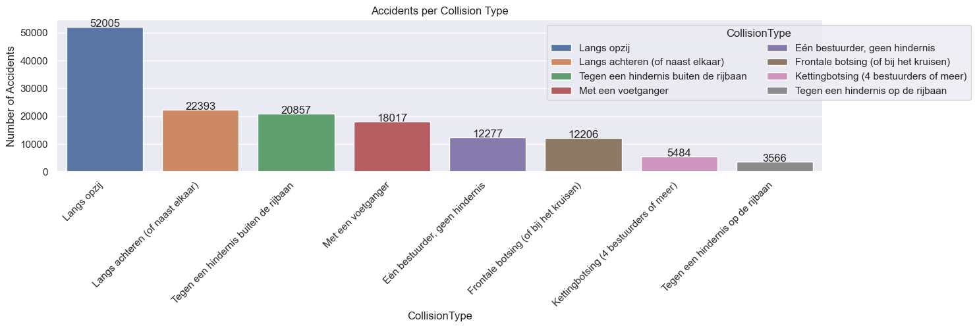
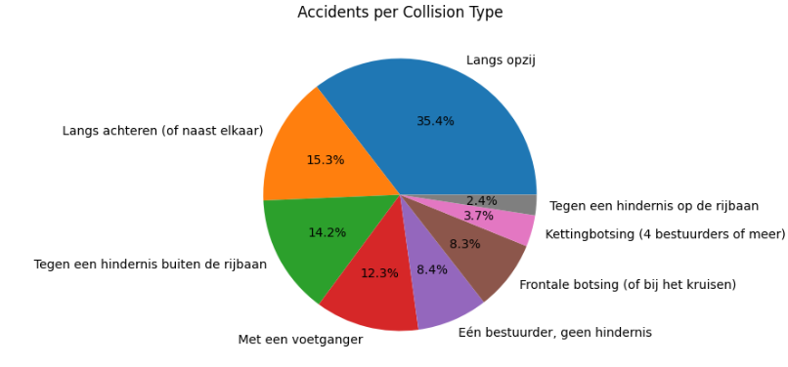
Accidents by Collision Type
Insights:
Langs opzij (Side collisions): Representing a substantial portion (35.4%), it highlights intersections as critical points needing better traffic management.
Langs achteren (Rear-end collisions): With 15.3%, it emphasizes possible issues like tailgating or sudden stops.
Tegen een hindernis buiten de rijbaan (Collisions with obstacles outside the roadway): At 14.2%, this suggests focusing on road conditions and hazards beyond the pavement.
Met een voetganger (Pedestrian collisions): 12.3% stresses pedestrian safety improvements.

Slide 18
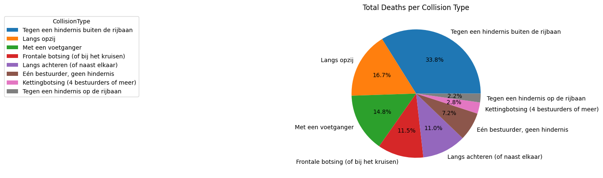
Key Findings:
Most Fatal Collision Type: The highest proportion of deaths (33.8%) occurs in collisions with an obstacle outside the roadway, indicating this is the most dangerous scenario.
Side Collisions: Side impact collisions (16.7%) rank second in fatalities, suggesting significant risks in situations involving lateral impacts.
Pedestrian Collisions: Pedestrian-related accidents account for 14.8% of fatalities, highlighting the importance of measures like safe crossings and traffic calming near pedestrian zones.
Head-On Collisions: These collisions (11.5%) also contribute substantially to fatalities, reflecting the dangers of opposing traffic crashes.

Slide 19
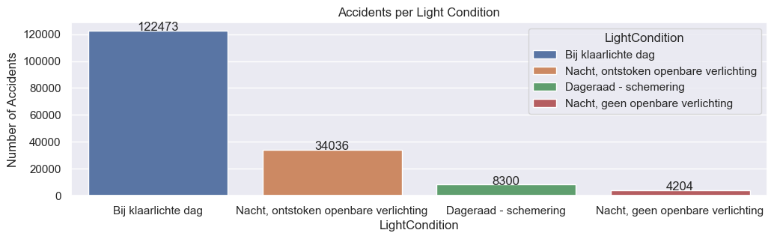
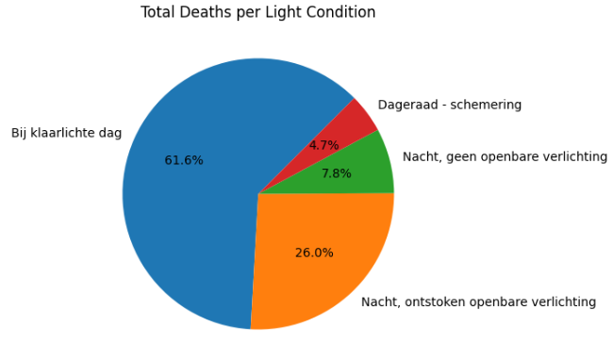
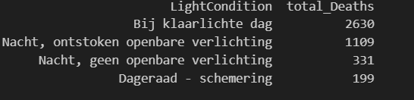
Accidents by Light Condition
Key Findings:
• Most accidents (122473, 65.3%) occur during daylight hours.
• Night accidents with public lighting (34036, 26.2%) are significantly more common than those without lighting (4204, 3.8%).
• Dawn/dusk periods show elevated risk relative to their short duration.
• Brussels has very few accidents at night without public lighting (77) compared to other provinces
Of 100 accidents, 4 cases are with death at night, at daylight, and 2 cases were possible death cases in 100 accidents.

Slide 20
Key Insights
Temporal Patterns
Geographic Patterns
• Rush hours (8-9 AM, 4-7 PM) show highest accident rates
• Fridays have the highest accident rates
• September and June are peak accident months
• Vlaams Gewest has highest accident numbers
• Antwerpen leads in both provincial and municipal accidents
• Urban areas account for 62% of all accidents
Road & Environment Factors
Safety Trends
• Side impacts are the most common collision type (29.5%)
• 92.6% of accidents occur on non-highway roads
• Daylight hours account for 65.3% of all accidents
• COVID-19 caused significant accident reduction in 2020
• Accident numbers have returned to pre-pandemic levels
• Highways have higher fatality rates but fewer total accidents

Slide 21
Recommendations
1
Target High-Risk Times and Locations
Increase enforcement during peak accident hours (4-7 PM) and on Fridays. Focus resources on high-risk provinces like Antwerpen and municipalities with disproportionate accident rates like (In Henegouwen, Namen, and Luxemburg).
2
Improve Road Infrastructure
Enhance road design to reduce side-impact collisions, which account for nearly 30% of all accidents. Focus on intersections in urban areas where these collisions are most common.
Address Collision Types
3
Develop targeted campaigns to address the most common collision types. Promote defensive driving techniques to reduce side-impact and rear-end collisions.
4
Enhance Pedestrian Safety
Implement additional pedestrian safety measures in urban areas, particularly in municipalities with high pedestrian-involved accident rates.
5

Slide 22
Conclusion
This analysis of traffic accidents in Belgium from 2019-2023 reveals clear patterns in accident distribution across time, geography, and environmental conditions.
The data shows that accidents peak during rush hours, on Fridays, and in September. Geographically, Vlaams Gewest and specifically Antwerpen province have the highest accident rates.
The COVID-19 pandemic caused a significant but temporary reduction in accidents in 2020, with numbers returning to pre-pandemic levels by 2022.
By implementing the recommendations outlined in this report, Belgium can work toward reducing traffic accidents and improving road safety for all citizens.

Slide 23

Thank you for your attention!
Q/A Time?

