Slide 1
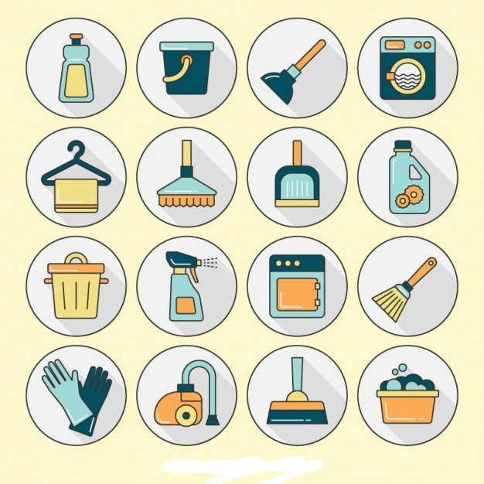

Prepared By:
Bhushan Savale.
Director, Anuvaa Softech Pvt. Ltd.

Slide 2
Know SocietyKatta:
Everything started for good cause brings so many challenges.
Urbanization, Apartment & Society Culture is one good example of this.
To reduce the civilization problem, fulfilling need of houses for increasing population in cities; we created apartments & societies.
but due to differences in culture, languages & busy schedule; maintaining household services, apartment issues & generating solution has become hectic.
Getting genuine people to solve issues is another big challenge.
Costing of services, on time delivery & ethics in business is something to be improved.
On all such issues www.societykatta.com is one stop solution.
Best technology support for creating communication to offline services with guaranteed on time delivery is our unique our unique characteristic.
All rights reserved by Anuvaa Softech Pvt. Ltd. 2018

Slide 3
Current Sytem:
Current system is manual
Time consumption & errors are unavoidable
Tracking mechanism is by using written communication
No follow up or communication medium
Less people to coordinate with management
More trouble in maintenance
No proper vendors
Less legal guidance
Less transparency in accounts
All rights reserved by Anuvaa Softech Pvt. Ltd. 2018

Slide 4
Current Sytem Limitations:
Maintaining details: Maintaining all the details like member, worker, management, and maintenance is very tedious job.
Excess paper work: For maintaining records lots of paper gets wasted.
Searching is very difficult: Searching for details about member, his maintenance, worker etc. is tedious.
Time consuming: Due to manual work, it takes lot of time to record a data as well as for searching.
Misplacement of records: Since records are stores in registers so there is high risk of misplacement of records.
All rights reserved by Anuvaa Softech Pvt. Ltd. 2018

Slide 5
Proposed Solution:
A one stop management and services solution
for the buildings with number of apartments for managing bills, tenants, facilities, resources and services.
All rights reserved by Anuvaa Softech Pvt. Ltd. 2018

Slide 6
What we do:
SocietyKatta.com is society management website with mobile app for Society
What we do:
Managing your society
Managing your guests/tenants/other people
Managing your accounts
Managing your services & facilities
Connecting society members with each other
Along with this:
Different vendors eg. Security, Cleaning etc.
Different services eg. Plumbing, Electrical, Car cleaning, Pest Management etc.
Legal services
Financial Auditing
Medical Support
Resources etc.
All rights reserved by Anuvaa Softech Pvt. Ltd. 2018

Slide 7
Advantages:
GUI: The proposed system will provide better Graphical User Interface.
Search: Searching member, worker details and maintenance details becomes comparatively easy.
Increase work speed: Due to automation of some part of the system work speed will increase.
Less paperwork: For the proposed system less paperwork is required.
Reduced errors: Due to computerized there are less possibilities of errors.
Single Point access: to all the online & offline facilities.
All rights reserved by Anuvaa Softech Pvt. Ltd. 2018

Slide 8
Users of the system:
Admin: will be able to add society members, managers, employees, assigning designation and workload, managing accounts, reminders for dues, notifications, notices, follow ups, polls etc.
Members: will be able to create profile, chat & group forums, classified advertisements, service or facility request, make payments, maintain flat records, guest arrival request etc.
Security: He/she will track of entry & exit, guest request validation, employee daily records etc.
All rights reserved by Anuvaa Softech Pvt. Ltd. 2018

Slide 9
Benefits:
Online Communication
Online payments
Accounts Management
Flat Management
Complaints & tracking
Facility booking
Events & Polls
Service Request as per convenient timing
Door to door service
Verified vendors
All rights reserved by Anuvaa Softech Pvt. Ltd. 2018

Slide 10
Competitors Analysis :
Companies | Charges per flat | On site services | Resource Management
SocietyKatta | 20 | Yes | Yes
ApartmentAdda | 20-22 | No | No
Common Floor | 15-20 | No | No
Society 123 | 20-25 | No | No
Zimmber | NA | Yes | Yes
All rights reserved by Anuvaa Softech Pvt. Ltd. 2018

Slide 11
Thank You..
All rights reserved by Anuvaa Softech Pvt. Ltd. 2018

