Slide 1
Bike sharing Assignment

Slide 2
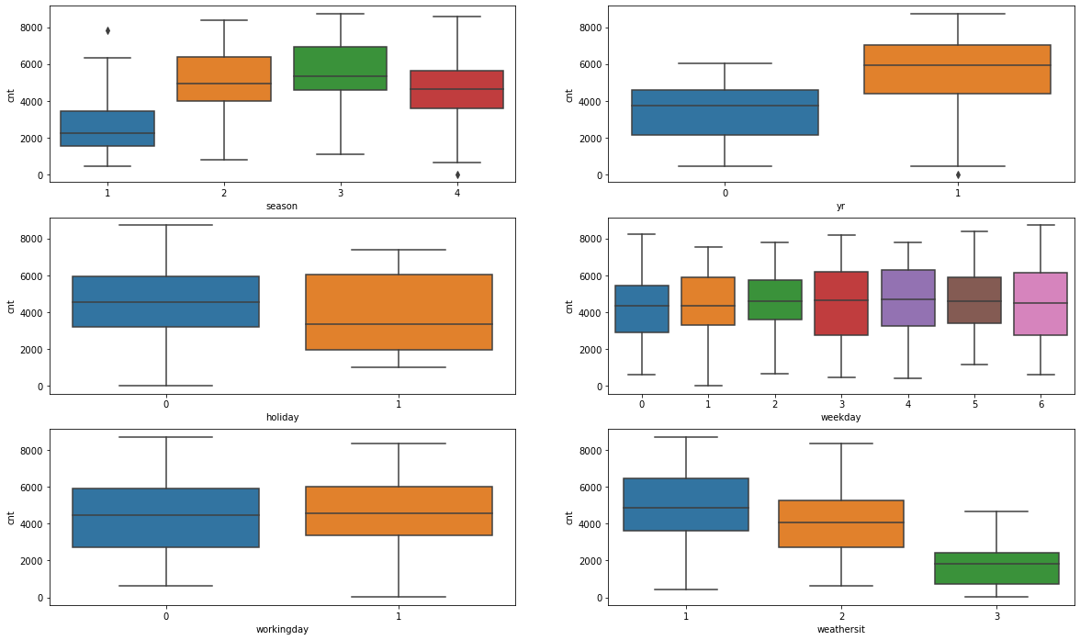
From your analysis of the categorical variables from the dataset,
what could you infer about their effect on the dependent variable?

Slide 3
2019 year has more bikes rented
More bikes are rented during fall season
More bikes rae rented during the normal working day

Slide 4
. Why is it important to use drop_first=True during dummy variable creation?
It helps to reduce the correlations created among the dummy variables
Looking at the pair-plot among the numerical variables,
which one has the highest correlation with the target variable?
➔temp and atemp has hightest correlation
How did you validate the assumptions of Linear
Regression after building the model on the training set?
➔After testing on training set we tested model on test sets ➔ after this we got y pred we plotted
the scatter plot y pred and y test and we took r value test

Slide 5
Based on the final model, which are the top 3 features contributing significantly towards explaining
the demand of the shared bikes?
➔humidity,weatherit,temp

