Slide 1
Statistics and Probability Refresher

Slide 2
Type of data
Numerical
Categorical
Ordinal

Slide 3

Numerical
Represents some sort of quantitative measurement
Heights of people, page load times, stock prices, etc.
Discrete Data
Integer based; often counts of some event.
How many purchases did a customer make in a year?
How many times did I flip “heads”?
Continuous Data
Has an infinite number of possible values
How much time did it take for a user to check out?
How much rain fell on a given day?

Slide 4
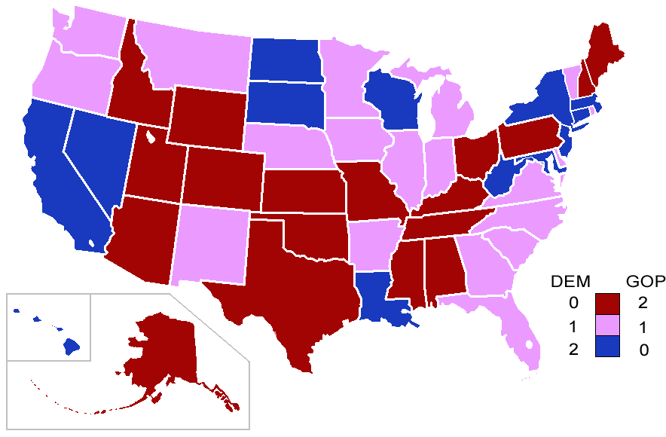
Categorical
Qualitative data that has no inherent mathematical meaning.
Gender, Yes/No (binary data), Race, State
Of Residence, Product Category, Political Party etc.
You can assign numbers to categories in order
to represent them more compactly, but
the numbers don’t have mathematical
meaning.

Slide 5

Ordinal
A mixture of numerical and categorical.
Categorical data that has mathematical meaning.
Example: movie rating on a 1-5 scale.
Ratings must be 1, 2, 3, 4 or 5.
But these values have mathematical meaning,
1 means it’s a worse movie than a 2.

Slide 6
Mean
AKA Average
Sum/number of samples
Example:
Number of children in each house on my street.
0, 2, 3, 2, 1, 0, 0, 2, 0
The Mean is (0+2+3+2+1+0+0+2+0)/9 = 1.11

Slide 7
Median
Sort the values, and take the value at the midpoint.
Example:
0, 2, 3, 2, 1, 0, 0, 2, 0
Sort it:
0,0,0,0, 1, 2,2,2,3
↑

Slide 8

Median
If you have an even number of samples,
take the average of the two in the middle.
Median is less susceptible to outliers than the mean.
Example: mean household income in the US is $72,641
but the median is only $51,939.

Slide 9
Mode
The most common value in a data set.
Not relevant to continuous numerical data.
Example:
0, 2, 3, 2, 1, 0, 0, 2, 0
How many of each value are there?
0:4, 1:1, 2:3, 3:1
The mode is 0

Slide 10
Variation and Standard Deviation
Variance measures how “spread-out” the data is.
Variance(𝜎²) is simply the average of the squared differences from the mean.
Example: What is the variance of the data set (1,4,5,4,8) ?
First, find the mean: (1+4+5+4+8)/5 = 4.4
Now, find the differences from the mean: (-3.4, -0.4, 0.6,
-0.4, 3.6)
Find the squared differences: (11.56, .16, 0.36, 0.16, 12.96)
Find the average of the squared differences:
𝜎2 = (11.56 + -.16 + 0.36 + 0.16 + 12.96) / 5 = 5.04

Slide 11
Variation and Standard Deviation
Standard deviation 𝜎 is just the square root of the variance.
𝜎2 = 5.04
𝜎 = 5.04 = 2.24
This is usually used as a way to identify the outliers.
Data points that lie more than one standard deviation from the mean can be considered unusual.
Population vs Sample
If we’re working with a sample of data instead of an entire data set. Then we have to use the “sample variance” instead of the “population variance”.
For N Samples, we just divide the squared variance by N-1 instead of N.
Population Variance 𝜎2 = (11.56 + -.16 + 0.36 + 0.16 + 12.96) / 5 = 5.04
Sample Variance S2 = (11.56 + -.16 + 0.36 + 0.16 + 12.96) / 4 = 6.3

Slide 12
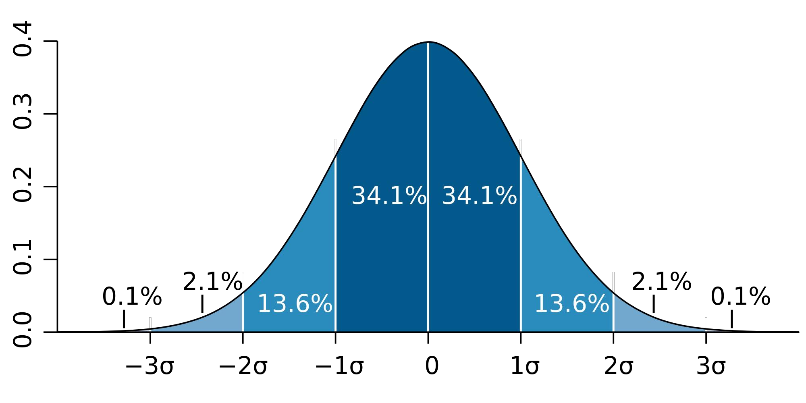
Probability Density Functions
Example: Normal Distribution

Slide 13
Probability Density Functions
Gives you the probability of a data point falling within the some given range of a given value.

Slide 14
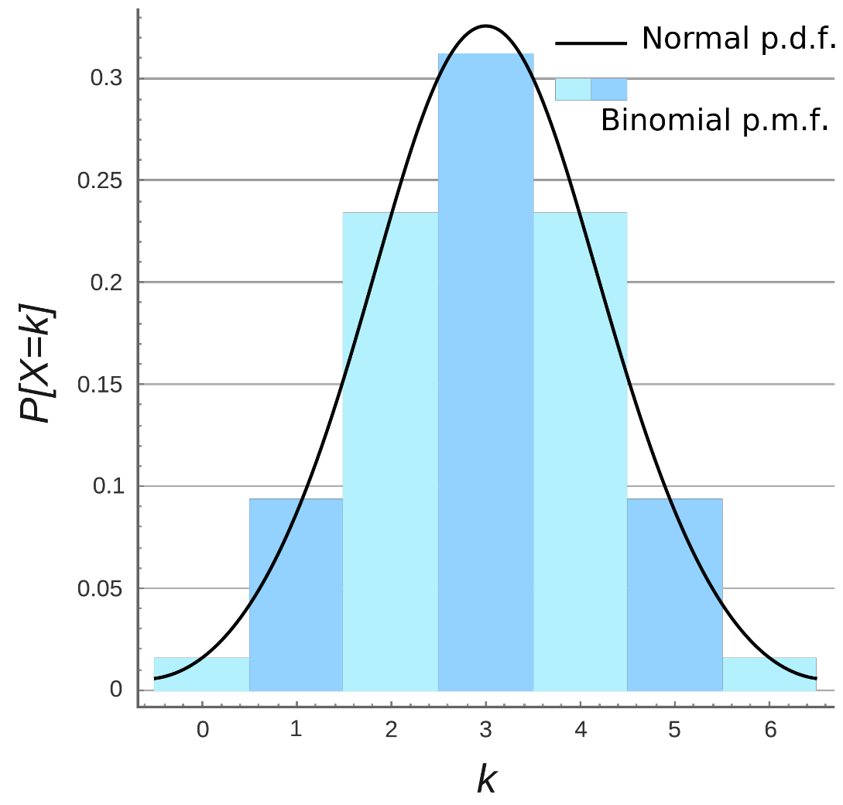
Probability Mass Function
Probability of discrete values occurring within the same range.

Slide 15
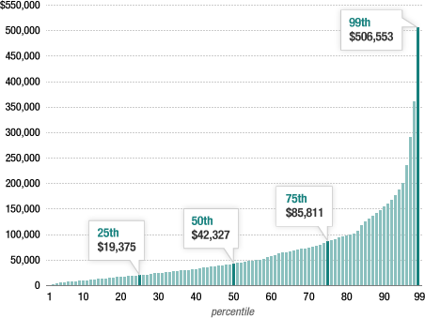
Percentiles and Moments
Percentiles
In a data set, what’s the point at which X% of the values are less than that value?
Example: Income Distribution
50% Percentile means Median

Slide 16
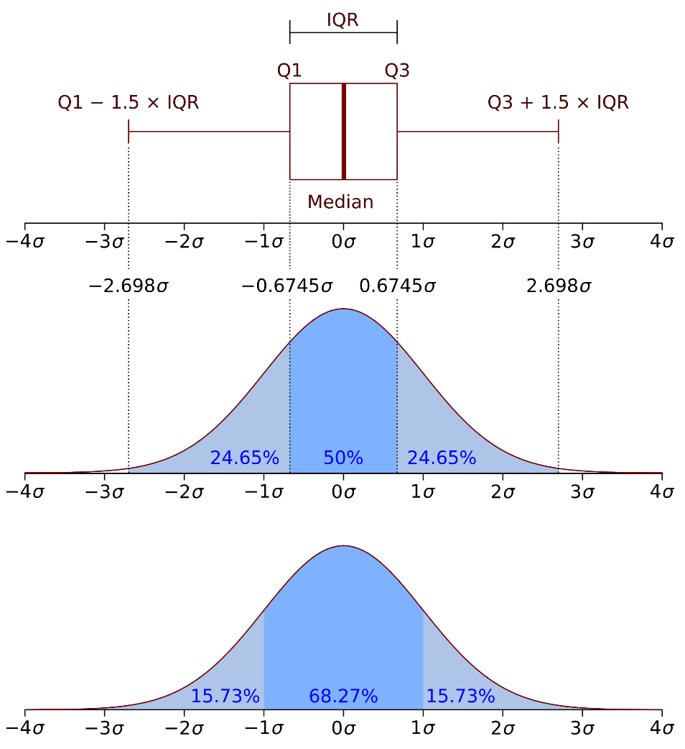
Percentiles and Moments
Percentiles in a Normal Distribution

Slide 17
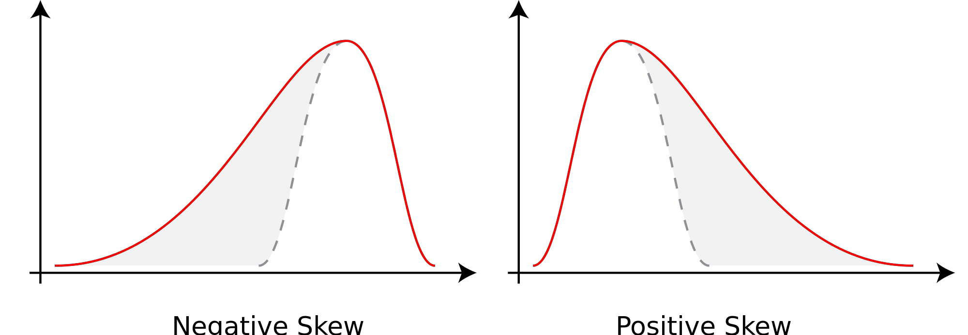
Percentiles and Moments
Moments
Quantitative measures of the shape of a probability density function.
Mathematically,
𝜇 = 𝑥 − 𝑐 𝑛𝑓 𝑥 𝑑𝑥 (for moment 𝑛 around value 𝑐)
The First moment is the mean.
The second moment is the variance.
The Third moment is the “Skew”
How “lopsided” is the distribution?
A distribution with a longer tail on the left
will be skewed left, and have a negative skew.

Slide 18
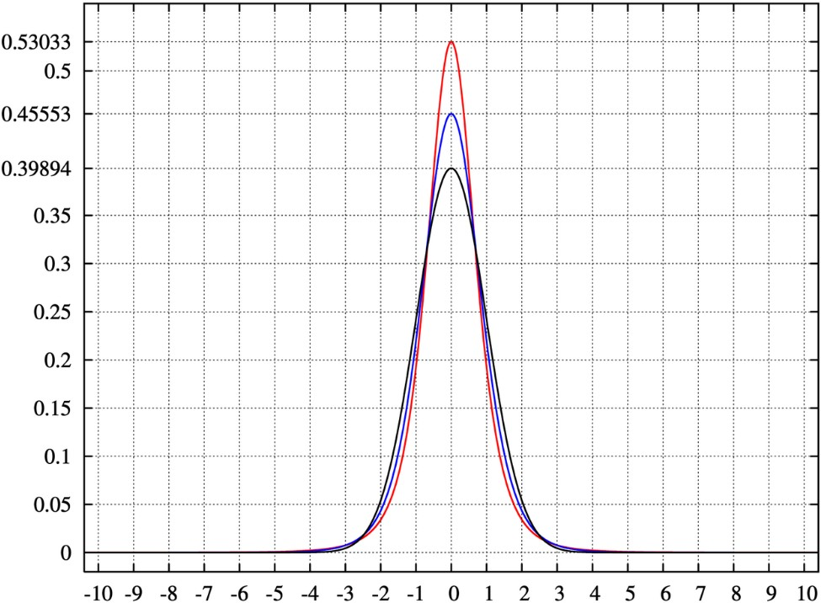
Percentiles and Moments
Moments
The Fourth moment is “kurtosis”.
How thick is the tail and how sharp is the peak, compared to a normal distribution ?
Example: higher peaks have higher kutosis.

Slide 19
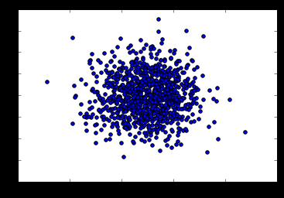
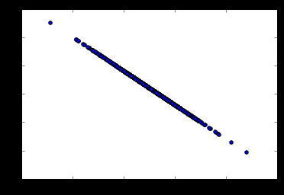
Covariance and Correlation
Covariance measures how two variables vary in tandem from their means.

Slide 20
Covariance and Correlation
Measuring covariance
Think of the data sets for the two variables as high-dimensional vectors.
Convert these to vectors of variances from the mean.
Take the dot product (cosine of the angle between them) of the two vectors.
Divide by the sample size.
Interpreting covariance is hard
Covariance close to 0, means that isn’t much correlation between the two variables.
And large covariances – that is far from 0, means there is a correlation.

Slide 21
Covariance and Correlation
Correlation
Just divide the covariance by the standard deviations of both the variables, and that normalizes things.
So a correlation of -1 means a perfect inverse correlation.
Correlation of 0: no correlation.
Correlation of 1: perfect correlation.

Slide 22
Conditional Probability
If I have two events that depend on each other, what’s the probability that both will occur?
Notation: P(A, B) is the probability of A and B both occurring
P(B|A): Probability of B given that A has occurred.
P(B|A) = P(A,B)/P(A)
For Example:
Students appear for 2 tests. 60% of students passed both tests, but the first test was easier – 80% passed that one. What percentage of students who passed the first test also passed the second?
P(B|A) = P(A,B)/P(A) = 0.6/0.8 = 0.75
75% of the students who passed the first test also passed the second test.

Slide 23
Bayes’ Theorem
Bayes’ Theorem:
P(A|B) = P(A)P(B|A)/P(B)
The probability of A given B, is the probability of A times the probability of B given A over the probability of B.
Example:
Let’s say we have a drug test that can accurately identify users of a drug 99% of the time, and accurately has a negative result for 99% of non-users. But only, 0.3% of the overall population actually uses this drug.

Slide 24
Bayes’ Theorem
Event A = Is a user of the drug, Event B = tested positive for the drug.
P(B) = 0.99*0.003 + 0.01 * 0.997 = 1.3%
P(A|B) = P(A)P(B|A)/P(B) = 0.003 * 0.99/0.013 = 22.8%
So the odds of someone being an actual user of the drug given that they tested positive is only 22.8%.
Even though P(B|A) = 99%, it doesn’t means P(A|B) is high.

