Slide 1



Imbalanced Garbage Image Classification

Slide 2

Learning Objectives
Understand and apply transfer learning using pre-trained CNN models.
Handle class imbalance with augmentation techniques.
Understand the role of deep learning in automated waste classification.
Compare model performance using accuracy and evaluation metrics.
Deploy the model using Gradio or Hugging Face.
Compare performance of different architectures (MobileNetV3 vs EfficientNetV2B2).
GOAL
Source :
www.freepik.com/

Slide 3
Tools and Technology used
Programming Language: Python
Deep Learning Framework: TensorFlow, Keras
Models: MobileNetV3-Large, EfficientNetV2B2
Data Augmentation: ImageDataGenerator (Keras)
Evaluation: scikit-learn (classification report, confusion matrix)
Visualization: Matplotlib, Seaborn
IDE/Environment: Jupyter Notebook
Deployment : Gradio, Hugging Face Space

Slide 4
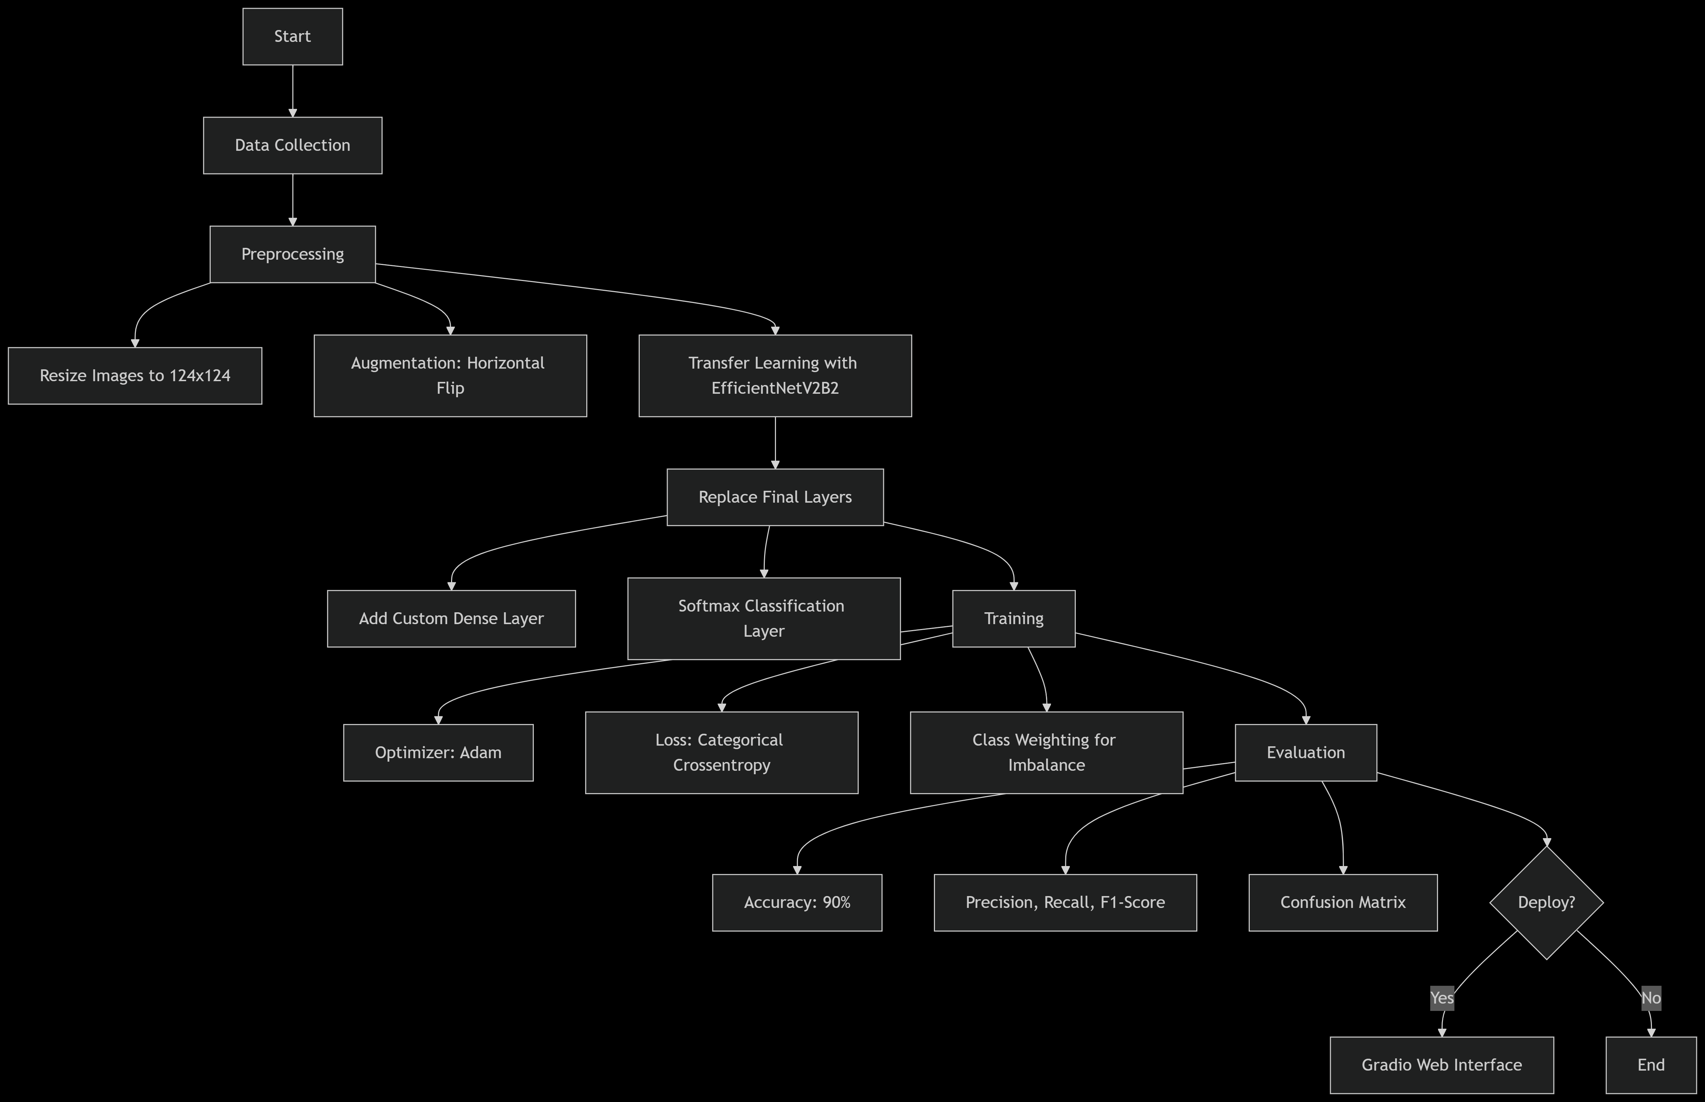
Methodology
Image Preprocessing:
EfficientNetV2B2: 124×124, horizontal flip
MobileNetV3-Large: 224×224, horizontal & vertical flip
Normalized pixel values
Model Setup & Transfer Learning: Used pre-trained EfficientNetV2B2 and MobileNetV3-Large with custom dense + softmax layers. Base layers frozen; only top layers trained.
Class Imbalance Handling: Applied class weights and data augmentation to improve minority class learning.
Training: Used Adam optimizer and categorical crossentropy loss.
Evaluation: Measured accuracy, precision, recall, F1-score, and confusion matrix.
Deployment: Integrated with Gradio and deployed on Hugging Face Spaces.

Slide 5
Problem Statement:
In this project, we aim to develop a sophisticated garbage classification system leveraging the EfficientNetV2B2 architecture. Our primary dataset serves as a foundation for building models that can eventually automate waste segregation, a critical step in optimizing recycling and waste management, ultimately aiding in environmental conservation.

Slide 6
Solution:
I developed a garbage classification system using transfer learning with both MobileNetV3-Large and EfficientNetV2B2. Images were resized (224×224 for MobileNet, 124×124 for EfficientNet) and augmented (horizontal + vertical flips for MobileNet; horizontal flip for EfficientNet). We addressed class imbalance using augmentation and class weights. Both models were fine-tuned by freezing the base and training custom classification heads. MobileNetV3-Large achieved 92% accuracy, while EfficientNetV2B2 achieved 90%, demonstrating efficient and effective waste classification. The models were optionally deployed with a Gradio UI for user-friendly interaction.
Website Link : https://huggingface.co/spaces/Bhushanmehar/garbage-classifier-app

Slide 7
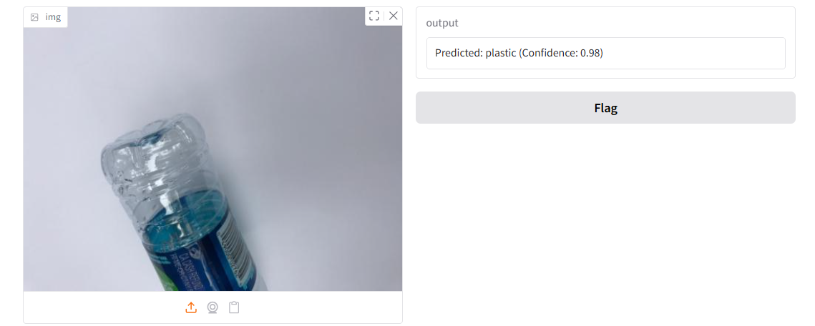
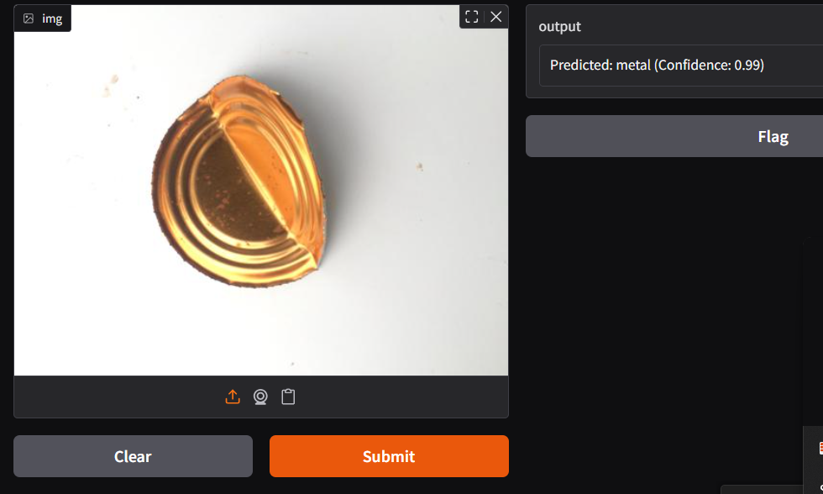
Screenshot of Output:
Website Link : https://huggingface.co/spaces/Bhushanmehar/garbage-classifier-app
Github Repo: https://github.com/bhushanbm7/Garbage_collection__Week-1.git

Slide 8
Conclusion:
This project successfully demonstrates the use of transfer learning for automated garbage classification using MobileNetV3-Large and EfficientNetV2B2. Despite facing challenges like class imbalance, both models performed well, with MobileNetV3 achieving 92% accuracy and EfficientNetV2B2 achieving 90%. Through effective preprocessing, augmentation, and model tuning, we built a system capable of supporting smart waste management. This lays the groundwork for real-world deployment in recycling and environmental sustainability initiatives.

