Slide 1
Agentic Retrieval – Azure AI Search
From Pro code to Low code integrations
Shrushti Shah, Microsoft MVP – M365, Senior Consultant
Rapid Circle, India
Bhushan Gawale, Microsoft MVP – AI Platform, TOGAF® 9, Solution Specialist (Data & AI)
Rapid Circle, India

Slide 2

Agenda
Why agentic retrieval matters now
Concept: how Azure AI Search agentic retrieval works
Pro code: FastAPI service using Azure AI Search + Azure OpenAI
Low code: Microsoft Copilot Studio agent calling the same API
Demo & scenarios
Best practices, pitfalls, and Q&A
Notes:
Who is this for: Developers, architects, makers, and copilot builders
Takeaway: How to use Azure AI Search Agentic Retrieval from both a custom API (pro code) and Microsoft Copilot Studio (low code)
What you’ll see: Architecture, code, agent setup, demo, and best practices

Slide 3
RAG: Retrieval Augmented Generation
Both plans offer coverage for medical services, such as doctor visits and lab tests, but the Health Plus plan also covers hospital stays and X-rays.¹
What is included in my Northwind Health Plus plan that is not in standard?
[Benefit_Options.pdf#page=3] Both plans offer coverage for medical services. Northwind Health Plus offers coverage for hospital stays, doctor visits, lab tests, and X-rays. Northwind Standard only offers coverage for doctor visits and lab tests. …
Large Language Model
User
Question
Search

Slide 4
Components of a high-quality RAG
1
2
3
Sophisticated LLM
Well prepared data
Powerful search functionality
Adheres to instructions
Supports function calling
Reasonably sized text
Meaningful vectors
Vector search
Hybrid search
Semantic re-ranking
Filtering
Notes:
Despite this – the fundamental problem remains with the results retrieval - Users ask complex, multi-part questions with missing context
- Traditional single-shot keyword/vector queries often miss nuance
- We need a mechanism that can plan, search iteratively, and cite sources

Slide 5
What is Agentic Retrieval?
Multi-step, LLM-guided retrieval that does below
Plans: decomposes a complex question into targeted sub-queries
Retrieves: runs parallel searches (keyword + vector) with semantic reranking
Synthesizes: composes a grounded response with citations
Uses “knowledge agent" associated with your search index
Conversation-aware: can leverage prior turns for follow-ups
Notes:
Analogy - Grocery delivery across multiple stores - you give a mixed list (produce, bakery, pharmacy). The planner decomposes the list into sub lists (query planning), checks several stores at the same time for price/availability (parallel retrieval), then consolidates one grounded cart with receipts/links (synthesis with citations).

Slide 6
Agentic retrieval engine
Public preview
Agentic methods applied to retrieval
Query planning
Fan-out query execution
Results merging
User query
Query planning
Search query 1
L1
L2
Merged results
…
L1
L2
Conversation turns
Search query n
L1
L2
Single LLM call
Use conversation history for context • Correct spellings in context • Decompose queries as needed • Paraphrase queries

Slide 7

Agentic retrieval engine in Azure AI Search
What is included in my Northwind Health Plus plan that is not in standard?
Activity Log
Query | Results
Northwind Health Plus plan benefits | 3
Standard Northwind Health plan benefits | 3
Northwind Health Plus plan benefits
Standard Northwind Health plan benefits
User
Question
Knowledge Agent
Search Index
Document References
Northwind Health Plus Summary.pdf
Northwind Health Comparison.pdf
Northwind Health Standard Summary.pdf

Slide 8
Semantic Ranker
Query:
toddler-friendly
movies about cats?
A re-ranker model (cross-encoder) that reranks documents and assigns scores.
1
Winnie the Pooh
1
The Aristocats
L2
2
The Aristocats
2
Lion King
3
Lion King
3
Winnie the Pooh
Semantic ranker scores range from 0-4:
0
1
2
3
4
Worst
Quality
Best
Quality

Slide 9
A complete stack gives you optimal retrieval
Question: "What underwater activities can I do in the Bahamas?"
Keyword results
1
Scuba Diving in Bahamas
Fusion (RRF)
Reranking with cutoff
1
Scuba Diving in the Carribean
1
Scuba Diving in Bahamas
Vector results
2
Scuba Diving in Bahamas
2
Scuba Diving in the Carribean
1
Scuba Diving in the Carribean
3
Water skiing in Seychelles
2
Water skiing in Seychelles

Slide 10
References list: Descending rank
Document Key | Ranker Score
Northwind Health Plus Summary.pdf | 3.4
Northwind Health Comparison.pdf | 3.2
Understanding Employer Health Plans.pdf | 1.5
Document Key | Ranker Score
Northwind Health Standard Summary.pdf | 3.8
Northwind Health Comparison.pdf | 3.5
Northwind Health Plus Summary.pdf | 3.4
Search
Northwind Health Plus plan benefits
Document Key | Ranker Score
Northwind Health Standard Summary.pdf | 3.8
Northwind Health Comparison.pdf | 3.5
FAQ: Northwind Enrollment & Eligibility.pdf | 2.0
Search
Standard Northwind Health plan benefits

Slide 11
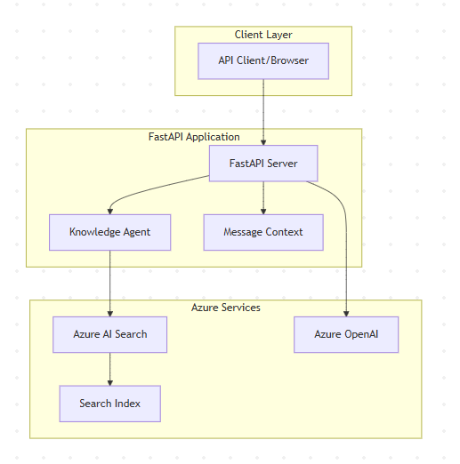
Demo - Architecture at a glance
Primary Components
FastAPI service (pro code) exposes `/perform-agentic-retrieval`
Azure AI Search index with text, vector, and semantic config
Azure OpenAI for embeddings + LLM planning/answering
Knowledge agent created once and reused across requests
Returns: final answer, activity, and sources

Slide 12
Low code: Microsoft Copilot Studio integration
Goal: Use the same API via an action/custom connector so agents can call it

Slide 13
Best practices & pitfalls
Best practices
Grounding: ensure documents are chunked and well-labeled for reranking
Balance: combine text + vector; tune `k` and filters
Observability: log subqueries and sources; store conversation state
Pitfalls
Missing semantic config harms results
Non-deterministic answers without grounding
Connector timeouts due to large payloads

Slide 14
Resources and next steps
Option 1
Get Started with Azure AI Search
aka.ms/AISearch-new
Demo Repository
https://github.com/bhushang19/agentic-retrieval-azure-search
Take the Azure AI Learn Courses
aka.ms/CreateAgenticAISolutions

Slide 15
QnA

Slide 16
Thank you!
Feel free to reach out:
Bhushan Gawale
https://www.linkedin.com/in/bhushangawale/
https://x.com/bhushangawale
Shrushti Shah
LinkedIn - https://www.linkedin.com/in/shrushti-shah-bba565162/

