Slide 1
DevOps

Slide 2
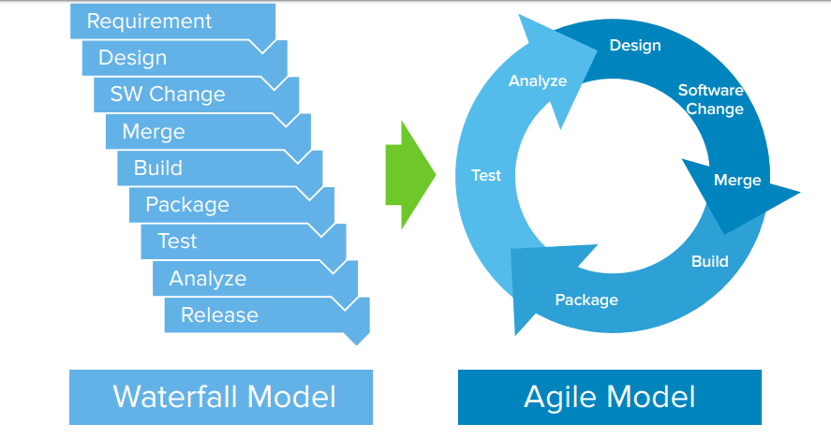

Slide 3
What is Dev Ops
DevOps is not a tool, technology, or any framework; it is more a philosophy and a concept. It is a set of practices that combines software development (Dev) and IT operations (Ops), which helps to shorten the systems development life cycle and provide continuous integration and delivery with high software quality.

Slide 4
DevOps Benefits
Improved collaboration and communication
Faster software or product delivery
Continuous cost reduction
Improved process
Faster resolution of issues
In the DevOps world, there is no single magical tool that fits all the needs. It is about choosing the right tool that fits an organization needs. Let’s find out about them.

Slide 5
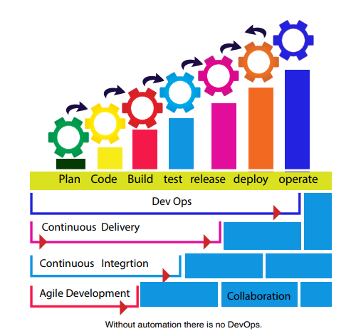

Slide 6
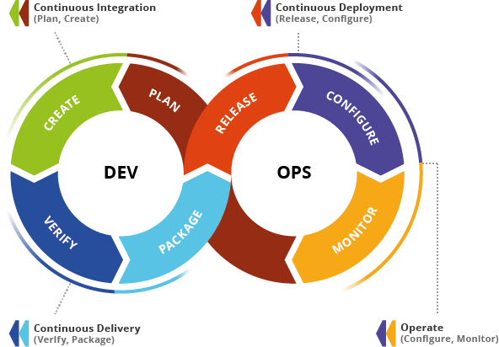

Slide 7
