Slide 1


E-Commerce Store
Sales Analysis
Power BI Dashboard | India E-Commerce Market Insights
₹34.6M
₹9.5M
45K Units
Total Revenue
Total Profit
Orders
Prepared with Power BI • Dataset: Indian E-Commerce Orders

Slide 2
Project Overview
🎯 Objective
Key Business Questions
Build an interactive Power BI dashboard to track and analyze online sales across India for an e-commerce store.
1. Which states generate the most revenue?
2. What are the top-selling product categories?
📊 Data Sources
3. How does profit vary month to month?
Two datasets: Orders (customer, state, city, date) and Details (amount, profit, quantity, category, payment mode).
4. Which payment methods are most popular?
5. Who are the top customers by spend?
🛠️ Tools Used
Microsoft Power BI Desktop — DAX measures, slicers, custom visuals, and a multi-page interactive report.
6. Which sub-categories drive the most profit?

Slide 3
Key Performance Indicators
₹34.6M
₹9.5M
Total Revenue
Total Profit
Sum of all order amounts
27.5% profit margin
45K
₹16M
Units Sold
Avg Order Value
Sum of quantities ordered
Average order value (AOV)
Data Source: Orders.csv + Details.csv | All values in Indian Rupees

Slide 4
Sales Performance: Geography & Category
Revenue by States
Sales Share by Category
💡 Insight: Electronics leads with 47% of total revenue. Uttar Pradesh is the top state, contributing ₹3.9M — 11.3% of all sales.

Slide 5
Profit & Payment Mode Analysis
Top Sub-Categories by Profit
Orders by Payment Method
💡 Insight: Electronic Games and Printers are the most profitable sub-categories. COD remains the dominant payment method at 30%, followed by UPI at 25%.

Slide 6
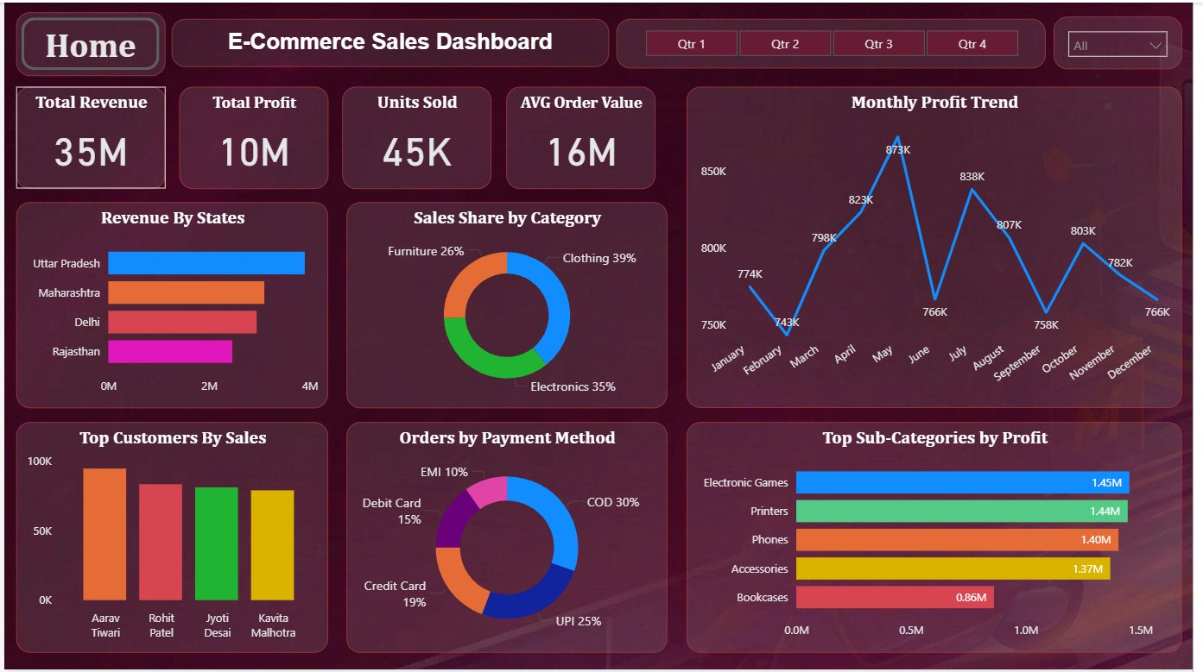
Power BI Dashboard Walkthrough
Quarter Slicers
Monthly Profit Trend
Top Customers by Sales
Orders by Payment Method

Slide 7
Key Findings & Recommendations
📍 Geographic Focus
📦 Electronics Dominates
Top 5 states — UP, Maharashtra, Delhi, Rajasthan, Gujarat — contribute 50%+ of total revenue. Target these with premium campaigns.
Electronics drives 47% of revenue. Electronic Games and Printers are highest-profit sub-categories with ₹1.45M+ each.
💳 Payment Preference
📅 Seasonal Opportunity
COD (30%) + UPI (25%) = 55% of orders. Offer COD incentives and UPI cashbacks to maximize conversions.
Profit stays consistently above ₹0.5M/month. A peak strategy around Q2 and festive quarters can boost 15-20%.

Slide 8
Thank You!
E-Commerce Store Sales Analysis
📊 Dashboard built in Power BI Desktop 📁 Dataset: Orders.csv + Details.csv 🌍 Scope: Pan-India E-Commerce

