Slide 1
MICRO-CAMERA BASED AIROTOR
Presented By
Team Dynamic Innovators
Under the Guidance of D.Y. Suryawanshi
Session 2021-22
Note - Presentation time will be limited to 15 minutes, including Q&A
VII Sem (Electronics Engineering)

Slide 2
Origin of Project
The proposal to do this project came from to solve a real life problem in medical field
During cavity operations doctor's vision to see cavity to a certain limit of angle....so that makes the process longer and hectic to perform the task...This is a much common problem we are trying to solve from medical field.

Slide 3
Motivation
The Motivation to do this project is to see the possibility to solve the MEDICAL FIELD problems using ENGINEERING BACKGROUND
Our Goal is to try to solve the limitations of Airotor in dental field to ease the difficulties face by doctors during Cavity Treatment.

Slide 4
Literature Survey
Sr.No | work | Year | Description
1 | Camera Viewing Attachment & Display System for Low Speed Dental Hand-Piece | May 28, 2019 | A system providing a removable camera attachment for a low-speed dental hand-piece & a cavity excavation viewing system. The camera viewing attachment provides a silicone for a low-speed boa that magnifies the cavity preparation site & an LED that illuminates the site.

Slide 5
Literature Survey
Sr.No | Work | Year | Description
2 | Dental Hand-Piece with Sound Masking Function | April 04, 2018 | The present papers relates to a dental hand piece having sound masking function. According to an embodiment of the present invention, the dental hand piece having sound masking function comprises

Slide 6
Sr.No | Work | Year | Description
3 | Medical Dentistry Hand-Piece with Image Transmission Arrangement | April 01, 1993 | A medical dentistry hand-piece connectable to a supply hose has a handle piece capable of swivelling with respect to the supply hose for securing an operational piece that carries a tool A converter that converts the images supplied by the image transmission arrangement into electric signals

Slide 7
Problem Statement
In the field of dental treatment when carious tooth or mouth problem occurs it is treated with the help of cutting and removing decay operator i.e dental handpiece or airotor.
Nowadays doctor's/ dentists are seeing inner view of patients mouth with the help of small mirror and treat patients accordingly
Dentists have to be more careful, they have to take more precautions while treating patients as there is no source of light and accuracy things . Limitations of such systems includes amount of time the process takes.

Slide 8
Problem Statement
Therefore such a systems requires a separate imaging camera that is going to take images and display it on screen.
With the advancement of technology we are going to introduce the camera viewing attachment include LED ( light emitting diode) that illuminates cavity preparation site so that doctors/ dentists can easily see the inner view of mouth and treat patients.
While using this system doctors can also discontinuing working on patients set up an acquisition mode for image to be taken , identify image and acquire its angulation. Identify what is captured and its orientation and then if needed continue working

Slide 9
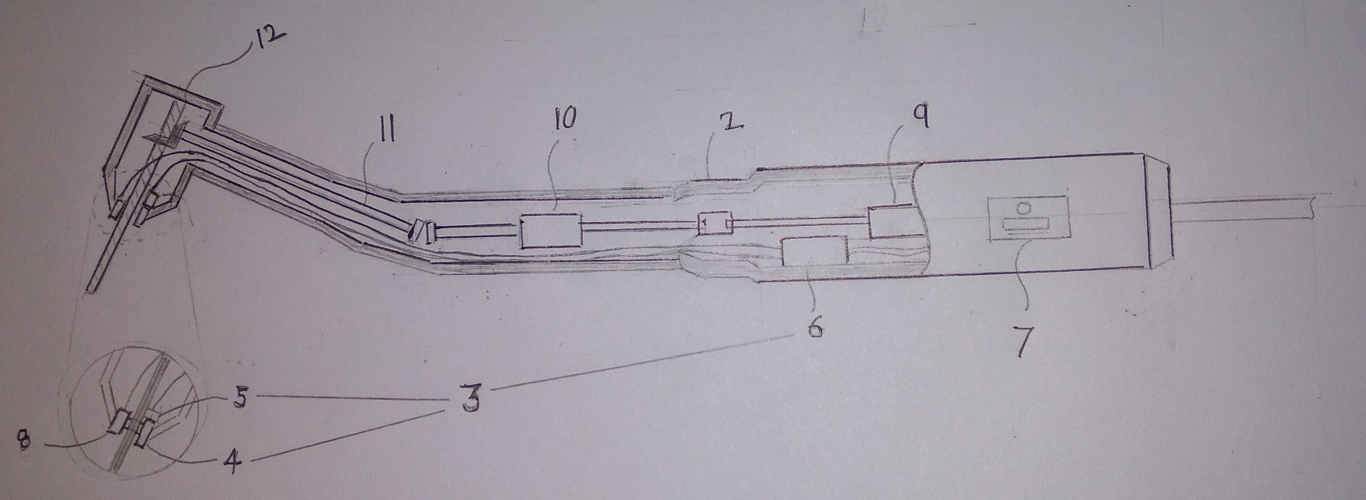
Airotor with Micro-Camera Device
Diagram Showing Interior of the Dental Handpiece
Department of Electronics Engineering, YCCE, Nagpur

Slide 10
Airotor with Micro-Camera Device
Parts in Handpiece | Notations
Dental Handpiece | 1
Handpiece Body | 2
Camera Apparatus/Device | 3
Lens Unit | 4
Sensor Unit | 5
Control Unit | 6
Operation Unit | 7
Lighting Unit | 8
Motor | 9
A Reducer | 10
A Roatationg Shaft | 11
A Gear | 12
A Drill/Bur | 13

Slide 11
Construction of Micro-Camera Device
Handpiece Body 2, consists -
Camera Device/Apparatus 3,
Other Parts of Airotor.
Camera Device 3, includes -
Lens Unit 4,
Sensor Unit 5,
Control Unit 6,
Operational Unit 7
Lighting Unit 8,
Lens Unit 4 & Lighting Unit 8 Present at external Portion of the Handpiece Body & also Sensor Unit 5 present above the lens unit 4
Lighting Unit 8, composed of a light emitting diode..
Sensor Unit 5, may use a CMOS (Complementary Metal Oxide Semiconductor)

Slide 12
Working of Micro-Camera Device
Lighting unit 8, illuminates the treatment site, then illuminating light reflect back & enter into lens unit 4.
Sensor unit 5, for converting light received from lens unit 4 into an image signal.
Control unit 6, for transmitting image signal to display device.
Control Unit 6, consist pf wireless communication network that is used transmission of image signal to display device.
Operating unit 7, for command for performing the transmitting image signal to display device.
Operating unit 7, can be consists of on/off function, zoom function, etc.

Slide 13
Usefulness of the Project for the Department/ Institution/Society
03/04/14 Department of Electronics Engineering, YCCE, Nagpur

Slide 14
Budget

Slide 15
Execution Plan
Dates | Description
15 July 2021 | Appointement with the Dentist for better understanding of current working Airotor.
31 July 2021 | Done with Sumission of Project Pre-liminary Investigation Report.
22 Sep 2021 | Final Paper Submission of Microcamera Based Airotor. .
22 Oct 2021 | Final Seminar Presentation of Microcamera based Airotor.
Execution Plan
Execution Plan

Slide 16
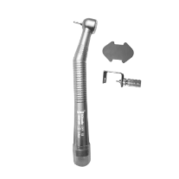
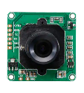
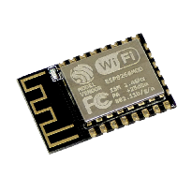
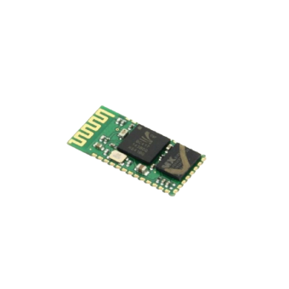
Component list & Estimated cost
COMPONENTS | COST
Airotor | ₹2,500.00
Micro-camera | ₹3,000.00
WIFI module (ESP8266) | ₹400.00
Bluetooth module (HC-05) | ₹350.00

Slide 17
REFERENCES
[1] Takeshi Hasegawa, .Michizo Yamanaka, “Hand-piece with built-in camera and dental treatment method”, E.P. Patent 2891467 A1, July 08, 2015.
https://patents.google.com/patent/EP2891467A1/en
[2] John Jesus Rodriquez, Jr, “ Camera Viewing Attachment & Display System for Low Speed Dental Hand-piece”,U.S.Patent10306124B1,May28,2019.
https://patents.google.com/patent/US10306124B1/ene
[3] John S Seney, “Dental bur cooling system”, U.S. Patent 5096421 A, March 17, 1992. https://patents.google.com/patent/US5096421A/en
[4] Johann Hain, Ulf Stein, ”Dental hand-piece with image transfer device” A.T. Patent 396740 B, November 25, 1993
https://patents.google.com/patent/AT396740B/enB
03/04/14 Department of Electronics Engineering, YCCE, Nagpur

Slide 18
Thank You

