Slide 1
ASPECT-BASED SENTIMENT ANALYSIS
End-to-End System: From Raw Data to Production API
Built on SemEval-2014 · bert-base-uncased · FastAPI · Docker
Val NER F1
Val Cat F1
Combined F1
VRAM Used
Training Time
0.916
0.630
1.546
2.55G
~2h
5 Epochs · GTX 1650 4GB · fp16 AMP · Gradient Accumulation
March 2026

Slide 2
THE PROBLEM SPACE
Why standard sentiment analysis falls short for restaurants
❝ The food was amazing but the service was unfortunately very slow and overpriced. ❞
Standard sentiment: ⚠️ MIXED — loses all signal
ABSA output: ✅ food → POSITIVE | service → NEGATIVE | price → NEGATIVE
Business Impact
Why This is Hard
• Real-time product feedback broken down by dimension • Identify which restaurant aspects drive customer churn • Fine-grained quality tracking for operations teams • Input layer for recommendation engines
• One sentence can carry conflicting sentiments (conflict label) • Aspect terms span multiple tokens after WordPiece tokenization • 33% of sentences have no explicit aspect terms (implicit) • 4GB VRAM constraint requires fp16 + gradient accumulation • 5 categories × 4 polarities = 20-class multi-head classification

Slide 3
DATASET DEEP DIVE
SemEval-2014 Task 4 — Restaurant Reviews
Total Sentences
Aspect Terms
Implicit Rows
Train / Val
Categories
3,041
3,693
1,020
2738/303
5
5 Aspect Categories
4 Sentiment Polarities
Key Data Insights
• 🍕 food — largest category • 🤝 service — second most frequent • 🏮 ambience — atmosphere & decor • 💰 price — value for money • 📝 anecdotes/miscellaneous — general
• ✅ positive — explicit praise • ❌ negative — explicit complaint • ➖ neutral — factual mention • ⚡ conflict — contradictory sentiment in same sentence
• Positive >> Negative >> Neutral >> Conflict • Conflict rare but hardest to classify • 1,020 rows (33%) are negative NER samples • BIO alignment needed: char spans → sub-word tokens

Slide 4
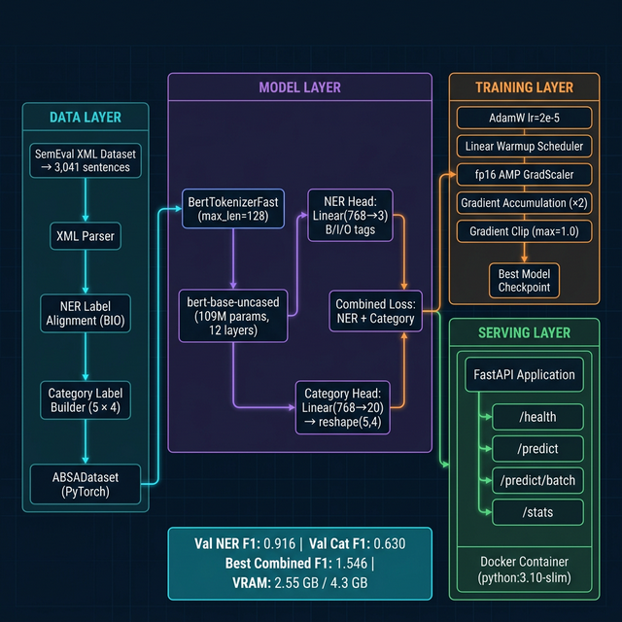
SYSTEM ARCHITECTURE
End-to-end data flow: XML → Dual-head BERT → FastAPI → Docker

Slide 5
MODEL DESIGN & GPU STRATEGY
Dual-head BERT with GTX 1650 (4GB) memory optimisations
Dual-Head Architecture
Why BERT-base-uncased?
• Shared encoder: bert-base-uncased (109M params) • NER head: Linear(768 → 3) → B / I / O tagging per token • Category head: Linear(768 → 20) → reshape(5 cats, 4 pols) • Multi-task learning: both heads trained jointly • Combined loss = NER loss + Category loss (equal weights)
• Best accuracy/VRAM tradeoff for 4GB GPU • 'uncased' handles informal restaurant review casing • WordPiece tokenizer enables sub-word BIO alignment • 12 layers give rich contextual representations
⚡ GTX 1650 Memory Strategy
Batch Size
Grad Accum
fp16 AMP
Grad Clip
Peak VRAM
8
×2
ON
1.0
2.55G
VRAM safe
Eff. batch = 16
−40% VRAM
fp16 stable
4.3G limit

Slide 6
TRAINING RESULTS & KEY DISCOVERIES
Full run: 5 epochs · 2,738 train / 303 val · GTX 1650
Epoch
Train Loss
Val Loss
NER F1
Cat F1
🔍 Key Discoveries
1
1.4007
0.9392
0.856
0.430
• NER F1 converged quickly (0.86 → 0.92 by epoch 2) • Category F1 kept improving each epoch (0.43 → 0.63) • NaNLoss bug: CrossEntropyLoss returns NaN when all batch labels are -1 • Fix: skip category if (labels[:,c] == -1).all() — 3-line change • Vectorized cat_loss: replaced 5-iteration loop with single F.cross_entropy • VRAM stayed stable at 2.55 GB across all 5 epochs — no OOM risk • Epoch 4 val_loss tiny spike (overfitting) — best checkpoint = epoch 5
2
0.7618
0.7620
0.910
0.496
3
0.5443
0.6840
0.906
0.554
4
0.4193
0.7106
0.914
0.591
5 ★
0.3563
0.6821
0.916
0.630

Slide 7
DATA QUALITY IMPROVEMENTS
Three targeted fixes to input data handling — implemented & verified
🔧 Change 1: Broken Spans → Ignored
IMPLEMENTED ✓
‹ Before› Invalid char spans (start≥end) fell back to (0,0). Token at position 0 was labelled 'O' — teaching the model wrong labels.
Verified in smoke test
‹ After› Spans with start≥end are dropped entirely at parse time. Zero corrupt NER labels in the dataset.
🏷️ Change 2: Implicit Rows as Explicit Negatives
‹ Before› Sentences with no aspect terms were silently processed — no visibility into how many existed.
IMPLEMENTED ✓
Verified in smoke test
‹ After› 1,020 rows (33%) confirmed as negative samples. Now logged explicitly: helps NER head learn 'O' labels from real context.
⚡ Change 3: Vectorized Category Loss
IMPLEMENTED ✓
‹ Before› Python for-loop over 5 categories. Each category computed independently, then averaged — slow and caused NaN when all labels were -1.
Verified in smoke test
‹ After› Single F.cross_entropy call over flattened (B×5, 4) tensor. Faster backprop, more stable gradients, NaN eliminated.

Slide 8
API DESIGN & DEPLOYMENT PLAN
FastAPI service → Docker → Cloud phases
API Endpoints
Deployment Phases
GET
/health
Phase 1 Local
Phase 2 Docker
Phase 3 Cloud
Phase 4 MLOps
Liveness + model load status
POST
/predict
uvicorn api.app:app --host 0.0.0.0 --port 8000 Dev + testing
docker build -t absa-api . docker run -p 8000:8000 --gpus all absa-api
AWS/GCP container registry Load balancer + auto-scaling CPU inference for cost savings
Model versioning (MLflow) Retraining pipeline A/B testing new checkpoints
Single sentence ABSA inference
POST
/predict/batch
Up to 32 sentences, sequential
GET
/stats
Dataset category/polarity distribution
GET
/docs
Auto-generated Swagger UI

Slide 9
UNIFIED NARRATIVE & NEXT STEPS
The Journey: Raw XML → Clean tensors → Dual-head BERT → 91.6% NER F1 → 63% Cat F1 → Production API
Every design decision was driven by a 4GB VRAM constraint — and every fix became a lesson in production ML engineering.
✅ What Was Achieved
🚀 Next Steps
• 109M-parameter BERT fine-tuned end-to-end on 2,738 examples • NER F1 = 0.916 — near-human level aspect-term detection • Category F1 = 0.630 — solid 5-class polarity classification • Zero OOM errors across 5 epochs (VRAM budget: 2.55/4.3 GB) • Three data-quality bugs found and fixed during training • Production-ready FastAPI service with Swagger UI + Docker
• Run 10-epoch full training (model still improving at epoch 5) • Add confidence calibration for /predict endpoint • Implement span-level F1 metric (stricter than token-level) • Add Gunicorn + Uvicorn workers for production throughput • Add MLflow experiment tracking for hyperparameter sweeps • Export to ONNX for CPU-only inference (50× cheaper cloud)

Slide 10
ABSA PROJECT — SUMMARY
An end-to-end NLP system from raw XML to a containerised production API
Val NER F1
Val Cat F1
Combined F1
VRAM
Epochs
Endpoints
0.916
0.630
1.546
2.55G
5
5
Aspect term extraction
Category sentiment
Best checkpoint
Peak usage (4.3G avail.)
Training completed
FastAPI ready
Stack: Python 3.10 · PyTorch 2.x · HuggingFace Transformers · FastAPI · Docker · Plotly · Matplotlib
Pipeline
XML Parser
BIO Aligner
ABSADataset
bert-base uncased
NER Head
Cat Head
AdamW + fp16
FastAPI
Docker
Model saved to: /home/bhush/genai/absa_project/models/

