Slide 1
Entity

Slide 2
Kinds of Entity:
1. Tangible Entity:
It is an entity in DBMS, which is a physical object that we can touch or see. In simple words, an entity that has a physical existence in the real world is called a tangible entity.
For example, in a database, a table represents a tangible entity because it contains a physical object that we can see and touch in the real world. It includes colleges, bank lockers, mobiles, cars, watches, pens, paintings, etc.

Slide 3
Difference Between Entity, Entity Set and Entity Type
Entity | Entity Type | Entity Set
A thing in the real world with independent existence | A category of a particular entity | Set of all entities of a particular entity type.
Any particular row (a record) in a relation (table) is known as an entity. | The name of a relation (table) in RDBMS is an entity type | All rows of a relation (table) in RDBMS is entity set
Entities can be tangible or intangible. | Defines attributes shared by entities of that type. | Represents a snapshot of all entities at a given time.
It is identified uniquely through a key attribute. | It represents the structure of the table without data. | It can grow or shrink as entities are added or removed.
Example: A student with ID 1. | Example: "Student" table schema. | Example: All records in the "Student" table.

Slide 4
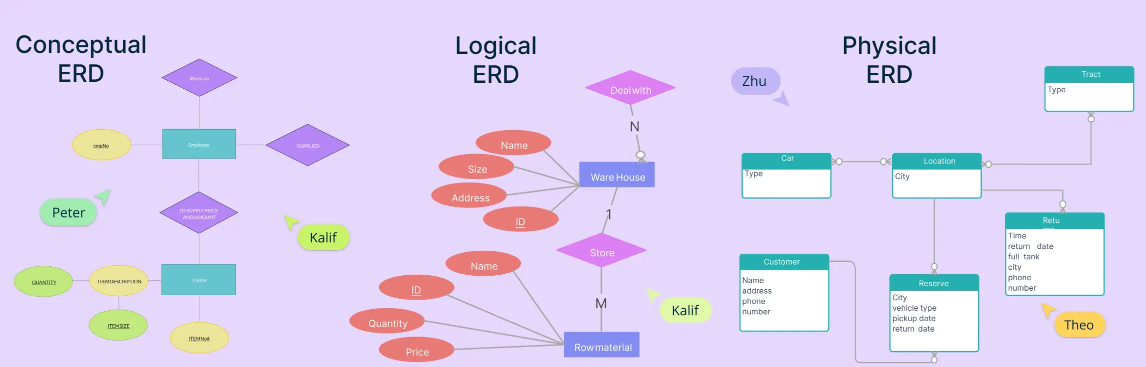
Types of Entity Relationship Diagrams

Slide 5
What Are the Types of ERD
When designing a database, it’s not just about tables and fields. Before implementation, we need to carefully map out what data needs to be stored, how it’s connected, and how it should behave. That’s where entity-relationship diagrams come in. ERDs are a visual storytelling tool for databases, helping everyone from business stakeholders to developers align on structure and function.
There are three main ERD types, each serving a different purpose at different stages of the database design process:
Conceptual ERD – Focuses on what the data is
Logical ERD – Explores how the data is organized
Physical ERD – Details how the data is stored in a specific system

Slide 6
Types of ERD at a Glance
ERD Type | Focus | Level of Detail | Audience | Use Case
Conceptual | High-level entities & relationships | Abstract (no attributes or keys) | Business users, analysts | Brainstorming, scoping, stakeholder discussions
Logical | Attributes, keys, relationships | Detailed (normalized) | Analysts, designers | Data modeling, preparing for implementation
Physical | Tables, columns, data types, constraints | Very detailed (DBMS-specific) | Developers, DBAs | Implementation and performance optimization

Slide 7
2. Intangible Entity:
It is an entity in DBMS, which is a non-physical object that we cannot see or touch.
In simple words, an entity that does not have any physical existence in the real world is known as an intangible entity.
For example, a bank account logically exists, but we cannot see or touch it

Slide 8
Entity Type:
A collection of entities with general characteristics is known as an entity type.
For example, a database of a corporate company has entity types such as employees, departments, etc.
In DBMS, every entity type contains a set of attributes that explain the entity.
The Employee entity type can have attributes such as name, age, address, phone number, and salary.
The Department entity type can have attributes such as name, number, and location in the department.

Slide 9
Kinds of Entity Type
1. Strong Entity Type: It is an entity that has its own existence and is independent.
The entity relationship diagram represents a strong entity type with the help of a single rectangle.
Example:
"Customer" is the entity type with attributes such as ID, Name, Gender, and Phone Number.
Customer is a strong entity type as it has a unique ID for each customer.

Slide 10
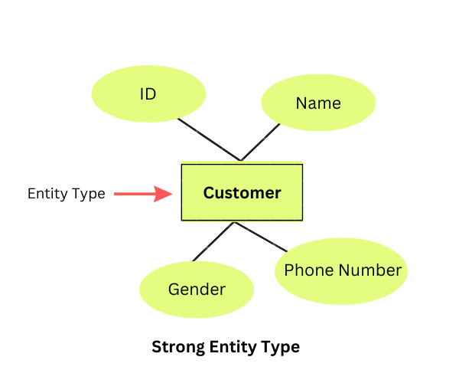

Slide 11
2. Weak Entity Type:
It is an entity that does not have its own existence and relies on a strong entity for its existence.
The Entity Relationship Diagram represents the weak entity type using double rectangles.

Slide 12
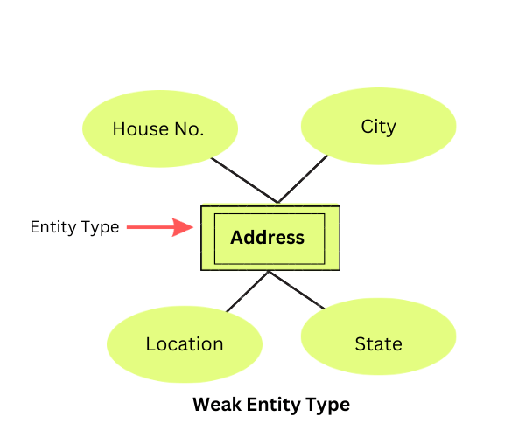

Slide 13
Example
"Address" is a weak entity type with attributes such as House No., City, Location, and State.
The relationship between a strong and a weak entity type is known as an identifying relationship.
Using a double diamond, the Entity-Relationship Diagram represents a relationship between the strong and the weak entity type.
Let us see an example of the relationship between the Strong entity type and weak entity type with the help of ER Diagram

Slide 14
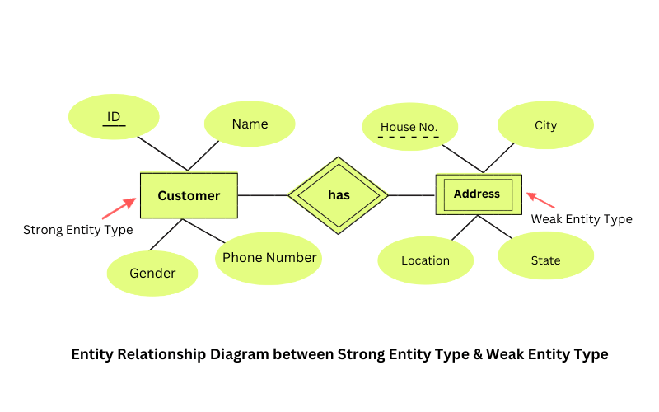

Slide 15
Entity Set
An entity set is a group of entities of the same entity type.
For example, an entity set of students, an entity set of motorbikes, an entity of smartphones, an entity of customers, etc.
Entity sets can be classified into two types

Slide 16
1. Strong Entity Set:
In a DBMS, a strong entity set consists of a primary key.
For example, an entity of motorbikes with the attributes, motorbike's registration number, motorbike's name, motorbike's model, and motorbike's colour.

Slide 17
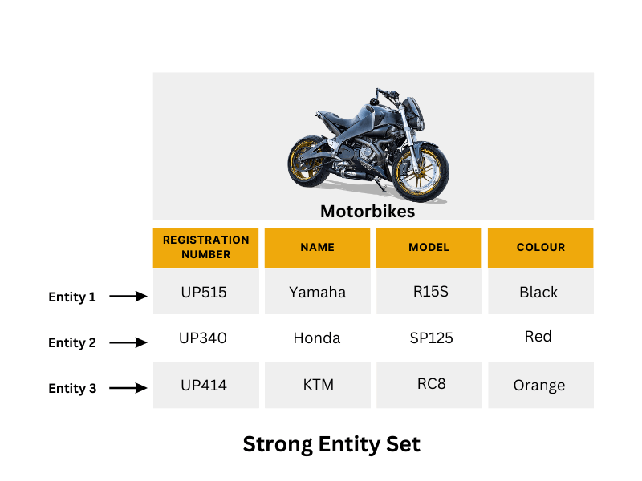

Slide 18
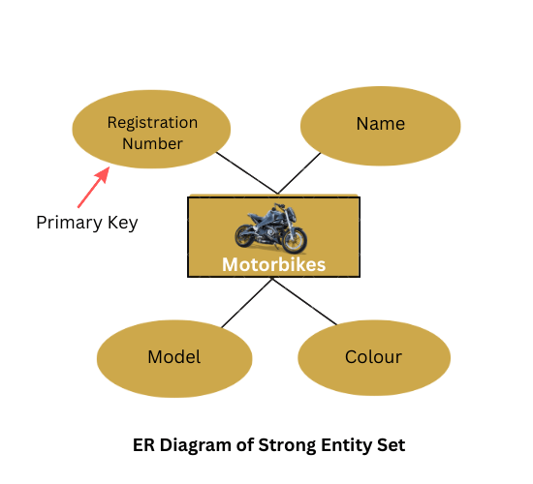

Slide 19
2. Weak Entity Set:
In a DBMS, a weak entity set does not contain a primary key.
For example, An entity of smartphones with its attributes, phone's name, phone's colour, and phone's RAM.

Slide 20
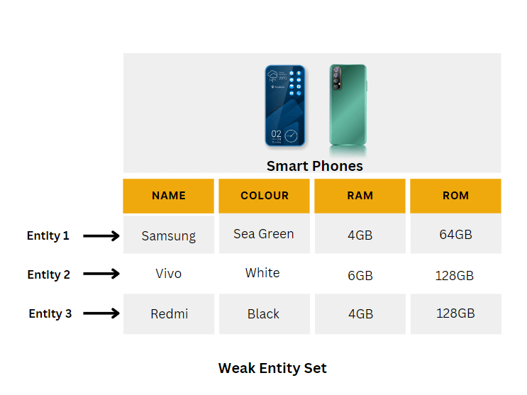

Slide 21
