Slide 1



SUGARCANE360: Plot-Specific AI & Sensor-Based Irrigation Advisory Prototype
CONTRIBUTORS:
SHAURYA BHUSHAN -26
Harish Chelliah-39
Purbasha Dass-47
1

Slide 2
PROBLEM STATEMENT
“Sugarcane requires large quantities of water (1,500 mm – 2,500 mm), but irrigation decisions are often based on farmer experience and rigid schedules rather than scientific field recommendations.”
This traditional approach leads to:
  Over-irrigation: Water wastage, high electricity bills, and nitrogen leaching beyond the root zone.
  Under-irrigation: Soil moisture stress during critical growth stages (stunting tillering and stalk elongation).
  Yield Loss: Reduced cane tonnage and impaired sucrose recovery.
  Labor Inefficiency: Inability to effectively prioritize among spatially distributed plots.
2

Slide 3
Objectives
  Combine Agricultural Telemetry: Integrate field sensor data, soil characteristics, 7-day weather forecasts, crop growth stages, and geospatial plot records into an intuitive decision support system.
  Minimal & Farmer-Friendly Dashboard: A calm, 4-section dashboard focusing on essential daily operational needs with plenty of whitespace.
  Plot-Specific Precision: Tailor irrigation start time, duration, and water liters for each plot individually.
  Explainable Decision Support: Justify recommendations using 4 core factors (Soil Moisture, Rain Probability, Temperature, Crop Stage).
  Human-in-the-Loop Validation: Empower the farmer to Accept, Modify runtime, or Override recommendations.
4

Slide 4
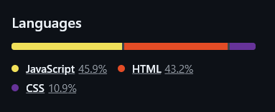
Methodology/tech used
Technology Stack
  HTML5: Semantic, accessible layout.
  CSS3: Custom agricultural color palette (Forest Green #1b4332, Sage #40916c, Cream #faf8f5, White #ffffff, Muted Yellow #d4a373), CSS Grid, Flexbox, responsive navbar rules.
  Vanilla JavaScript (ES6+): Centralized mock state (js/data.js), shared navbar/toast handlers (js/main.js), modular page controllers.
  Chart.js (CDN): Lightweight data visualization for moisture trends, water savings, and yield progression.
  Lucide Icons (CDN): Modern, clean agricultural SVG icons.
  Zero Frameworks / Zero External Backend: 100% runnable in any modern web browser.
5

Slide 5
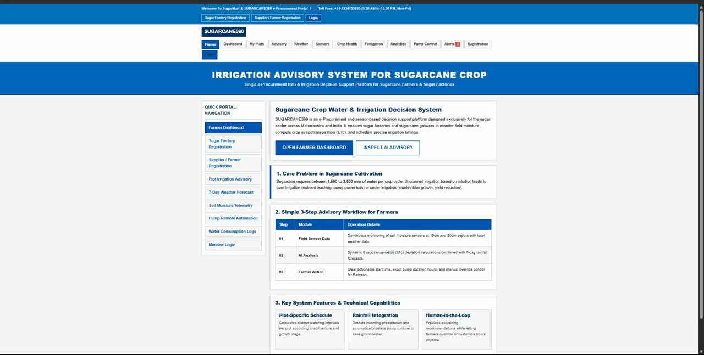
Implementation / Demo
6

Slide 6
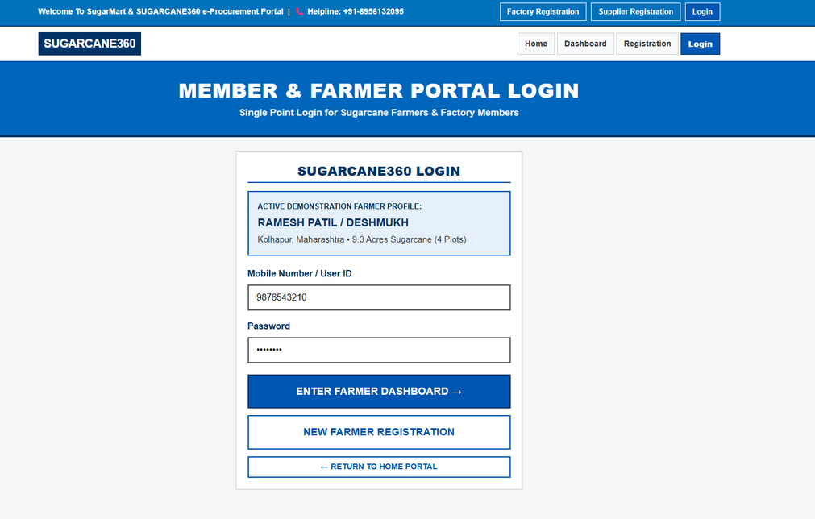
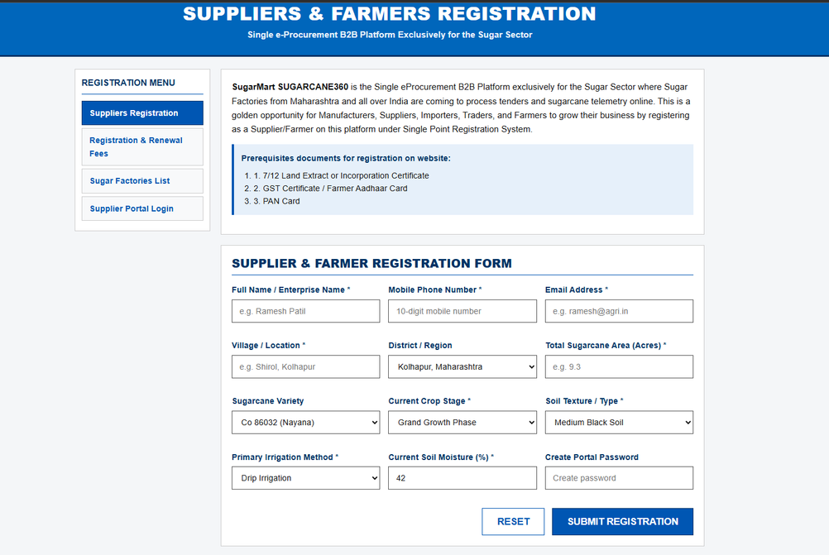
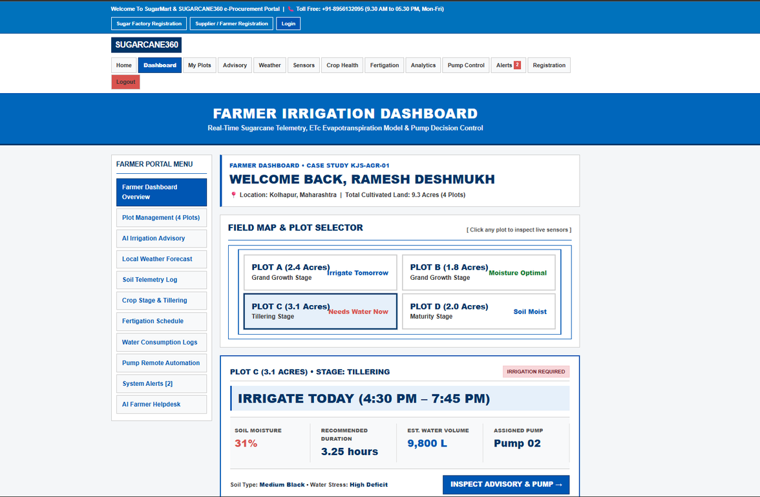
Implementation / Demo
6

Slide 7
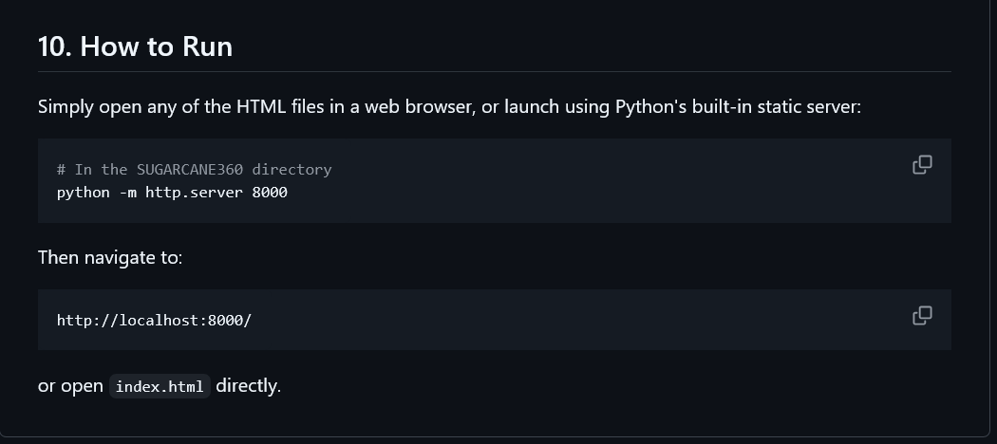
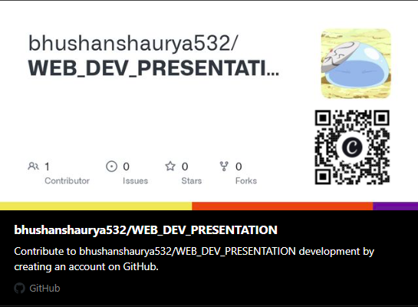
Results/outcome
Interactive Decision-Support UI: Built a responsive, zero-latency dashboard that translates raw agricultural parameters
7

Slide 8
Conclusion and future scope
The project successfully delivers a lightweight, accessible decision-support interface that shifts sugarcane water management from intuitive guesswork to data-backed, scientific scheduling. By executing crop water requirement calculations entirely on the client side
Future Scope
  Backend & API Architecture: Integrate a dedicated backend (such as Python/FastAPI or Node.js) to manage persistent user profiles, historical plot analytics, and cross-device state synchronization.
  IoT Sensor Integration: Connect the platform to on field hardware
  Adding Aadhaar-based authentication (OTP/e-KYC) via the backend enables seamless farmer onboarding without passwords
7
terms and conditions apply(pls juice the stock)**

Slide 9
THANK YOU
8

