Slide 1
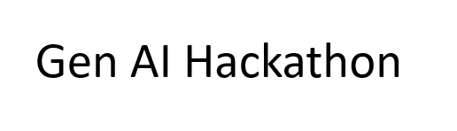
Gesture-Based Human-Computer Interaction System
Using OpenCV, MediaPipe, and PaLM (text-bison-001)
Neural Ninjas: Rajan Bhushan
Prabhat Sudarshan

Slide 2
Introduction
Developing a gesture-based interface using OpenCV and MediaPipe.
Utilizing Long Short-Term Memory (LSTM) networks for gesture recognition.
Integrating Google PaLM for intelligent command processing.
Building a dynamic UI using Flask inside Streamlit.

Slide 3
LSTM Model for Gesture Recognition
Input: 4 frames of (21 landmarks × 3 coordinates).
Model Structure:
- LSTM layers capture motion patterns.
- Dense layers classify gestures.
Output: Softmax layer predicts 6 gesture classes.

Slide 4
Real-Time Inference & Gesture Commands
Live hand tracking with gesture recognition.
Gestures mapped to system commands:
- Up, Down, Left, Right → Menu Navigation.
- Select → Confirm Choice.
Google PaLM refines and interprets gesture-based commands.

Slide 5
Flask & Streamlit Integration
Flask dynamically updates a webpage with recognized gestures.
Streamlit embeds the Flask-rendered UI for real-time interaction.
The user can navigate and select items through hand gestures.
Example: Menu selection in a food-ordering system.

Slide 6
Hand Tracking & Data Collection
MediaPipe Hands detects 21 key points on the hand.
Gesture validity check ensures correct recognition.
Data collection strategy:
- Capture every 5th frame.
- Store 4 frames per gesture instance.
- Save labeled gestures into a CSV file.

Slide 7
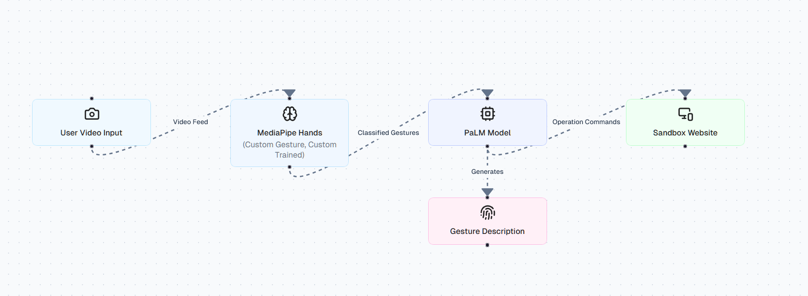
Flowchart

Slide 8
Conclusion & Next Steps
Successfully implemented hand gesture recognition.
Real-time navigation and selection using AI-powered inference.
Next Steps:
- Enhance UI for a better user experience.
- Expand gesture commands for more functionality.
- Optimize model efficiency for faster response.

