Slide 1
Comparing Two Sentences And Finding Their Matching Score Using Embedding Techniques

Slide 2
Feature Extraction = Text Representation = Text Extraction = Text Vectorization
Vectorization
Basic Vectorization
(Count/Frequency Based)
Word Embedding
(Semantic Based)
OHE
Word2vec
2. Bag of words
2. LLM based-BERT
3. N grams
4. TF-IDF

Slide 3
COMMON TERMS
CORPUS : large collection of text data
VOCABULARY : vocabulary set of all unique documents in the Corpus
DOCUMENT : one single piece of text inside corpus.
WORD :a word is the smallest meaningful unit .
For ex :
Corpus = [ ‘I love NLP’ , ‘NLP is fun’ ]
Vocabulary = [I , love , NLP , is , fun]

Slide 4
OHE (ONE HOT ENCODING)
For ex : Corpus = [ ‘I love NLP’ , ‘NLP is fun’ ]
Vocabulary = [I , love , NLP , is , fun]
V = 5
 | I | Love | NLP | is | fun
I | 1 | 0 | 0 | 0 | 0
Love | 0 | 1 | 0 | 0 | 0
NLP | 0 | 0 | 1 | 0 | 0
is | 0 | 0 | 0 | 1 | 0
fun | 0 | 0 | 0 | 0 | 1

Slide 5
BAG OF WORD (B.O.W)
Count , ignore grammar , word order
For ex :
“This is a very good Marks”
“This is not very good Marks”

Slide 6
N GRAMS
Bi- gram , tri -gram and so on -> called N-gram
Ex :
sentence = ‘ People watch Youtube on Mobile ’
Bi-gram = ‘people watch’
Tri-gram = ‘people watch youtube’
and so on.

Slide 7
TF-IDF (TERM-FREQUENCY - INVERSE DOCUMENT FREQUENCY)
Tf -IDF score = TF * IDF
TF - measure how often term appears in document (always between 0<tf<1 )
IDF - measures how important or rare a terms in across all docs
For ex : t= watch
Mostly used in info retrieval technique like search engine
Doc 1 | People watch Youtube
Doc 2 | Youtube watch Youtube
Doc 3 | People write comment
Doc 4 | Youtube write comment

Slide 8
Word embedding Techniques
Vectorization
Basic Vectorization
(Count/Frequency Based)
Word Embedding
(Semantic Based)
Frequency Based != Word embedding
Frequency based = Basic Vectorization
Word Embedding = semantic based dense vectors
Word2vec
2. LLM based- BERT

Slide 9
Word 2 Vec
Embedding technique , dense vec , context , sim meaning -> similar vector
Diff between above techniques (ohe,bow,tf-idf,ngrams ):
1.semantic meaning captured (happy and joy is similar)
2. Low dim vector (computation fast )
3. Dense vector [0.5 0.9 0.8 0.7] (no sparsity not lead to overfitting)
Types of Word2vec : both are (shallow n n/w)
1.CBOW (small dataset ) 2.Skip Gram (large data)
This is NOW replaced by contextual Model (BERT)

Slide 10
LLM based (Contextual Embedding)
Traditional (static) embedding (word2vec)
Ex : “bank” [ 0,12 -0.45 3.4 .. .. ..]
LLM (contextual meaning) (eg. BERT , GPT , LLama)
Ex : “I sat on the river bank ” embedding similar to “shore” and “nature”
Ex ; “I deposited cash at the bank ” embedding similar to “finance” and “building”
This magics happens in Transformer architecture:
Tokenization → Positional Encoding → Self Attention(context part) → Output Layers

Slide 11
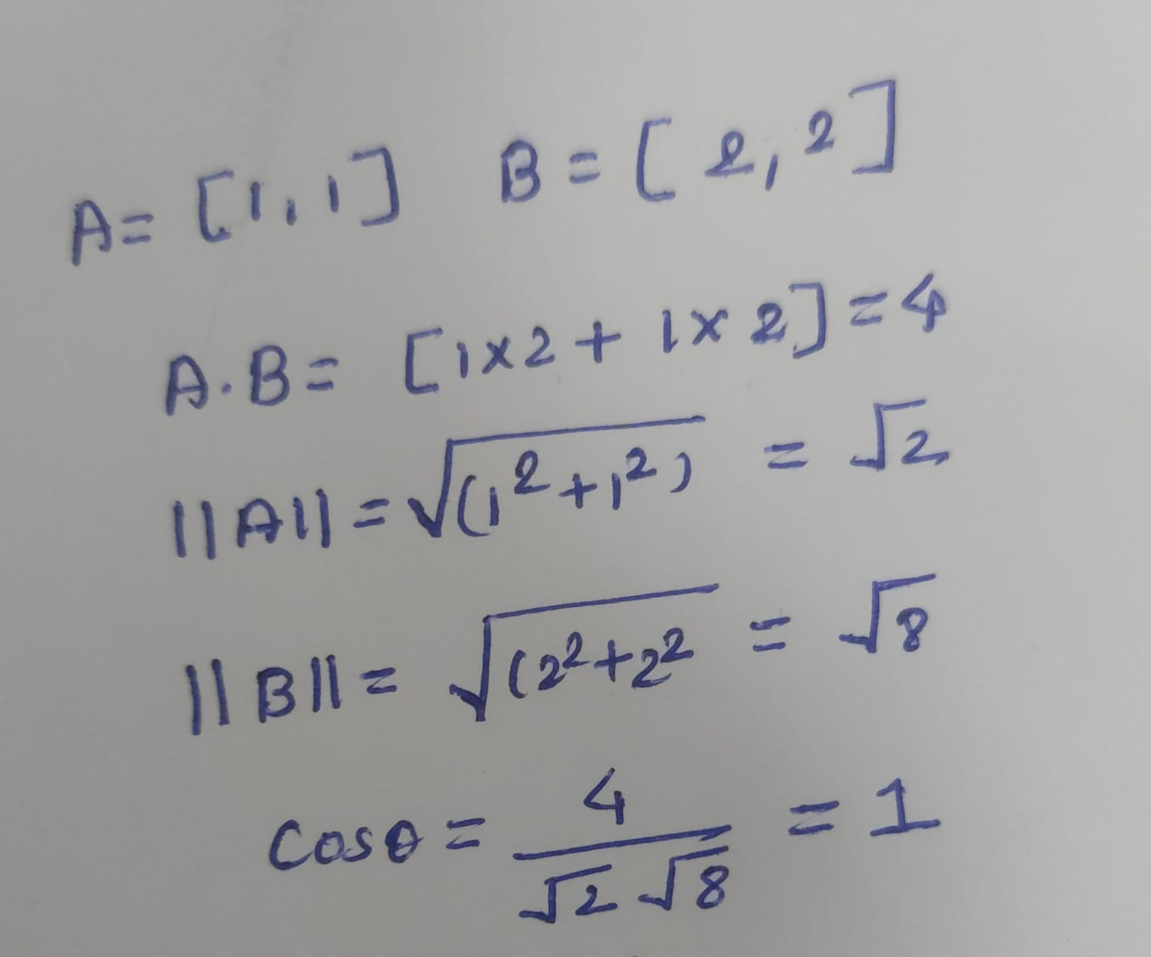
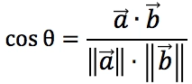
Cosine Similarity
Focus on direction rather than Magnitude
Cos (θ) | Angle | Meaning
1 | 0॰ | Identical Direction (Very similar)
0 | 90॰ | No Similarity (no relation)
-1 | 180॰ | Opposite Direction (very diff)

