Slide 1

Advertising Data Analysis: A Multiple Linear Regression Approach
Presented by
Yash Gadbail (MS2403)
Bhushan Zade (MS2421)

Slide 2
Questions
Is there a relationship between advertising and sales?
How strong is this relationship?
Which type of advertising—TV, radio, or newspaper—has the most impact?
How much will sales increase for every dollar spent?
Can we accurately predict future sales?
Do different media create a synergy effect?

Slide 3
Exploratory Data Analysis
Load dataset & examine structure
Summarize key statistical properties
Identify missing values & outliers
Visualize distributions (boxplots, histograms)
Compute and interpret correlations

Slide 4
Dataset Overview
The dataset consists of advertising expenditure across three channels: TV, Radio, and Newspaper
The response variable, Sales, represents product revenue generated
The objective is to identify the most effective advertising channel

Slide 5
Summary Statistics
Statistic | TV | Radio | Newspaper | Sales
Mean | 147.04 | 23.264 | 30.554 | 15.1305
Median | 149.75 | 22.900 | 25.750 | 16.000
SD | 85.8542 | 14.8468 | 21.7786 | 5.2839
Min. | 0.70 | 0.000 | 0.30 | 1.60
1st Qu. | 74.38 | 9.975 | 12.75 | 11.00
3rd Qu. | 218.82 | 36.525 | 45.10 | 19.05
Max. | 296.40 | 49.600 | 114.00 | 27.00

Slide 6
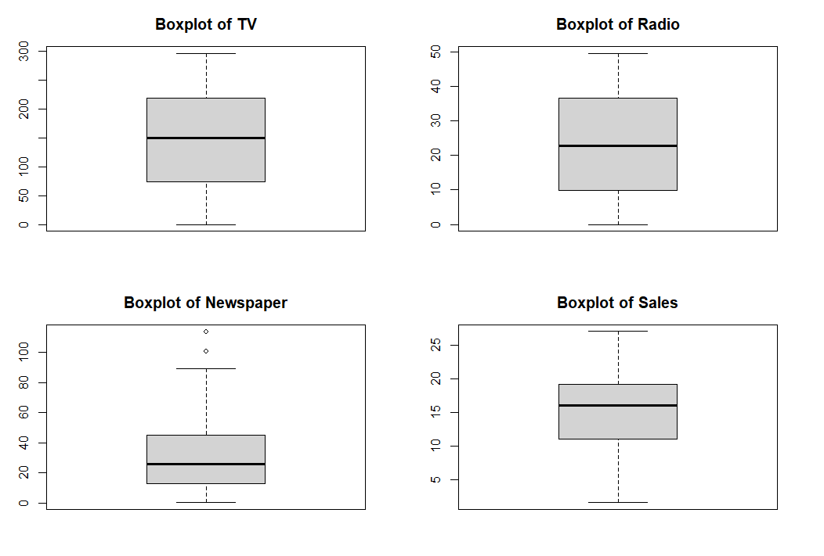
Data Visualization: Distribution Analysis

Slide 7
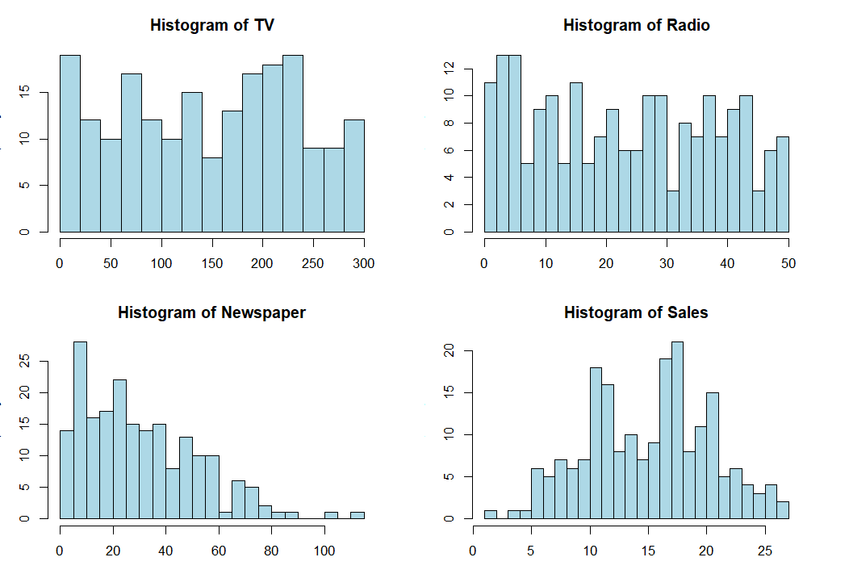
Histograms

Slide 8
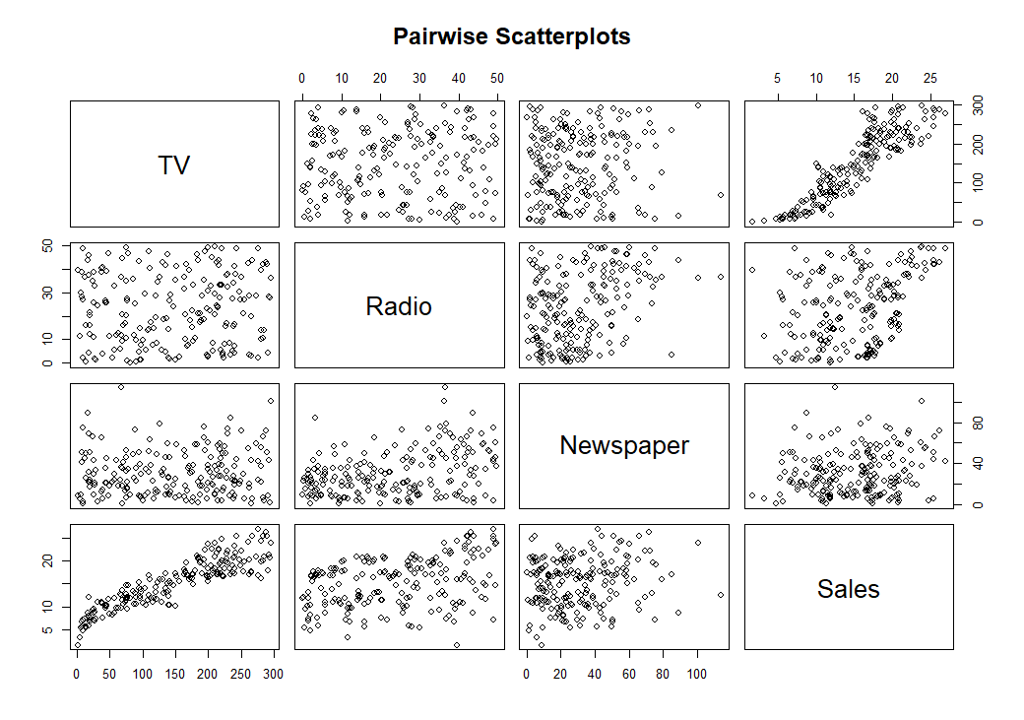

Slide 9
Correlation Matrix
Variable | TV | Radio | Newspaper | Sales
TV | 1.000 | 0.055 | 0.057 | 0.901
Radio | 0.055 | 1.000 | 0.354 | 0.350
Newspaper | 0.057 | 0.354 | 1.000 | 0.158
Sales | 0.901 | 0.350 | 0.158 | 1.000

Slide 10
Correlation Analysis
TV advertising has the strongest positive correlation with sales.
Radio has a moderate impact on sales.
Newspaper advertising does not seem to have a significant effect on sales.

Slide 11
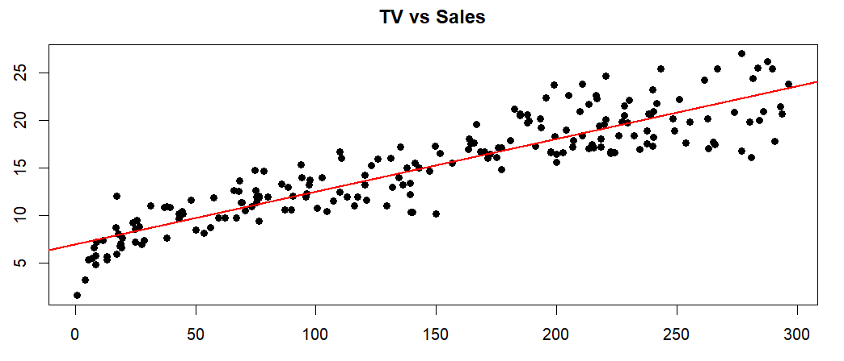
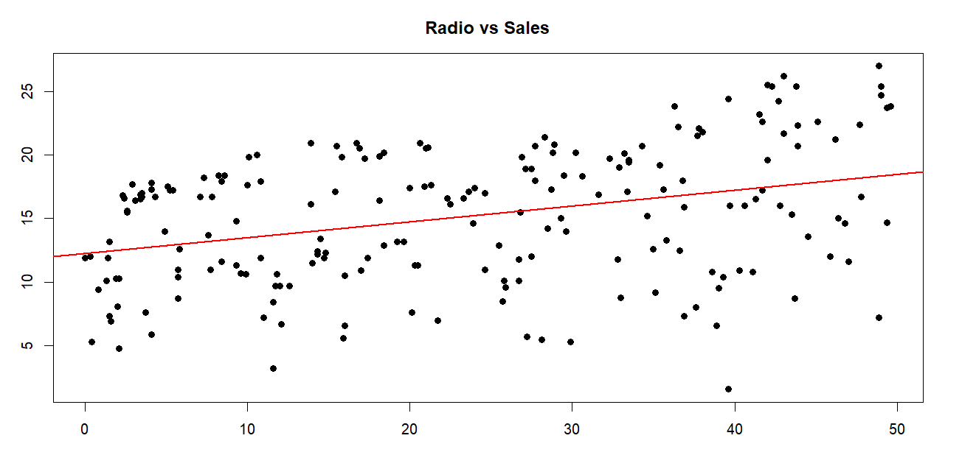
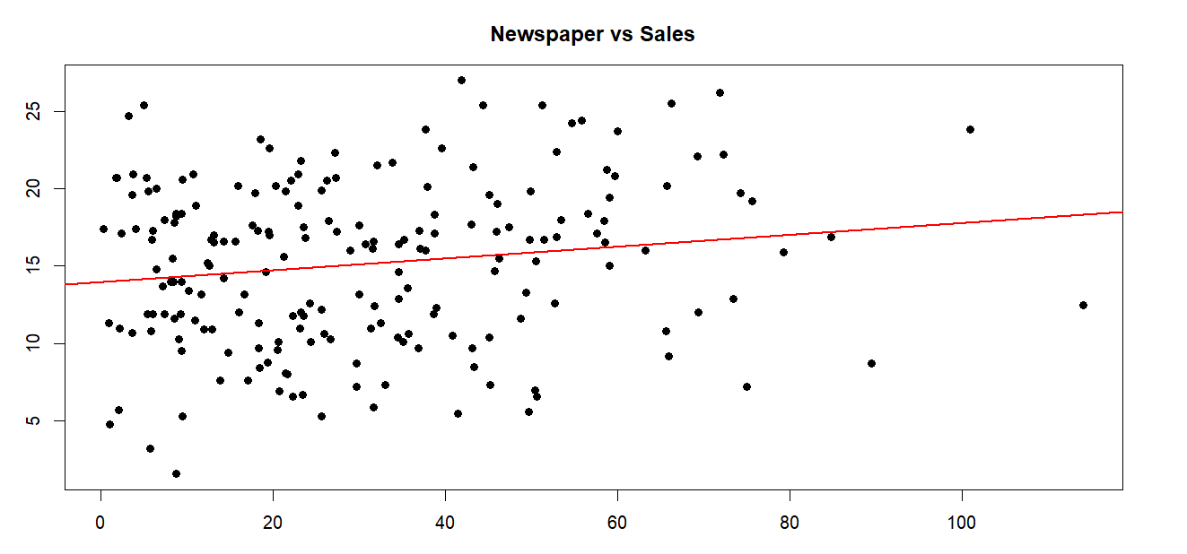

Slide 12
Simple Linear Regression Models
Model | Intercept | Coefficient | Std. Error | t-value | p-value | R² | Adj. R² | Residual Std. Error (RSE)
TV vs. Sales | 6.9748 | 0.0555 | 0.0019 | 29.26 | < 2e-16 *** | 0.8122 | 0.8112 | 2.296
Radio vs. Sales | 12.2357 | 0.1244 | 0.0237 | 5.251 | 3.88e-07 *** | 0.1222 | 0.1178 | 4.963
Newspaper vs. Sales | 13.9596 | 0.0383 | 0.0170 | 2.251 | 0.0255 * | 0.0249 | 0.0200 | 5.231

Slide 13
Multiple Linear Regression
We aim to build a multiple regression model to examine the relationship between Sales (dependent variable) and three advertising channels—TV, Radio, and Newspaper (independent variables). By fitting this model, we can determine how each advertising medium influences sales and assess their overall effectiveness in driving revenue.
Sales ~ TV + Radio + Newspaper

Slide 14
Regression Results
Statistic | Value
Residual Std. Error | 1.662
Degrees of Freedom | 196
Multiple R-squared | 0.9026
Adjusted R-squared | 0.9011
F-statistic | 605.4
p-value | < 2.2e-16 ***
Min | 1Q | Median | 3Q | Max
-7.3034 | -0.8244 | -0.0008 | 0.8976 | 3.7473
Notes:
Interpretation:
The Multiple R-squared (0.9026) indicates that 90.26% of the variance in Sales is explained by TV, Radio, and Newspaper advertising. The Adjusted R-squared (0.9011) accounts for the number of predictors, meaning the model is a strong fit. The F-statistic (605.4) and p-value (< 2.2e-16) show that the overall model is highly significant, meaning at least one predictor has a meaningful impact on Sales.
Interpretation:
Residuals represent the difference between actual and predicted Sales values. The median residual (-0.0008) is close to zero, indicating that the model predicts Sales well on average. The interquartile range (1Q: -0.8244, 3Q: 0.8976) suggests that most residuals are small, but some extreme residuals exist, as seen in the minimum (-7.3034) and maximum (3.7473).

Slide 15
Regression Coefficients
Predictor | Estimate | Std. Error | t-value | p-value | Significance
Intercept | 4.6251 | 0.3075 | 15.041 | < 2e-16 | ***
TV | 0.0544 | 0.0014 | 39.592 | < 2e-16 | ***
Radio | 0.1070 | 0.0085 | 12.604 | < 2e-16 | ***
Newspaper | 0.0003 | 0.0058 | 0.058 | 0.954 | (Not Significant)
Notes:
Intercept (4.6251): When TV, Radio, and Newspaper spending are zero, the expected Sales is 4.63 units. TV (0.0544, p < 0.001): For every $1 increase in TV advertising, Sales increase by 0.0544 units (highly significant). Radio (0.1070, p < 0.001): For every $1 increase in Radio advertising, Sales increase by 0.107 units (highly significant). Newspaper (0.0003, p = 0.954): Newspaper advertising has no significant impact on Sales, meaning increasing Newspaper spending does not meaningfully affect Sales.

Slide 16
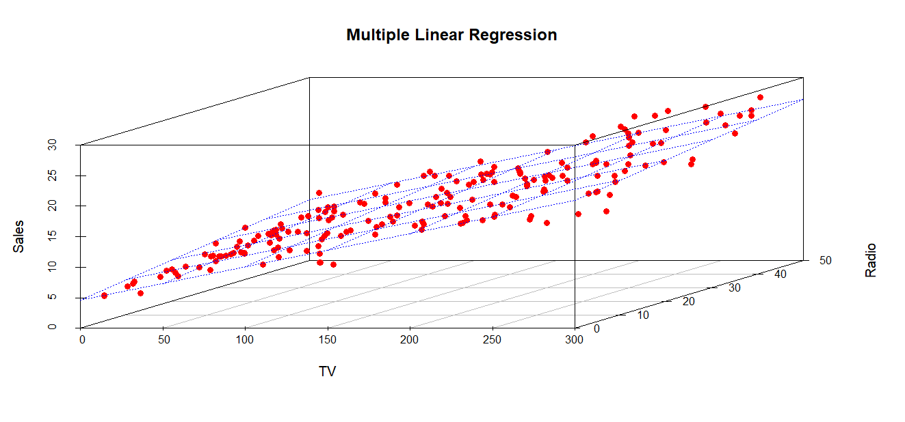
Visualization

Slide 17
Predictor | Full Model (All Predictors) | Reduced Model (Without Newspaper)
Intercept | 4.6251 (SE = 0.3075) | 4.6309 (SE = 0.2903)
TV | 0.0544 (SE = 0.0014) | 0.0544 (SE = 0.0014)
Radio | 0.1070 (SE = 0.0085) | 0.1072 (SE = 0.0079)
Newspaper | 0.0003 (SE = 0.0058) (Not Significant) | Removed
Metric | Full Model (TV, Radio, Newspaper) | Reduced Model (TV, Radio)
Residual Std. Error (RSE) | 1.662 | 1.657 (Slightly better)
Multiple R² | 0.9026 | 0.9026 (Same)
Adjusted R² | 0.9011 | 0.9016 (Improved)
F-statistic | 605.4 | 912.7 (Higher, better model)
p-value (Overall Model) | < 2.2e-16 | < 2.2e-16
Notes:
Adjusted R² improved slightly (0.9011 → 0.9016), meaning the model fit is better after removing the unnecessary Newspaper variable.
F-statistic increased (605.4 → 912.7), which indicates a stronger model fit.
Residual Standard Error (RSE) decreased (1.662 → 1.657), meaning the model’s predictions are slightly more precise.

Slide 18
Model selection criteria
Model | Degrees of Freedom (df) | AIC | BIC
Full Model (TV + Radio + Newspaper) | 4 | 774.67 | 787.87
Reduced Model (TV + Radio) | 4 | 774.67 | 787.87
The Reduced Model (TV + Radio) is preferred because it is equally good but avoids an unnecessary predictor (Newspaper).

Slide 19
Advertising & Sales Analysis
Is there a relationship between advertising and sales?
Yes, advertising explains 90.16% of the variation in sales (Adjusted R² = 0.9016).
2. How strong is this relationship?
The relationship is very strong. TV and Radio have a significant impact on sales (p < 2e-16), while Newspaper is not significant (p = 0.954).
3. Which type of advertising has the most impact?
TV is the strongest predictor (Estimate = 0.0544).
Radio also has a significant impact (Estimate = 0.1072).
Newspaper has no significant impact (Estimate = 0.0003).
4. How much will sales increase per $1000 spent?
TV increases sales by 54.4 units per $1000 spent.
Radio increases sales by 107.2 units per $1000 spent.
Newspaper has no measurable impact.
5. Can we accurately predict future sales?
Yes, with 90.16% accuracy (Adjusted R² = 0.9016), the model is highly predictive.
6. Do different media create a synergy effect?
Yes, TV and Radio together drive sales, while Newspaper does not add value.

Slide 20
Suggestions
Invest in TV and Radio advertising as they significantly boost sales.
Avoid Newspaper ads as they have no measurable impact.
Use the reduced model (TV & Radio) for future sales predictions.

Slide 21
Thank You!

