Slide 1

Advertising Data Analysis: A Multiple Linear Regression Approach
Presented by
Yash Gadbail (MS2403)
Bhushan Zade (MS2421)

Slide 2
Questions
Is there a relationship between advertising and sales?
How strong is this relationship?
Which type of advertising—TV, radio, or newspaper—has the most impact?
How much will sales increase for every dollar spent?
Is the relationship truly linear, or do we need transformations?
Can we accurately predict future sales?
Do different media create a synergy effect?

Slide 3
Summary Statistics
Statistic | TV | Radio | Newspaper | Sales
Mean | 147.04 | 23.264 | 30.554 | 15.1305
Median | 149.75 | 22.900 | 25.750 | 16.000
SD | 85.8542 | 14.8468 | 21.7786 | 5.2839
Min. | 0.70 | 0.000 | 0.30 | 1.60
1st Qu. | 74.38 | 9.975 | 12.75 | 11.00
3rd Qu. | 218.82 | 36.525 | 45.10 | 19.05
Max. | 296.40 | 49.600 | 114.00 | 27.00
TV has the highest average spending, Newspaper shows the most variation, and ad investments are right-skewed, influencing stable Sales.

Slide 4
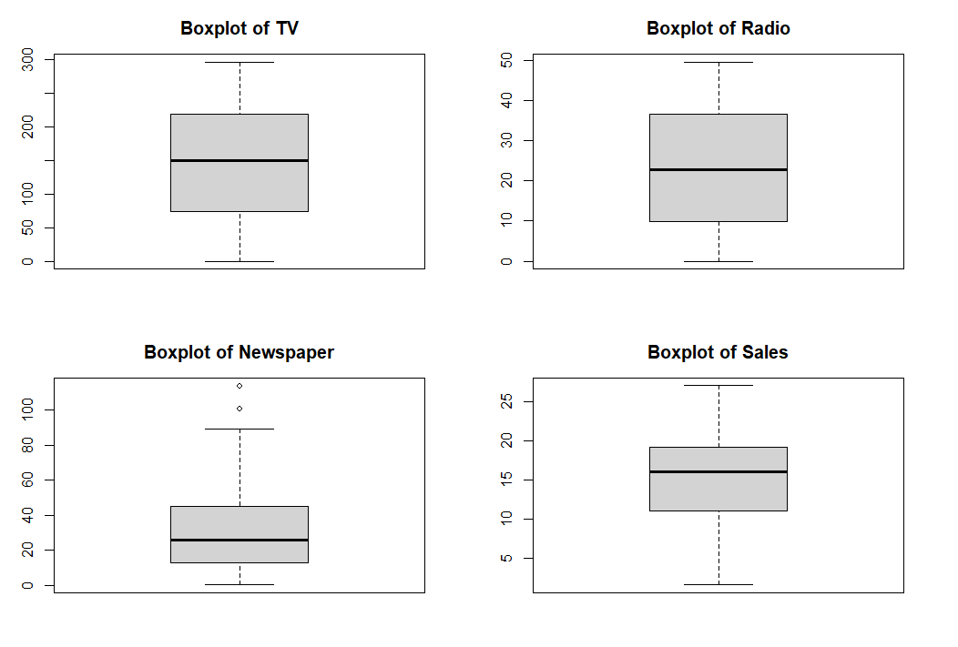
Data Visualization: Distribution Analysis

Slide 5
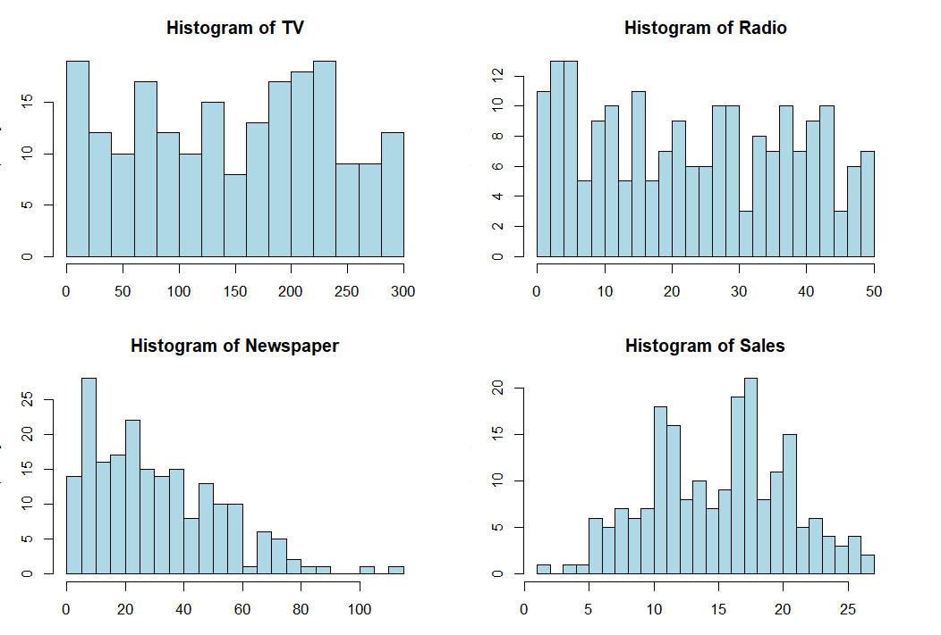
Histograms

Slide 6
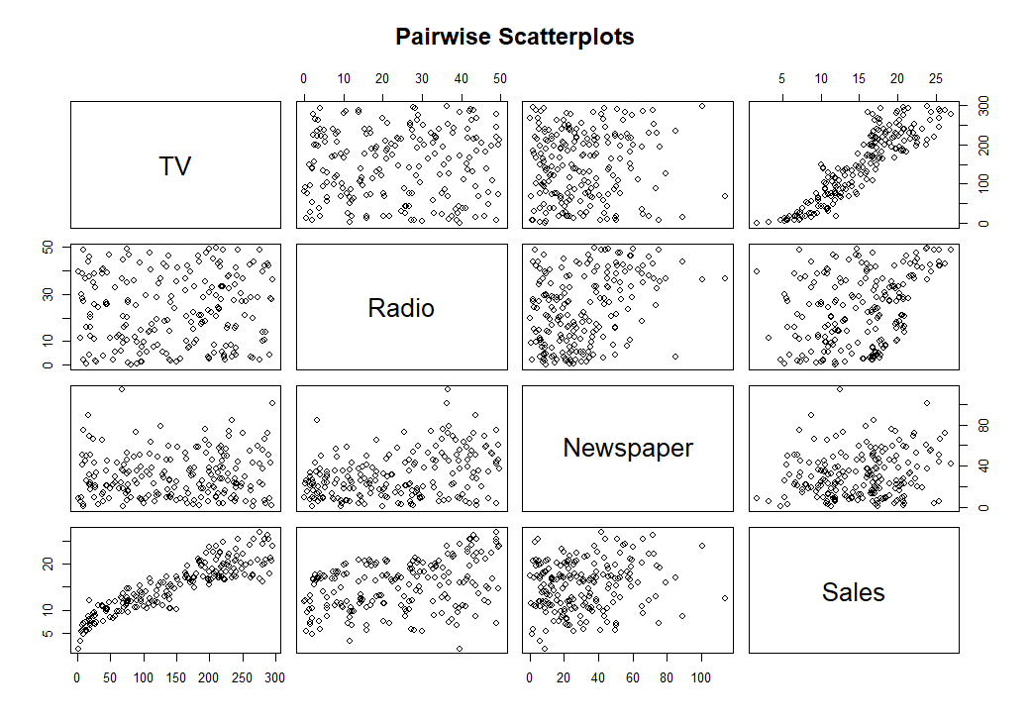
Sales has a clear positive linear relationship with TV and Radio but a weaker correlation with Newspaper.

Slide 7
Correlation Matrix
Variable | TV | Radio | Newspaper | Sales
TV | 1.000 | 0.055 | 0.057 | 0.901
Radio | 0.055 | 1.000 | 0.354 | 0.350
Newspaper | 0.057 | 0.354 | 1.000 | 0.158
Sales | 0.901 | 0.350 | 0.158 | 1.000
TV advertising has the strongest impact on Sales, followed by Radio. Newspaper advertising has a minimal effect.

Slide 8
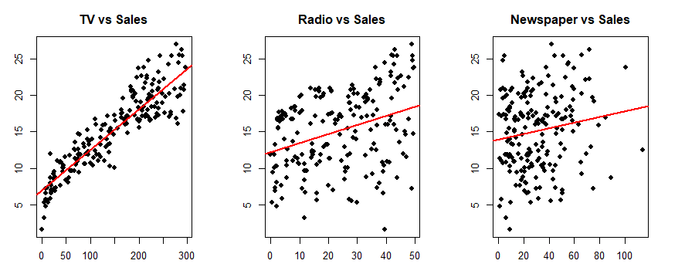
TV advertising is the most effective predictor of sales by far.
Radio has a weak effect, but it's still better than Newspaper.
Newspaper advertising shows almost no influence on Sales.

Slide 9
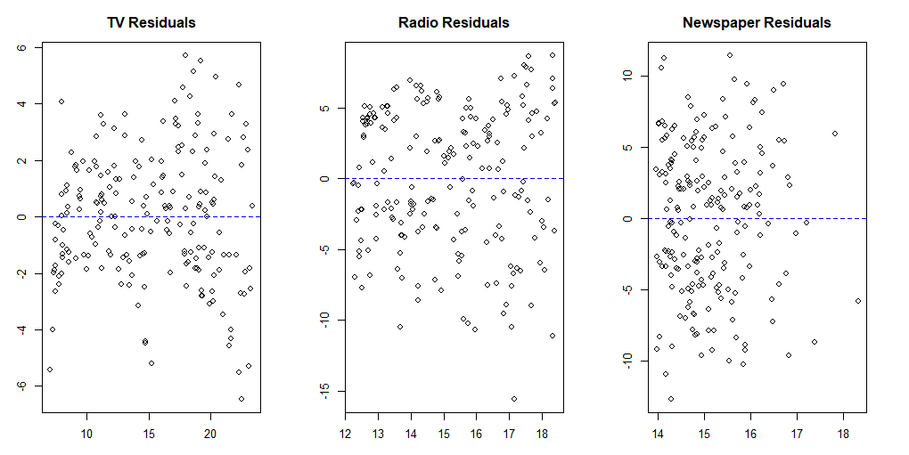

Slide 10
Simple Linear Regression Models
Model | Intercept | Coefficient | Std. Error | t-value | p-value | R² | Adj. R² | Residual Std. Error (RSE)
TV vs. Sales | 6.9748 | 0.0555 | 0.0019 | 29.26 | < 2e-16 *** | 0.8122 | 0.8112 | 2.296
Radio vs. Sales | 12.2357 | 0.1244 | 0.0237 | 5.251 | 3.88e-07 *** | 0.1222 | 0.1178 | 4.963
Newspaper vs. Sales | 13.9596 | 0.0383 | 0.0170 | 2.251 | 0.0255 * | 0.0249 | 0.0200 | 5.231

Slide 11
Multiple Linear Regression
We aim to build a multiple regression model to examine the relationship between Sales (dependent variable) and three advertising channels—TV, Radio, and Newspaper (independent variables). By fitting this model, we can determine how each advertising medium influences sales and assess their overall effectiveness in driving revenue.
Sales ~ TV + Radio + Newspaper

Slide 12
Regression Results
Statistic | Value
Residual Std. Error | 1.662
Degrees of Freedom | 196
Multiple R-squared | 0.9026
Adjusted R-squared | 0.9011
F-statistic | 605.4
p-value | < 2.2e-16 ***
Min | 1Q | Median | 3Q | Max
-7.3034 | -0.8244 | -0.0008 | 0.8976 | 3.7473
The multiple linear regression model explains 90.26% of Sales variation, with TV having the strongest impact, Radio contributing moderately, and Newspaper having negligible influence.
Notes:
Interpretation:
The Multiple R-squared (0.9026) indicates that 90.26% of the variance in Sales is explained by TV, Radio, and Newspaper advertising.
The Adjusted R-squared (0.9011) accounts for the number of predictors, meaning the model is a strong fit.
The F-statistic (605.4) and p-value (< 2.2e-16) show that the overall model is highly significant, meaning at least one predictor has a meaningful impact on Sales.
Interpretation:
Residuals represent the difference between actual and predicted Sales values.
The median residual (-0.0008) is close to zero, indicating that the model predicts Sales well on average.
The interquartile range (1Q: -0.8244, 3Q: 0.8976) suggests that most residuals are small, but some extreme residuals exist, as seen in the minimum (-7.3034) and maximum (3.7473).

Slide 13
Regression Coefficients
Predictor | Estimate | Std. Error | t-value | p-value | Significance
Intercept | 4.6251 | 0.3075 | 15.041 | < 2e-16 | ***
TV | 0.0544 | 0.0014 | 39.592 | < 2e-16 | ***
Radio | 0.1070 | 0.0085 | 12.604 | < 2e-16 | ***
Newspaper | 0.0003 | 0.0058 | 0.058 | 0.954 | (Not Significant)
TV is still the most important predictor, but Radio helps enhance the model.
Notes:
Intercept (4.6251): When TV, Radio, and Newspaper spending are zero, the expected Sales is 4.63 units.
TV (0.0544, p < 0.001): For every $1 increase in TV advertising, Sales increase by 0.0544 units (highly significant).
Radio (0.1070, p < 0.001): For every $1 increase in Radio advertising, Sales increase by 0.107 units (highly significant).
Newspaper (0.0003, p = 0.954): Newspaper advertising has no significant impact on Sales, meaning increasing Newspaper spending does not meaningfully affect Sales.

Slide 14
Predictor | Full Model (All Predictors) | Reduced Model (Without Newspaper)
Intercept | 4.6251 (SE = 0.3075) | 4.6309 (SE = 0.2903)
TV | 0.0544 (SE = 0.0014) | 0.0544 (SE = 0.0014)
Radio | 0.1070 (SE = 0.0085) | 0.1072 (SE = 0.0079)
Newspaper | 0.0003 (SE = 0.0058) (Not Significant) | Removed
Metric | Full Model (TV, Radio, Newspaper) | Reduced Model (TV, Radio)
Residual Std. Error (RSE) | 1.662 | 1.657 (Slightly better)
Multiple R² | 0.9026 | 0.9026 (Same)
Adjusted R² | 0.9011 | 0.9016 (Improved)
F-statistic | 605.4 | 912.7 (Higher, better model)
p-value (Overall Model) | < 2.2e-16 | < 2.2e-16
Notes:
Adjusted R² improved slightly (0.9011 → 0.9016), meaning the model fit is better after removing the unnecessary Newspaper variable.
F-statistic increased (605.4 → 912.7), which indicates a stronger model fit.
Residual Standard Error (RSE) decreased (1.662 → 1.657), meaning the model’s predictions are slightly more precise.

Slide 15
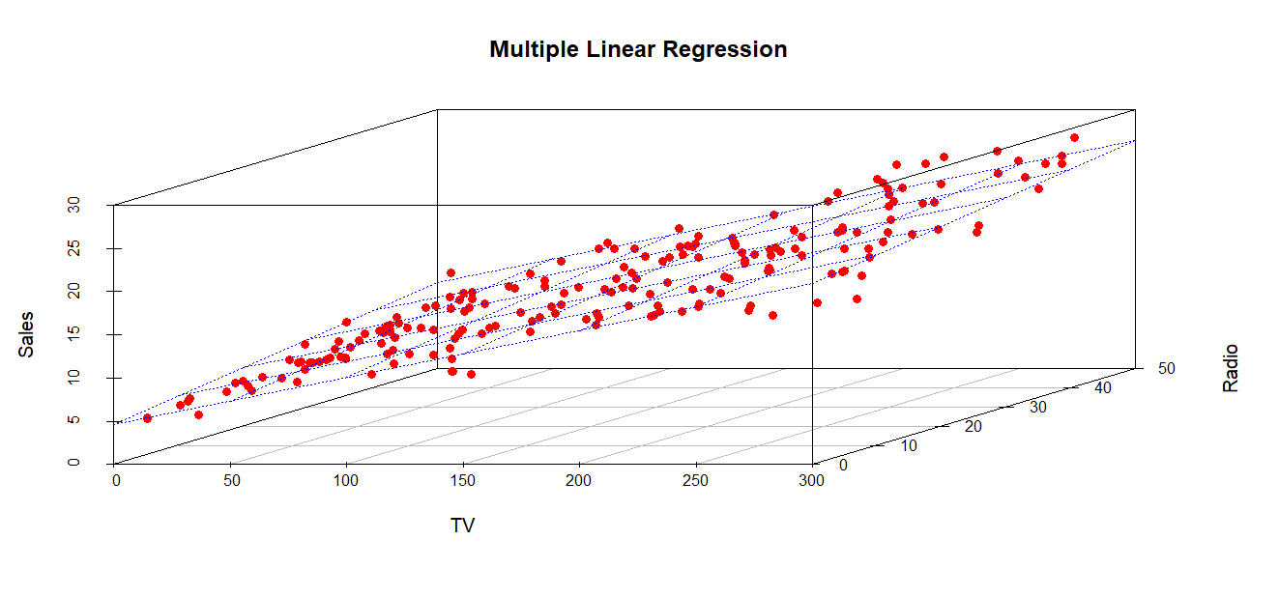
Visualization

Slide 16
Model selection criteria
Model | Degrees of Freedom (df) | AIC | BIC
Full Model (TV + Radio + Newspaper) | 4 | 774.67 | 787.87
Reduced Model (TV + Radio) | 4 | 774.67 | 787.87

Slide 17
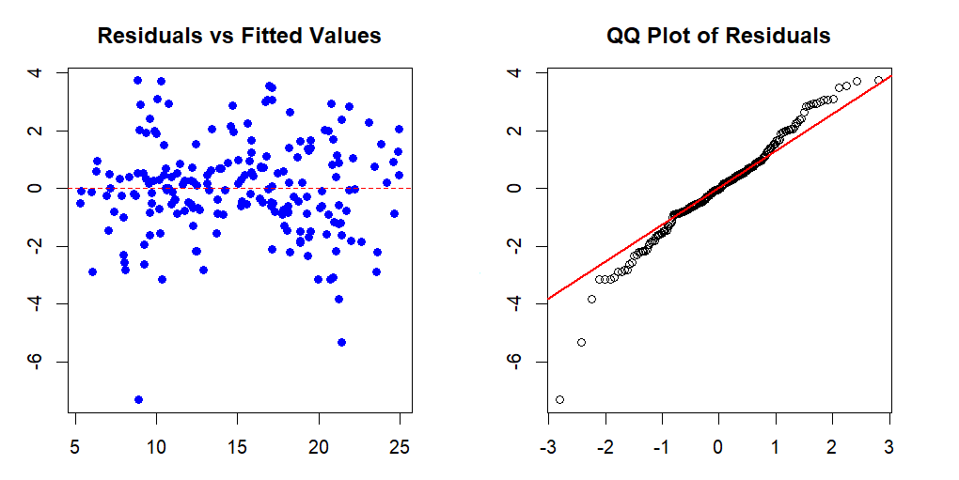
Residuals vs Fitted Values
The model explains 90.3% of sales variation with good fit (RMSE: 1.645), but residuals are slightly non-normal, indicating minor model inadequacy.

Slide 18
Comparison table
Model | R² | Adjusted R² | Residual Standard Error (RSE)
Log Model (lm_log) | 0.7934 | 0.7903 | 0.1937
Sqrt Model (lm_sqrt) | 0.874 | 0.872 | 0.2583
TV Model (lm_tv) | 0.8122 | 0.8112 | 2.296
Radio Model (lm_radio) | 0.1222 | 0.1178 | 4.963
Newspaper Model (lm_newspaper) | 0.02495 | 0.02003 | 5.231
Reduced Model (model_reduced) | 0.9026 | 0.9016 | 1.657
Full Model (model_full) | 0.9026 | 0.9016 | 1.657

Slide 19
Model selection criteria
Model | df | AIC | BIC
model_full | 4 | 774.67 | 787.87
model_reduced | 4 | 774.67 | 787.87
lm_log | 5 | -83.10 | -66.61
lm_sqrt | 5 | 32.15 | 48.64
The log transformation improved model fit by linearizing relationships and stabilizing variance, leading to a much higher likelihood. Since AIC and BIC depend on −2ln⁡(L), the increase in likelihood made them drop drastically, even turning negative.
The log-transformed model (lm_log) is the best choice overall, as it has the lowest AIC and BIC

Slide 20
Synergy effect
Sales ~ TV + Radio + TV x Radio
Term | Estimate | Std. Error | t value | p-value
Intercept | 6.193e+00 | 4.101e-01 | 15.101 | < 2e-16
TV | 4.358e-02 | 2.489e-03 | 17.512 | < 2e-16
Radio | 4.227e-02 | 1.473e-02 | 2.869 | 0.00457
TV:Radio | 4.431e-04 | 8.673e-05 | 5.110 | 7.63e-07
Statistic | Value
Residual standard error | 1.561
Degrees of freedom | 196
Multiple R-squared | 0.914
Adjusted R-squared | 0.9127
F-statistic | 694.7
F-statistic p-value | < 2.2e-16

Slide 21
Advertising & Sales Analysis
Is there a relationship between advertising and sales?
  Yes, advertising strongly influences sales. The linear model explains 91.4% of the variation in sales, with both TV and Radio playing significant roles. The interaction between TV and Radio also suggests that their combined effect on sales is greater than their individual impacts.
How strong is this relationship?
  The relationship is very strong, with an R² of 91.4%. TV and Radio have a significant impact on sales, and the interaction term (TV:Radio) further enhances this relationship. The model suggests that both TV and Radio together provide a more accurate prediction of sales than either alone.
Which type of advertising has the most impact?
  TV and Radio have the strongest effects on sales:
  TV: The most powerful predictor of sales, with a large and statistically significant impact.
  Radio: Has a strong impact, but slightly less influential than TV.
  Newspaper: In this model, Newspaper does not have a significant effect on sales when compared to TV and Radio

Slide 22
Advertising & Sales Analysis
How much will sales increase for every dollar spent?
  TV: For every $1,000 spent on TV advertising, sales increase by approximately 43.58 units.
  Radio: For every $1,000 spent on Radio advertising, sales increase by approximately 42.27 units.
Can we accurately predict future sales?
  Yes, the linear model has high accuracy, with an R² of 91.4%, indicating that it explains a substantial amount of the variation in sales. This makes the model a strong predictor of future sales.
Do different media create a synergy effect?
  Yes, TV and Radio work well together and enhance sales.
  Newspaper does not add value and can be ignored.
Is the relationship truly linear, or do we need transformations?
  The relationship is mostly linear, but the synergy model (lm_synergy) with the interaction term (TV:Radio) significantly improves performance (lower AIC: 751.66, lower BIC: 768.15) compared to simpler models. No transformation is needed since the fit is already strong.

Slide 23
Thank You!

