Slide 1
Lending Club Case Study

Slide 2
Background
LendingClub is a prominent peer-to-peer lending platform that facilitates the connection between individuals seeking loans (borrowers) and individuals or institutional investors willing to provide the funds (lenders). Borrowers apply through online platform.
Business Objective:
To identify the variables which are strong indicators of default and provide insights to make the decision

Slide 3
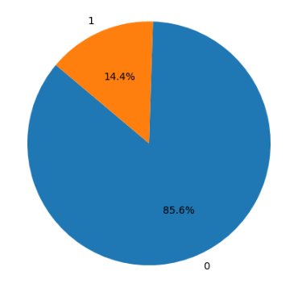
Data Understanding
Default Distribution
14.4% of the Total Loans are Default

Slide 4
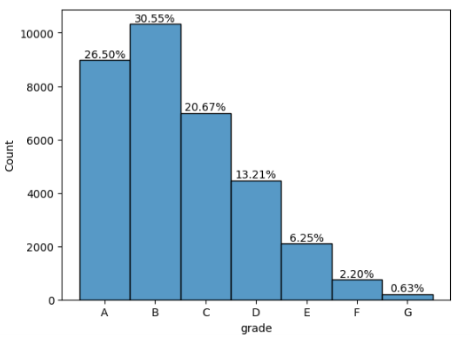
Loan Distribution Across Grades
30.55% Of The Total Loans Are Given To Grade B

Slide 5
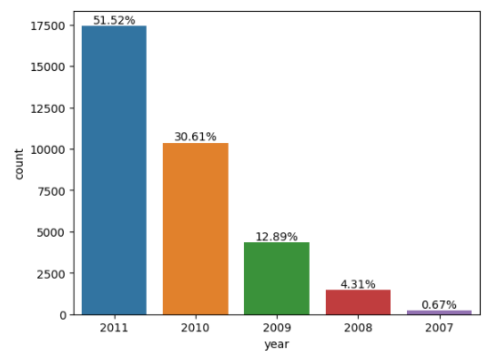
Time Frame of Data 2007-2011
75% Increase In Applicants In 2011 Compared To 2010
120% Increase In Applicants In 2010 Compared To 2009

Slide 6
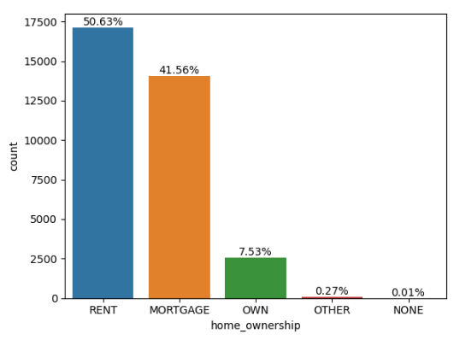
Home Ownership
50.63% Of The Loan Applicant Lives In Rented Home
41.56% Of The Loan Applicant Has Mortgaged Their Home

Slide 7
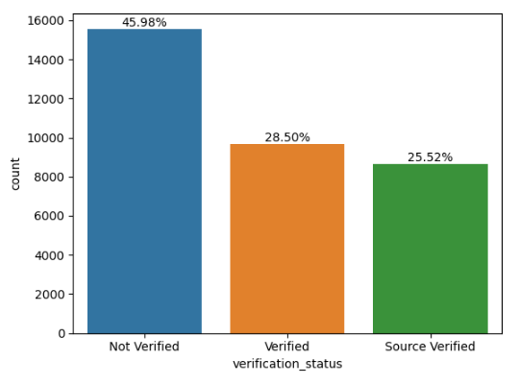
Loan Applicant Verification
45.98% Of The Loan Applicants Are Not Verified

Slide 8
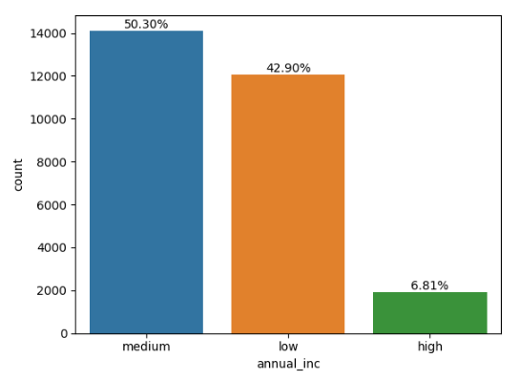
Loan Applicant’s Annual Income
50.30% Of The Loan Applicants Have Annual Income In The Range Of 100000 To 150000

Slide 9
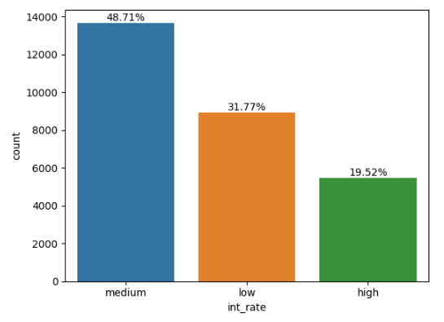
Loan Interest Rate
48.71% Of The Loans Are Given At Interest Rate Between 10% To 15%

Slide 10
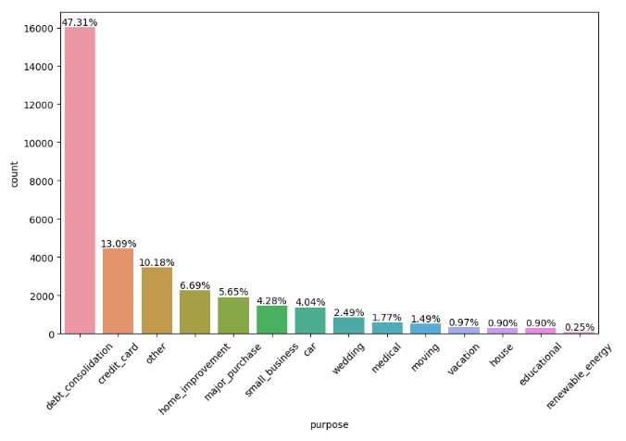
Loan Purpose Distribution
47.31% Debt Consolidation Loans
13.09% Credit Card Loans
6.69% Home Improvement Loans
5.65% Major Purchase Loans

Slide 11
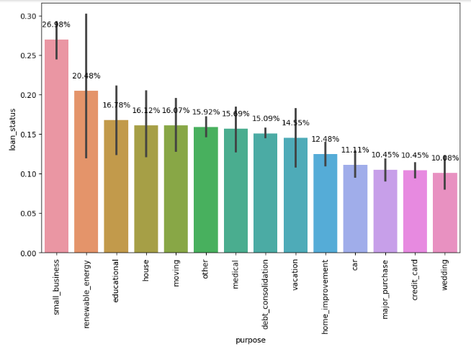
Default Rate Across Loan Purpose
Small Business – 26.98%
Educational – 20.48%
House – 16.12%
Debt Consolidation – 15.09%
Credit Card – 10.45%
Major Purchase – 10.45%

Slide 12
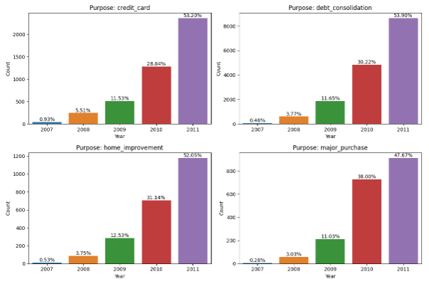
Top 4 Products Over Time
There Is Increase In Home_Improvement Loans In Year 2010
340% More Debt Consolidation Loans Are Given Than Credit Card Loans

Slide 13
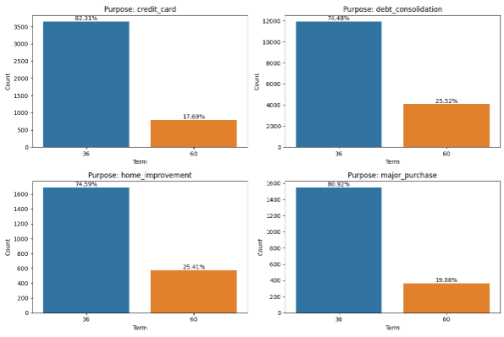
Term Distribution In Top 4 Products
Across All Products Majorly 36 Month Term Loan Is Given

Slide 14
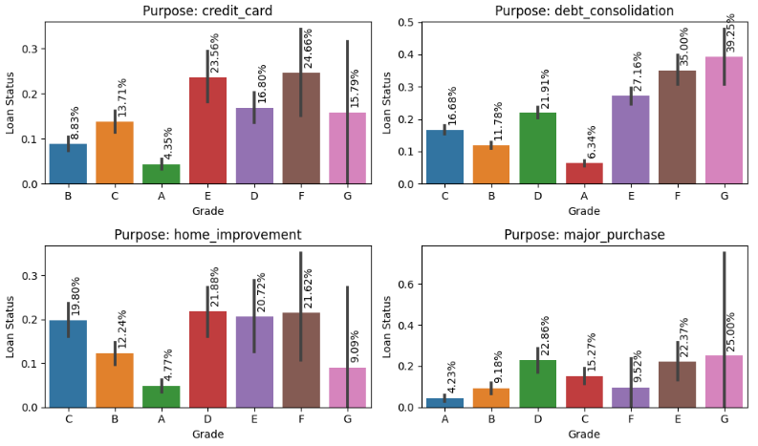
Grade Distribution In Top 4 Products

Slide 15
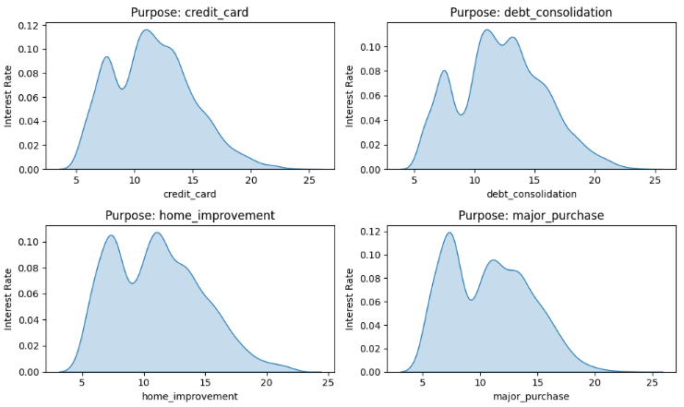
Interest Rate In Top 4 Products
Credit Card | 12%
Debt Consolidation | 11%
Home Improvement | 11%
Major Purchase | 12%

Slide 16
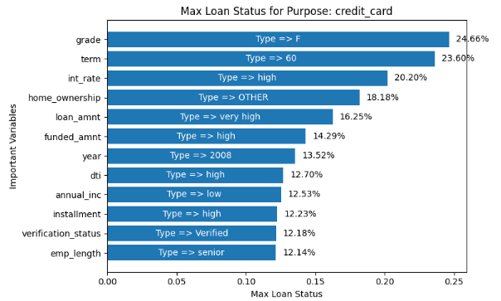
Important Variable : Credit Card

Slide 17
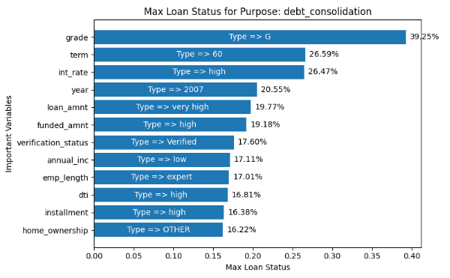
Important Variable : Debt Consolidation

Slide 18
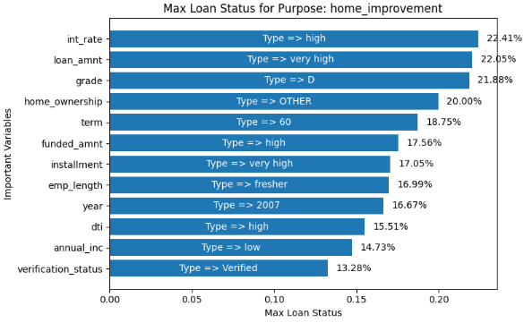
Important Variable : Home Improvement

Slide 19
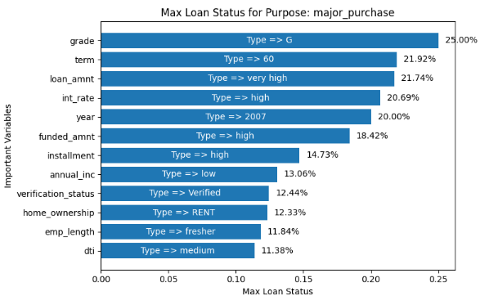
Important Variable :Major Purchase

