Slide 1
Team 30: Pastry-DistAlgo
Akhil Bhutani, Nikhil Navadiya, Vivek Kumar Sah

Slide 2
Problem
To closely implement Pastry: Scalable, Decentralized Object Location and Routing for Large-Scale Peer-to-Peer Systems in DistAlgo
Perform thorough performance evaluation for metrics as presented in the paper like average number of routing hops with and without failures, probabilistic evaluation of number of hops during routing process

Slide 3
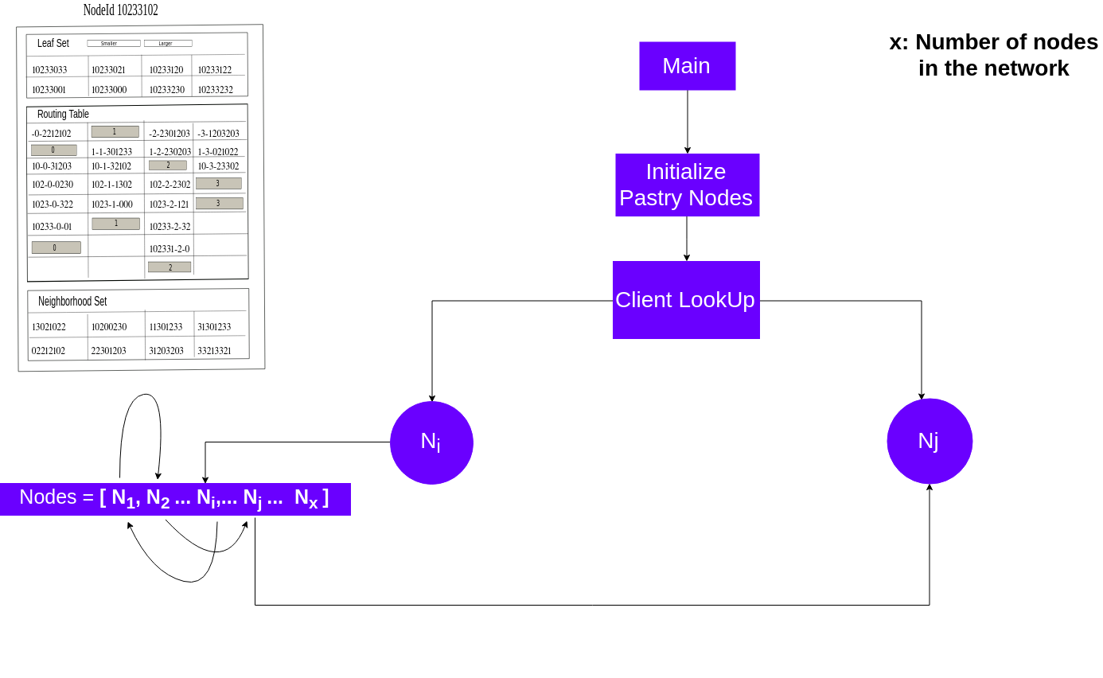
Method and Implementation

Slide 4
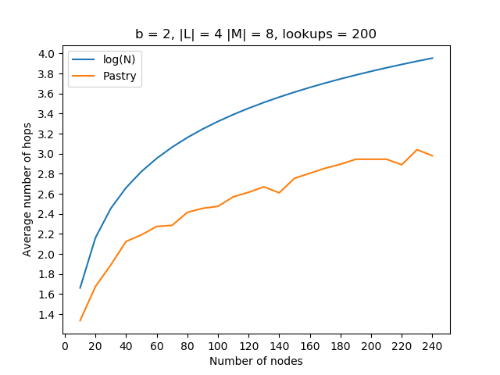
Results
Average number of hops as a function of network size

Slide 5
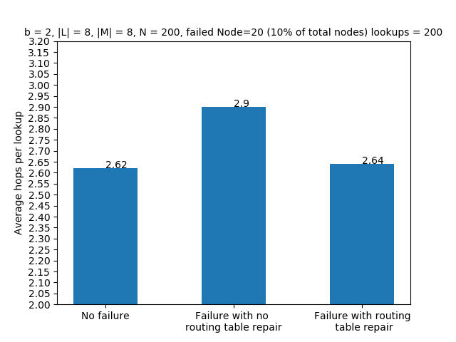
2. Number of routing hops vs node failure

